Slide 1

The Anticoagulation in Intracerebral Hemorrhage (ICH) Survivors for Stroke Prevention and Recovery (ASPIRE) Study
ASPIRE Pharmacy Training Slides
v1.0
StrokeNet NCC Central Pharmacy
Phone: 513-584-3166
Email: StrokeNetcpharm@ucmail.uc.edu

Slide 2
What are we investigating?
ASPIRE is a randomized, double-blinded, phase 3 clinical trial designed to test the efficacy and safety of apixaban, compared with aspirin, in patients with a recent intracerebral hemorrhage (ICH) and non-valvular atrial fibrillation (AF).
Approximately 150 sites
700 total subjects – each participant followed 12-36 months (maximum)

Slide 3
ASPIRE Study Drug
700 subjects randomized 1:1 ratio between study drug arms:
  Apixaban 5mg or matching Apixaban 5mg placebo
    If applicable, Apixaban 2.5mg or matching Apixaban 2.5mg placebo
  Aspirin 81mg or matching Aspirin 81mg placebo
Study drug and matching placebo are similar in color, shape, and size

Slide 4
Study Drug Packaging
Bottles are packaged into blinded kits measuring 4”x4”x2” and sealed with tamper-evident tape. Do not open before dispensing.

Slide 5
Study Drug Packaging
Each kit contains two bottles with a 100-day supply of study drug per bottle, accounting for a 90-day supply plus an additional 10-day buffer.
Study contacts will take place every 3 months (90 days) after randomization (+/- 5 days).

Slide 6
Study Drug Packaging
Kits will include one bottle of active or placebo Apixaban (5mg or 2.5mg) and one bottle of active or placebo Aspirin (81mg).
5mg Study Drug Arms:
  Apixaban 5mg Active + Aspirin 81mg Placebo
  Aspirin 81mg Active + Apixaban 5mg Placebo
2.5mg Study Drug Arms*:
  Apixaban 2.5mg Active + Aspirin 81mg Placebo
  Aspirin 81mg Active + Apixaban 2.5mg Placebo
*For subjects with ≥2 of following: age ≥80 years, body weight ≤60 kg, serum creatinine 1.5-2.4 mg/dL

Slide 7
Study Drug Labels
Apixaban 5mg active or placebo bottles have yellow labels
Apixaban 2.5mg active or placebo bottles have pink labels

Slide 8
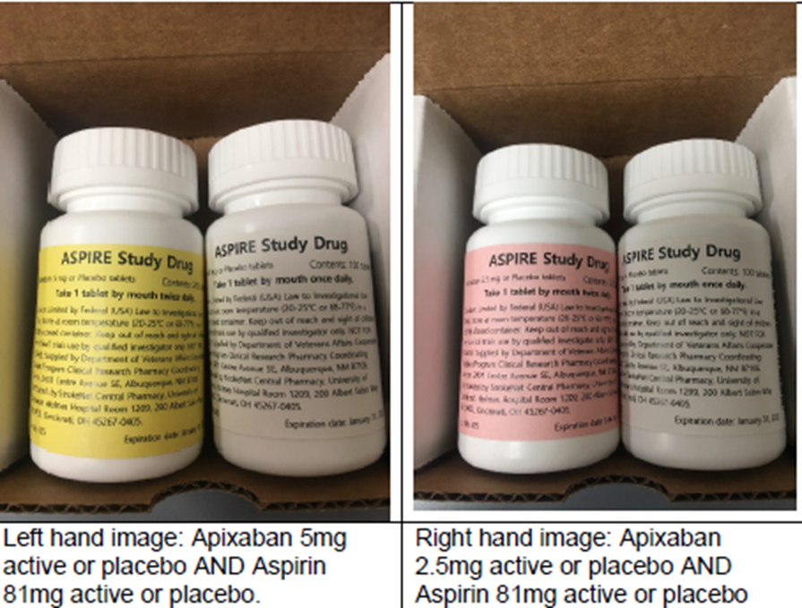
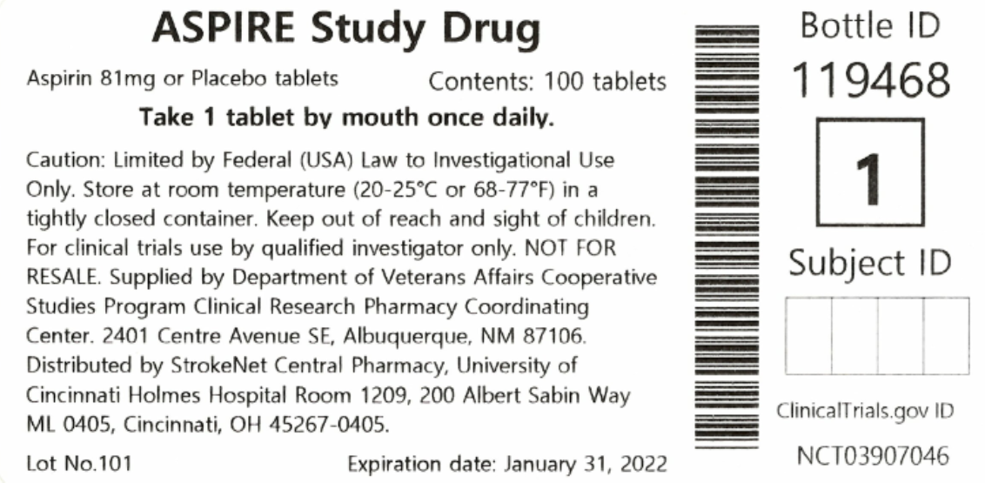
Study Drug Labels
Aspirin 81mg active or placebo bottles have white labels

Slide 9
Study Drug Requests
WebDCU study drug shipment requests will automatically be sent to the NCC Central Pharmacy for fulfillment when:
  Sites are released to enroll
  Subjects are randomized
  Subjects are due for a refill visit
  Study drug is damaged/expired in WebDCU

Slide 10
Study Drug Shipping
Study drug shipments are processed Monday-Thursday and will be received by sites Tuesday-Friday.
  No shipments will take place for receipt on Saturday, Sunday, or holidays (unless approved by both NCC Central Pharmacy and the receiving site).
UPS® will send an email with a tracking number to the clinical performing site (CPS) to track shipments.
  Only one email can be entered to receive UPS® tracking information.
  If you would like to use a group email for this notification, please enter the email in the “Investigational product shipping address” in WebDCU.
  UPS® tracking website: https://www.ups.com/WebTracking/track?loc=en_US
Study drug will be sent unmonitored and non-temperature controlled.

Slide 11
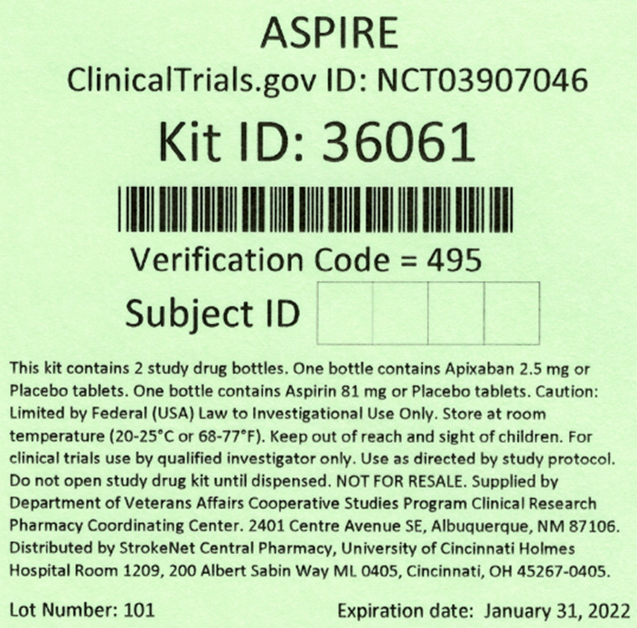
Study Drug Receiving
Study teams will receive a UPS email confirmation AND a WebDCU email confirmation that drug has shipped.
An investigational drug packing slip will be included with each shipment of drug kits.
Drug kits have a 5-digit Kit ID on the box along with a 3-digit Verification Code.
Confirm receipt of drug by verifying kit numbers against the packing slip.
Confirm receipt of drug in WebDCU – verification code on drug kits will be requested.

Slide 12
Receiving Study Drug in WebDCU
To receive study drug in WebDCU:
From the main menu page, click [Drug Tracking] and then [Drug Site Receiving]. A list of all study drug shipments that have been shipped to your site will appear.
  Note: Use the ‘Drug Site Receiving Pending’ system filter located in the ‘Page Actions’ drop-down menu to filter for the shipments that need to be received.
Select the study drug kit that needs to be received by clicking on the blue number link in the left-hand column.
Click on ‘Edit Record’ at the top of the screen.
Verify that the code on the kit matches the drug kit code listed in WebDCU (Q3).
  If the kit codes do not match, contact the study’s Data Manager.
Edit the receiving status (Q8) radio button to indicate ‘Confirm received.’
Enter the date received (Q10), the 3-digit drug kit verification code (Q11), and any receiving notes (Q12).
To finish, click ‘Save Record.’ You will need to repeat this process for each kit received.

Slide 13
Study Drug Storage and Accountability
Drug kits should be stored at 20-25°C (68-77°F); excursions permitted between 15-30°C (59-86°F) per USP controlled room temperature guidelines.
DO NOT break the tamper evident seal until the kit is dispensed.
Storage areas must have a temperature monitoring system.
Sites are required to maintain study drug accountability records and temperature monitoring logs.
  Sites may use their own institution-specific/electronic inventory and temperature monitoring systems if the systems gather all the necessary information on the example paper logs provided in WebDCU under Toolbox > Project Documents.

Slide 14
Temperature Excursions
Report temperature excursions if storage temperature falls below 15°C (59°F) and/or rises above 30°C (86°F) per USP rounding rules.
  If temperature is 30.4°C, temperature is rounded down to 30°C and is not reportable.
  If temperature is 30.5°C, temperature is rounded up to 31°C and is reportable.
  Excursions with the duration maximum of 30 minutes and with no previous excursions, do not need to be reported.
Report excursions using the Study Drug Temperature Excursion Report Form (TERF) found in WebDCU under Toolbox > Project Documents.
  Excursions must be reported immediately, preferably within 48 hours of occurrence.
  Email the TERF to ASPIRE@yale.edu and StrokeNetcpharm@ucmail.uc.edu.

Slide 15
Quarantine Procedures
If a temperature excursion occurs, immediately quarantine the study drug at the appropriate storage temperature (20-25°C).
If received in WebDCU, temporarily remove from inventory by marking as ‘Quarantined’ under [Drug Tracking] > [Drug Site Removing].
  See WebDCU Instructions to Quarantine Study Drug in WebDCU under Toolbox > Project Documents.
The NCC Project Manager or NCC Central Pharmacy will determine if the study drug is usable or not after the TERF has been reviewed.
  If deemed usable, return the study drug to inventory in WebDCU and resume study enrollment.
  If deemed unusable, update the study drug to ‘Damaged’ in WebDCU and destroy per institutional policy. A replacement study drug request will be triggered for resupply.

Slide 16
Randomization in WebDCU
Once a subject has been deemed eligible and informed consent has been obtained, a study team member will log into WebDCU to randomize the subject by completing the following CRFs (in this order):
  Subject Enrollment (under [Study Progress])
  F304: CHA₂DS₂-VASc
  F101: Eligibility
  F102: Randomization (after adding Baseline visit)
Once the randomization form is submitted, the subject will be randomized per ASPIRE’s double blind 1:1 randomization scheme. WebDCU will display a message indicating the subject was successfully randomized.

Slide 17


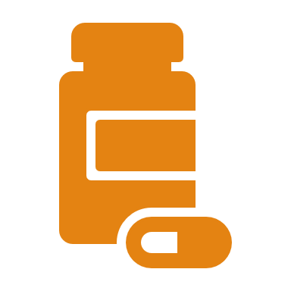
WebDCU Overview
F512: Study Drug Kit Assignment
F513: Study Drug Kit Dispensing
F514: Study Drug Kit Usage and Adherence
Complete this CRF when you are ready to provide a new drug kit to the subject.
The CRF will provide you with the drug kit ID assigned to the subject.
Complete this CRF prior to dispensing to confirm the correct drug kit was pulled.
Confirm the start date with the subject once the drug kit is received and started.
Complete this CRF at the next study visit to calculate study drug adherence.
The pill count should be performed after the bottle stop date is confirmed.

Slide 18
Study Drug Assignment
Complete and submit F512: Study Drug Kit Assignment to determine the treatment dose based on the subject’s age, weight, and renal function.
  Patient is determined to be on 5mg dose: The assigned drug kit ID will populate on the screen. Print the CRF and provide a copy to the pharmacy to dispense the proper study drug kit.
  Patient is determined to be on 2.5mg dose: If the assigned kit is not in inventory, the site will get a warning message. At the same time, a notification will be sent to the NCC Central Pharmacy and a shipment will be sent out for overnight delivery as soon as possible. Once received in WebDCU, re-save F512 and the correct drug kit ID will populate. Print and provide to the pharmacy as noted above.

Slide 19
Study Drug Dispensing
Retrieve the study drug kit from inventory and verify the drug kit ID.
Confirm the tamper-evident tape is intact. If so, open and verify the foil seals of the study drug bottles are also intact.
  If either are broken or tampered with, the study drug kit should not be dispensed and marked as ‘Damaged’ in WebDCU. Report to the Emergency Randomization Hotline (1-866-450-2016) and destroy per institutional policy.
Document dispensing/destruction on an IP Accountability Log.
Complete F513: Study Drug Kit Dispensing to confirm the correct study drug kit was pulled by entering the drug kit ID and verification code.

Slide 20
Study Drug Accountability
At the next study visit, complete F514: Study Drug Usage and Adherence to document the number of pills remaining in each bottle.
  If visits are completed remotely, a new study drug kit can be mailed after confirming continued eligibility using an overnight vendor of your choice.
  Once the new drug kit is confirmed as received by the subject, pill counts can be provided over the phone. Subjects can then be instructed to stop taking from previous bottles and start taking from new bottles.
If non-compliance is noted, the study team must re-educate the subject on the importance of study drug compliance and record on the CRF.

Slide 21
Study Drug Destruction
Once study drug is accounted for and contents documented appropriately, it is not necessary to save returned, damaged, or expired study drug bottles.
Expired, damaged, or unused study drug should be destroyed per institutional policy. If required, study drug may be returned to the NCC Central Pharmacy via preferred postal carrier at the expense of the site.
  Remove any subject identifies from all study drug kits/bottles.
  Complete the Study Drug Return Form (found in WebDCU under Toolbox > Project Documents) and return with the shipment.
  Provide tracking information via e-mail to StrokeNetcpharm@ucmail.uc.edu.

Slide 22
Removing Study Drug in WebDCU
To remove study drug in WebDCU:
From the main menu page, click [Drug Tracking] and then [Drug Site Removing]. A list of all study drug kits previously removed and currently in inventory will appear.
  Note: Use the ‘Last dispensable date passed, removal pending’ system filter located in the ‘Page Actions’ drop-down menu to filter for study drug kits that are past their last dispensable date and need to be removed.
Select the study drug kit that needs to be removed by clicking on the blue number link in the left-hand column.
Click on ‘Edit Record’ at the top of the screen.
Edit the removing confirmed (Q7) radio button to indicate ‘Yes.’
Enter the date removed (Q8), the removing type (Q9), and any removing notes (Q10).
  For expiring drug kits, select ‘Expired’ and add the comment ‘Kit Expiring MM/DD/YYYY.’
  Other removing options include: Damaged, Missing, Returned, Recall, Quarantined, Temperature excursions, Site closing, and Other.
To finish, click ‘Save Record.’ You will need to repeat this process for each kit you would like to remove.
Once the study rug kit is confirmed as destroyed, update the following:
  Edit the drug kit destroyed confirmed (Q14) radio button to indicate ‘Yes.’
  Enter the method of destruction (Q15) and date destroyed (Q16).

Slide 23
Questions?
StrokeNet NCC Central Pharmacy
University of Cincinnati
Holmes Hospital Room 1209
200 Albert Sabin Way ML 0405
Cincinnati, OH 45267-0405
Phone: 513-584-3166
Email: StrokeNetcpharm@ucmail.uc.edu
FOR RETURNS ONLY:
StrokeNet Central Pharmacy
UC Medical Science Bldg.
231 Albert Sabin Way
Room G162
Cincinnati, OH 45267-0405

