Slide 1
BioCHESS
Peter Kan, MD

Slide 2
This work is supported by:

Slide 3
BioCHESS
To create a multi-center cSDH tissue bank through the CHESS trial infrastructure and an existing NIH-funded biorepository for tissue storage (BioSEND)
Approximately 200 patients that undergo surgery in CHESS
With either de novo cSDH or recurrent cSDH at presentation for CHESS
Samples collected from randomized cSDH surgery treatment as well as rescue surgery after failed CHESS treatment (surgery or MMAE)
To be linked to the prospective CHESS clinical and imaging follow-up.

Slide 4
BioCHESS Consent
BioCHESS is a separate consent from the main trial (CHESS).
BioCHESS informed consent is to occur only after the main CHESS consent has been signed.
If a subject declines participation in BioCHESS they can still participate in CHESS.
BioCHESS informed consent will be documented within the WebDCU system.

Slide 5
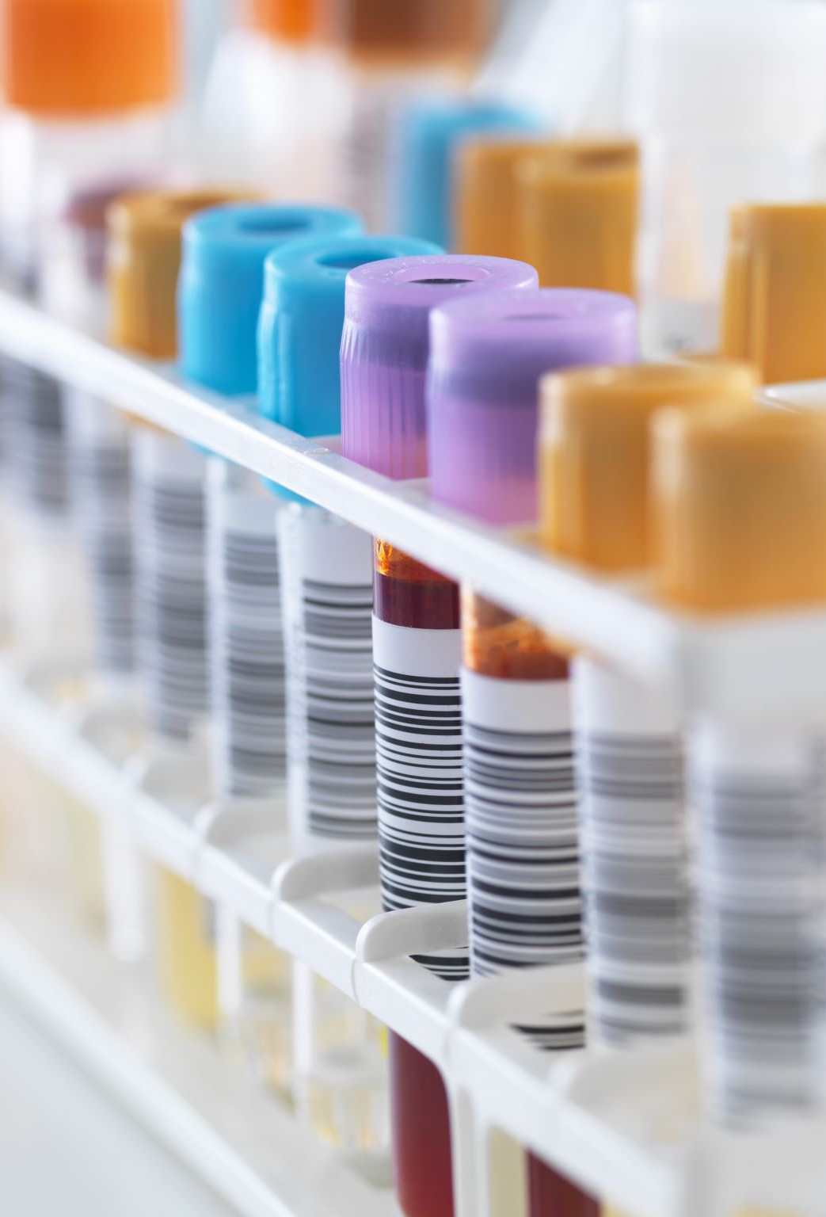
BioCHESS includes the collection, processing, aliquoting, and shipping of the following samples:
Plasma
Buffy Coat
Serum
Membrane (in Fixed, Fresh Frozen, and RNALater)
Dura (in Fixed, Fresh Frozen, and RNALater)
Subdural Hematoma Fluid (Frozen)

Slide 6
Ordering Kits and Supplies
Study sites are responsible for ordering study kits from BioSEND.
Sites should proactively confirm kits are on hand in preparation for randomization/rescue surgery.
Sites should allow TWO weeks for kit orders to be processed and delivered.
Details can be found in the BioCHESS/BioSend Manual of Procedures.

Slide 7
Site Required Equipment (supplied by local site)
Available at Collection Site:
Personal Protective Equipment (PPE)
Lab coat, nitrile/latex gloves, safety glasses
Tourniquets
Alcohol prep pads
Gauze pads
Bandages
Butterfly needles and hubs
Microcentrifuge tube rack
Test tube rack
Sharp bins and lid
Available to process samples:
Centrifuge capable of >1500 rcf (1500 x g) with refrigeration to 4° C
-80° C Freezer
Available to Ship specimens:
Dry ice (min of 10 lbs/shipment)

Slide 8
Blood Collection Order
Serum
EDTA (plasma)
EDTA can contaminate subsequent tubes if collected first, so they should be collected after other tube types.

Slide 9
Serum Processing

Slide 10
EDTA (Plasma) Processing

Slide 11
Membrane and Dura Collection
Once the membrane and dura samples have been surgically retrieved, split each sample into 3 sections as follows:
Placed in the prefilled formalin (submerged completely) and shipped to Indiana University ambient.
Please see BioSend Manual of Procedures for ambient shipping details.
Placed in the prefilled RNALater tube (submerged completely) and freeze this sample in a -80° freezer.
Last section should be flash frozen and placed in the final green-top tube.
If liquid nitrogen is not available; alternatively, the section can be placed in the container and frozen at -80°.

Slide 12
Subdural Hematoma Fluid Collection
Collect subdural hematoma fluid into sterile 15ml individually wrapped conical and freeze upright in -80 freezer.
Important to note:
Do not collect more than 14ml of fluid in the tube, as overfilled may leak or burst when freezing.

Slide 13
Sample Record and Shipment Notification Form
Appendix I must be completed the day that samples are collected to capture information related to sample collection and processing.
This form includes information that will be used to reconcile sample collection and receipt.
All sample shipments to BioSEND must include the shipment notification Form(s).
Emailed to BioSEND@iu.edu at the time the samples are being shipped
Included in the shipment with the samples.

Slide 14
Packaging and Shipping
All study personnel responsible for shipping should be certified in biospecimen shipping.
If not available at your University, training and certification is available through the CITI training site (“Shipping and Transport of Regulated Biological Materials”
Frozen shipped samples must be shipped Monday-Wednesday only.
Ambient shipped samples must be shipped Monday-Thursday.

Slide 15
BioCHESS and CHESS Considerations
BioCHESS is optional participation for CHESS subjects.
BioCHESS is optional participation for CHESS clinical sites.
Please review requirements carefully and determine feasibility at your individual institutions.
Sites will be compensated an additional $500/consented subject with samples adequately collected, processed, and upon confirmation samples are received by BioSEND.

