Slide 1
CHESS
Chronic Subdural Hematoma Treatment with Embolization Versus Surgery Study
NINDS UG3 NS128397
Protocol v14 Training

Slide 2
This work is supported by the National Institute of Neurological Disorders and Stroke
[Grant Number UG3NS128397]

Slide 3
Principal
Investigators
Key Study Team
Members
Peter Kan, MD
  Contact PI
Ajith Thomas, MD
  Co-PI
Christy Cassarly, PhD
  Co-PI
  Unblinded Statistician
Farhan Siddiq, MD
  Co-PI
Magdy Selim, MD
  Neurologist, Steering Committee
Adnan Qureshi, MD
  Chair of Steering Committee
Renee Martin, PhD
  Blinded Statistician
Suzan Moser
  FDA Regulatory Affairs
Jessica Spahn
  Project Manager
Ibrahim Bhatti, MD
  Clinical Review Committee Manager
Muhammad Shakir, MD
  Clinical Imaging Laboratory Manager
Riley Luckmann
  Data Manager
Emily Philpot
  Data Manager

Slide 4
NINDS Representatives
Jeremy Brown, MD
  NINDS Program Scientist
Bruce Mertz, M.S.
  NINDS Grants Specialist
Gretchen Scott, BSN, RN
  NINDS Program Official
Joan Ohayon, MSN, CRNP, MSCN
  NINDS Liaison to DSMB

Slide 5
Clinical Site PI’s
University of Texas Medical Branch
  Peter Kan, MD
Cooper Health System
  Ajith Thomas, MD
Baptist Medical Center-Jacksonville
  Ricardo Hanel, MD
Beth Israel Deaconess Medical Center
  Phillip Taussky, MD
Emory University
  Jonathan Grossberg, MD
Geisinger Medical Center
  Clemens Schirmer, MD
Global Neurological Institute
  Mandy Binning, MD
Good Samaritan Hospital
  Andrew Ringer, MD
Ichan School of Medicine at Mount Sinai
  Christopher Kellner, MD
Massachusetts General Hospital
  Stapleton, Christopher, MD
North Shore University Health System
  William Ares, MD
Northwestern University
  Matthew Potts, MD
Rutgers, The State University of New Jersey
  Amit Singla, MD
SUNY Upstate Medical University
  Grahame Gould, MD
University of Illinois
  Ali Alaraj, MD
University of Kansas Medical Center
  Koji Ebersole, MD
University of Miami
  Robert Starke, MD
University of Minnesota
  Bharathi Jagadeesan, MD
University of Missouri
  Steven Carr, MD
University of Pennsylvania
  Jan Burkhardt, MD
University of South Florida
  Maxim, Mokin, MD
University of Utah
  Ramesh Grandhi, MD
University of Washington
  Michael Levitt, MD
UT-Health Science Center-Houston
  Sunil Sheth, MD
UT-Health Science Center-San Antonio
  Justin Mascitelli, MD
UT Southwestern Medical Center
  Babu Welch, MD
Wake Forest University Health Science
  Stacey Wolfe, MD
Washington University, St. Louis
  Joshua Osbun, MD
Westchester Medical Center
  Chirag Gandhi, MD
Mayo Clinic Arizona
  Bernard Bendock, MD

Slide 6
CHESS Study Design
Prospective, multi-center, randomized controlled, open-label clinical trial.
Patients with moderately symptomatic CSDH are randomized in a 1:1 ratio to MMAE or conventional surgery.
  Moderately symptomatic CSDH patients:
    Patients with moderate focal deficits - moderate weakness (4/5 weakness or better on MRC scale)
    Gait difficulty (TUG greater than or equal to 11 seconds)
    Aphasia (ASR between 0-4)
MMAE is performed using Embosphere Microspheres (Biosphere Medical, S.A.) or CONTOUR Embolization Particles (Boston Scientific Corporation).
  Type of particles utilized will be based on treating physician preference.
Conventional surgery in CSDH is surgical drainage through burr holes or craniotomy. *SEPs is not an option*
  Type of surgery will be based on treating physician preference.

Slide 7
Trial Design
Prospective, randomized, open-label
Moderately symptomatic CSDH
1:1 randomization
  MMAE or surgery
Sample Size: 394
Time in Study: 180 (+30) days
Clinical Centers: 30-35 US sites in
Projected Timeline
  Start-up: 9 Months
  Enrollment/Follow-up: 3.75 years
  Close Out: 6 Months

Slide 8
Key Eligibility Criteria
Inclusion
Age 40-90 years
Unilateral convexity CSDH (≥10 mm thickness), OR Bilateral CSDH if only one side is considered for treatment and the contralateral side is <5 mm
CSDH at least 2/3 isodense or hypodense
Qualifying baseline head CT performed within the 7 days prior to randomization
Able to undergo assigned treatment within 48 hours after randomization
Exclusion
Known contraindications to angiography
Known collateral vessel pathways potentially endangering normal territories or cranial nerves
Known large diameter arteriovenous shunt that cannot be addressed with coil embolization
No measurable deficit TUG, ASR, or MRC

Slide 9
INCLUSION CRITERIA
Age 40-90 years inclusively.
Per CT of the head, (one of the following):
  Unilateral convexity CSDH measuring at least 10 mm in thickness OR
  Bilateral CSDH if only one side is considered for treatment and the contralateral side is asymptomatic and < 5 mm in thickness.
CSDH at least 2/3 isodense or hypodense, verified on axial CT slice used to measure the thickness of the qualifying CSDH.
Qualifying baseline head CT performed within the 7 days prior to randomization.
Able to undergo assigned treatment within 48 hours after randomization.
Patient or legally authorized representative agrees to be randomized, and provides written informed consent and Health Insurance Portability and Accountability Act (HIPAA) authorization.

Slide 10
Exclusion Criteria
Secondary cause apart from trauma for the qualifying SDH, such as an underlying vascular abnormality or tumor.
Tentorial or interhemispheric SDH.
Previous craniotomy for the treatment of CSDH if the craniotomy exceeds 7 cm at the maximal dimension on the baseline CT.
mRS of 5 or higher.
Emergent surgical evacuation such as open craniotomy, burr hole drainage, or Subdural Evacuating Port System (SEPS) is required for the patient.
Continued on next slide:

Slide 11
Exclusion Criteria
Unable to withhold all antiplatelet agents or OACs for the first 7 days after randomization.
Indication that withdrawal of care will be implemented for the qualifying SDH.
Prior surgical treatment for CSDH if the surgery is less than 30 days prior to randomization.
On tranexamic acid.
Platelet count of <100,000 per microliter refractory to transfusion.
Coagulopathy that cannot be corrected to an INR of ≤1.5.
Continued on next slide:

Slide 12
Exclusion Criteria
Known contraindications to angiography.
Known intolerance to occlusion procedures.
Known vascular anatomy (small artery size) or blood flow (high vascular resistance peripheral to the feeding arteries) that precludes catheter placement or embolic agent (Embosphere Microspheres or CONTOUR particles) injection.
Known presence of collateral vessel pathways potentially endangering normal territories or cranial nerves during embolization.
Known large diameter arteriovenous shunt, i.e., where the blood does not pass through an arterial/capillary/venous transition but directly from an artery to a vein or presence of patent extra-to-intracranial anastomoses (where study embolization devices could pass directly into the internal carotid artery, vertebral artery, or intracranial vasculature) that cannot be addressed with coil embolization.
Continued on next slide

Slide 13
Exclusion Criteria
Patient has a known active systemic infection or sepsis.
Patient is pregnant, planning to become pregnant, or lactating.
Life expectancy of less than 6 months due to comorbid terminal conditions.
Concurrent participation in another research protocol for investigation of an experimental therapy.
Known or suspected to not be able to comply with the study protocol.
No measurable deficit on the Timed Up and Go [TUG], Aphasia Severity Rating [ASR], or MRC.
Continued from previous slides

Slide 14
Primary Endpoint
The proportion of subjects (per the Clinical Review Committee) to need rescue surgery or die within 180 days of randomization

Slide 15
Safety Endpoints
The proportion of subjects with symptomatic ischemic stroke within 180 days of randomization.
The proportion of subjects with serious/life threatening adverse events within 180 days of randomization.
The proportion of subjects with worsening of neurological status or development of new disabling neurological symptoms (>1 point on the Markwalder Scale) anytime within 180 days of randomization.
The proportion of subjects with seizures within 180 days of randomization.
The proportion of subjects with cranial neuropathy within 180 days of randomization.

Slide 16
Exploratory Endpoints
Proportion of subjects with volumetric reduction of ≥ 50% on CT imaging at 90 days post-randomization.
Change in quality of life from baseline to 180 days post-randomization (assessed using the EQ-5D-5L).
Change in cognitive outcome from baseline to 180 days post-randomization (assessed using t-MoCA).
Change in headache severity assessed from baseline to 180 days post-randomization (using HIT-6).
The proportion of subjects with favorable functional outcome defined as an improvement in mRS at 180 days post-randomization compared with baseline. If baseline mRS is 0, favorable outcome is mRS of 0.

Slide 17
Summary of Ongoing Randomized-Controlled Trials (RCTs)
 | MEMBRANE (US) | STEM (US)* | EMBOLISE (US)* | MAGIC-MT (China)*
Study Type | RCT | RCT | RCT | RCT
Patients | Chronic SDH | Chronic or subacute SDH | Chronic or subacute SDH | Non-acute SDH
Inclusion Criteria | mRS 0 to 3 No prior treatment GCS 9 or higher Markwalder 2 or less | Pre-morbid mRS 0 to 1 No prior treatment Has neurological symtoms At least 10 mm cSDH thickness with mass effect Imaging evidence of chronicity (more than 50% hypo- or iso-dense on CT) | Pre-morbid mRS 0 to 2 Markwalder 2 or less | Symptomatic non-acute SDH with mass effect mRS <2 prior to symptom onset.
Treatment Groups | Conventional Management (surgical or non-surgical) vs. Conventional Management plus MMAE | Conventional Management (surgical or non-surgical) vs. Conventional Management plus MMAE | Conventional Management (surgical or non-surgical) vs. Conventional Management plus MMAE | Conventional Management (surgical or non-surgical) vs. Conventional Management plus MMAE
Number of patients | 376 | 310 | 600 | 727
Embolic Agent | NBCA (liquid) | SQUID (liquid) | ONYX (liquid) | ONYX (liquid)
Primary Outcome | Hematoma recurrence/progression or requiring re-intervention (180 days) | Residual or re-accumulation of the SDH (>10 mm) or Surgical Rescue surgery or any new, major disabling stroke after enrollment, MI, or death from any neurological cause (180 days) | Incidence of hematoma recurrence/progression requiring re-intervention (90 days) | Symptomatic SDH recurrence/progression rate (90 days)
*Partial results presented at ISC 2024

Slide 18
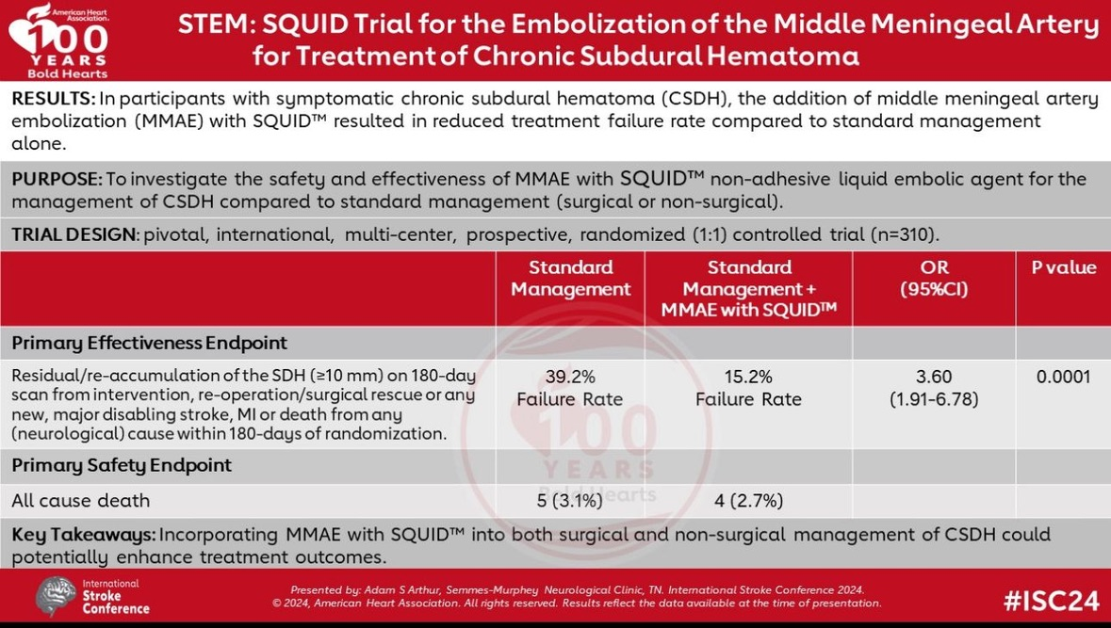

Slide 19
STEM: Primary Effectiveness Endpoint: Subgroups
Surgical Arm OR = 2.4
(0.97-6.03; p=0.058)

Slide 20
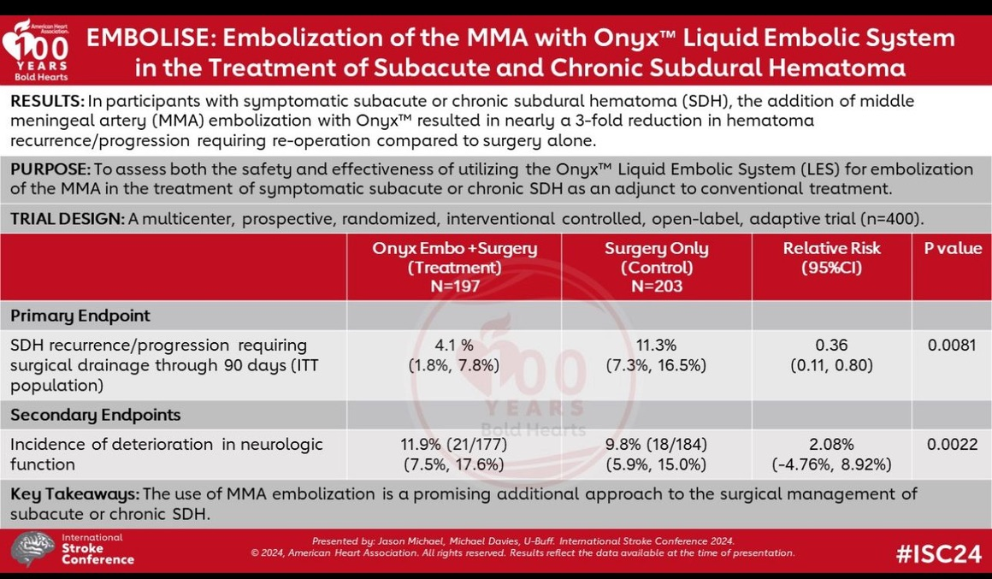

Slide 21
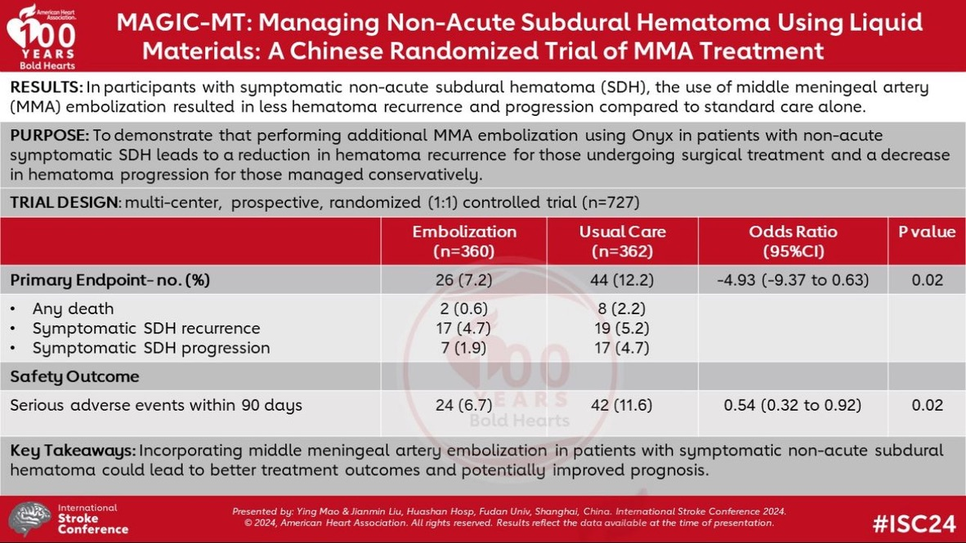

Slide 22
MAGIC-MT PRIMARY OUTCOMES
OUTCOME | Embolization(n=360) | Usual Care (N=362) | Measure of Effect | Difference or Odds Ratio (95% CI) | P Value
Primary Outcome- no. (%) | 26 (7.2) | 44 (12.2) | Percentage-point difference | -4.93 (-9.37 to -0.63) | 0.02
Any death | 2 (0.6) | 8 (2.2)
Symptomatic Subdural Hematoma Recurrence (Burr hole arm) | 17 (4.7) | 19 (5.2)
Symptomatic Subdural Hematoma progression (No burr hole arm) | 7 (1.9%) | 17 (4.7)

Slide 23
Conclusions from RCTs presented at ISC 2024
CHESS is asking a different primary question.
  All 3 studied the role of MMAE as an adjunct to standard of care in patients with mild or severe symptoms..
  CHESS asks whether MMAE can be used as a standalone therapy in moderately symptomatic patients.
Further data is needed to definitively answer the benefit of MMAE plus surgery vs. surgery alone.
  EMBOLISE showed a large benefit of MMAE plus surgery over MMAE in the primary outcome.
  MAGIC-MT did not show a benefit.
  Benefit for MMAE plus surgery over surgery in STEM just missed statistical significance.
CHESS is enrolling a different patient population and generalizable compared to the trials presented.
  Patients with recurrent disease (around 25% of patients)
  Patients with bilateral disease (around 15% of patients)
Difference in embolic agent. CHESS will be the first US study to look at particles as the embolic agent.
  Cost of particles is about 5% of liquid embolics.
  Particle embolization is done under conscious sedation, but liquid embolic embolization typically requires general anesthesia.

Slide 24
Site Feedback on Recent RCTs Presented at ISC
The site PI’s for the 26 confirmed sites were sent a letter summarizing the results from the 3 MMAE trials presented at ISC 2024.
  Response Rate: 21/26 (81%)
  20/21 had no concerns of equipoise
  1/21 expressed concern about equipoise but later confirmed willingness to enroll

Slide 25
Randomization and Procedures

Slide 26
Assessments

Slide 27
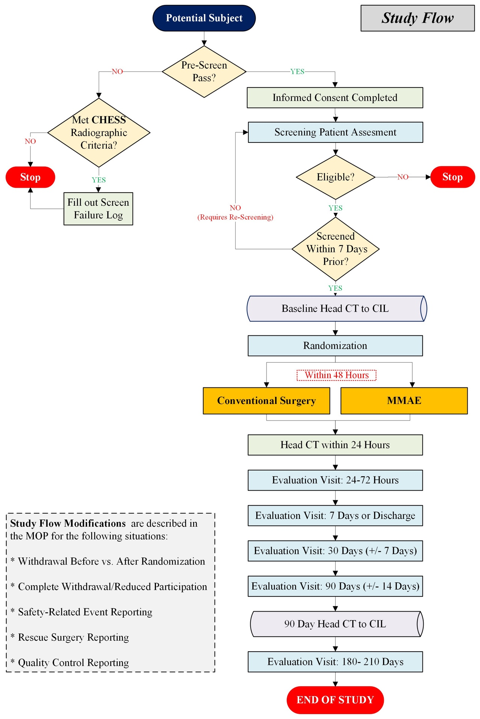
STUDY FLOW

Slide 28
Timeline for Assessments
Study event | Baseline | Randomization | 48 hours After Randomized (±24 hours) ⁰ | 7 days After Randomized or at Discharge¹ | 30 days After Randomized (±7 days) | 90 DAYS after Randomized (±14 days) | 180 days After Randomized (+30 days) | Rescue Surgery Assessment
Informed Consent | ✔ | _ | _ | _ | _ | _ | _ | _
Study Treatment (Surgery or MMAE) | _ | ✔ | _ | _ | _ | _ | _ | _
Lab Work/Imaging
Pregnancy Test (Women) | ✔ | _ | _ | _ | _ | _ | _ | _
Platelet count | ✔ | _ | _ | _ | _ | _ | _ | _
Coagulation Profile | ✔ | _ | _ | _ | _ | _ | _ | _
Serum Creatinine | ✔ | _ | ✔ | _ | _ | _ | _ | _
CT Scan of Head Without Contrast | ✔⁵ | _ | ✔² | _ | _ | ✔⁵ | ✔⁵ | ✔
Clinical History Assessment
Medical History, Demographics | ✔ | _ | _ | _ | _ | _ | _ | _
Medications | ✔ | _ | ✔ | ✔ | ✔ | ✔ | ✔
SAE Monitoring | _ | ✔ | ✔ | ✔ | ✔ | ✔ | ✔ | _
AE Monitoring | _ | ✔ | ✔ | ✔ | ✔ | ✔⁴ | ✔⁴ | _
Notes:
⁰ All activities at the 48 Hour After Randomized visit are to be performed after the randomized treatment.
¹ The 7 Days After Randomize or at Discharge procedures are performed at hospital discharge or 7 days after randomization, whichever occurs first.
² The 48 Hours After Randomized CT Scan of Head Without Contrast is performed within 24 hours after conventional surgery or MMAE treatment.
³ Pre-CSDH mRS will be performed without Rankin focused assessment (RFA) and mRS via RFA will be performed at baseline and 180 d.
⁴ All AEs will be reported up to and including 30 days after the study treatment (MMAE or conventional surgery) procedure. After 30 days, only AEs related to the study treatment or device (Embosphere Microspheres or CONTOUR Embolization Particles), safety outcomes, and SAEs will be reported.
⁵ ASR, TUG, MRC, and head CT will go to the Central Review Committee for the first two randomized subjects at each site at the baseline, 90 day, and 180-day visits.

Slide 29
Timeline for Assessments
Study event | Baseline | Randomization | 48 hours After Randomized (±24 hours) ⁰ | 7 days After Randomized or at Discharge¹ | 30 days After Randomized (±7 days) | 90 DAYS after Randomized (±14 days) | 180 days After Randomized (+30 days) | Rescue Surgery Assessment
Clinical Assessments
Markwalder Scale | ✔ | _ | ✔ | ✔ | ✔ | ✔ | ✔ | _
NIHSS | ✔ |  | ✔ | ✔ | ✔ | ✔ | ✔
MRC | ✔⁵ | _ | ✔ | ✔ | ✔ | ✔⁵ | ✔⁵ | ✔
mRS (RFA) | ✔³ | _ | _ | _ | _ | _ | ✔ | _
Pre-cSDH mRS | ✔³ | _ | _ | _ | _ | _ | _ | _
EQ-5D-5L | ✔ | _ | _ | _ | _ | _ | ✔ | _
t-MOCA | ✔ | _ | _ | _ | _ | _ | ✔ | _
HIT-6 | ✔ | _ | _ | _ | _ | _ | ✔ | _
TUG | ✔⁵ | _ | _ | _ | _ | ✔⁵ | ✔⁵ | ✔
ASR | ✔⁵ | _ | _ | _ | _ | ✔⁵ | ✔⁵ | ✔
Notes:
⁰ All activities at the 48 Hour After Randomized visit are to be performed after the randomized treatment.
¹ The 7 Days After Randomize or at Discharge procedures are performed at hospital discharge or 7 days after randomization, whichever occurs first.
² The 48 Hours After Randomized CT Scan of Head Without Contrast is performed within 24 hours after conventional surgery or MMAE treatment.
³ Pre-CSDH mRS will be performed without Rankin focused assessment (RFA) and mRS via RFA will be performed at baseline and 180 d.
⁴ All AEs will be reported up to and including 30 days after the study treatment (MMAE or conventional surgery) procedure. After 30 days, only AEs related to the study treatment or device (Embosphere Microspheres or CONTOUR Embolization Particles), safety outcomes, and SAEs will be reported.
⁵ ASR, TUG, MRC, and head CT will go to the Central Review Committee for the first two randomized subjects at each site at the baseline, 90 day, and 180-day visits.

Slide 30
Screening for Potential Subjects
All consecutive CSDH subjects admitted are expected to be reviewed by study team (within 24 hr of admission) for eligibility
Pre-Consent Screening
Post-Consent Screening
Post-Consent Additional Baseline
Demographics
Medical History
Review of Medications
General Physical Exam
Vital Signs
Neurological Examination
Head CT (Viz RECRUIT)
Lab Work
Markwalder Scale
MRC
TUG
ASR
mRS/Rankin Focused Assessment
EQ-5D
T-MOCA
HIT-6
NIHSS
Screen failures for patients meeting radiographic criteria but otherwise are ineligible for CHESS must be documented

Slide 31
Informed Consent
Informed Consent/HIPAA is required before research-related activities
Up-to-date consent forms available on WebDCU (English and Spanish)
Authorized, trained personnel facilitate in-person consent
  Remote/e-Sign provisions available if approved by IRBs at onboarding
Use of Legal Authorized Representative (LAR)
  If subject’s decision-making ability is impaired/lacks cognitive ability per investigator assessment
  Subject will need to be reconsented if capacity is regained
  If no LAR is available + subject unable to provide consent, do not enroll

Slide 32
Randomization
  Randomization can occur:
    Once informed consent is obtained
    All inclusion criteria and no exclusion criteria are met
  WebDCU will randomly assign treatment
  Must undergo assigned treatment within 48hr
  Once a subject is randomized, they are considered enrolled in the study

Slide 33
Recruitment Goals
# of Subjects | Minimum Per Site Per Year | Across 4 Years
Consent | 4-5 | ~520
Randomize | 3-4 | ~394

Slide 34
Anticoagulation after Randomization
  Antiplatelets and OACs withheld for the first 7 days after randomization
    After 7 days they may be restarted at the discretion of the local investigator if the CT scan is stable or better
  If an antiplatelet agent or OAC cannot be held for 7 days the patient should NOT be randomized
    *Reminder, this is an Exclusion Criteria*
  If a patient is randomized and an antiplatelet agent or OAC later becomes required before treatment (either MMAE or conventional surgery) the treatment should NOT be performed

Slide 35
At the discretion of the interventionalist:
  Embosphere Microspheres
  (100-300, or 300-500 microns)
  OR
  PVA CONTOUR Embolization particles
  (150-250, 250-355, or 355-500 microns)
  General anesthesia (GA) or monitored anesthesia care (MAC)
  +/- Intravenous heparin (ACT)
  Femoral artery or radial artery access
Randomized to MMAE

Slide 36
Randomized to
MMAE
  Subject will undergo particle embolization with:
    Embosphere Microspheres
      (100 to 300 or 300 to 500 micron)
OR
    PVA CONTOUR Embolization particles
      (150 to 250, 250 to 355, or 355 to 500 micron)
*This decision is based on discretion of the treating physician*

Slide 37
Middle meningeal artery embolization (MMAE)
Discretion of the Interventionalist
  General anesthesia (GA) or monitored anesthesia care (MAC)
  +/- Intravenous heparin (ACT)
  Femoral artery or radial artery access

Slide 38
An ICA angiogram will be performed over the cranium to assess the ophthalmic artery anatomy and retinal blush.
ECA angiography to identify angiographic anastomosis to the internal carotid artery and the ophthalmic.
If collateral vessels (anastomoses to the internal carotid artery or ophthalmic artery) are present, coil embolization of the proximal vessels will be performed. If no collateral vessels are found, a microcatheter of choice will be advanced selectively to the frontal followed by the parietal branch followed by embolization.
Alternatively, if no collaterals are identified, particle embolization can take place in the parent MMA before the bifurcation once the catheter is above the orbit on the lateral projection.
Middle Meningeal Artery Embolization (MMAE)
Procedure

Slide 39
Origin of the MMA from the ophthalmic artery would entail a trans-internal carotid artery approach to the MMA. MMAE will not be performed and the procedure ended.
In the case of MMA perforation (noted on microcatheter injection), immediate coil embolization and occlusion of the MMA will be performed through the same microcatheter and the procedure will end after.
It is suggested that Embosphere Microsphere 100 to 300 micron variant or CONTOUR Embolization Particles 150 to 250 micron be used with an 017 microcatheter, and Embosphere Microsphere 300 to 500 micron variant or CONTOUR Embolization Particles 250 to 355 micron or 355 to 500 micron variants be used with an 021 microcatheter.
The microcatheter shall be occasionally flushed of particles and super-selective angiography repeated during the procedure to identify emerging dangerous anastomosis as MMA flow diminishes. If any new anastomotic pathway is seen on micro catheter injections as the MMA embolization progresses, the procedure will be stopped to avoid untoward events.
Middle Meningeal Artery Embolization (MMAE)
Procedure

Slide 40
Middle Meningeal
Artery Embolization
(MMAE)
The following will be recorded on the Case Report Form:
  MMAE procedure outcome (when the vasculature surrounding the MMA territory can no longer be visualized)
  Embosphere Microsphere or CONTOUR Embolization Particles Used
  Coils used & reasons for their use, including to treat perforation
  Estimated blood loss
  Procedure time (time of vascular access to last sheath removed)
  Fluoroscopy time (the total time that fluoroscopy is used during the MMAE procedure as noted on the fluoroscopy monitor)
  Dose of heparin use and ACT result after heparin administration

Slide 41
At the discretion of the treating physician:
  Burr hole drainage
  OR
  Craniotomy
  Please Note: Subdural Evacuating Port System (SEPS) is not an option for conventional surgery
Randomized to Conventional Surgery

Slide 42
Conventional Surgery
The following will be recorded on the Case Report Form:
  Conventional surgery procedure outcome (evacuation of >50% of the hematoma volume based on the 24-hour post-operative CT scan)
  Procedure performed (craniotomy or burr hole)
  Estimate blood loss
  Drain location
  Procedure Time (time of anesthesia induction to extubation)
  Surgical time (skin incision to closure)

Slide 43
Assessment of Subjects
Before Randomization Assessments
After Randomization Assessments
Demographics
Medical History
Review of Medications
Informed Consent
Screening Lab Work
Baseline Clinical Scale Assessments
Head CT without Contrast
Lab Work (Creatinine)
Head CT without Contrast (48hrs,90d,180d)
AE and SAE Monitoring
Clinical Scale Assessments:
Markwalder Scale
MRC
TUG
ASR
mRS
EQ-5D-5L
t-MOCA
HIT-6
MRC, TUG, and ASR will be performed by trained study team members not directly performing the surgical, endovascular, or medical treatment
Notes:
MRC, TUG, and ASR will be performed by trained study team members not directly performing the surgical, endovascular, or medical treatment

Slide 44
Assessment of Subjects After Randomization
24-72hrs After Randomization
7 days After Randomization
30±7 days After Randomization
Medications
Serum creatinine
MRC
Markwalder Scale
Head CT without contrast (within 24 hours after conventional surgery or MMAE treatment)
AE/SAE Monitoring
Medications
MRC
Markwalder Scale
AE/SAE Monitoring
Medications
MRC
Markwalder Scale
AE/SAE Monitoring

Slide 45
Assessment of Subjects After Randomization
90±14 days After Randomization
180+30 days After Randomization
Medications
Markwalder Scale
MRC
TUG
ASR
Head CT without contrast
AE/SAE Monitoring
Medications
Markwalder Scale
MRC
Head CT without contrast
mRS
EQ-5D-5L
t-MOCA
HIT-6
TUG
ASR
AE/SAE Monitoring
Notes:
MRC, TUG, and ASR will be performed by trained study team members not directly performing the surgical, endovascular, or medical treatment

Slide 46
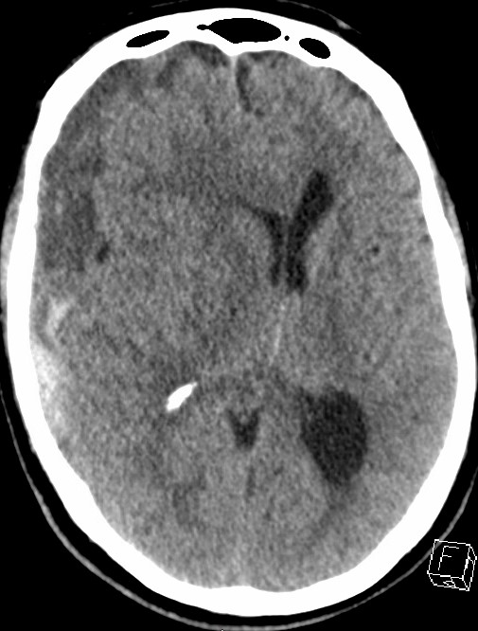
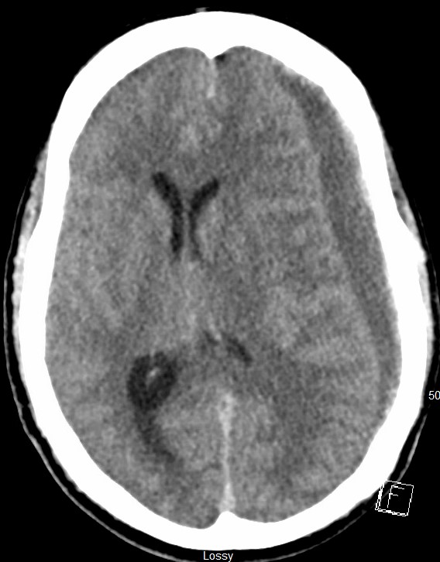
Measurement of Midline Shift (MLS)
MLS will be measured in mm as the perpendicular distance from a midline structure (Septum Pellucidum) to a line drawn between the anterior and posterior attachments of the falx. Measured at level of foramen of Monroe
A
A
B
B
Notes:
Figure 1: Right sided CSDH displaying midline shift; the ideal midline A is determined as the line between the most anterior and posterior parts of the falx cerebri. Line B is drawn perpendicular to line A to the septum pellucidum and is then calculated as shift
Figure 2: Left sided CSDH displaying midline shift; the ideal midline A is determined as the line between the most anterior and posterior parts of the falx cerebri. Line B is drawn perpendicular to line A to the septum pellucidum and is then calculated as shift

Slide 47
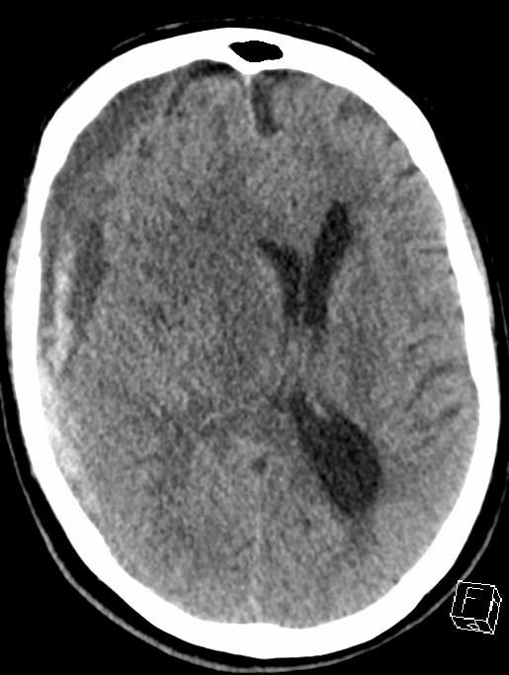
Measurement of Hematoma Thickness
Maximum thickness calculated as maximal width of CSDH above temporal bones and up to two slices above lateral ventricles and one slice below the lateral ventricles.
Upper limit excludes miscalculation due to high skull calvarium
Lower limit avoids measurement on tentorial bleeding, excludes slices below one below ventricles
W
L
Notes:
Figure 3: cSDH maximum width measured axial (W) perpendicular to maximum length (L).

Slide 48
Standardized Assessments
TUG: Assesses balance, walking ability, and fall risk in older adults
The Timed Up and Go (TUG) Test
Interpretation
Sit in a chair with your back against the back
Rising from the chair on the command "go"
Walking 3 meters at a comfortable pace
Turning around at the 3 meter mark
Walking back to the starting point
Returning to sitting in the chair
Mobility is assessed based on time to complete the test:
    < 10 seconds: Normal
    < 20 seconds: Good mobility
    < 30 seconds: Walking and balance problems
TUG score of <11 seconds will still qualify with measurable deficit on the ASR or MRC
  At least one of these scales has to have a measurable deficit for enrollment purposes
Notes:
https://www.cdc.gov/steadi/media/pdfs/STEADI-Assessment-TUG-508.pdf

Slide 49
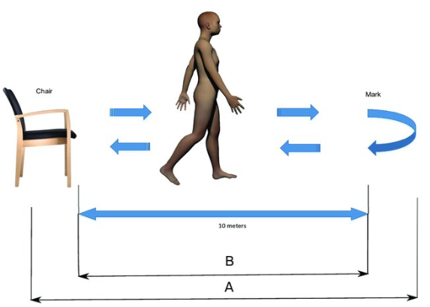
The Timed Up and Go (TUG) Test
3 meters
Notes:
Steinmetzer T, Maasch M, Bönninger I, Travieso CM. Analysis and classification of motor dysfunctions in arm swing in Parkinson’s disease. Electronics. 2019 Dec 3;8(12):1471.

Slide 50
Neurological Assessment of Subjects
The Timed Up and Go (TUG) Test
Please Click Link for Video
https://www.youtube.com/watch?v=tNay64Mab78

Slide 51
Standardized Assessments
MRC (Medical Research Council) Scale: Assesses muscle strength
Upper Limb
Lower Limb
Patient seated or lying down with arms relaxed.
Shoulder Abduction: Resist as patient lifts arm out to the side.
Elbow Flexion: Resist as patient bends elbow against your hand.
Wrist Extension: Resist as patient pulls wrist back.
Patient lying down with legs extended.
Hip Flexion: Ask patient to lift leg off the bed.
Knee Extension: Resist as patient extends knee against your hand.
Foot Dorsiflexion : Resist as patient pulls toes towards shin.
Scoring
(0) No contraction
(1) Flicker or trace of contraction
(2) Active movement, with gravity eliminated
(3) Active movement against gravity
(4) Active movement against gravity and resistance
(5) Normal power
For eligibility based on MRC: at least one muscle group on the contralateral side to the CSDH must have a score of 4.
If any muscle groups have a score 0-3, the patient is ineligible based on severe deficit outside the scope of the target population
Notes:
https://www.cdc.gov/steadi/media/pdfs/STEADI-Assessment-TUG-508.pdf

Slide 52
Please click link for MRC VIDEO

Slide 53
Standardized Assessments
Aphasia Severity Rating (ASR)
Description | Score
Speech, writing and/or auditory comprehension are not functional. Any attempts to speak or use of fluent utterances are not understandable to the listener OR the individual may not attempt to speak at all. | 0
The individual may occasionally produce words or phrases that are meaningful in context, but communication is fragmentary and not possible without significant help from the listener e.g. guessing, questioning. Conversation is very ‘one sided’ with the listener bearing almost all of the burden. An extremely limited amount or range of information is exchanged. Misunderstandings or failed communications are very frequent | 1
Basic conversation about most familiar or everyday topics is possible but significant break down occurs with more abstract or difficult conversations. The burden of conversation is not fully shared by the individual who experiences several instances of word finding failures, paraphasias, and/or misunderstandings by the listener requiring need for repair. | 2
Despite some observable issues related to speech fluency or comprehension, there is no significant limitation. The individual may hesitate to access words or self-correct during conversation, but is able to share a significant portion of the burden of communication with the listener. | 3
Although the individual feels that he/she has a problem with language, this is barely apparent to the listener who may not detect any problem with speaking or understanding. | 4
Notes:
https://www.cdc.gov/steadi/media/pdfs/STEADI-Assessment-TUG-508.pdf

Slide 54
Standardized Assessments
Modified Rankin Scale (mRS)
Definition | Score
No symptoms at all | 0
No significant disability despite symptoms; able to carry out all usual duties and activities | 1
Slight disability; unable to carry out all previous activities, but able to look after own affairs without assistance | 2
Moderate disability; requiring some help, but able to walk without assistance | 3
Moderately severe disability; unable to walk without assistance and unable to attend to own bodily needs without assistance | 4
Severe disability; bedridden, incontinent and requiring constant nursing care and attention | 5
Notes:
https://www.cdc.gov/steadi/media/pdfs/STEADI-Assessment-TUG-508.pdf

Slide 55
Standardized Assessments
Markwalder Scale
Definition | Score
Patient neurologically normal | 0
Patient alert and oriented; mild symptoms such as headache, absent or mild neurological deficit, such as reflex asymmetry | 1
Patient drowsy or disoriented with variable neurological Grade deficits, such as hemiparesis | 2
Patient stuporous but responding appropriately to noxious stimuli; severe focal signs such as hemiplegia | 3
Patient comatose with absent motor response to painful stimuli; decerebrate or decorticate posturing | 4
Notes:
https://www.cdc.gov/steadi/media/pdfs/STEADI-Assessment-TUG-508.pdf

Slide 56
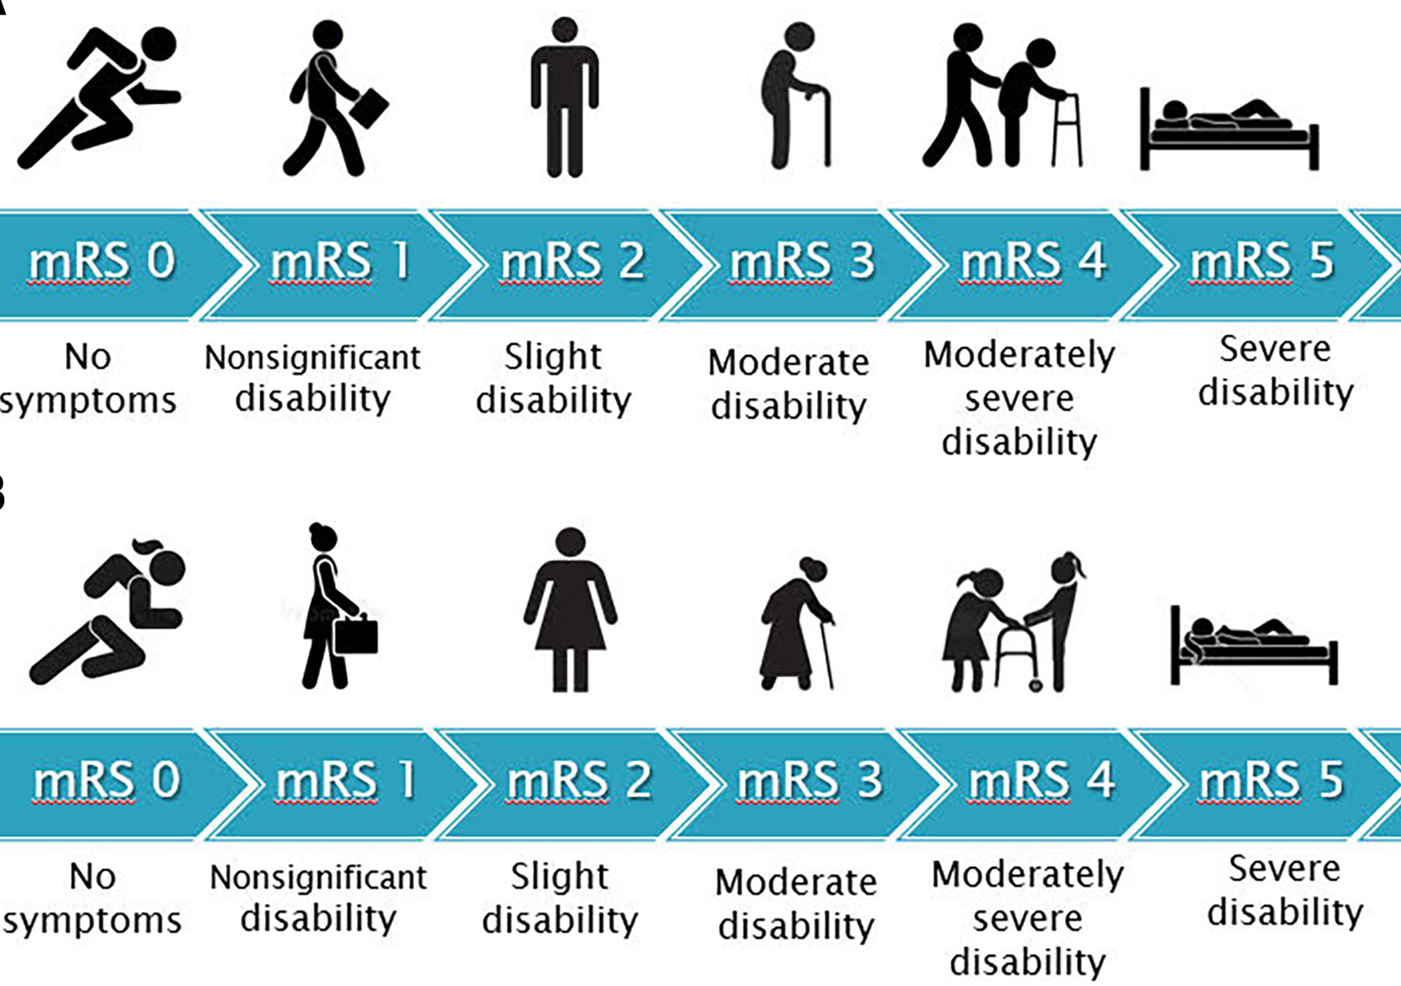
Modified Rankin Score (mRS)
Notes:
Saver JL, Chaisinanunkul N, Campbell BC, Grotta JC, Hill MD, Khatri P, Landen J, Lansberg MG, Venkatasubramanian C, Albers GW, XIth Stroke Treatment Academic Industry Roundtable. Standardized nomenclature for modified rankin scale global disability outcomes: consensus recommendations from stroke therapy academic industry roundtable XI. Stroke. 2021 Sep;52(9):3054-62.

Slide 57
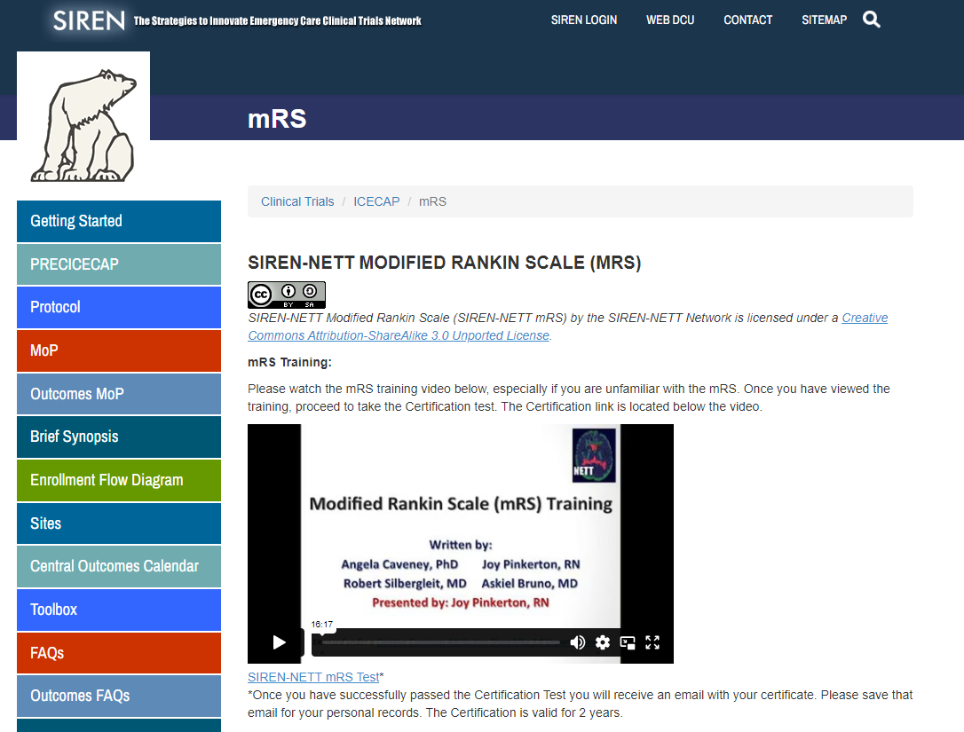
Modified Rankin Score Certification
Video Link
https://dcu.musc.edu/campus/mRSTraining/mRSTraining.mp4
https://siren.network/clinical-trials/icecap

Slide 58
Neurological Assessment Scales
Markwalder Scale: Markwalder TM, Steinsiepe KF, Rohner M, Reichenbach W, Markwalder H. The course of chronic subdural hematomas after burr-hole craniostomy and closed-system drainage. Journal of neurosurgery. 1981 Sep 1;55(3):390-6.
Medical Research Council Muscle Power Assessment (MRC): Naqvi U. Muscle strength grading. InStatPearls [Internet] 2022 Aug 29. StatPearls Publishing.
Modified Rankin Score (mRS): Joint Commission. Specifications manual for Joint Commission national quality measures. Perinatal Care (PC)-06 version. 2018.
European Quality of Life – 5 Dimensions (EQ-5D-5L): EuroQol Research Foundation. EQ-5D-5L User Guide, Version 3.0, September 2019. Available from https://euroqol.org/publications/user-guides/
Telephone Montreal Cognitive Assessment (t-MOCA): T-MoCA. (Version 8.3). Montreal Cognitive Assessment. Retrieved December 2023 from https://mocacognition.com/paper#paper_form_blind_telephone
Headache Impact Test (HIT-6): Yang M, Rendas-Baum R, Varon SF, Kosinski M. Validation of the Headache Impact Test (HIT-6™) across episodic and chronic migraine. Cephalalgia. 2011 Feb;31(3):357-67.
Timed Up and Go (TUG) Test: https://www.cdc.gov/steadi/media/pdfs/STEADI-Assessment-TUG-508.pdf
Aphasia Severity Rating (ASR): Simmons-Mackie, N., Kagan, A., & Shumway, E. (2018). Aphasia Severity Rating. Toronto, ON: Aphasia Institute

Slide 59
Open Discussion

Slide 60
Rescue Surgery
&
Clinical Review Committee

Slide 61
Significance of CRC
FDA/NIH recommends incorporating endpoint assessment and adjudication committees in clinical trials
CHESS's primary outcome is subjective, and the intervention is not blinded, making central endpoint assessment crucial
CHESS trial leadership established an independent CRC to determine the primary endpoint in a blinded manner

Slide 62
CHESS Primary Endpoint
Proportion of subjects centrally deemed (per CRC) to need rescue surgery or die within 180-210 days of randomization

Slide 63
CRC
Comprised of:
CRC Manager (with alternative)
4 Neurosurgeons (“Adjudicators”)
All adjudicators are independent of the CHESS trial and have active experience in managing CSDH
CRC Role in CHESS:
Review clinical information (MRC, TUG, ASR) & CT scans to centrally and independently determine the need for rescue surgery in a blinded fashion

Slide 64
Assessments required for CRC review
Head CT
TUG (Gait)
ASR (Aphasia)
MRC Muscle Power Assessment (Weakness)
*If clinical assessments are not available because emergent surgery was required, the associated AE report will be reviewed by the CRC*

Slide 65
Rescue Surgery Criteria
Radiographic Criteria
Clinical Symptom Criteria

Slide 66
Radiographic Criteria
Compared to baseline, an increase of maximal thickness of 20% or more.
Compared to baseline, an increase of midline shift of 3 mm or more.

Slide 67
Measurement of Hematoma thickness
Maximum thickness: Maximal width of CSDH above temporal bones and up to two slices above lateral ventricles and one slice below the lateral ventricles
Upper limit excludes miscalculation due to skull curvature at the top
Lower limit avoids measurement on tentorial bleeding
W
L
Notes:
https://www.cdc.gov/steadi/media/pdfs/STEADI-Assessment-TUG-508.pdf

Slide 68
Measurement of Midline Shift (MLS)
MLS will be measured in mm as the perpendicular distance from a midline structure (Septum Pellucidum) to a line drawn between the anterior and posterior attachments of the falx. Measured at level of foramen of Monroe
A
A
B
B
Notes:
https://www.cdc.gov/steadi/media/pdfs/STEADI-Assessment-TUG-508.pdf

Slide 69
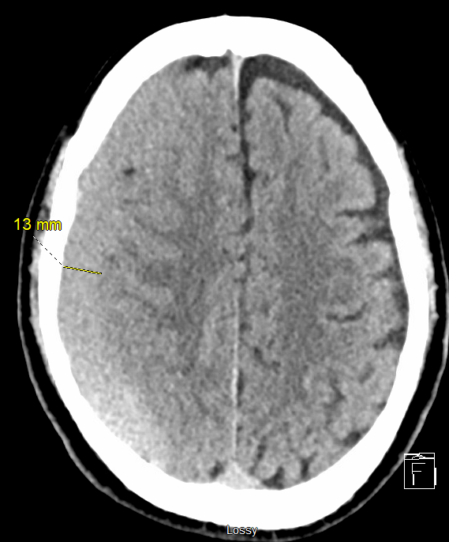
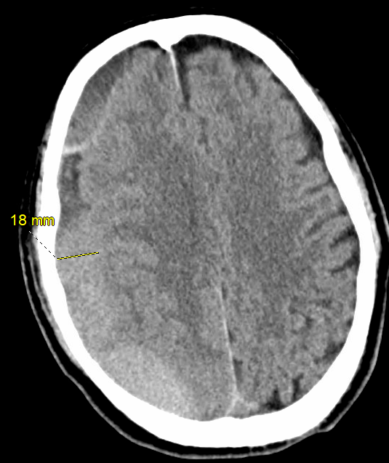
Example of Radiographic Criteria
Notes:
https://www.cdc.gov/steadi/media/pdfs/STEADI-Assessment-TUG-508.pdf

Slide 70
Clinical Symptom Criteria
For each of the clinical symptom scores (TUG, ASR, MRC)
  If a deficit was identified at baseline and the respective score is the same at 6 weeks or more from presentation, OR
  The respective score worsens at any time
    For the MRC, the worsened score has to be in a muscle group contralateral to the side of the CSDH and the deterioration cannot be explained by any other reason

Slide 71
Clinical Symptom Criteria
CHESS defined TUG worsening
An increase in the TUG of 30%
CHESS defined ASR worsening
An ASR drop by 1 point or more
CHESS defined MRC worsening
An MRC score worsening of 0-2 for any muscle group contralateral to the CSDH weakness

Slide 72
Guidelines for Initiation of CRC Review
Situation 1:
First and second subject randomized at each site.
If any clinical symptom criteria for rescue surgery are met and at least one of the radiographic criteria for surgery are met at any time, the site should initiate the adjudication procedure by the CRC.
Adjudication request should be initiated separately at 90-day and 180-day visit. (QC purposes only).
Situation 2:

Slide 73
Guidelines for Initiation of CRC Review
Situation 3:
If the site treating physician believes that a subject needs rescue surgery but did not meet the CRC clinical and radiographic criteria for rescue surgery.
Situation 4:
If the clinical situation is determined to be emergent, the site PI or treating neurosurgeon can proceed with surgery before CRC review.
A post-hoc review by the CRC is still the primary endpoint.

Slide 74
Situation 4: Emergent Rescue Surgery
  If MRC, TUG, and ASR were unavailable because of emergent nature, the post hoc determination will be made based on the same CT criteria and the associated serious adverse event (SAE) report
  For surgery to be recommended, the same CT criteria have to be met and the last documented neurological examination before surgery has to show deterioration from baseline (described in the SAE narrative) as adjudicated by the CRC

Slide 75
Timeline for CRC Adjudication
In all situations, the site must provide data required for CRC review within 5 business days from the time of initiation
After the site initiates and provides all data required for CRC review, the CRC should return the adjudication within 48 hours

Slide 76
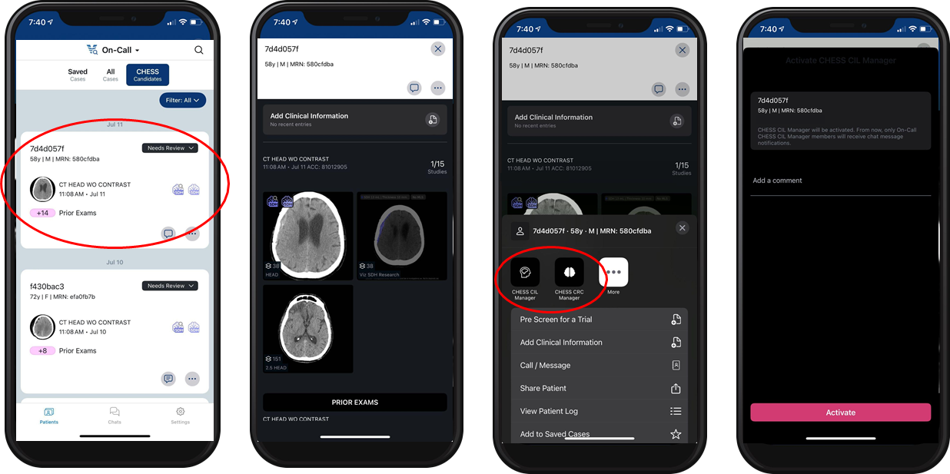
Viz.AI-Site User Process
Clicking the CRC/CILM activation button sends the scan to CRC/CILM, where the DICOM header is deidentified with new dummy identifiers. Managers see a similar view with all identifiable information replaced by new string of characters.

Slide 77
Process for Initiating CRC Review
CT scans (both baseline and at the time of adjudication request) are selected by the site personnel for transmission to the CRC Manager in the Viz App
Date and Time of CT scan and clinical data at the time of adjudication request (TUG, ASR, MRC, and/or SAE form) is entered in WebDCU by the site
Upon submission, an automated email notification is triggered by WebDCU to the CRC Manager notifying them of a new case for review
The CRC Manager reviews the data for completeness
  If not complete, the CRC manager works with the site personnel via queries in WebDCU to address issues
Once the information is verified complete, the CRC Manger will initiate the CRC adjudication review and assign review to the two adjudicators that are on call

Slide 78
Process for Initiating CRC Review
CRC adjudicators will review the data and enter their decision into WebDCU as soon as possible (no later than 48 hours) after the request is initiated by CRC Manager
The adjudicators may request more information through the CRC Manager who will request additional information via queries to the site through WebDCU
WebDCU will notify CRC Manager once both adjudicators have completed review
If Adjudicators agree, no further action will be needed
  If they disagree the CRC manger will work with them to submit the final consensus adjudication within 48 hours
The final adjudication decision will be communicated to the site within 48 hours

Slide 79
In all cases the CRC recommendation for rescue surgery is the primary endpoint regardless of whether the patient actually received surgery.

Slide 80
Rescue Surgery Procedures
Rescue surgery includes surgical evacuation procedures such as:
  Craniotomy
  Burr holes
  SEPs
    Important to note: SEPs is allowed for Rescue Surgery, but not for conventional surgery at time of randomization

Slide 81
CRC flowchart
CRC situations* met, adjudication needed
CT are uploaded in Viz;
CRC Review Required?
No
*CRC Review Required when:
First or second subject randomized at site reaches 90-day visit;
First or second subject randomized at site reaches 180-day visit; Any of the clinical symptom criteria for rescue surgery are met and at least one of the radiographic criteria for rescue surgery are met at any time; OR The site treating physician believes that a subject needs rescue surgery but did not meet the CRC clinical and radiographic criteria for rescue surgery
Site selects CRC Manager as recipient for the CT which triggered CRC Review* as well as the Baseline CT.
Site completes imaging CRF in WebDCU
Viz deidentifies images (except date, time, age, sex); Viz assigns random, unique Patient ID and Accession number.
****CRC can see Subject ID, Viz Patient ID, Accession number, imaging timepoint, etc. via their interface in WebDCU. Note that there is a consensus step if Adjudicators disagree
Image passes CRC Manager Review?**
CRC Manager queries site via WebDCU.
CRC Manager selects 2 assigned CRC Adjudicators as recipients for images in Viz (no change to DICOM header).
CRC Adjudicators enter results into WebDCU****
END

Slide 82
Central Imaging Laboratory

Slide 83
Central Imaging Laboratory (CIL)
Radiological analysis of head CT scans is a core component of the CHESS trial
Exploratory endpoints include the proportion of subjects with ≥ 50% volumetric reduction of CSDH at 90 days post-randomization
Independent blinded CIL Image Analyst must determine CSDH volume on baseline and 90-day CT scans for validity

Slide 84
Central Imaging Laboratory (CIL)
Imaging Studies in CHESS
Pre-enrollment/Baseline head CT scan → CIL Manager (in Viz)
Head CT at 24 hours post-surgery or MMAE treatment → Safety Scan
Head CT at 90 days post-randomization → CIL Manager (in Viz)
Head CT at 180 days post-randomization → Long term follow-up

Slide 85
CIL Flowchart
Baseline CT OR 90day CT
Site uploads CT into Viz; Viz deidentifies images (except date, time, age, sex); Viz assigns random, unique Patient ID and Accession number.
**Images uploaded are consistent with data on imaging CRF (e.g. date/time)
***CIL Analyst will only see Accesssion number in WebDCU
.
Baseline CT OR 90d CT?
Site selects CIL Manager as recipient for images
END
Site completes/edits imaging CRF in WebDCU
Image passes CIL Manager Review?**
CIL Manager queries site via WebDCU.
Images stored on a secure server in MU
CIL Manager will provide CT scan images to CIL Analyst (all PHI is removed EXCEPT Accession number)
CSDH hematoma volume, MLS and Thickness is measured
CIL Analyst enters results into WebDCU***

Slide 86
Open Discussion

Slide 87
Viz Recruit
CHESS Study

Slide 88
Viz Recruit Team
Selena McHone, CCRP, RT, MHA
Sr. Clinical Specialist
Chess Program Lead
Evens Blanc, MBA
Clinical Research Manager
Chess Operations Lead
Skip McCann, RT, MHM
Medical Science Liaison
Viz Recruit
Jamie Stern, CCRP, MS, MBA
Director, Pathway Solutions
Viz Recruit

Slide 89
Investigator Meeting Agenda
Overview
Viz RECRUIT Workflow for CHESS
User Processes by Role
Q&A

Slide 90
Viz RECRUIT SDH Research
How it works in the CHESS Trial
Healthcare Data
AI Analysis
Trigger Activation
Increase Patient Outcomes
Viz RECRUIT SDH RESEARCH algorithm pre-screens, detects, measures volume, and alerts on SDH meeting trial criteria.
Viz RECRUIT allows you to activate the Central Imaging Lab and Clinical Review Committee when there is a patient identified that meets study criteria.
This results in the right patient getting screened and enrolled in the study; improving patient outcomes, treatment rate and provider experience.
Viz ingests live CT imaging data.

Slide 91
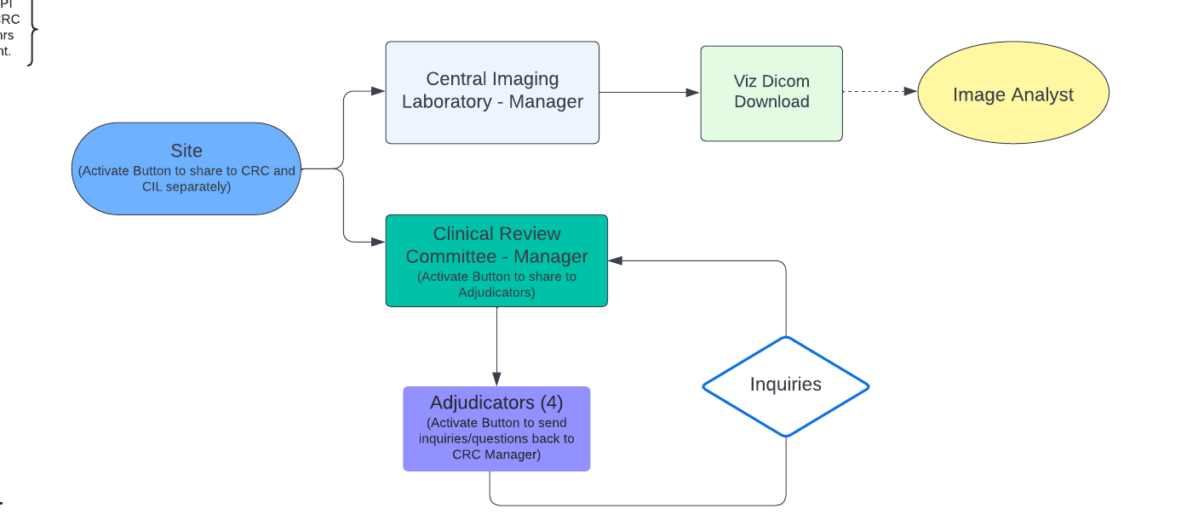
Viz RECRUIT Workflow for CHESS

Slide 92
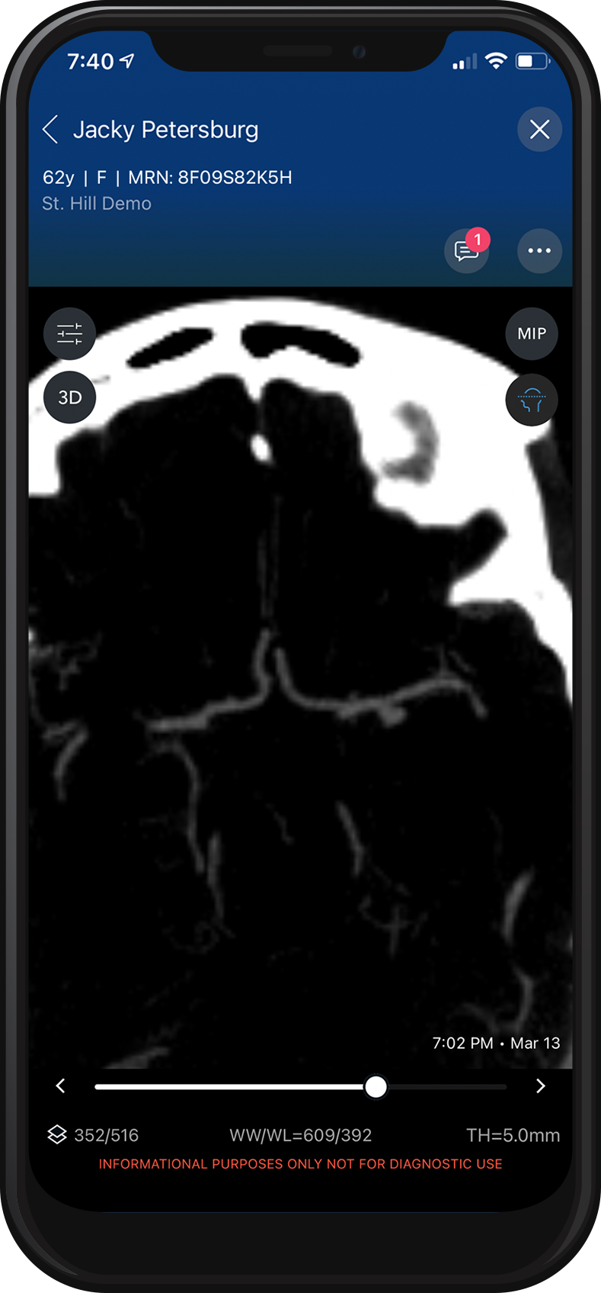
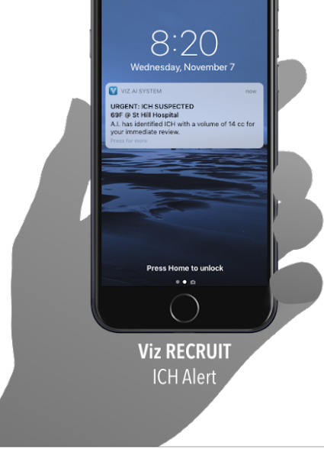
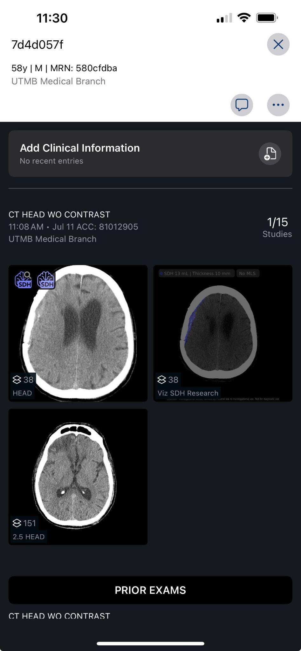
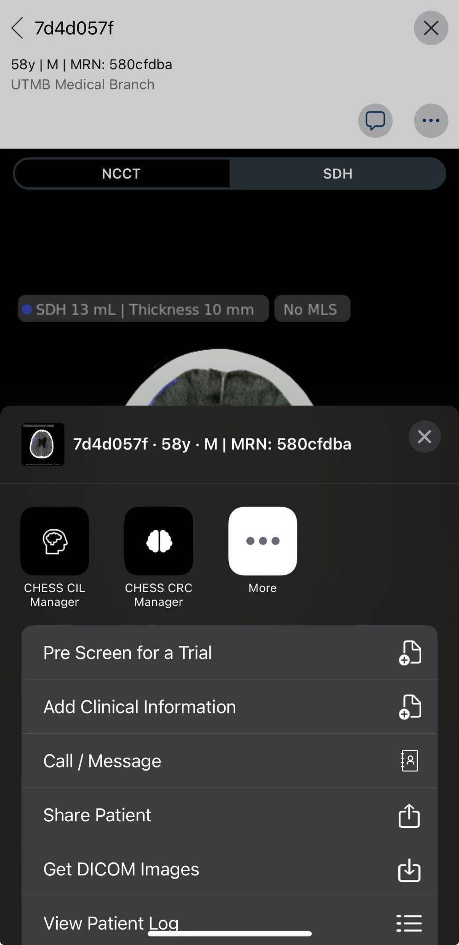
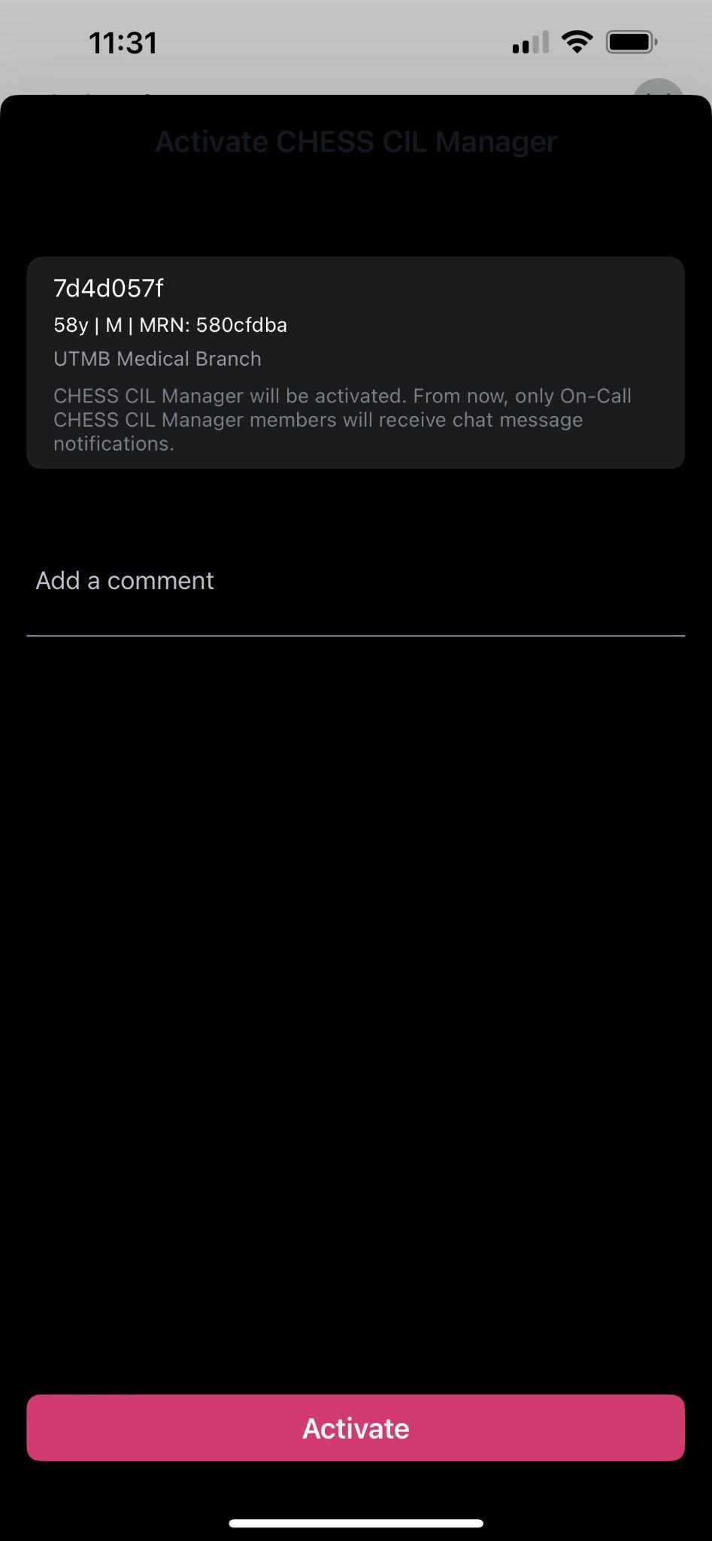
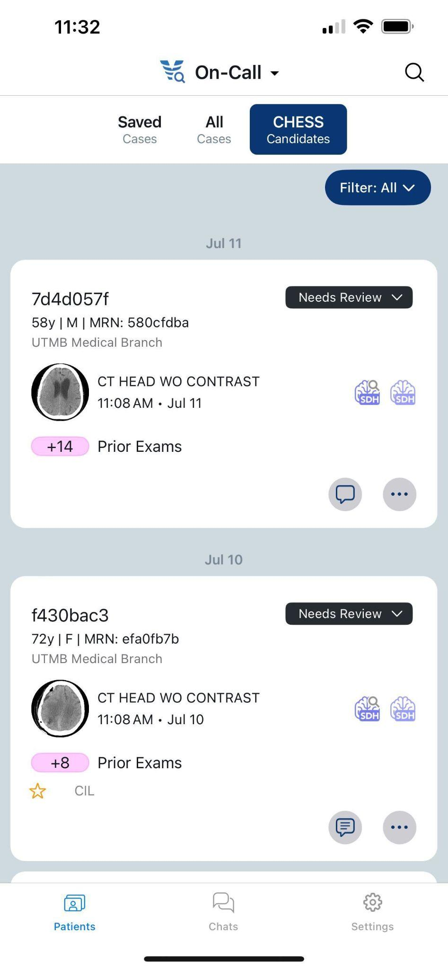
Viz RECRUIT for CHESS
Once a candidate has been identified in Viz, the research team will activate the CIL Manager and CRC Manager, independently, when needed. They will “Add a comment” prior to activation with the scan status based on timeline, this would be “Baseline”, “90 Day”, or “180 Day”, as well as Rescue Assessment 1 or Rescue Assessment 2.
92

Slide 93
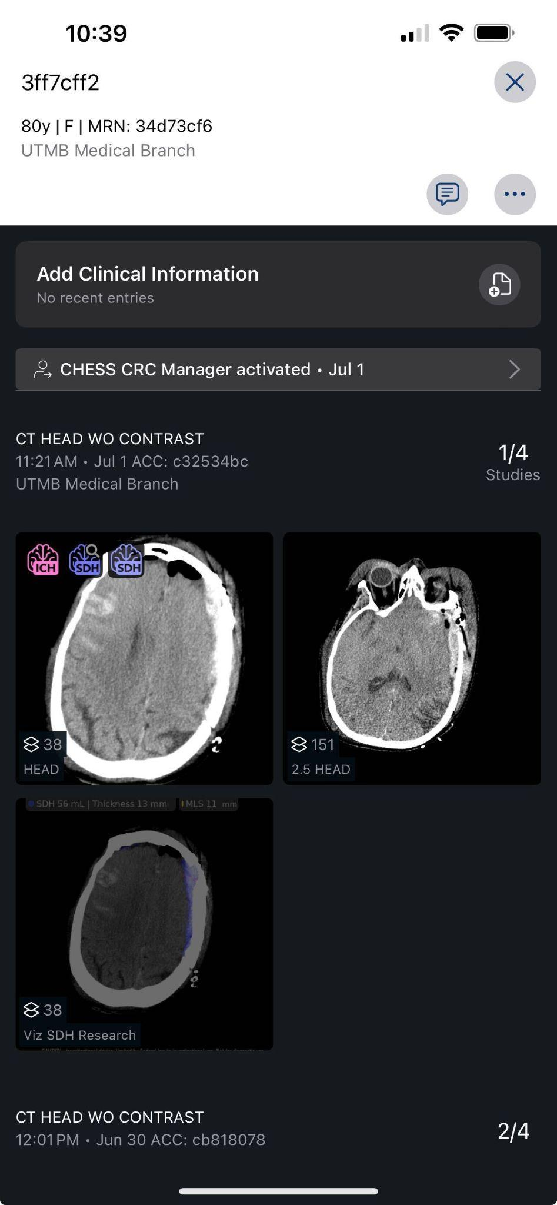
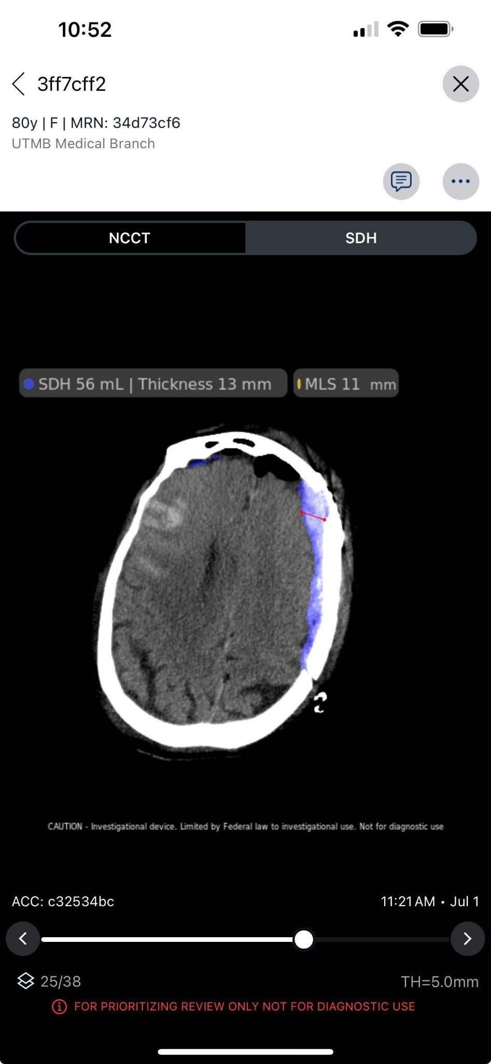
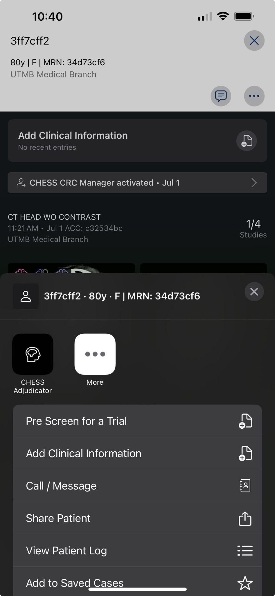

CRC Manager User Process
CRC Managers will utilize the “CHESS Adjudicators” button to activate and share the image set with Adjudicators. They will “Add a comment” prior to activation with the scan status based on timeline, this would be “Baseline”, “90 Day”, or “180 Day”.

Slide 94
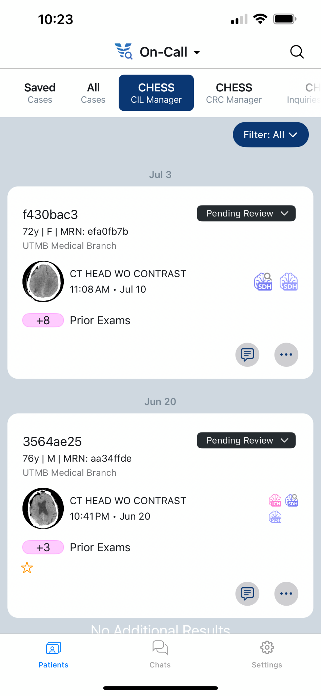
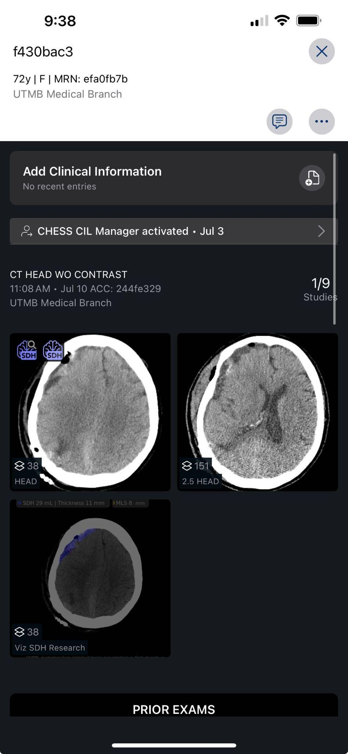
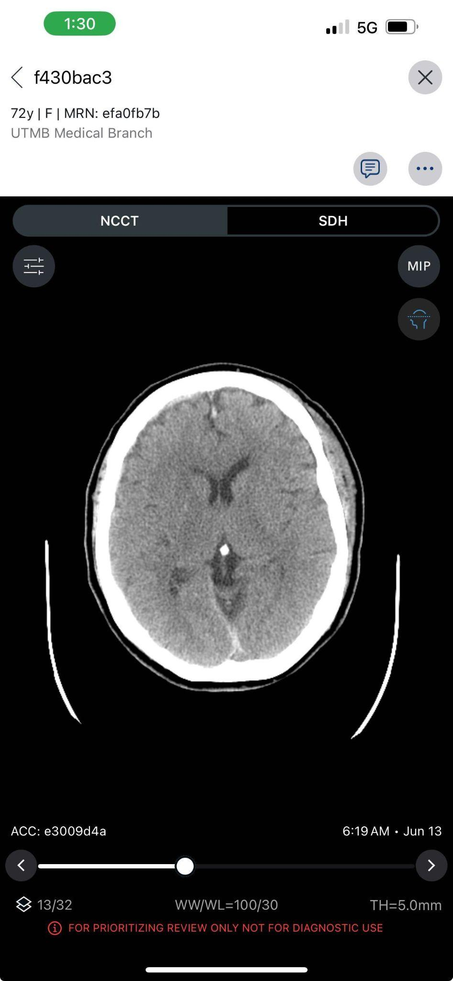
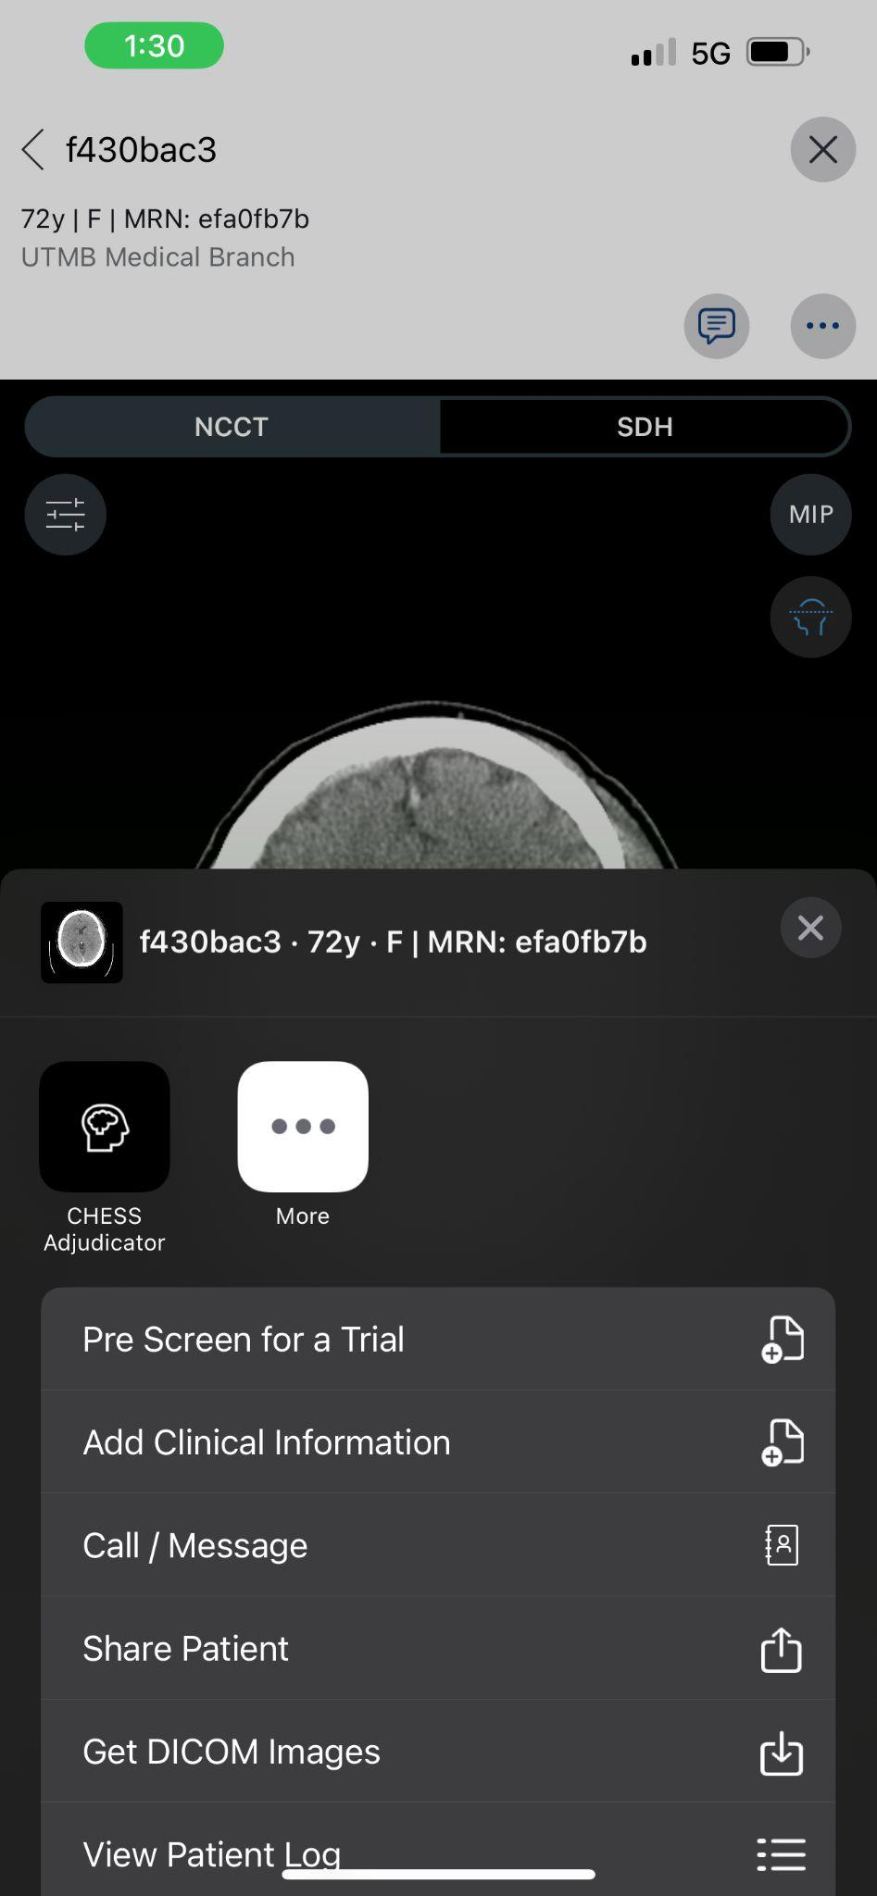
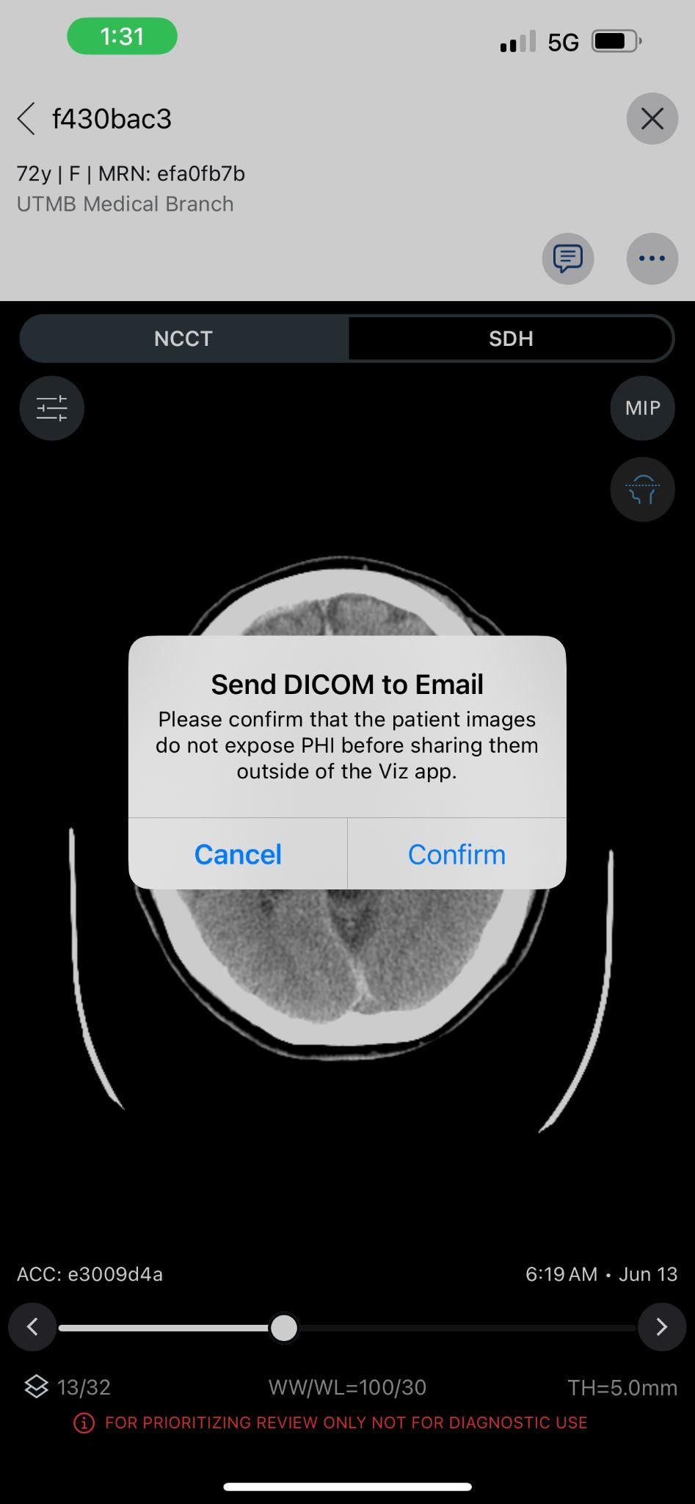
CIL Manager User Process
CIL Manager will utilize the Dicom Download functionality to send an email link for download. This will be sent to the Image Analyst for dicom download.

Slide 95
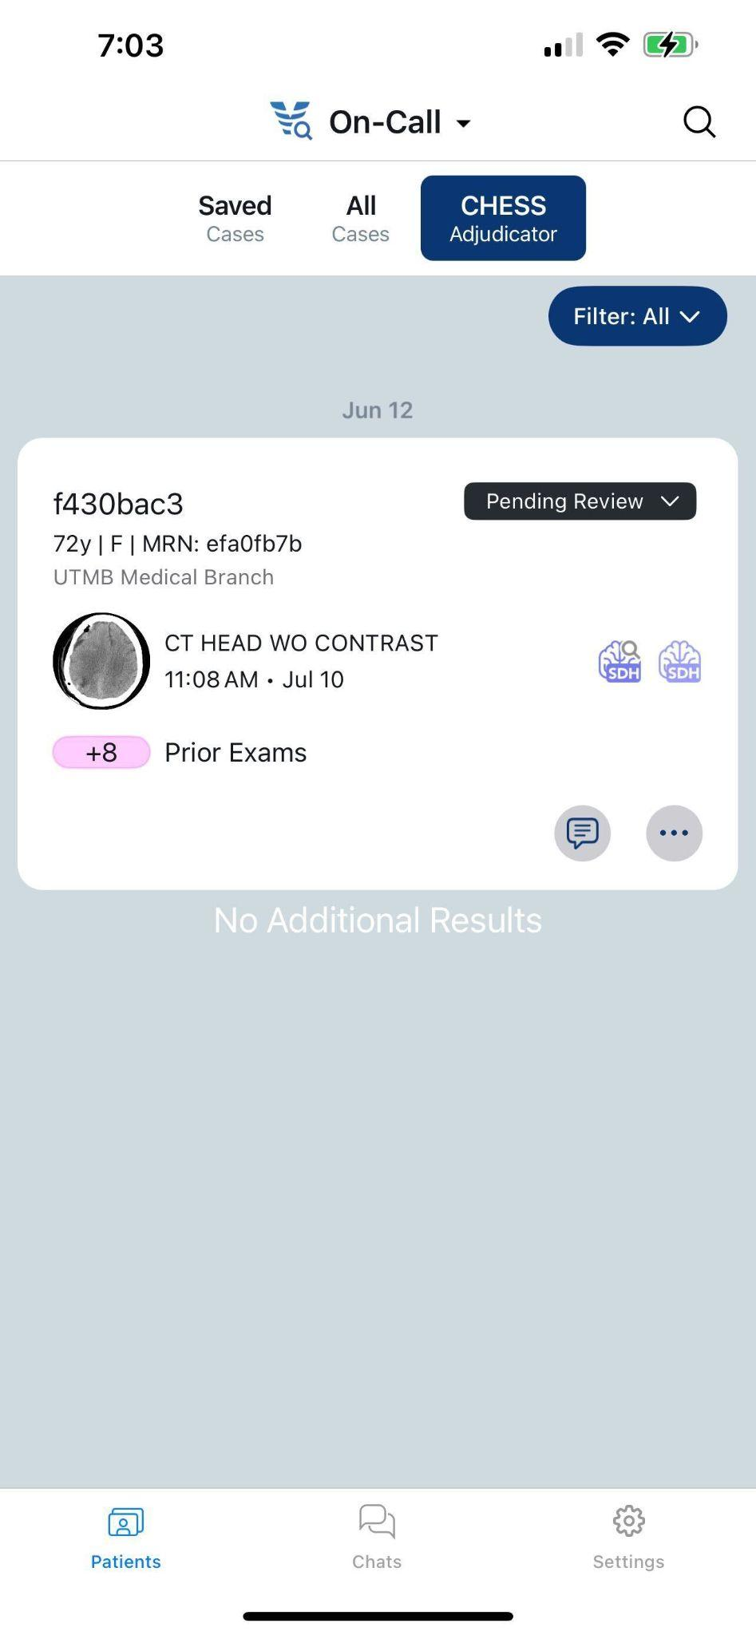
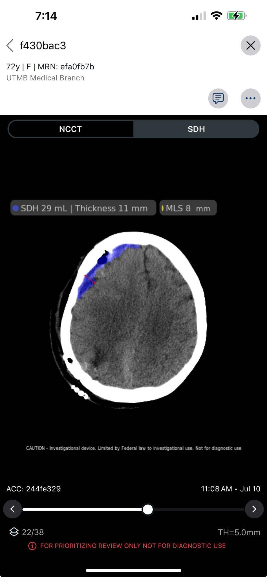
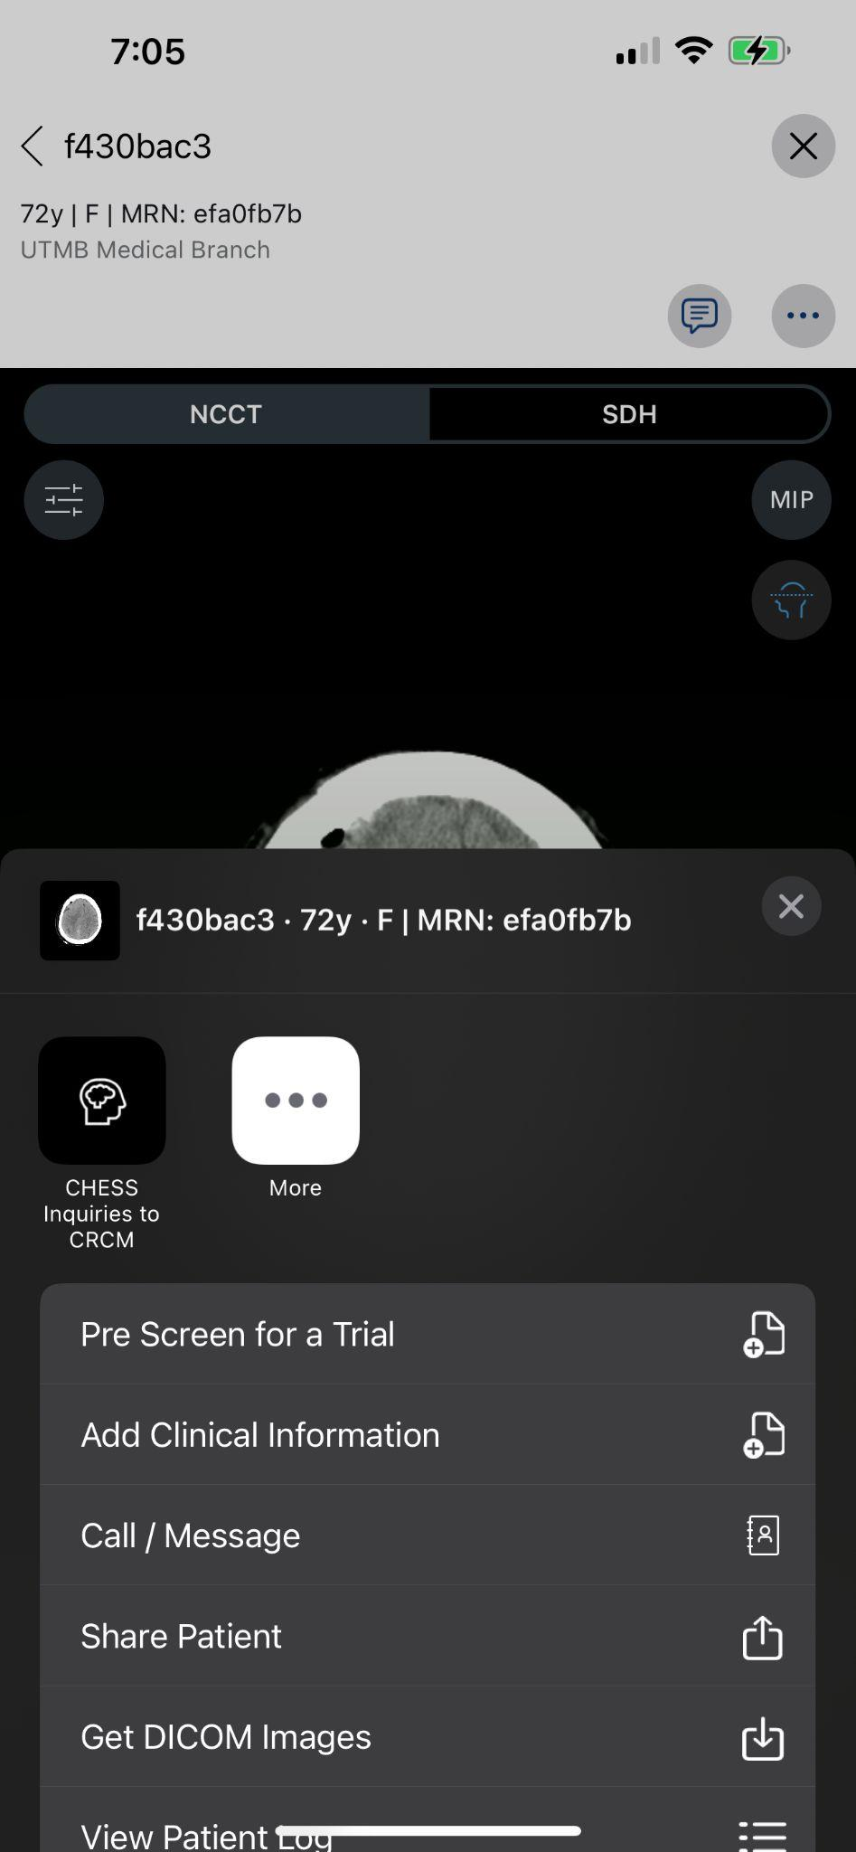
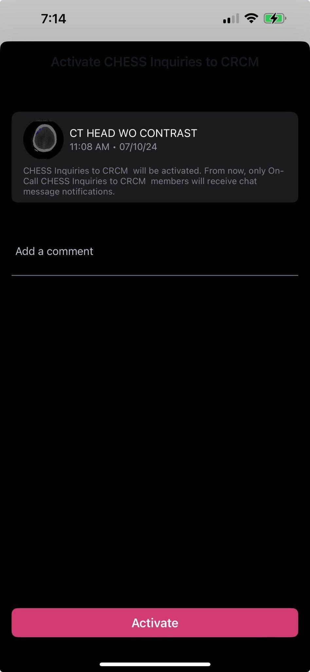
Adjudicator User Process
Adjudicators have an option to send an inquiry back to the CRC Manager. Utilization of the “CHESS Inquiries to CRCM” button will allow a comment to be added and directed back to the CRC Manager.

Slide 96
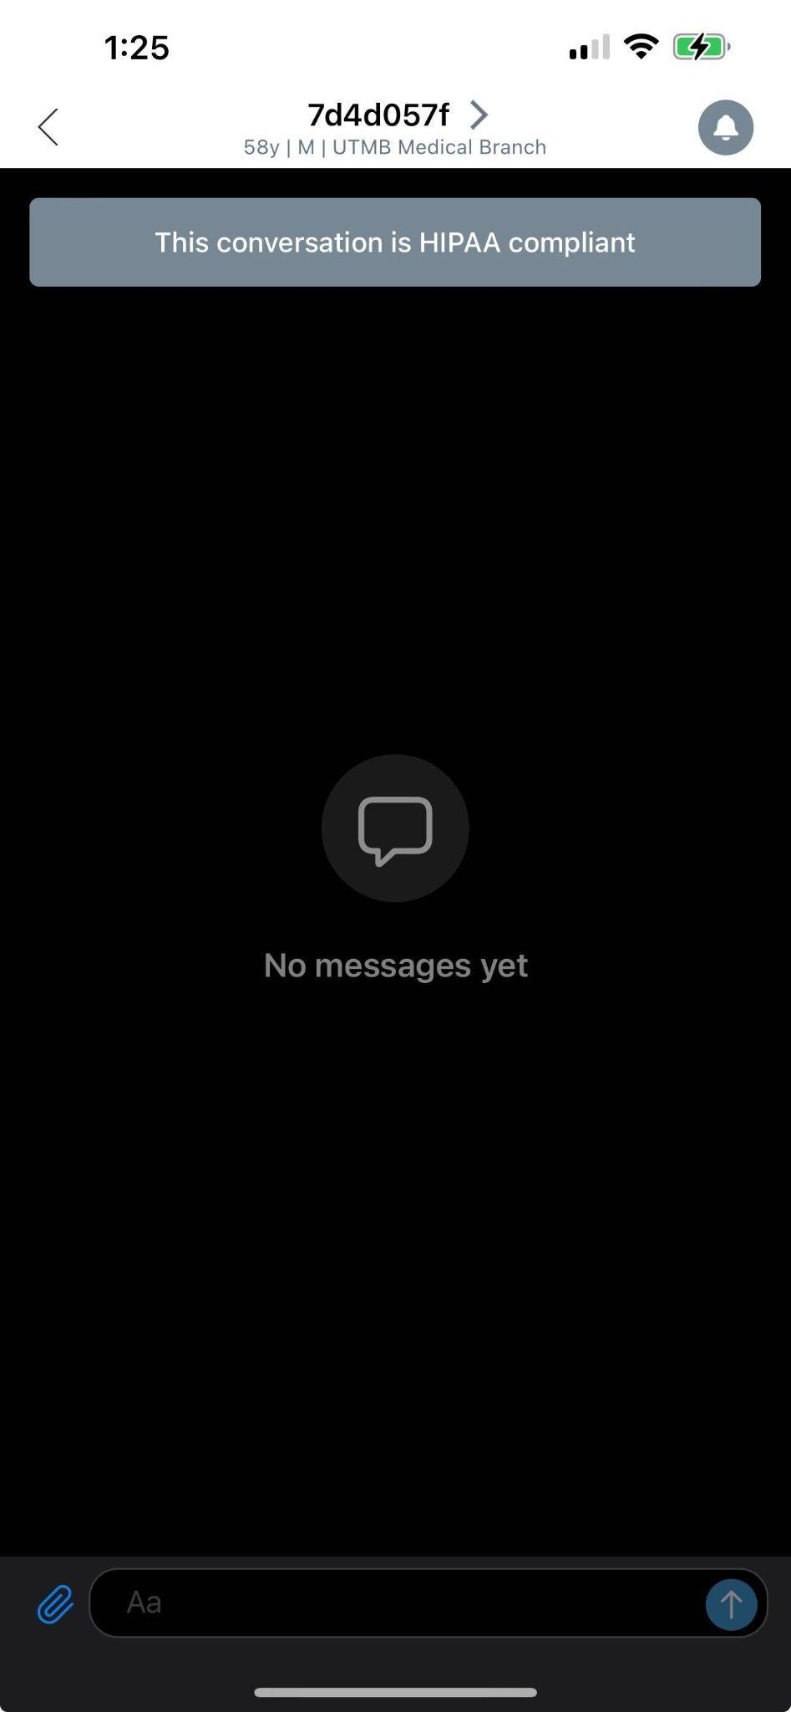
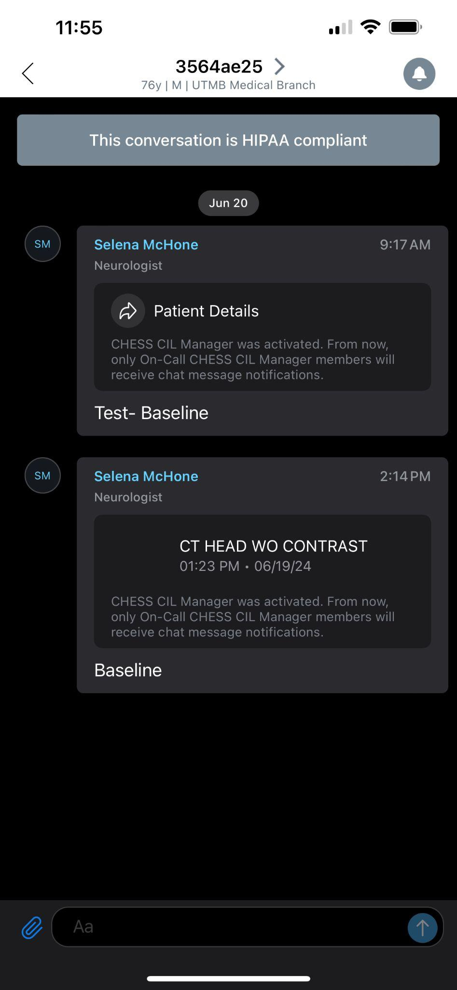
Viz RECRUIT for CHESS
Chat
Contains current and historical patient specific communication
Documentation of all image transfer with comments
To confirm that you are viewing the scan that has been alerted on, you are able to view the exam, date, and last message sent by users
Additional Call Outs
After sending a patient to another user, you can add the case to “Saved Cases” (via the ellipsis button) to allow a star icon to populate on the bottom of the patient card for a visual reminder that you have previously shared this patient.
A designated user is able to mark patient statuses in the right corner of a patient card. The options for statuses include “Needs Review” (default), “Enrolled”, “Eligible”, or “Ineligible”
96

Slide 97
Questions?

Slide 98
BioCHESS
Peter Kan, MD

Slide 99

This work is supported by:

Slide 100

BioCHESS
To create a multi-center cSDH tissue bank through the CHESS trial infrastructure and an existing NIH-funded biorepository for tissue storage (BioSEND)
Approximately 200 patients that undergo surgery in CHESS
  With either de novo cSDH or recurrent cSDH at presentation for CHESS
  Samples collected from randomized cSDH surgery treatment as well as rescue surgery after failed CHESS treatment (surgery or MMAE)
  To be linked to the prospective CHESS clinical and imaging follow-up.

Slide 101

BioCHESS Consent
BioCHESS is a separate consent from the main trial (CHESS).
BioCHESS informed consent is to occur only after the main CHESS consent has been signed.
  If a subject declines participation in BioCHESS they can still participate in CHESS.
BioCHESS informed consent will be documented within the WebDCU system.

Slide 102
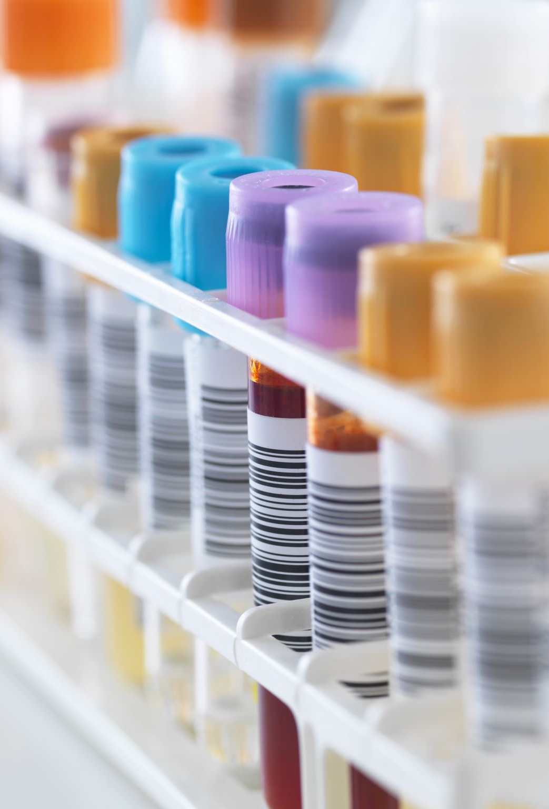
BioCHESS includes the collection, processing, aliquoting, and shipping of the following samples:
Plasma
Buffy Coat
Serum
Membrane (in Fixed, Fresh Frozen, and RNALater)
Dura (in Fixed, Fresh Frozen, and RNALater)
Subdural Hematoma Fluid (Frozen)

Slide 103
Ordering Kits and Supplies
Study sites are responsible for ordering study kits from BioSEND.
  Sites should proactively confirm kits are on hand in preparation for randomization/rescue surgery.
  Sites should allow TWO weeks for kit orders to be processed and delivered.
  Details can be found in the BioCHESS/BioSend Manual of Procedures.

Slide 104
Site Required Equipment (supplied by local site)
Available at Collection Site:
  Personal Protective Equipment (PPE)
    Lab coat, nitrile/latex gloves, safety glasses
  Tourniquets
  Alcohol prep pads
  Gauze pads
  Bandages
  Butterfly needles and hubs
  Microcentrifuge tube rack
  Test tube rack
  Sharp bins and lid
Available to process samples:
  Centrifuge capable of >1500 rcf (1500 x g) with refrigeration to 4° C
  -80° C Freezer
Available to Ship specimens:
  Dry ice (min of 10 lbs/shipment)

Slide 105
Blood Collection Order
Serum
EDTA (plasma)
EDTA can contaminate subsequent tubes if collected first, so they should be collected after other tube types.

Slide 106
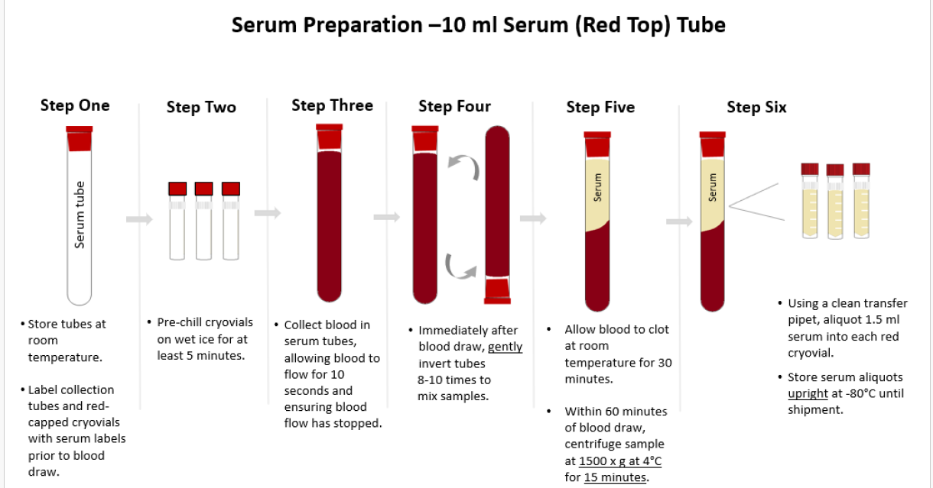
Serum Processing

Slide 107
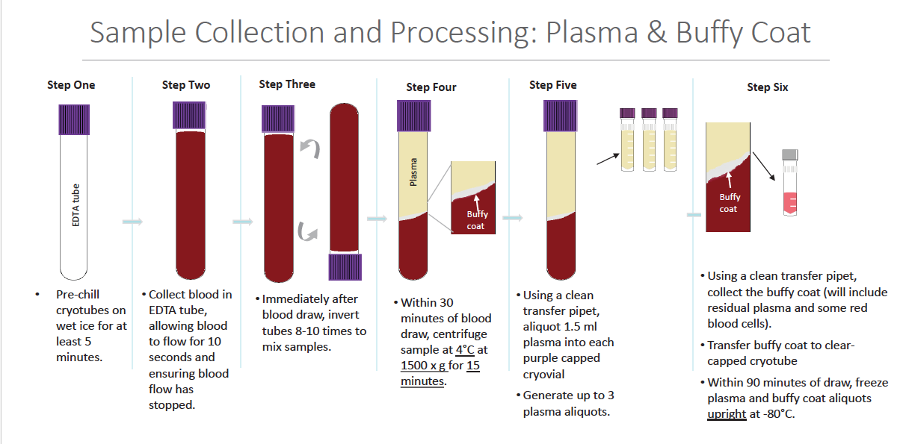
EDTA (Plasma) Processing

Slide 108
Membrane and Dura Collection
Once the membrane and dura samples have been surgically retrieved, split each sample into 3 sections as follows:
  Placed in the prefilled formalin (submerged completely) and shipped to Indiana University ambient.
    Please see BioSend Manual of Procedures for ambient shipping details.
  Placed in the prefilled RNALater tube (submerged completely) and freeze this sample in a -80° freezer.
  Last section should be flash frozen and placed in the final green-top tube.
    If liquid nitrogen is not available; alternatively, the section can be placed in the container and frozen at -80°.

Slide 109
Subdural Hematoma Fluid Collection
Collect subdural hematoma fluid into sterile 15ml individually wrapped conical and freeze upright in -80 freezer.
  Important to note:
    Do not collect more than 14ml of fluid in the tube, as overfilled may leak or burst when freezing.

Slide 110
Sample Record and Shipment Notification Form
Appendix I must be completed the day that samples are collected to capture information related to sample collection and processing.
This form includes information that will be used to reconcile sample collection and receipt.
All sample shipments to BioSEND must include the shipment notification Form(s).
  Emailed to BioSEND@iu.edu at the time the samples are being shipped
  Included in the shipment with the samples.

Slide 111
Packaging and Shipping
All study personnel responsible for shipping should be certified in biospecimen shipping.
  If not available at your University, training and certification is available through the CITI training site (“Shipping and Transport of Regulated Biological Materials”
Frozen shipped samples must be shipped Monday-Wednesday only.
Ambient shipped samples must be shipped Monday-Thursday.

Slide 112
BioCHESS and CHESS Considerations
BioCHESS is optional participation for CHESS subjects.
BioCHESS is optional participation for CHESS clinical sites.
  Please review requirements carefully and determine feasibility at your individual institutions.
Sites will be compensated an additional $500/consented subject with samples adequately collected, processed, and upon confirmation samples are received by BioSEND.

Slide 113
Safety Reporting

Slide 114
What is an AE?
Any untoward medical occurrence, whether or not it is considered related to the study intervention
Can be any unfavorable and unintended symptom, sign, disease or clinically significant abnormal test result occurring during the study, which was either not present at baseline, or if present, worsened during the study in terms of either severity or frequency
Not AEs:
  Events existing at Baseline, unless they worsen in severity or frequency during the study
  Pre-existing conditions that are discovered after Baseline– document as medical history
  Surgery, intubation, etc. are not AEs but rather actions taken for AEs

Slide 115
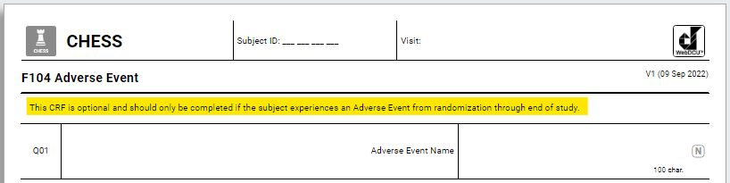
AE Reporting
All AEs reported will be recorded on the AE CRF throughout the entire duration of the study (from randomization through the 180-day visit/EOS)
AEs will be assessed at the time they occur (or are discovered) and are followed until resolution/EOS
The Site Investigator makes an assessment as to seriousness, severity, and causality to treatment procedure and MMAE device
Information will be collected on the action taken and outcome status

Slide 116
AE Reporting
Reported on the Adverse Event CRF (1 AE = 1 CRF)
Report the diagnosis, not the symptoms
Fever, cough, chest pain, and crackles? That’s pneumonia!
Avoid abbreviations/colloquialisms
Do not include subject PHI
SAEs should be submitted within 24 hours of first knowledge
AEs should be submitted within 5 days of first knowledge

Slide 117
Unanticipated Adverse Device Effect
Per 21 CFR 812.3, a UADE is any serious adverse effect on health or safety, any life-threatening problem or death caused by, or associated with a device, if that effect, problem, or death was not previously identified in nature, severity, or degree of incidence in the application; or any other unanticipated serious problem associated with a device that relates to the rights, safety, or welfare of subjects

Slide 118
Prompt Reporting of Safety Events to Sponsor and IRB
SAEs: FDA
  For IDE’s, anticipated SAEs are only reported in the regular annual/progress reports
  Unlike drug IND studies, there is no requirement for quick, special FDA reporting of SAEs
SAEs: CIRB
  SAEs that are both unexpected and related must be reported as soon as possible, but in no event later than 5 business days of the researcher becoming aware of the event
UADES: FDA, CIRB, Local IRBs
  Any UADE must be reported by the Investigator to the study Sponsor and reviewing IRB as soon as possible, but in no case later than 10 days after the Investigator learns of the UADE
  Study Sponsor will conduct an evaluation of the device effect and must report to FDA, all reviewing IRB’s, and participating investigators within 10 working days after the Sponsor first receives notice of the effect
Notes:
In practice, UADE are extremely rare because virtually all problems are anticipated.

Slide 119
Are you serious (SAE)? Yes, if:
Death/leads to death
Life threatening
Prolongs hospitalization or requires rehospitalization
Results in significant disability
Requires medical or surgical intervention to prevent above
Notes:
https://www.fda.gov/safety/reporting-serious-problems-fda/what-serious-adverse-event
Death
Death was the outcome of the adverse event
Life-threatening
Patient was at substantial risk of dying at the time of the adverse event, or if use or continued use of the device or other medical product might have resulted in the death of the patient
Hospitalization (initial or prolonged)
Admission to the hospital or prolongation of hospitalization was a result of the adverse event
Emergency room visits that do not result in admission to the hospital should be evaluated for one of the other serious outcomes (e.g., life-threatening; required intervention to prevent permanent impairment or damage; other serious medically important event)
Disability or permanent damage
Adverse event resulted in a substantial disruption of a person's ability to conduct normal life functions, i.e., the adverse event resulted in a significant, persistent or permanent change, impairment, damage or disruption in the patient's body function/structure, physical activities and/or quality of life
Congenital anomaly/birth defect
Exposure to a medical product prior to conception or during pregnancy may have resulted in an adverse outcome in the child
Required Intervention to Prevent Permanent Impairment or Damage (Devices)
Medical or surgical intervention was necessary to preclude permanent impairment of a body function, or prevent permanent damage to a body structure, either situation suspected to be due to the use of a medical product
Other Serious (Important Medical Events)
Event does not fit the other outcomes but may jeopardize the patient and may require medical or surgical intervention (treatment) to prevent one of the other outcomes
Examples include allergic brochospasm (a serious problem with breathing) requiring treatment in an emergency room, serious blood dyscrasias (blood disorders) or seizures/convulsions that do not result in hospitalization

Slide 120
Severity
Using NCI Common Terminology Criteria for Adverse Events (CTCAE)
  Grade 1: Mild; asymptomatic or mild symptoms; clinical or diagnostic observations only; intervention not indicated
  Grade 2: Moderate; minimal, local or noninvasive intervention indicated; limiting age appropriate instrumental activities of daily living
  Grade 3: Severe or medically significant but not immediately life-threatening; hospitalization or prolongation of hospitalization indicated; disabling; limiting self-care activities of daily living
  Grade 4: Life-threatening consequences; urgent intervention indicated
  Grade 5: Death related to AE
Notes:
The CTCAE provides a grading (severity) scale for each AE term and AEs are listed alphabetically within categories based on anatomy or pathophysiology.

Slide 121
AE Relatedness to Treatment Procedure for CSDH (MMAE or Conventional Surgery)
Definitely related to treatment procedure, for example, known to be a complication of the treatment procedure, and having no other explanation
Probably related to the treatment procedure, that is, not reasonably explained by the patient’s clinical state or other therapies
Possibly related to the treatment procedure, that is, could have been explained by other therapies or patient’s clinical state
Notes:
Definitely related Must have all four of the following:
Has a reasonable temporal relationship to intervention
Could not readily have been produced by subject’s clinical state or have been due to environmental or other interventions
Follows a known pattern of response to intervention
Disappears or decreases with reduction in dose or cessation of intervention and recurs with re-exposure
Probably related Must have three of the following:
Has a reasonable temporal relationship to intervention
Could not readily have been produced by subject’s clinical state or have been due to environmental or other interventions
Follows a known pattern of response to intervention
Disappears or decreases with reduction in dose or cessation of intervention
Possibly related Must have two of the following:
Has a reasonable temporal relationship to intervention
Could not readily have been produced by the subject’s clinical state or environmental or other interventions
Follows a known pattern of response to intervention

Slide 122
AE Relatedness to MMAE Device (Embosphere Microspheres or CONTOUR Embolization Particles)
Definitely related to MMAE device, for example, known to be a complication of the device, and having no other explanation
Probably related to the MMAE device, that is, not reasonably explained by the patient’s clinical state or other therapies
Possibly related to the MMAE device, that is, could have been explained by other therapies or patient’s clinical state

Slide 123
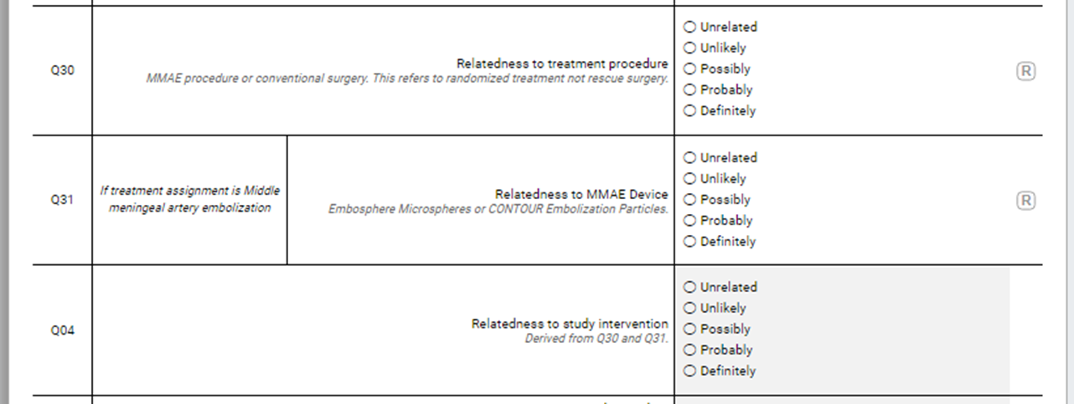
Relatedness

Slide 124
AE CRF Submission
Data enter CRF
Save – rules will run in background (to check for missing data fields, etc.)
Submit – only after the CRF is submitted can it go to the MSM
MSM will be notified in real-time to review site-reported SAEs
MSM’s review will be used as the final classification of SAEs, including relatedness to the device
Notes:
Talk more about MSM role

Slide 125
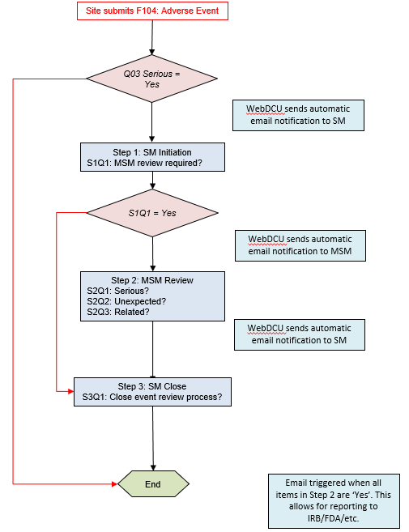
AE Review Flowchart

Slide 126
Type of Event and Definitions
Symptomatic ischemic stroke – rapid onset of a new focal neurological deficit with imaging or other evidence of infarction in a part of the central nervous system consistent with symptoms
Symptomatic hemorrhagic stroke – rapid onset of a new focal neurological deficit with imaging or other evidence of new intraparenchymal hemorrhage consistent with symptoms
Seizure – diagnosis based on clinical impression ideally by a neurologist or based on an abnormal EEG supporting the diagnosis of epilepsy/seizure
Cranial neuropathy – facial paralysis or visual loss

Slide 127
Q21 Neurological Deterioration
Did the event cause worsening of neurological status or development of new disabling neurological symptoms? Yes/No
Defined as a decline of 1 point or more on the Markwalder scale

Slide 128
Site Reporting and Recruitment

Slide 129
Recruitment-Based Probation
If either:
  Site does not randomize patient within 6 months of activation, OR
  6 months elapses without randomizing at any point in the trial
Site will enter probation:
  Operations Committee + National Coordinating Center will assist to address issues
  If 3 months elapses without action, site will be replaced

Slide 130
Strategies for Maximizing Enrollment
Viz RECRUIT will alert site team of all consecutive CSDHs
Educate of multiple departments (neurology, neurosurgery, ED, ICU) about study via emails/flyers/training module CHESS slides
Give grand rounds/presentations about study
Outreach to referring hospital/centers regarding CHESS study
Recruitment plan, with coverage for weekends/holidays

Slide 131
Role of the Investigator
Informed Consent
Site-Specific Operations
Protocol Compliance
Regulatory/Good Clinical Practice Compliance

Slide 132
Investigator’s Role: Informed Consent
Highly important to ensure protection of subjects
Ensure standardized, comprehensive process is implemented
Delegate responsibility to trained staff (Delegation of Authority)
Provide sufficient time
Use non-technical language
Answer all questions, ensure subject understanding

Slide 133
Investigator’s Role: Site-Specific Operations
Maintain study records per ALCOA (Attributable, Legible, Contemporaneous, Original, Accurate)
Retain source data (papers, EMR, consents, etc.)
Ensuring site can support target enrollment goals in timeframe for CHESS
Ensuring that adequate facilities and resources are available to support CHESS activities
Assembling qualified staff familiar with CHESS to support study-related activities

Slide 134
Investigator’s Role: Protocol Compliance
Personnel should be familiar with protocol, procedures, and reporting requirements while conducting study
Deviations must be logged and reported
Planned deviations must receive advanced approval from central sponsor and cIRB/BRANY

Slide 135
Investigator’s Role: Regulatory/GCP Compliance
Adhere to requirements for IRBs, FDA, laws, local institutions
Report AEs/SAEs in required timeframes
Adhere to Good Clinical Practice (GCP)
  Protect subject rights, safety, welfare
  Obtain informed consent before research-related activities
  Ensure medical decisions are made by qualified healthcare personnel
  Provide adequate care for subject AEs
  Make reasonable efforts to ascertain reasons for subject withdrawal

Slide 136
Prompt Communication
Site
Executive Members
NCC Project Manager
WebDCU Staff
CRC Manager (Adjudicate)
NCC (Contracts/
Billing)
BioSend (BioCHESS)
cIRB (BRANY)
Communication between the site and central study team is essential to the success of CHESS
Central team will coordinate communication for major changes in CHESS protocol
  Important for Site PIs to aid in implementation of new processes/regulations
  Upcoming: Incorporating CMS/Medicare Approval
Prompt notification from sites to central study team include the following:
  Change in Key Site Personnel → DOA in WebDCU
  Deviations → Planned deviations require advance approval by central sponsor and cIRB/BRANY
  SAEs → WebDCU and (in specific instances) cIRB/BRANY

Slide 137
Publications Policy
Publications Committee will be chartered at end of trial:
  Co-Principal Investigators + Investigators/Designees from Top 3 Enrolling Sites
Any trial personnel may submit analysis proposal(s) to committee
  Committee will review and guide team
  Committee approval is required before submissions to journals/scientific meetings
Proposals for ancillary studies:
  Submit to Executive Committee, who will review + engage oversight (DSMB, NINDS)
  Proposed study must also include 1 CHESS Co-PI as part of its Executive Committee

Slide 138
Open Discussion

Slide 139
Thank you!
Please complete Protocol Training Attestation Form and upload to WebDCU.

