Slide 1
CHESS Chronic Subdural Hematoma Treatment with Embolization Versus Surgery Study NINDS 4UH3NS128397-02 Protocol v17 Training

Slide 2
Principal Investigators
Key Study Team
Members
Peter Kan, MD
Contact PI
Ajith Thomas, MD
Co-PI
Christy Cassarly, PhD
Co-PI
Unblinded Statistician
Farhan Siddiq, MD
Co-PI
Magdy Selim, MD
Neurologist, Steering Committee
Adnan Qureshi, MD
Chair of Steering Committee
Renee Martin, PhD
Blinded Statistician
Austin Rolfes
FDA/CMS Regulatory Affairs
Jessica Spahn & Robert Garcia
Project Managers
Ibrahim Bhatti, MD
Clinical Review Committee Manager
Muhammad Shakir, MD
Clinical Imaging Laboratory Manager
Alyssa Straka, Emily Philpot, & Evan Tomaschek
WebDCU Support

Slide 3
Trial Design
Prospective, randomized, open-label
Moderately symptomatic CSDH
1:1 randomization
MMAE or surgery
Sample Size: 394
Time in Study: 180 (+30) days
Clinical Centers: 30-35 US sites in
Projected Timeline
Start-up: 9 Months
Enrollment/Follow-up: 3.75 years
Close Out: 6 Months

Slide 4
Key Eligibility Criteria
Inclusion
Age 40-90 years
Unilateral convexity CSDH (≥10 mm thickness), OR Bilateral CSDH if only one side is considered for treatment and the contralateral side is <5 mm
CSDH at least 2/3 isodense or hypodense
Qualifying baseline head CT performed within the 7 days prior to randomization
Able to undergo assigned treatment within 48 hours after randomization
Exclusion
Known contraindications to angiography
Known collateral vessel pathways potentially endangering normal territories or cranial nerves
Known large diameter arteriovenous shunt that cannot be addressed with coil embolization
No measurable deficit TUG, ASR, or MRC

Slide 5
Inclusion/Exclusion Criteria for TUG, ASR, & MRC scores:
TUG
A measurable deficit is defined as: Time >10 seconds.
Patient automatically excluded if secondary to CSDH, patient is unable to complete TUG (ie, TUG >120 seconds, unable to walk, or tries TUG but quits in <120 seconds).
ASR
A measurable deficit is defined as: score <4.
Patient automatically excluded if secondary to CSDH, ASR of 0, 1, or 2.
MRC
A measurable deficit is defined as: <5 in any muscle group contralateral to the site of the CSDH
Patient automatically excluded if secondary to CSDH, MRC of 0, 1, 2, or 3 in any muscle group contralateral to the side of the CSDH.
Must have at least one “measurable deficit” to meet inclusion criteria.
Conversely, if any deficit is considered too severe secondary to CSDH-the patient meets exclusion criteria and should not be enrolled in CHESS.

Slide 6
Primary Endpoint
The proportion of subjects (per the Clinical Review Committee) to need rescue surgery or die within 180 days of randomization

Slide 7
Safety Endpoints
The proportion of subjects with symptomatic ischemic stroke within 180 days of randomization.
The proportion of subjects with serious/life threatening adverse events within 180 days of randomization.
The proportion of subjects with worsening of neurological status or development of new disabling neurological symptoms (>1 point on the Markwalder Scale) anytime within 180 days of randomization.
The proportion of subjects with seizures within 180 days of randomization.
The proportion of subjects with cranial neuropathy within 180 days of randomization.

Slide 8
Exploratory Endpoints
Proportion of subjects with volumetric reduction of ≥ 50% on CT imaging at 90 days post-randomization.
Change in quality of life from baseline to 180 days post-randomization (assessed using the EQ-5D-5L).
Change in cognitive outcome from baseline to 180 days post-randomization (assessed using t-MoCA).
Change in headache severity assessed from baseline to 180 days post-randomization (using HIT-6).
The proportion of subjects with favorable functional outcome defined as an improvement in mRS at 180 days post-randomization compared with baseline. If baseline mRS is 0, favorable outcome is mRS of 0.

Slide 9
Timeline for Assessments
Study event | Baseline | Randomization | 24 Hours After Study Treatment (+24 Hours) | 7 days After Randomized or at Discharge¹ | 30 days After Randomized (±7 days) | 90 DAYS after Randomized (±14 days) | 180 days After Randomized (+30 days) | Rescue Surgery Assessment
Informed Consent | ✔ | _ | _ | _ | _ | _ | _ | _
Study Treatment (Surgery or MMAE) | _ | ✔ | _ | _ | _ | _ | _ | _
Lab Work/Imaging
Pregnancy Test (Women) | ✔ | _ | _ | _ | _ | _ | _ | _
Platelet count | ✔ | _ | _ | _ | _ | _ | _ | _
Coagulation Profile | ✔ | _ | _ | _ | _ | _ | _ | _
Serum Creatinine | ✔ | _ | ✔ | _ | _ | _ | _ | _
CT Scan of Head Without Contrast | ✔³ | _ | ✔⁴ | _ | _ | ✔³ | ✔³ | ✔³
Clinical History Assessment
Medical History, Demographics | ✔ | _ | _ | _ | _ | _ | _ | _
Medications | ✔ | _ | ✔ | ✔ | ✔ | ✔ | ✔
SAE Monitoring | _ | ✔ | ✔ | ✔ | ✔ | ✔ | ✔ | _
AE Monitoring | _ | ✔ | ✔ | ✔ | ✔ | ✔⁴ | ✔⁴ | _
Notes:
1 The 7 DAYS After Randomized or at DISCHARGE procedures are performed at hospital discharge or 7 days after randomization, whichever
occurs first.
2 Assessment of MRC, TUG, and ASR at the 90 Day, 180 Day, and any Rescue Surgery Assessment evaluations will be performed by licensed
trained study team members not directly performing the surgical, endovascular, or medical treatment for the patient. To evaluate blinding
procedures, the 90 Day, 180 Day, and Rescue Surgery MRC, TUG, and ASR assessor(s) will be asked to which group they believe the subject
has been assigned.
3 CT Scan of Head Without Contrast will be sent for central review for all randomized subjects for their Baseline and 90 Day and any Rescue
Surgery Assessment evaluations. The 180 Day CTs for the first 2 subjects randomized at each site will also be sent for central review.
4 This CT Scan of Head Without Contrast is performed within 24 hours after study treatment (MMAE or conventional surgery).

Slide 10
Timeline for Assessments
Study event | Baseline | Randomization | 24 Hours After Study Treatment (+24 Hours) | 7 days After Randomized or at Discharge¹ | 30 days After Randomized (±7 days) | 90 DAYS after Randomized (±14 days) | 180 days After Randomized (+30 days) | Rescue Surgery Assessment
Clinical Assessments
Markwalder Scale | ✔ | _ | ✔ | ✔ | ✔ | ✔ | ✔ | _
NIHSS | ✔ | _ | ✔ | ✔ | ✔ | ✔ | ✔
MRC | ✔ | _ | ✔ | ✔ | ✔ | ✔² | ✔² | ✔²
mRS | ✔ | _ | _ | _ | _ | _ | ✔ | _
Pre-cSDH mRS | ✔ | _ | _ | _ | _ | _ | _ | _
EQ-5D-5L | ✔ | _ | _ | _ | _ | _ | ✔ | _
t-MOCA | ✔ | _ | _ | _ | _ | _ | ✔ | _
HIT-6 | ✔ | _ | _ | _ | _ | _ | ✔ | _
TUG | ✔ | _ | _ | _ | _ | ✔² | ✔² | ✔²
ASR | ✔ | _ | _ | _ | _ | ✔² | ✔² | ✔²
Assessment of Blinding | _ | _ | _ | _ | _ | ✔² | ✔² | ✔²
Notes:
1 The 7 DAYS After Randomized or at DISCHARGE procedures are performed at hospital discharge or 7 days after randomization, whichever
occurs first.
2 Assessment of MRC, TUG, and ASR at the 90 Day, 180 Day, and any Rescue Surgery Assessment evaluations will be performed by licensed
trained study team members not directly performing the surgical, endovascular, or medical treatment for the patient. To evaluate blinding
procedures, the 90 Day, 180 Day, and Rescue Surgery MRC, TUG, and ASR assessor(s) will be asked to which group they believe the subject
has been assigned.
3 CT Scan of Head Without Contrast will be sent for central review for all randomized subjects for their Baseline and 90 Day and any Rescue
Surgery Assessment evaluations. The 180 Day CTs for the first 2 subjects randomized at each site will also be sent for central review.
4 This CT Scan of Head Without Contrast is performed within 24 hours after study treatment (MMAE or conventional surgery).

Slide 11
Screening for Potential Subjects
All consecutive CSDH subjects admitted are expected to be reviewed by study team (within 24 hr of admission) for eligibility
Pre-Consent Screening
Post-Consent Screening
Post-Consent Additional Baseline
Demographics
Medical History
Review of Medications
General Physical Exam
Vital Signs
Neurological Examination
Head CT
Lab Work
Markwalder Scale
MRC
TUG
ASR
mRS
EQ-5D
T-MOCA
HIT-6
NIHSS
Screen failures for patients meeting radiographic criteria but otherwise are ineligible for CHESS must be documented

Slide 12
Randomization
Randomization can occur:
Once informed consent is obtained
All inclusion criteria and no exclusion criteria are met
WebDCU will randomly assign treatment
Must undergo assigned treatment within 48hr
Once a subject is randomized, they are considered enrolled in the study

Slide 13
Recruitment Goals
# of Subjects | Minimum Per Site Per Year | Across 4 Years
Consent | 5-6 | ~520
Randomize | 4-5 | ~394

Slide 14
Anticoagulation after Randomization
Antiplatelets and OACs withheld for the first 7 days after randomization
After 7 days they may be restarted at the discretion of the local investigator if the CT scan is stable or better
If an antiplatelet agent or OAC cannot be held for 7 days the patient should NOT be randomized
*Reminder, this is an Exclusion Criteria*
If a patient is randomized and an antiplatelet agent or OAC later becomes required before treatment (either MMAE or conventional surgery) the treatment should NOT be performed

Slide 15
At the discretion of the interventionalist:
Embosphere Microspheres
(100-300, or 300-500 microns)
OR
PVA CONTOUR Embolization particles
(150-250, 250-355, or 355-500 microns)
General anesthesia (GA) or monitored anesthesia care (MAC)
+/- Intravenous heparin (ACT)
Femoral artery or radial artery access
Randomized to MMAE

Slide 16
An ICA angiogram will be performed over the cranium to assess the ophthalmic artery anatomy and retinal blush.
ECA angiography to identify angiographic anastomosis to the internal carotid artery and the ophthalmic.
If collateral vessels (anastomoses to the internal carotid artery or ophthalmic artery) are present, coil embolization of the proximal vessels will be performed. If no collateral vessels are found, a microcatheter of choice will be advanced selectively to the frontal followed by the parietal branch followed by embolization.
Alternatively, if no collaterals are identified, particle embolization can take place in the parent MMA before the bifurcation once the catheter is above the orbit on the lateral projection.
Middle Meningeal Artery Embolization (MMAE) Procedure

Slide 17
Origin of the MMA from the ophthalmic artery would entail a trans-internal carotid artery approach to the MMA. MMAE will not be performed and the procedure ended.
In the case of MMA perforation (noted on microcatheter injection), immediate coil embolization and occlusion of the MMA will be performed through the same microcatheter and the procedure will end after.
It is suggested that Embosphere Microsphere 100 to 300 micron variant or CONTOUR Embolization Particles 150 to 250 micron be used with an 017 microcatheter, and Embosphere Microsphere 300 to 500 micron variant or CONTOUR Embolization Particles 250 to 355 micron or 355 to 500 micron variants be used with an 021 microcatheter.
The microcatheter shall be occasionally flushed of particles and super-selective angiography repeated during the procedure to identify emerging dangerous anastomosis as MMA flow diminishes. If any new anastomotic pathway is seen on micro catheter injections as the MMA embolization progresses, the procedure will be stopped to avoid untoward events.
Middle Meningeal Artery Embolization (MMAE) Procedure

Slide 18
At the discretion of the treating physician:
Burr hole drainage
OR
Craniotomy
Please Note: Subdural Evacuating Port System (SEPS) is not an option for conventional surgery
Randomized to Conventional Surgery

Slide 19
Standardized Assessments
TUG: Assesses balance, walking ability, and fall risk in older adults
The Timed Up and Go (TUG) Test
Interpretation
Sit in a chair with your back against the back
Rising from the chair on the command "go"
Walking 3 meters at a comfortable pace
Turning around at the 3 meter mark
Walking back to the starting point
Returning to sitting in the chair
Mobility is assessed based on time to complete the test:
< 10 seconds: Normal
< 20 seconds: Good mobility
< 30 seconds: Walking and balance problems
TUG score of <11 seconds will still qualify with measurable deficit on the ASR or MRC
At least one of these scales has to have a measurable deficit for enrollment purposes
Notes:
https://www.cdc.gov/steadi/media/pdfs/STEADI-Assessment-TUG-508.pdf

Slide 20
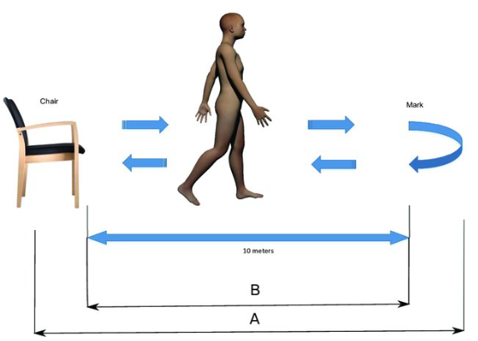
The Timed Up and Go (TUG) Test
3 meters
Notes:
Steinmetzer T, Maasch M, Bönninger I, Travieso CM. Analysis and classification of motor dysfunctions in arm swing in Parkinson’s disease. Electronics. 2019 Dec 3;8(12):1471.

Slide 21
Standardized Assessments
MRC (Medical Research Council) Scale: Assesses muscle strength
Upper Limb
Lower Limb
Patient seated or lying down with arms relaxed.
Shoulder Abduction: Resist as patient lifts arm out to the side.
Elbow Flexion: Resist as patient bends elbow against your hand.
Wrist Extension: Resist as patient pulls wrist back.
Patient lying down with legs extended.
Hip Flexion: Ask patient to lift leg off the bed.
Knee Extension: Resist as patient extends knee against your hand.
Foot Dorsiflexion : Resist as patient pulls toes towards shin.
Scoring
(0) No contraction
(1) Flicker or trace of contraction
(2) Active movement, with gravity eliminated
(3) Active movement against gravity
(4) Active movement against gravity and resistance
(5) Normal power
For eligibility based on MRC: at least one muscle group on the contralateral side to the CSDH must have a score of 4.
If any muscle groups have a score 0-3, the patient is ineligible based on severe deficit outside the scope of the target population
Notes:
https://www.cdc.gov/steadi/media/pdfs/STEADI-Assessment-TUG-508.pdf

Slide 22
Standardized Assessments
Aphasia Severity Rating (ASR)
Description | Score
Speech, writing and/or auditory comprehension are not functional. Any attempts to speak or use of fluent utterances are not understandable to the listener OR the individual may not attempt to speak at all. | 0
The individual may occasionally produce words or phrases that are meaningful in context, but communication is fragmentary and not possible without significant help from the listener e.g. guessing, questioning. Conversation is very ‘one sided’ with the listener bearing almost all of the burden. An extremely limited amount or range of information is exchanged. Misunderstandings or failed communications are very frequent | 1
Basic conversation about most familiar or everyday topics is possible but significant break down occurs with more abstract or difficult conversations. The burden of conversation is not fully shared by the individual who experiences several instances of word finding failures, paraphasias, and/or misunderstandings by the listener requiring need for repair. | 2
Despite some observable issues related to speech fluency or comprehension, there is no significant limitation. The individual may hesitate to access words or self-correct during conversation, but is able to share a significant portion of the burden of communication with the listener. | 3
Although the individual feels that he/she has a problem with language, this is barely apparent to the listener who may not detect any problem with speaking or understanding. | 4
Notes:
https://www.cdc.gov/steadi/media/pdfs/STEADI-Assessment-TUG-508.pdf

Slide 23
Standardized Assessments
Modified Rankin Scale (mRS)
Definition | Score
No symptoms at all | 0
No significant disability despite symptoms; able to carry out all usual duties and activities | 1
Slight disability; unable to carry out all previous activities, but able to look after own affairs without assistance | 2
Moderate disability; requiring some help, but able to walk without assistance | 3
Moderately severe disability; unable to walk without assistance and unable to attend to own bodily needs without assistance | 4
Severe disability; bedridden, incontinent and requiring constant nursing care and attention | 5
Notes:
https://www.cdc.gov/steadi/media/pdfs/STEADI-Assessment-TUG-508.pdf

Slide 24
Standardized Assessments
Markwalder Scale
Definition | Score
Patient neurologically normal | 0
Patient alert and oriented; mild symptoms such as headache, absent or mild neurological deficit, such as reflex asymmetry | 1
Patient drowsy or disoriented with variable neurological Grade deficits, such as hemiparesis | 2
Patient stuporous but responding appropriately to noxious stimuli; severe focal signs such as hemiplegia | 3
Patient comatose with absent motor response to painful stimuli; decerebrate or decorticate posturing | 4
Notes:
https://www.cdc.gov/steadi/media/pdfs/STEADI-Assessment-TUG-508.pdf

Slide 25
Rescue Surgery & Clinical Review Committee

Slide 26
CRC
Comprised of:
CRC Manager (with alternative)
5 Neurosurgeons (“Adjudicators”)
All adjudicators are independent of the CHESS trial and have active experience in managing CSDH
CRC Role in CHESS:
Review clinical information (MRC, TUG, ASR) & CT scans to centrally and independently determine the need for rescue surgery in a blinded fashion

Slide 27
Rescue Surgery Criteria
Radiographic Criteria
Clinical Symptom Criteria

Slide 28
Radiographic Criteria
Compared to baseline, an increase of maximal thickness of 20% or more.
Compared to baseline, an increase of midline shift of 3 mm or more.

Slide 29
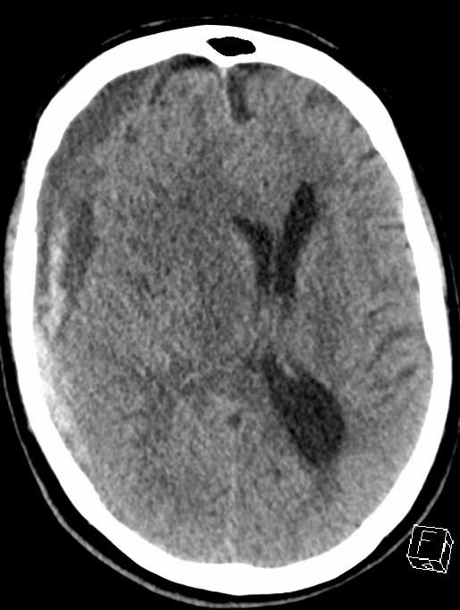
Measurement of Hematoma thickness
Maximum thickness: Maximal width of CSDH above temporal bones and up to two slices above lateral ventricles and one slice below the lateral ventricles
Upper limit excludes miscalculation due to skull curvature at the top
Lower limit avoids measurement on tentorial bleeding
W
L
Notes:
https://www.cdc.gov/steadi/media/pdfs/STEADI-Assessment-TUG-508.pdf

Slide 30
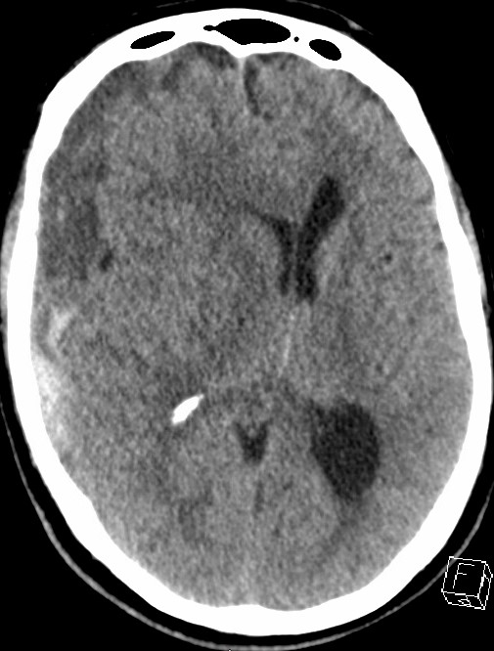
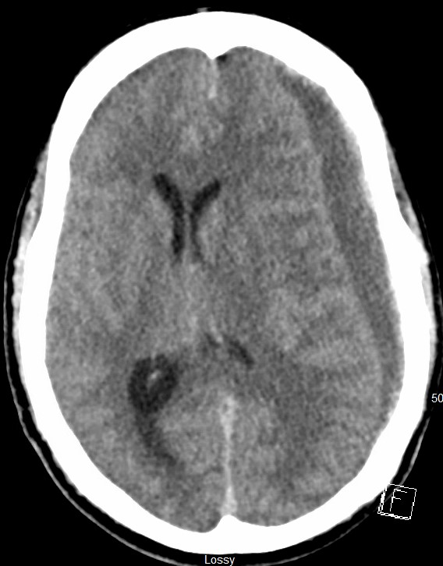
Measurement of Midline Shift (MLS)
MLS will be measured in mm as the perpendicular distance from a midline structure (Septum Pellucidum) to a line drawn between the anterior and posterior attachments of the falx. Measured at level of foramen of Monroe
A
A
B
B
Notes:
https://www.cdc.gov/steadi/media/pdfs/STEADI-Assessment-TUG-508.pdf

Slide 31
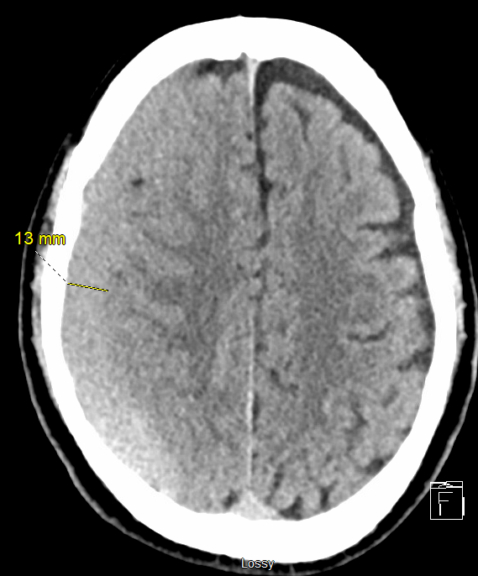
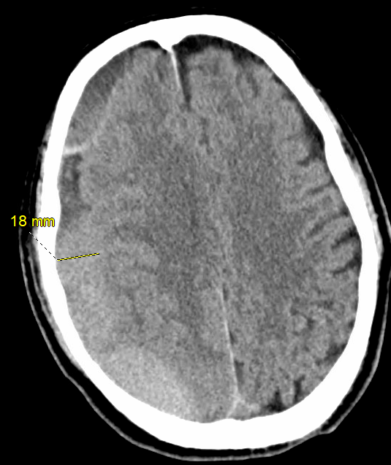
Example of Radiographic Criteria
Notes:
https://www.cdc.gov/steadi/media/pdfs/STEADI-Assessment-TUG-508.pdf

Slide 32
Clinical Symptom Criteria
For each of the clinical symptom scores (TUG, ASR, MRC)
If a deficit was identified at baseline and the respective score is the same at 6 weeks or more from presentation, OR
The respective score worsens at any time
For the MRC, the worsened score has to be in a muscle group contralateral to the side of the CSDH and the deterioration cannot be explained by any other reason

Slide 33
Clinical Symptom Criteria
CHESS defined TUG worsening
An increase in the TUG of 30% that cannot be explained by any other reason
CHESS defined ASR worsening
An ASR drop by 1 point or more that cannot be explained by any other reason
CHESS defined MRC worsening
An MRC score worsening of 0-2 for any muscle group contralateral to the CSDH weakness that cannot be explained by any other reason

Slide 34
Guidelines for Initiation of CRC Review
Situation 1:
First and second subject randomized at each site.
If any clinical symptom criteria for rescue surgery are met and at least one of the radiographic criteria for surgery are met at any time, the site should initiate the adjudication procedure by the CRC.
Adjudication request should be initiated separately at 90-day and 180-day visit. (QC purposes only).
Situation 2:

Slide 35
Guidelines for Initiation of CRC Review
Situation 3:
If the site treating physician believes that a subject needs rescue surgery but did not meet the CRC clinical and radiographic criteria for rescue surgery.
Situation 4:
If the clinical situation is determined to be emergent, the site PI or treating neurosurgeon can proceed with surgery before CRC review.
A post-hoc review by the CRC is still the primary endpoint.

Slide 36
Situation 4: Emergent Rescue Surgery
If MRC, TUG, and ASR were unavailable because of emergent nature, the post hoc determination will be made based on the same CT criteria and the associated serious adverse event (SAE) report
For surgery to be recommended, the same CT criteria have to be met and the last documented neurological examination before surgery has to show deterioration from baseline (described in the SAE narrative) as adjudicated by the CRC

Slide 37
CRC Situations to Account For Missing Data
In extenuating circumstances, if MRC, TUG, ASR, and/or CT are unavailable, then a structured narrative from the clinical site investigator describing the participant’s status (similar to the SAE narrative obtained in Situation 4) and an attestation that, based on the narrative, they do not require surgery, will be used to confirm that the participant did not require rescue surgery.
The narrative can ONLY be based on an in-person or virtual visit.
Telephone visits would NOT be sufficient.

Slide 38
Timeline for CRC Adjudication
In all situations, the site must provide data required for CRC review within 5 business days from the time of initiation
After the site initiates and provides all data required for CRC review, the CRC should return the adjudication within 5 business days.

Slide 39
Process for Initiating CRC Review
CT scans (both baseline and at the time of adjudication request) are selected by the site personnel for transmission to the CRC Manager through Ambra.
Date and Time of CT scan and clinical data at the time of adjudication request (TUG, ASR, MRC, and/or SAE form) is entered in WebDCU by the site
Upon submission, an automated email notification is triggered by WebDCU to the CRC Manager notifying them of a new case for review
The CRC Manager reviews the data for completeness
If not complete, the CRC manager works with the site personnel via queries in WebDCU to address issues
Once the information is verified complete, the CRC Manger will initiate the CRC adjudication review and assign review to the two adjudicators that are on call

Slide 40
Process for Initiating CRC Review
CRC adjudicators will review the data and enter their decision into WebDCU as soon as possible (no later than 5 business days) after the request is initiated by CRC Manager
The adjudicators may request more information through the CRC Manager who will request additional information via queries to the site through WebDCU
WebDCU will notify CRC Manager once both adjudicators have completed review
If Adjudicators agree, no further action will be needed
If they disagree the CRC manger will work with them to submit the final consensus adjudication

Slide 41
Rescue Surgery Procedures
Rescue surgery includes surgical evacuation procedures such as:
Craniotomy
Burr holes
SEPs
Important to note: SEPs is allowed for Rescue Surgery, but not for conventional surgery at time of randomization

Slide 42
Central Imaging Laboratory

Slide 43
Central Imaging Laboratory (CIL)
Radiological analysis of head CT scans is a core component of the CHESS trial
Exploratory endpoints include the proportion of subjects with ≥ 50% volumetric reduction of CSDH at 90 days post-randomization
Independent blinded CIL Image Analyst must determine CSDH volume on baseline and 90-day CT scans for validity

Slide 44
Central Imaging Laboratory (CIL) / CT Imaging Transfer
Imaging Studies in CHESS
Pre-enrollment/Baseline head CT scan → CIL Manager (in Ambra)
Head CT at 24 hours post-surgery or MMAE treatment → Safety Scan
Head CT at 90 days post-randomization → CIL Manager (in Ambra)
Head CT at 180 days post-randomization → Long term follow-up

Slide 45
Safety Reporting

Slide 46
What is an AE?
Any untoward medical occurrence, whether or not it is considered related to the study intervention
Can be any unfavorable and unintended symptom, sign, disease or clinically significant abnormal test result occurring during the study, which was either not present at baseline, or if present, worsened during the study in terms of either severity or frequency
Not AEs:
Events existing at Baseline, unless they worsen in severity or frequency during the study
Pre-existing conditions that are discovered after Baseline– document as medical history
Surgery, intubation, etc. are not AEs but rather actions taken for AEs

Slide 47
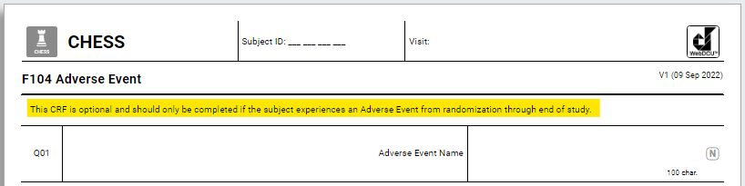
AE Reporting
All AEs reported will be recorded on the AE CRF throughout the entire duration of the study (from randomization through the 180-day visit/EOS)
AEs will be assessed at the time they occur (or are discovered) and are followed until resolution/EOS
The Site Investigator makes an assessment as to seriousness, severity, and causality to treatment procedure and MMAE device
Information will be collected on the action taken and outcome status

Slide 48
AE Reporting
Reported on the Adverse Event CRF (1 AE = 1 CRF)
Report the diagnosis, not the symptoms
Fever, cough, chest pain, and crackles? That’s pneumonia!
Avoid abbreviations/colloquialisms
Do not include subject PHI
SAEs should be submitted within 24 hours of first knowledge
AEs should be submitted within 5 days of first knowledge

Slide 49
Unanticipated Adverse Device Effect
Per 21 CFR 812.3, a UADE is any serious adverse effect on health or safety, any life-threatening problem or death caused by, or associated with a device, if that effect, problem, or death was not previously identified in nature, severity, or degree of incidence in the application; or any other unanticipated serious problem associated with a device that relates to the rights, safety, or welfare of subjects

Slide 50
Prompt Reporting of Safety Events to Sponsor and IRB
SAEs: FDA
For IDE’s, anticipated SAEs are only reported in the regular annual/progress reports
Unlike drug IND studies, there is no requirement for quick, special FDA reporting of SAEs
SAEs: CIRB
SAEs that are both unexpected and related must be reported as soon as possible, but in no event later than 5 business days of the researcher becoming aware of the event
UADES: FDA, CIRB, Local IRBs
Any UADE must be reported by the Investigator to the study Sponsor and reviewing IRB as soon as possible, but in no case later than 10 days after the Investigator learns of the UADE
Study Sponsor will conduct an evaluation of the device effect and must report to FDA, all reviewing IRB’s, and participating investigators within 10 working days after the Sponsor first receives notice of the effect
Notes:
In practice, UADE are extremely rare because virtually all problems are anticipated.

Slide 51
Are you serious (SAE)? Yes, if:
Death/leads to death
Life threatening
Prolongs hospitalization or requires rehospitalization
Results in significant disability
Requires medical or surgical intervention to prevent above
Notes:
https://www.fda.gov/safety/reporting-serious-problems-fda/what-serious-adverse-event
Death
Death was the outcome of the adverse event
Life-threatening
Patient was at substantial risk of dying at the time of the adverse event, or if use or continued use of the device or other medical product might have resulted in the death of the patient
Hospitalization (initial or prolonged)
Admission to the hospital or prolongation of hospitalization was a result of the adverse event
Emergency room visits that do not result in admission to the hospital should be evaluated for one of the other serious outcomes (e.g., life-threatening; required intervention to prevent permanent impairment or damage; other serious medically important event)
Disability or permanent damage
Adverse event resulted in a substantial disruption of a person's ability to conduct normal life functions, i.e., the adverse event resulted in a significant, persistent or permanent change, impairment, damage or disruption in the patient's body function/structure, physical activities and/or quality of life
Congenital anomaly/birth defect
Exposure to a medical product prior to conception or during pregnancy may have resulted in an adverse outcome in the child
Required Intervention to Prevent Permanent Impairment or Damage (Devices)
Medical or surgical intervention was necessary to preclude permanent impairment of a body function, or prevent permanent damage to a body structure, either situation suspected to be due to the use of a medical product
Other Serious (Important Medical Events)
Event does not fit the other outcomes but may jeopardize the patient and may require medical or surgical intervention (treatment) to prevent one of the other outcomes
Examples include allergic brochospasm (a serious problem with breathing) requiring treatment in an emergency room, serious blood dyscrasias (blood disorders) or seizures/convulsions that do not result in hospitalization

Slide 52
Severity
Using NCI Common Terminology Criteria for Adverse Events (CTCAE)
Grade 1: Mild; asymptomatic or mild symptoms; clinical or diagnostic observations only; intervention not indicated
Grade 2: Moderate; minimal, local or noninvasive intervention indicated; limiting age appropriate instrumental activities of daily living
Grade 3: Severe or medically significant but not immediately life-threatening; hospitalization or prolongation of hospitalization indicated; disabling; limiting self-care activities of daily living
Grade 4: Life-threatening consequences; urgent intervention indicated
Grade 5: Death related to AE
Notes:
The CTCAE provides a grading (severity) scale for each AE term and AEs are listed alphabetically within categories based on anatomy or pathophysiology.

Slide 53
AE Relatedness to Treatment Procedure for CSDH (MMAE or Conventional Surgery)
Definitely related to treatment procedure, for example, known to be a complication of the treatment procedure, and having no other explanation
Probably related to the treatment procedure, that is, not reasonably explained by the patient’s clinical state or other therapies
Possibly related to the treatment procedure, that is, could have been explained by other therapies or patient’s clinical state
Notes:
Definitely related Must have all four of the following:
Has a reasonable temporal relationship to intervention
Could not readily have been produced by subject’s clinical state or have been due to environmental or other interventions
Follows a known pattern of response to intervention
Disappears or decreases with reduction in dose or cessation of intervention and recurs with re-exposure
Probably related Must have three of the following:
Has a reasonable temporal relationship to intervention
Could not readily have been produced by subject’s clinical state or have been due to environmental or other interventions
Follows a known pattern of response to intervention
Disappears or decreases with reduction in dose or cessation of intervention
Possibly related Must have two of the following:
Has a reasonable temporal relationship to intervention
Could not readily have been produced by the subject’s clinical state or environmental or other interventions
Follows a known pattern of response to intervention

Slide 54
AE Relatedness to MMAE Device (Embosphere Microspheres or CONTOUR Embolization Particles)
Definitely related to MMAE device, for example, known to be a complication of the device, and having no other explanation
Probably related to the MMAE device, that is, not reasonably explained by the patient’s clinical state or other therapies
Possibly related to the MMAE device, that is, could have been explained by other therapies or patient’s clinical state

Slide 55
AE CRF Submission
Data enter CRF
Save – rules will run in background (to check for missing data fields, etc.)
Submit – only after the CRF is submitted can it go to the MSM
MSM will be notified in real-time to review site-reported SAEs
MSM’s review will be used as the final classification of SAEs, including relatedness to the device
Notes:
Talk more about MSM role

Slide 56
Type of Event and Definitions
Symptomatic ischemic stroke – rapid onset of a new focal neurological deficit with imaging or other evidence of infarction in a part of the central nervous system consistent with symptoms
Symptomatic hemorrhagic stroke – rapid onset of a new focal neurological deficit with imaging or other evidence of new intraparenchymal hemorrhage consistent with symptoms
Seizure – diagnosis based on clinical impression ideally by a neurologist or based on an abnormal EEG supporting the diagnosis of epilepsy/seizure
Cranial neuropathy – facial paralysis or visual loss

Slide 57
Site Reporting and Recruitment

Slide 58
Recruitment-Based Probation
If either:
Site does not randomize patient within 6 months of activation, OR
6 months elapses without randomizing at any point in the trial
Site will enter probation:
Operations Committee + National Coordinating Center will assist to address issues
If 3 months elapses without action, site will be replaced

Slide 59
Strategies for Maximizing Enrollment
Educate of multiple departments (neurology, neurosurgery, ED, ICU) about study via emails/flyers/training module CHESS slides
Give grand rounds/presentations about study
Outreach to referring hospital/centers regarding CHESS study
Recruitment plan, with coverage for weekends/holidays

Slide 60
Role of the Investigator
Informed Consent
Site-Specific Operations
Protocol Compliance
Regulatory/Good Clinical Practice Compliance

Slide 61
Investigator’s Role: Informed Consent
Highly important to ensure protection of subjects
Ensure standardized, comprehensive process is implemented
Delegate responsibility to trained staff (Delegation of Authority)
Provide sufficient time
Use non-technical language
Answer all questions, ensure subject understanding

Slide 62
Investigator’s Role: Site-Specific Operations
Maintain study records per ALCOA (Attributable, Legible, Contemporaneous, Original, Accurate)
Retain source data (papers, EMR, consents, etc.)
Ensuring site can support target enrollment goals in timeframe for CHESS
Ensuring that adequate facilities and resources are available to support CHESS activities
Assembling qualified staff familiar with CHESS to support study-related activities

Slide 63
Investigator’s Role: Protocol Compliance
Personnel should be familiar with protocol, procedures, and reporting requirements while conducting study
Deviations must be logged and reported
Planned deviations must receive advanced approval from central sponsor and cIRB/BRANY

Slide 64
Investigator’s Role: Regulatory/GCP Compliance
Adhere to requirements for IRBs, FDA, laws, local institutions
Report AEs/SAEs in required timeframes
Adhere to Good Clinical Practice (GCP)
Protect subject rights, safety, welfare
Obtain informed consent before research-related activities
Ensure medical decisions are made by qualified healthcare personnel
Provide adequate care for subject AEs
Make reasonable efforts to ascertain reasons for subject withdrawal

Slide 65
Prompt Communication
Site
Executive Members
NCC Project Manager
WebDCU Staff
CRC Manager (Adjudicate)
NCC (Contracts/
Billing)
BioSend (BioCHESS)
cIRB (BRANY)
Communication between the site and central study team is essential to the success of CHESS
Central team will coordinate communication for major changes in CHESS protocol
Important for Site PIs to aid in implementation of new processes/regulations
Upcoming: Incorporating CMS/Medicare Approval
Prompt notification from sites to central study team include the following:
Change in Key Site Personnel → DOA in WebDCU
Deviations → Planned deviations require advance approval by central sponsor and cIRB/BRANY
SAEs → WebDCU and (in specific instances) cIRB/BRANY

Slide 66
Publications Policy
Publications Committee will be chartered at end of trial:
Co-Principal Investigators + Investigators/Designees from Top 3 Enrolling Sites
Any trial personnel may submit analysis proposal(s) to committee
Committee will review and guide team
Committee approval is required before submissions to journals/scientific meetings
Proposals for ancillary studies:
Submit to Executive Committee, who will review + engage oversight (DSMB, NINDS)
Proposed study must also include 1 CHESS Co-PI as part of its Executive Committee

Slide 67
Thank you!
Please complete Protocol Training Attestation Form and upload to WebDCU.

