Slide 1


Protocol Training Will Start Soon

Slide 2
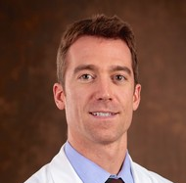
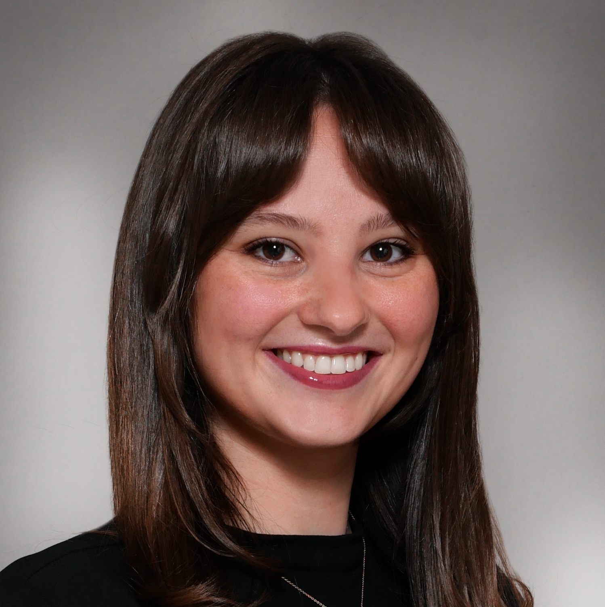
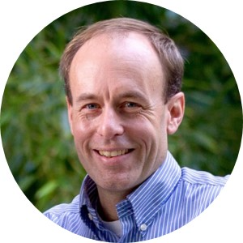
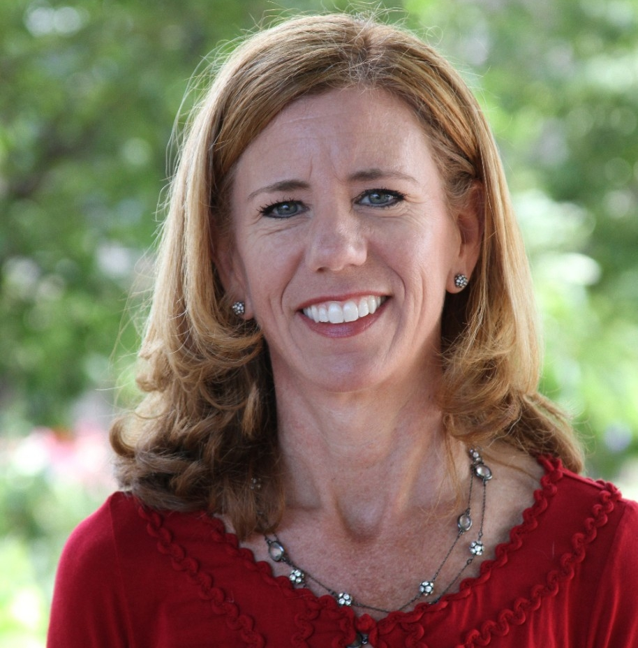

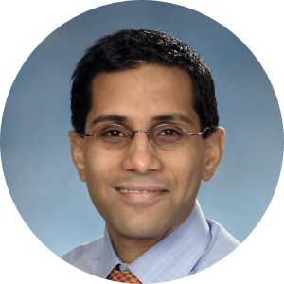
Protocol Training
Adam de Havenon
Yale
Nora Hibbard
UC
Maarten Lansberg
Stanford
Stephanie Kemp
Stanford
Catherine Viscoli
Yale
Kevin Sheth
Yale

Slide 3
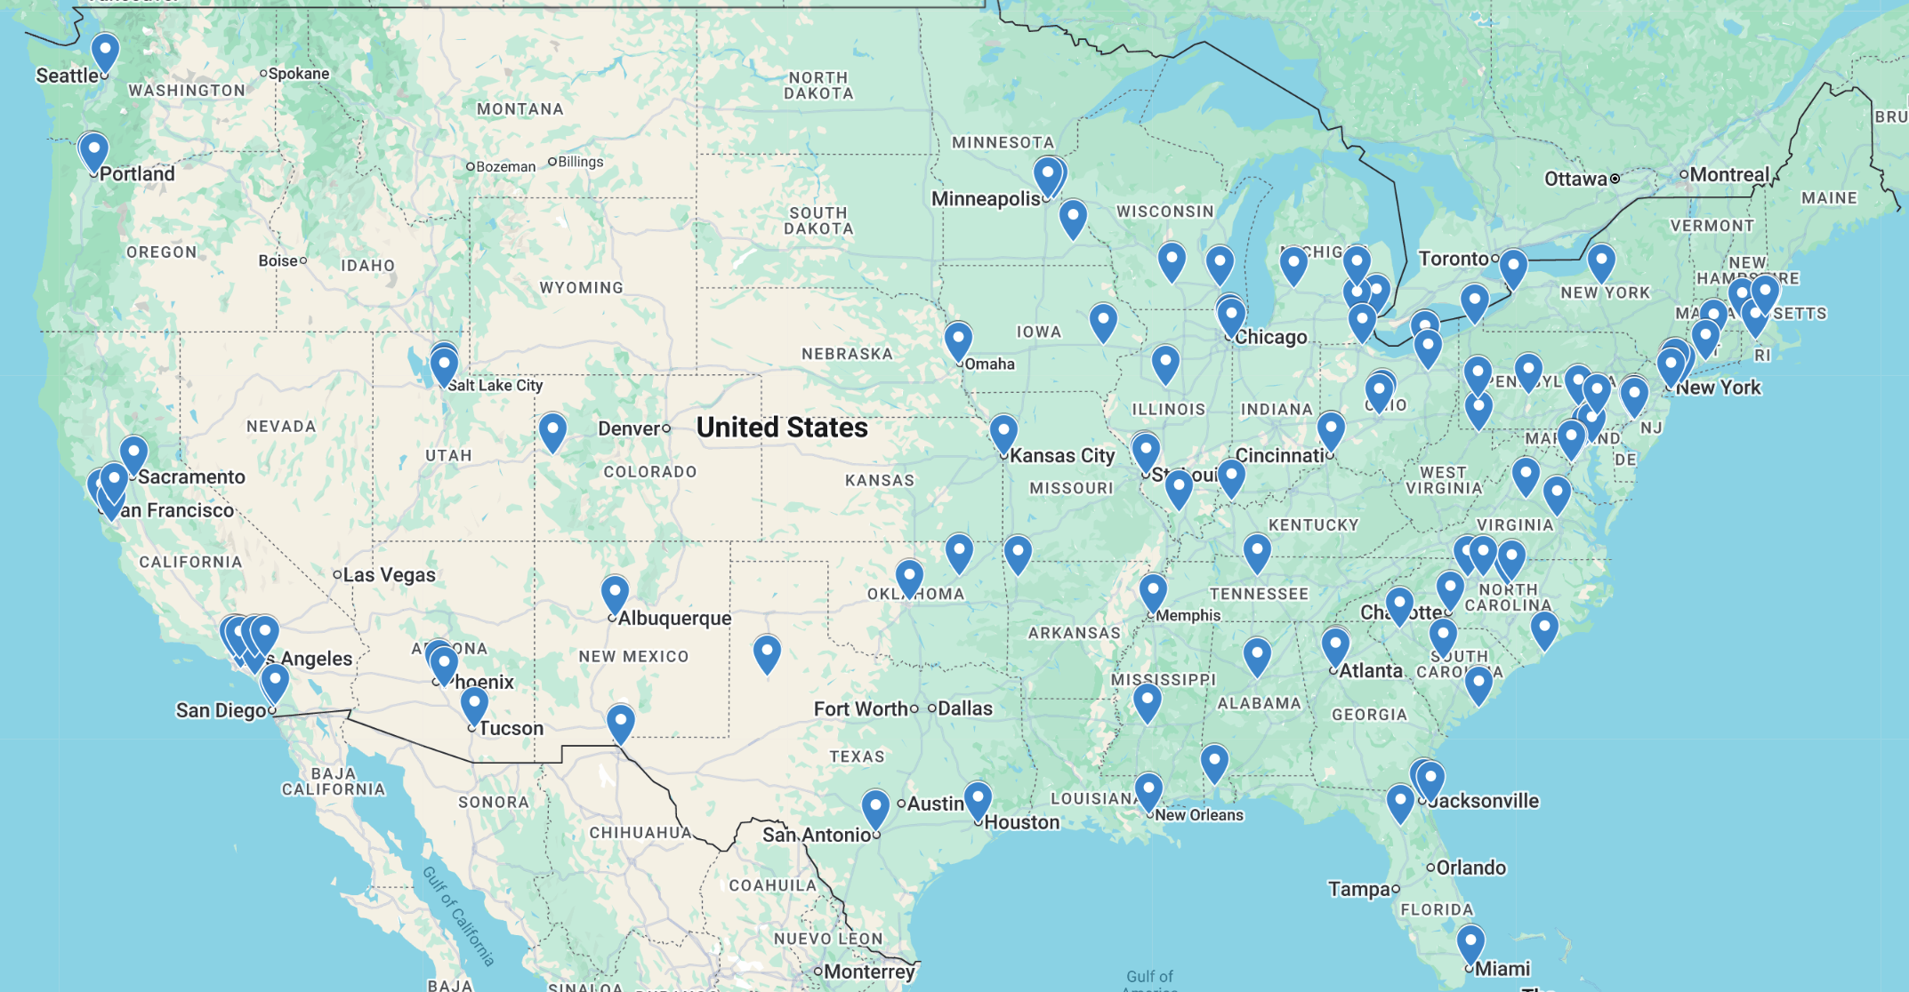
It takes a village – 113 sites
Insert US map with sites

Slide 4

Shout outs!
12 ROAR Leaders (Elaine Hill, Sarah Hobbs, Michael Kampp, Zarine Gazali, Margaret Houghton, Jennifer Powers, Anna Bican, Sarah Bruton, April Vaughan, Andrea Sevilla, Lauren Klein and Theresa McQuaid)
6 sites furthest along in startup
  UVA Medical Center
  University of Cincinnati Medical Center
  University of Alabama Birmingham Hospital
  NYU Langone Hospital – Brooklyn
  Boston Medical Center
  Barnes Jewish Hospital in St. Louis

Slide 5

Central Pharmacy at
VA - Albuquerque
DSMB
MSM
Prevention Working Group
Taxpayers
Site Investigator & Coordinators
NIH / NINDS
StrokeNet NDMC
Mentors
Event Adjudication Committee
Patients
StrokeNet NCC
ROAR
Colleagues
Fellows
Our families
Patient Advisory Board
Recruitment & Retention Committee

Slide 6

clarity@yale.edu
Maarten Lansberg lansberg@stanford.edu
Kevin Sheth kevin.sheth@yale.edu
Adam de Havenon adam.dehavenon@yale.edu
Stephanie Kemp skemp@stanford.edu
Nora Hibbard hibbarna@ucmail.edu
Catherine Viscoli catherine.viscoli@yale.edu

Slide 7
Why Clarity?
There are 175,000 recurrent ischemic strokes every year in the US
The impact of recurrent stroke is devastating!
Compared to first-time stroke:
  Double the mortality^{1,2}
  Triple the rate of disability³
There is a need for better secondary stroke prevention that is effective, safe and affordable for the majority of stroke survivors
¹Aarnio K et al. Stroke. 2014;45:2670–2676.
²Khanevski A et al. Acta Neurologica Scandinavica. 2019;140:3–8.
³Dhamoon M et al. J Stroke Cerebrovasc Dis. 2014; 23(5): 1131–1137.
Notes:
Recent changes in guidelines are expected to shift targets in general population though safety of this approach in those with sCVD is unknown.

Slide 8
Vision
To establish effective, safe, and affordable secondary stroke prevention

Slide 9
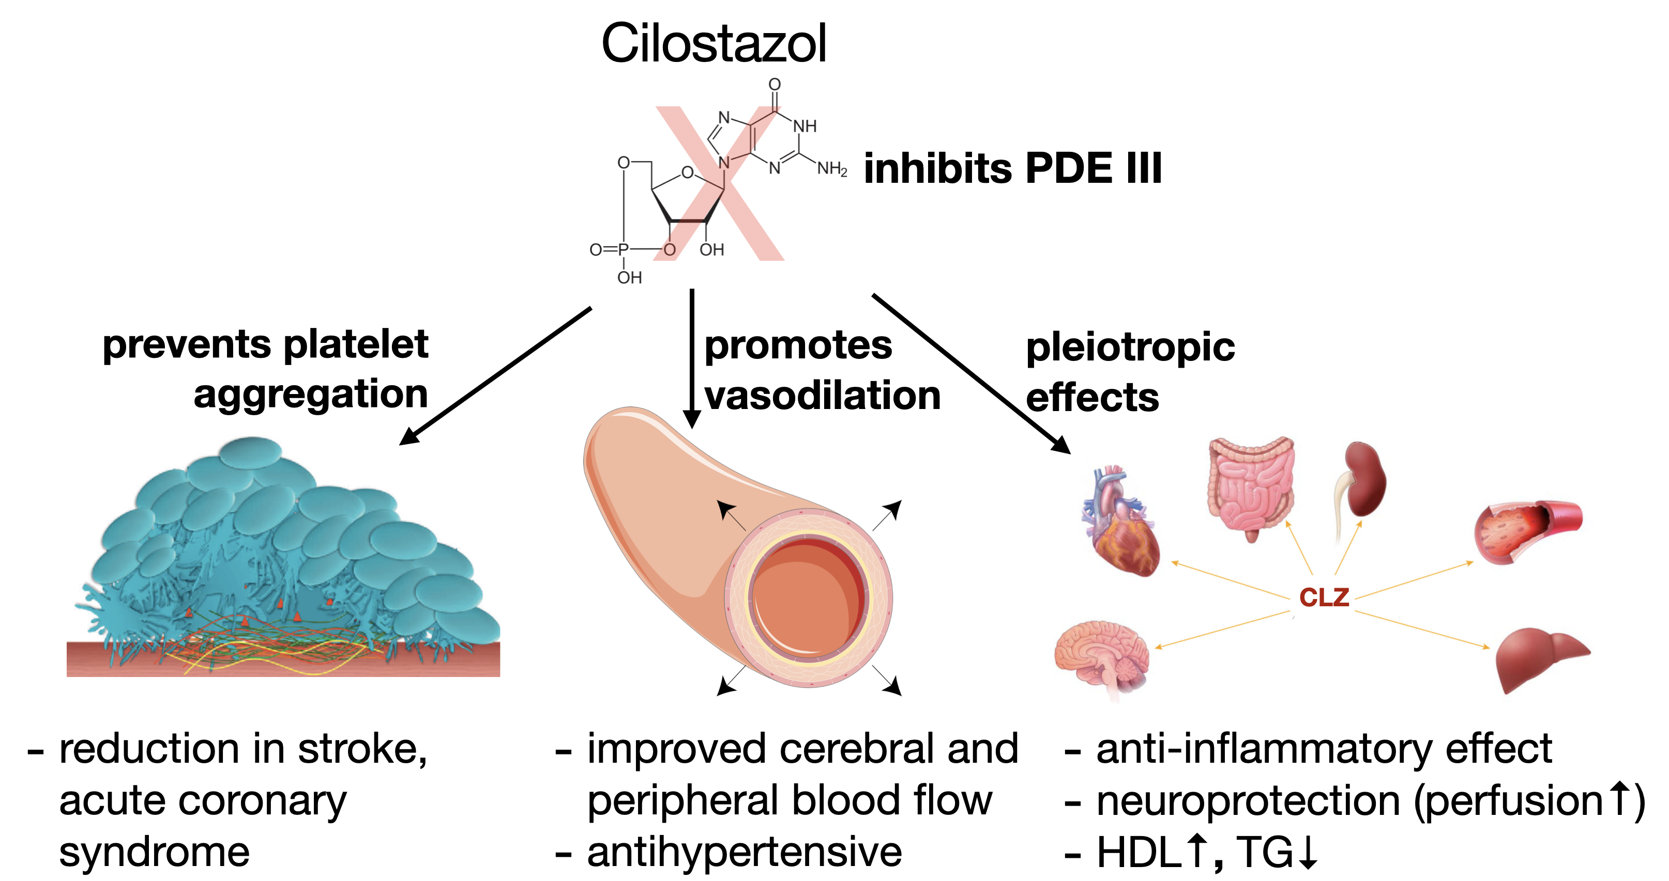
Cilostazol
Optimal Candidate Drug to Realize Vision

Slide 10
Cilostazol: Clinical use and experience
FDA approval: Indicated for claudication in 1999
Risk profile: No bleeding complications; Occasional headache, palpitation and gastrointestinal complaints
Cost: Cilostazol is generic and costs $6-10 per month
Bedenis R, et al. Cochrane Database of Systematic Reviews. 2014.

Slide 11
The CSPS.com trial demonstrates benefit in secondary stroke prevention
Design: Phase 3 open-label RCT
Population: 1,879 Japanese patients with non-cardioembolic stroke
Intervention: Cilostazol 100 mg BID, added to aspirin or clopidogrel
Toyoda K, et al. Lancet Neurol 2019;18:539–48.
Notes:
There is very legitimate equipoise regarding risk/benefit of aggressive medical management in high risk sCVD patients

Slide 12
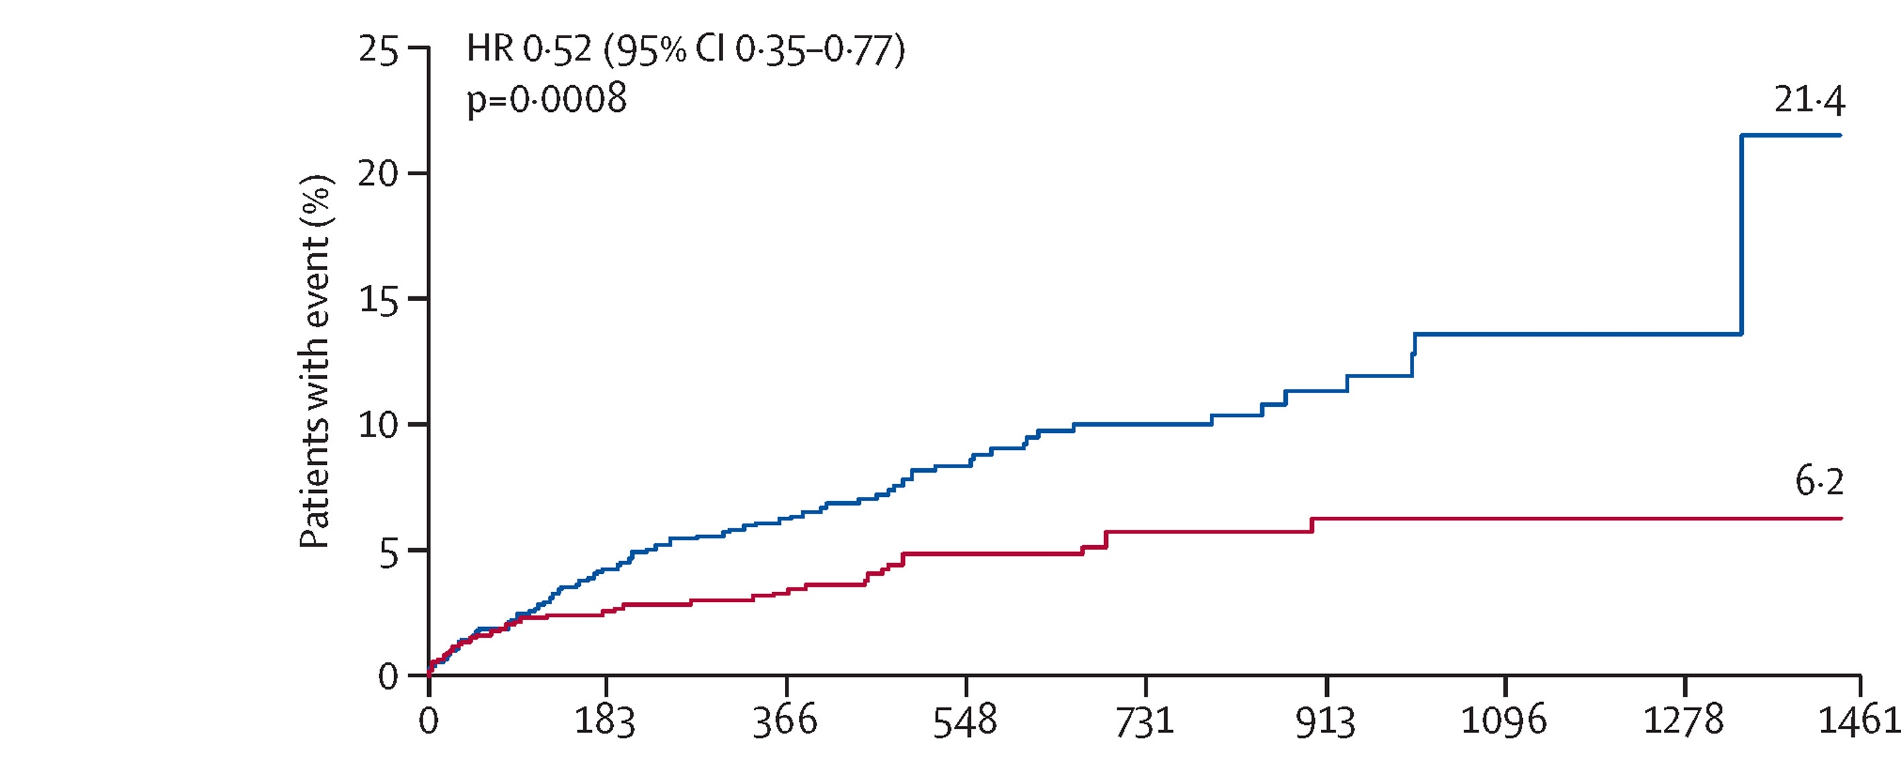

Stroke, MI and Vascular Death (MACE)
HR 0.52 (95% CI 0.35-0.77)
Toyoda K, et al. Lancet Neurol 2019;18:539–48.

Slide 13
Effectiveness in Perspective

Slide 14
Effectiveness in Perspective
+
ASA / Plavix

Slide 15
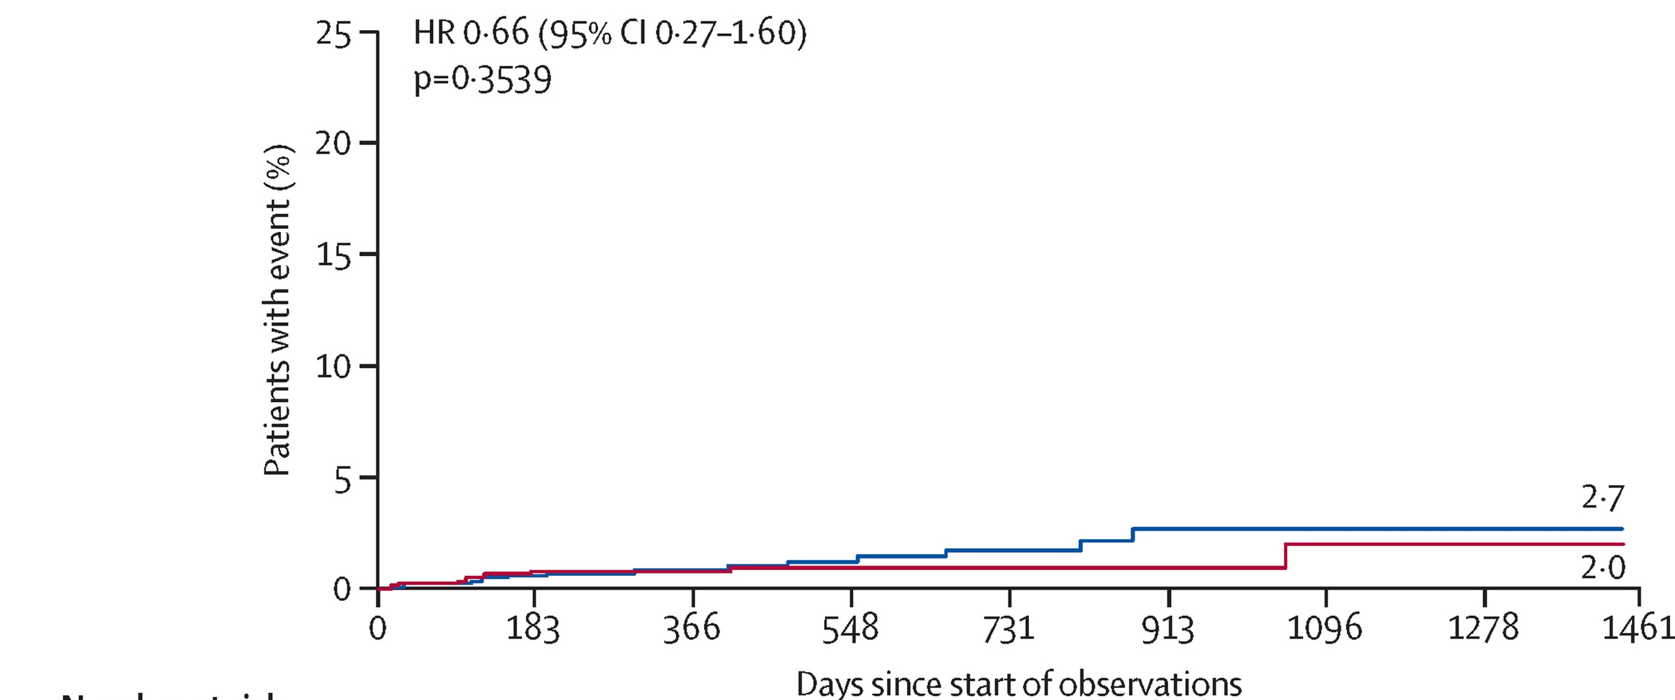
Safe: No increase in severe bleeding
HR 0.66 (95% CI 0.27-1.60)
P=0.35
Toyoda K, et al. Lancet Neurol 2019;18:539–48.

Slide 16
Limitations of CSPS.com
Open label
Non-Asians were not represented (0%)
Women were underrepresented (29%)

Slide 17
CSPS.com did not change practice in US
Prescription patterns after stroke
    1% cilostazol
    33% clopidogrel
2017
2019
CSPS.com
de Havenon A, Sheth KN, Madsen TE, et al. Cilostazol for Secondary Stroke Prevention: History, Evidence, Limitations, and Possibilities. Stroke. 2021;52:e635–e645.

Slide 18
CSPS.com did not change practice in US
Prescription patterns after stroke
    1% cilostazol
    33% clopidogrel
    1% cilostazol
    36% clopidogrel
2017
2019
CSPS.com
2024
de Havenon A, Sheth KN, Madsen TE, et al. Cilostazol for Secondary Stroke Prevention: History, Evidence, Limitations, and Possibilities. Stroke. 2021;52:e635–e645.

Slide 19
Mission
Obtain the evidence that will make cilostazol standard of care for secondary stroke prevention

Slide 20
Strategy
High-quality phase 3 RCT that offers a rewarding and enjoyable experience for participants and research teams

Slide 21
Rewarding and Enjoyable
Participant | Research Team
Per visit reimbursement | Pragmatic Inclusion Criteria
Newsletters / Holiday cards | GWTG to help screen
In-Person or Remote Study Visits
Direct-to-Participant Drug Shipments
Foster Community

Slide 22
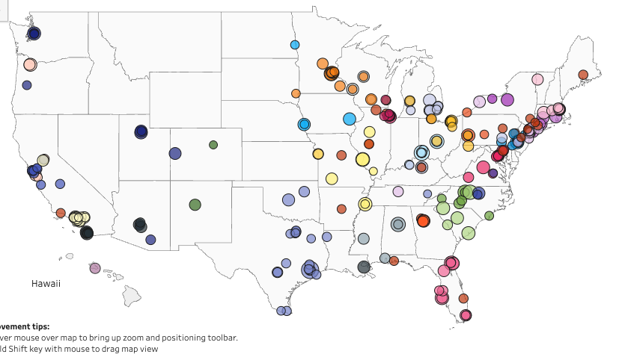


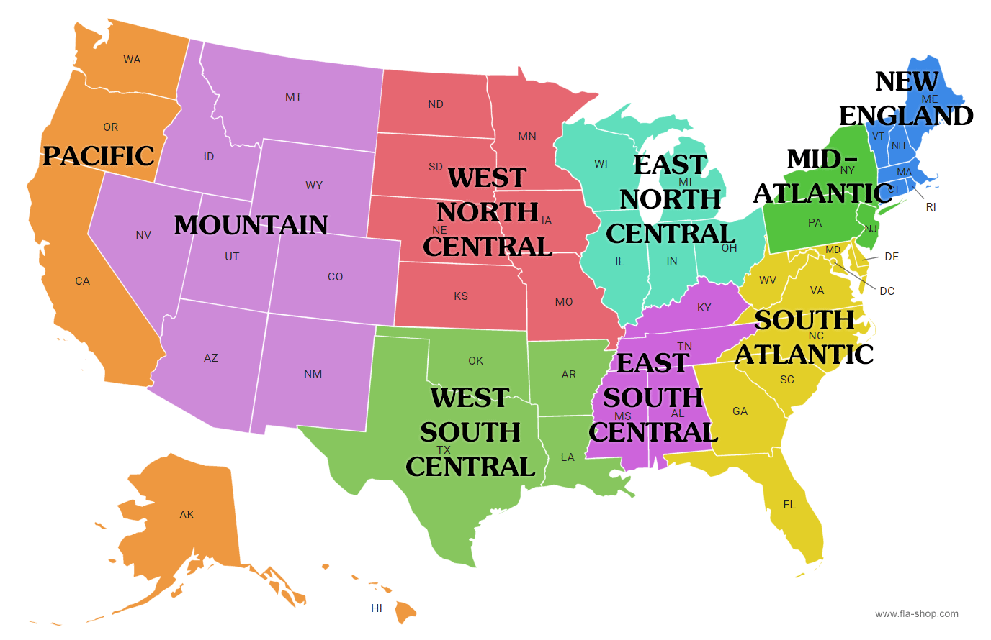
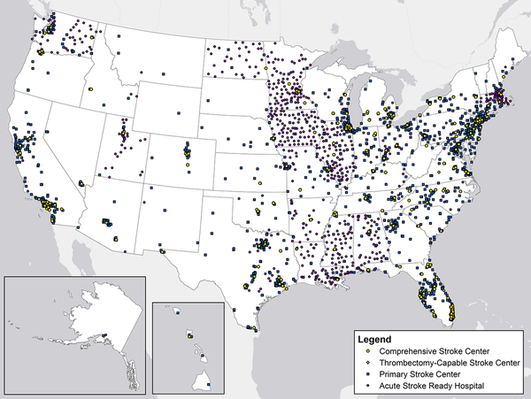
Community
National: NIH StrokeNet
Global: Cilostazol Consortium
USA
UK
190 survey responses
Many sites without prior StrokeNet trials
Australia
Africa
Regional: ROAR Coordinator Cores
Local: Site Initiatives
Clarity participant lunch
Stroke support group presentations

Slide 23
High Quality
Population: 2,000 patients within 180 days of a non-cardioembolic ischemic stroke or high-risk TIA
Intervention: Cilostazol 100 mg
Control: Matched placebo
Outcome: Major adverse cardiovascular events (MACE)
Duration: Up to 5 years follow-up
Sites: ~110
Countries: USA and Australia

Slide 24
Study Procedures

Slide 25
Timeline
Stroke
Randomization
<6 months
Min Follow-up
Median Follow-up
Max Follow-up
T0
Year 1
Year 2
Year 3
Year 4
Year 5
Screening
<6 months
Intervention
Follow-Up Visits at 1 month, then every 3 months paired with study drug shipments*
*Visits will be either in person or virtual

Slide 26
Schedule of Events
 | Screening / Consent | Randomization | Day 30 | Day 90 90-Day Intervals | End of Study
Visit Window (Days) |  | Within 180 days of event | ±5 | ±5 | ±5
Screening/Administrative
Informed consent | X
Inclusion/exclusion | X
Obtain/verify contact info | X | X |  | X
Demographics and medical history | X
TOAST classification |  | X
Study Intervention Administration
Confirm eligibility to receive study drug |  | X |  | X
Randomization |  | X
Dispense study drug |  | X |  | X
Check study intervention compliance |  |  | X | X | X
Efficacy and Safety Assessments
Modified Rankin Scale (mRS) |  | X |  | X | X
EQ-5D-5L / EQ VAS |  | X |  | X (18 mo)
Montreal Cognitive Assessment |  | X |  | X (18 mo)
Restricted medications |  | X | X | X | X
Endpoint assessments |  |  | X | X | X
Events of special interest assessment |  |  | X | X | X
Notes:
*Screening and end of study visits are preferably in-person. Other visits can be conducted virtually or in-person.
** Required only for women under 55 of child-bearing potential. Testing will occur at the Randomization visit only with pregnancy status obtained verbally at each subsequent study visit.
***Study drug will be shipped by mail promptly after the visit.
****MoCA Blind / Telephone, EQ-5D-5L and EQ VAS, and mRS will be obtained at the 18-month follow-up visit, but not at other follow-up visits.

Slide 27
Inclusion Criteria (protocol v 2.0)
≥40 years
Ischemic stroke or high-risk TIA (ABCD2 score ≥6)
Can be randomized within 180 days after ischemic stroke or high-risk TIA
Treated with single or dual antithrombotic therapy with aspirin, clopidogrel and/or ticagrelor
Two or more of the following risk factors: age 65 years or older, hypertension, diabetes mellitus, history of ischemic stroke other than the qualifying event for this trial, currently smoking, peripheral arterial disease, coronary artery disease including prior MI, aortic atherosclerotic plaque ≥4 mm, ≥50% stenosis or occlusion of a major intracranial artery (ICA, M1, M2, A1, P1, vertebral, or basilar) or extracranial artery (ICA or vertebral)
In the opinion of the site investigator, patient is medically stable, capable of participating in the trial, and willing and able to attend follow-up
Able to receive study medication by mail and able to begin taking study medication promptly after receipt
Provision of signed and dated informed consent form by patient or legally authorized representative

Slide 28
Exclusion Criteria
Atrial fibrillation, mechanical heart valve, or left ventricular assist device
Use of prohibited medications (as specified in the Restricted Medication Table in the MOP)
Modified Rankin Scale 5
Planned cardiac surgery, percutaneous coronary intervention, carotid endarterectomy or stenting (patients are eligible post-procedure)
History of symptomatic non-traumatic intracerebral hemorrhage within last 2 years
Known thrombocytopenia (platelet count ≤100,000 per microliter (µL))
Severe liver dysfunction (active hepatitis or hepatic insufficiency with Child-Pugh score B or C)
Pregnant, breast-feeding, or of child-bearing potential but not on birth control
Confirmed diagnosis of heart failure with current or prior symptoms or signs (e.g. paroxysmal nocturnal dyspnea, reduced exercise tolerance, ankle swelling, elevated jugular venous pressure)
Hypersensitivity to cilostazol or any component of the formulation (e.g. anaphylaxis, angioedema)
Currently enrolled in an investigational intervention study
Life expectancy less than 6 months
Participant does not allow contacting of their surrogate (e.g. family member or friend) or health care practitioner to obtain health information should participant become unwilling or unable to follow the study schedule.
Participants who are incarcerated, including prisoners or participants compulsorily detained for treatment of psychiatric disease.

Slide 29
Consent and Randomization Visits
Consent and Randomization visits can often be consolidated into a single visit
But, do not randomize until patient is ready to receive study drug by mail and start taking study drug
  Do not randomize during acute hospital stay (may be randomized at time of hospital discharge)
  Do not randomize if patient is going to an ARU or SNF where study drug administration is impractical or not allowed

Slide 30
Randomization and Blinding
1:1 randomization using covariate-adaptive algorithm
Balancing factors:
  Time from index event
  Age
  Background antithrombotic treatment at time of randomization
  Diagnosis (stroke vs high-risk TIA)
Double-blind:
  Participants, investigators, and outcome adjudicators blinded
Matching placebo identical in appearance and administration
Central randomization via WebDCU

Slide 31
Recruitment Strategy
Target first patient enrolled: End Summer 2026
Start identifying potential participants now
  Work with stroke research team to create a local list
  Communicate with and find an easy way to have your vascular neurology colleagues refer potential patients to you and your list
  Have a coordinator or fellow review discharges
Develop an inpatient and outpatient strategy and workflow
Leverage local resources (eg CTSA) to develop local strategies
Get to know your CLARITY ROAR leader!

Slide 32
Retention Strategy
Know your participants!
  Develop a personal connection with each participant
  Know the participant’s surrogate
  Obtain multiple contact methods and verify at each follow-up
Frequent contact (at one month and then every 3 months)
Goal: near-zero withdrawal of consent
Structured approach before labeling “lost to follow-up”

Slide 33
Study MEDICATION

Slide 34
Ordering and Dispensing
Following randomization, order first dose of study medication in WebDCU
Study medication order form will ask for participant address for medication shipment
Study medication order will be processed by the central pharmacy at the VA in Albuquerque, New Mexico
Central pharmacy will ship study medication directly to the participant
Study coordinator can track study medication shipment
Study coordinator will call participant once study medication has been delivered to confirm receipt and discuss use of study medication

Slide 35
Management and Compliance
Study medication shipped to the participant every 3 months
  90-day supply + 10-day buffer
  Every time medication is ordered the address can be changed
  Off-schedule drug orders are possible
Compliance assessed at each visit by participant self-report
Non-adherence triggers re-education by site staff
All interruptions/discontinuations documented in eCRF
Participants remain in follow-up even if drug stopped

Slide 36
Dosing and Administration
Initial dose: 1 tablet once daily for 2 weeks
Maintenance dose: 1 tablet twice daily thereafter
Administration
  ≥30 minutes before or ≥2 hours after meals
Avoid grapefruit and discouraged medications

Slide 37
Dose Reduction or Interruption
See MOP for Details
New diagnosis of CHF or other prohibited condition → stop study medication
Pregnancy → stop study medication
Start of a prohibited medication (eg anticoagulation) → stop study medication
Start of certain restricted medications (eg Prozac) → reduce study medication dose
Adverse reactions (eg headache) → consider dose reduction per MOP guidance
Bleeding → hold study medication and resume when benefit outweighs risk
Elective procedures → manage per guidelines without unblinding

Slide 38
Potential Adverse Reactions
Potential side effects | Cilostazol (n, %) | Control (n, %) | Odds ratio
Headache | 743/4804, 15.5% | 413/4778, 8.6% | 2.0
Diarrhea | 303/2434, 12.5% | 126/2403, 5.2% | 2.4
Dizziness | 349/3419, 10.2% | 292/3418, 8.5% | 1.2
Palpitations | 281/4566, 6.2% | 124/4581, 2.7% | 2.3
Nausea | 76/1548, 4.9% | 53/1547, 3.4% | 1.5

Slide 39
Endpoints & Safety

Slide 40
Efficacy Endpoints
Time to first occurrence of any component of the composite of ischemic stroke, acute myocardial infarction, and cardiovascular death (MACE)
Time to first occurrence of ischemic stroke
Time to first occurrence of any stroke
Time to first occurrence of acute myocardial infarction
Time to cardiovascular death
Change in:
  EQ-5D-5L / EQ VAS
  Montreal Cognitive Assessment auditory items (MoCA Blind / Telephone)
  modified Rankin Scale (mRS)

Slide 41
Safety Endpoints
Time to first occurrence of major hemorrhage
Time to first occurrence of hemorrhagic stroke
Time to first occurrence of symptomatic intracranial hemorrhage
Time to first occurrence of major extracranial hemorrhage

Slide 42
Adjudicated Events
All major endpoints centrally adjudicated
Clinical Events Committee (CEC) uses blinded review
Source documents uploaded within 5 days of event
Endpoints include:
  Ischemic stroke
  Myocardial infarction
  Death
  Major hemorrhage
Ensures consistency and minimizes site-level bias

Slide 43
Safety Monitoring Framework
Oversight by independent DSMB
Medical Safety Monitor (MSM) reviews events in real time
Key safety focus:
  Major hemorrhage (primary safety endpoint)
  Intracranial hemorrhage
  Heart failure events
Reportable events captured via WebDCU
No routine reporting of minor adverse events

Slide 44
Data & Statistics

Slide 45
Data and Quality Control
Central data capture via WebDCU
Combination of:
  On-site monitoring
  Remote monitoring
  Central statistical monitoring
Real-time data validation and query resolution
Secure handling of PHI and consent documents
NDMC responsible for data integrity and storage

Slide 46
Statistical Analysis Plan
Primary analysis: intention-to-treat
Model: Cox proportional hazards
Outcome: time to first MACE event
Hypothesis: HR does not = 1 (two-sided α = 0.05)
Adjusted for randomization covariates
Secondary endpoints analyzed similarly

Slide 47
Interim Analyses and Monitoring
Interim analyses at:
  50% of events (~108)
  75% of events (~161)
DSMB may recommend:
  Early stopping for efficacy
  Futility
  Safety concerns
Sample size re-estimation prior to first interim
Event-driven design ensures adequate power

Slide 48
Next Steps
Investigators
  Complete Protocol Training Attestation form and upload to WebDCU
Coordinators
  Additional Study Coordinating Training is coming
  Join the StrokeNet site startup CRP webinar on Wed May 27
  Complete the Clarity website survey sent 5/12
  Upload your DOA and people regulatory documents to WebDCU
Everyone
  Give us feedback on how we are doing at Clarity@Yale.edu
  Suggest ways to make Clarity a better study for you and your participants

Slide 49



