Slide 1


Minimally Invasive Neuroendoscopic Ultra-Early Targeted ICH Evacuation​ (MINUTE)
ABC/2 Method
Study Chairs:
J Mocco, MD, Professor of Neurosurgery, Mount Sinai Medical School, New York
Magdy Selim, MD, PhD, Professor of Neurology, Harvard Medical School, Boston
Sharon Yeatts, PhD, Professor of Biostatistics, Medical University of South Carolina
Sponsored by NINDS (Grant PAR-24-101)

Slide 2
ABC/2 Method for Intracerebral Hemorrhage Volume
Measuring the volume of ICH from CT measurements
Fast and accurate method
Measure length and width on the CT slice with the largest area of hematoma

Slide 3
ABC/2 Formula
Volume of hematoma = A x B x C / 2
A = Length in cm
B = Width in cm (at 90° to A)
C = Height (the number of slices with hematoma present multiplied by the slice thickness – usually 0.5 cm)
Reference: https://radiopaedia.org/articles/abc2?lang=us

Slide 4
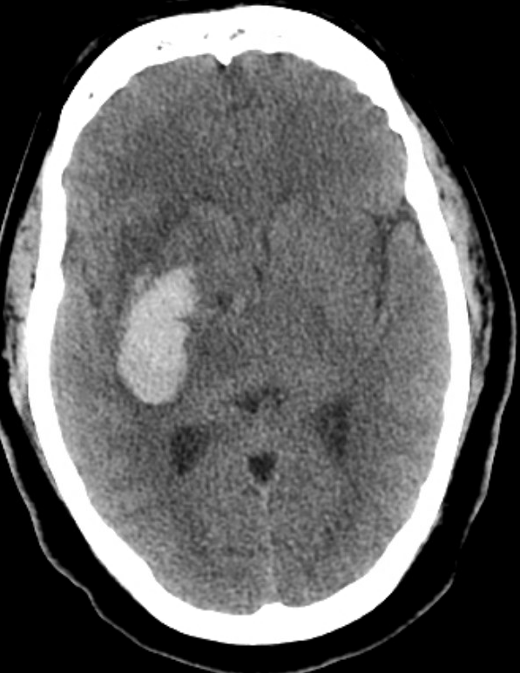

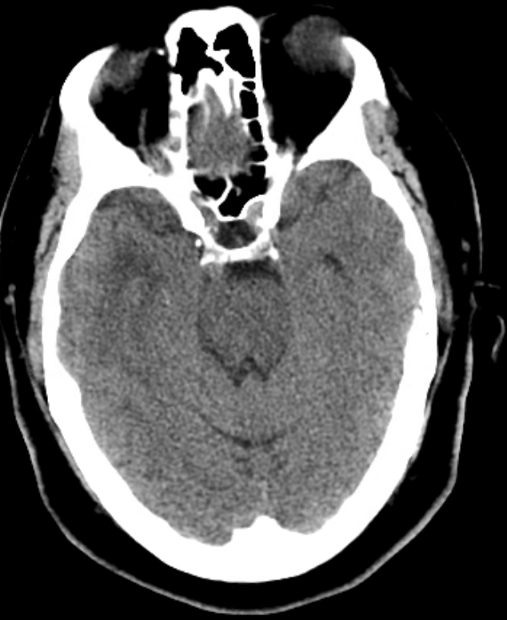
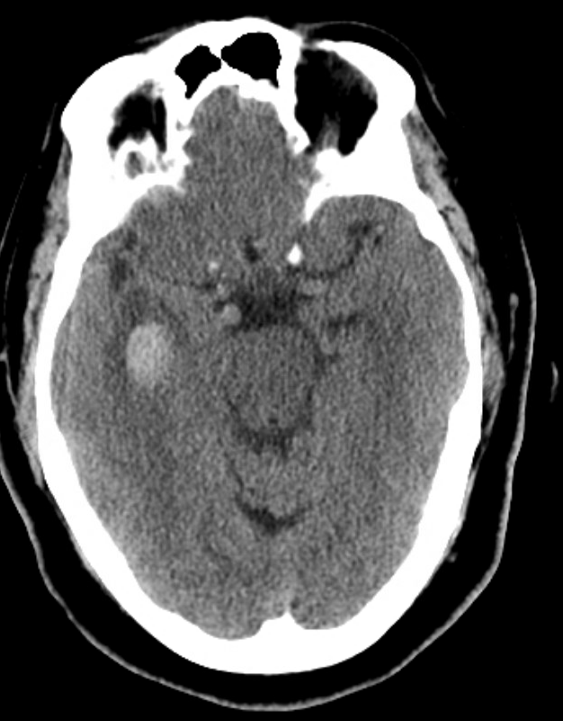
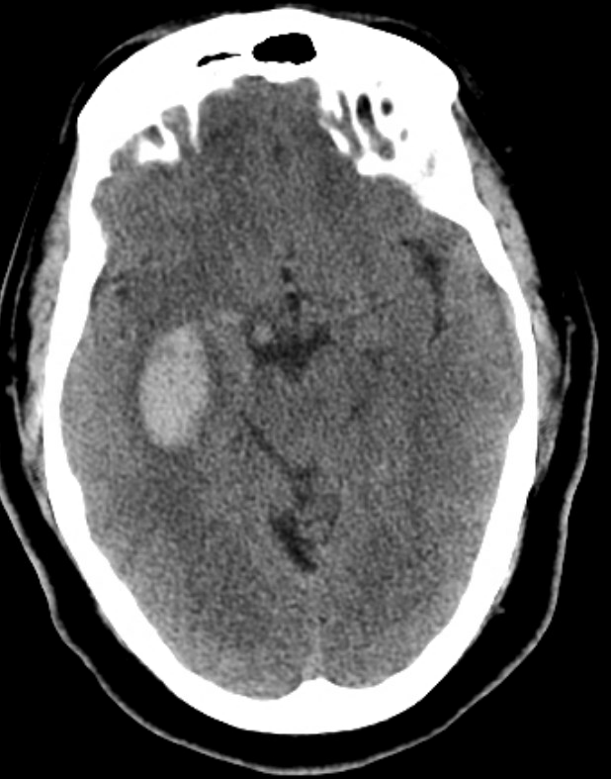
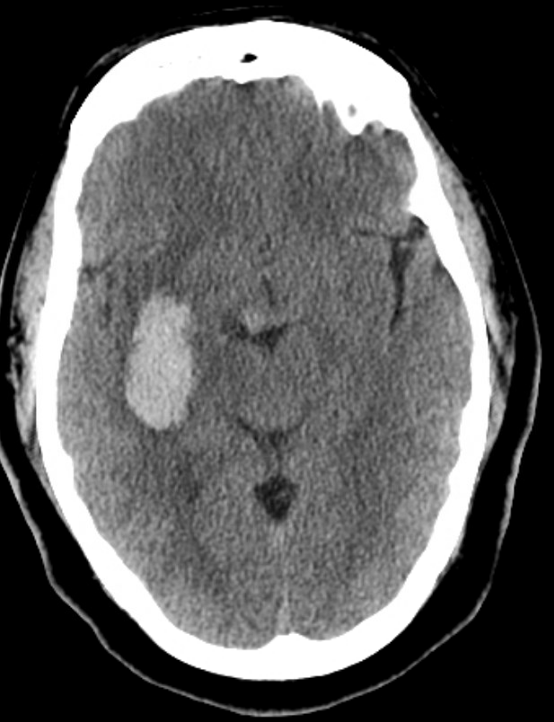
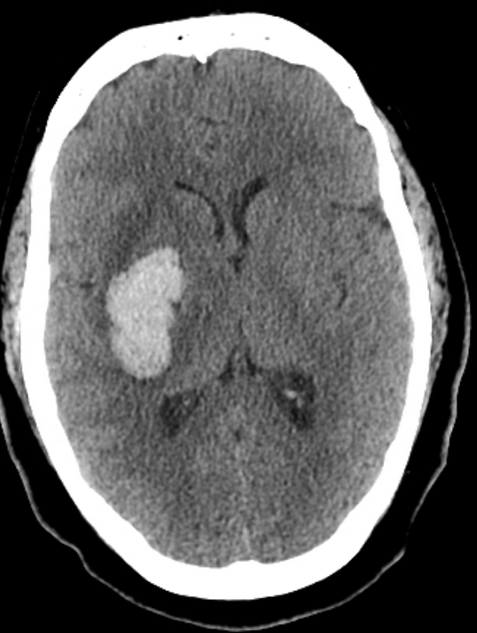

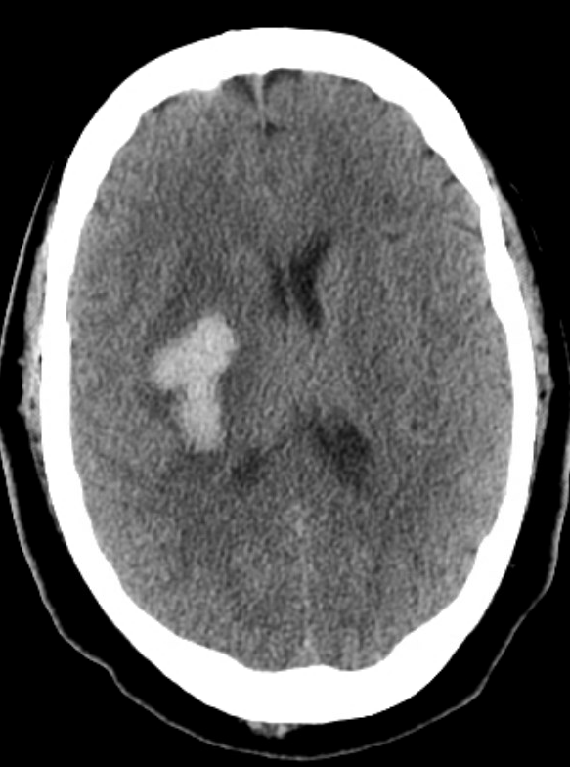
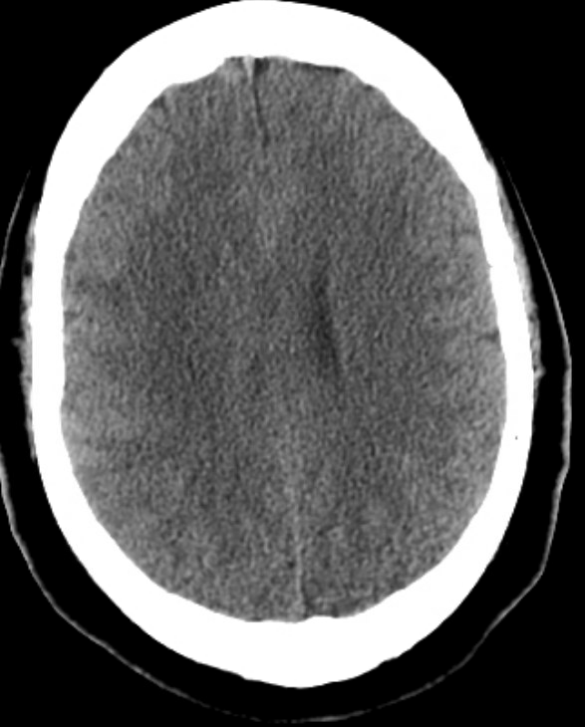
Example
A
Select the slice of the CT with the largest hematoma
A – measure longest axis (cm).…………………………………….............4.3
B
B – longest axis perpendicular to A (cm)………………………….............2.3
C – number of slices with hematoma present x slice thickness (cm!)….7x0.5
*CT slice thickness mostly in mm
Final calculation: (AxBx​​​C)/2 =17.3 ml
Sites will enter the calculated volume directly into F102 Randomization in WebDCU.

