Slide 1


Minimally Invasive Neuroendoscopic Ultra-Early Targeted ICH Evacuation​ (MINUTE)
Case Submission Sample & Template
Created by:
J Mocco, MD, Professor of Neurosurgery, Mount Sinai Medical School, New York
Christopher Kellner, MD, Associate Professor of Neurosurgery, Mount Sinai Hospital System
Tomoyoshi Shigematsu, MD, Associate Professor of Neurosurgery, Mount Sinai Hospital System
Kristian Varga, MD, Neurosurgeon, University Hospital Bratislava
Sponsored by NINDS (Grant PAR-24-101)
Updated: 2/26/2026

Slide 2
Case Sample

Slide 3
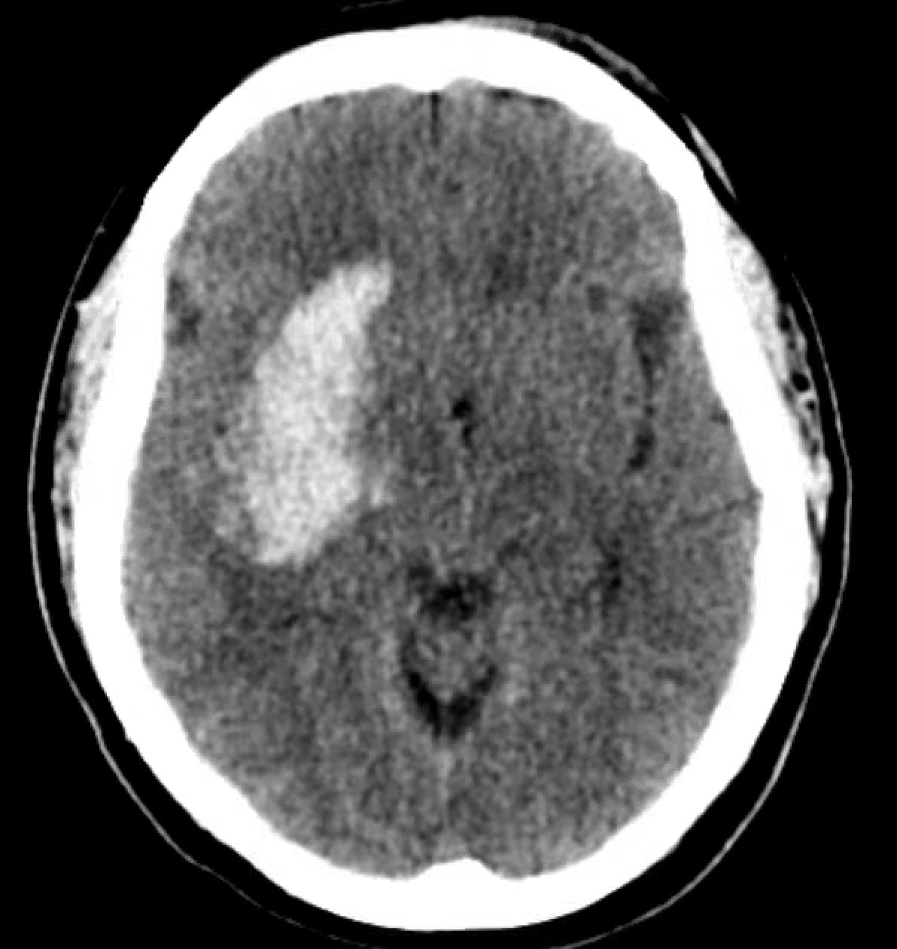
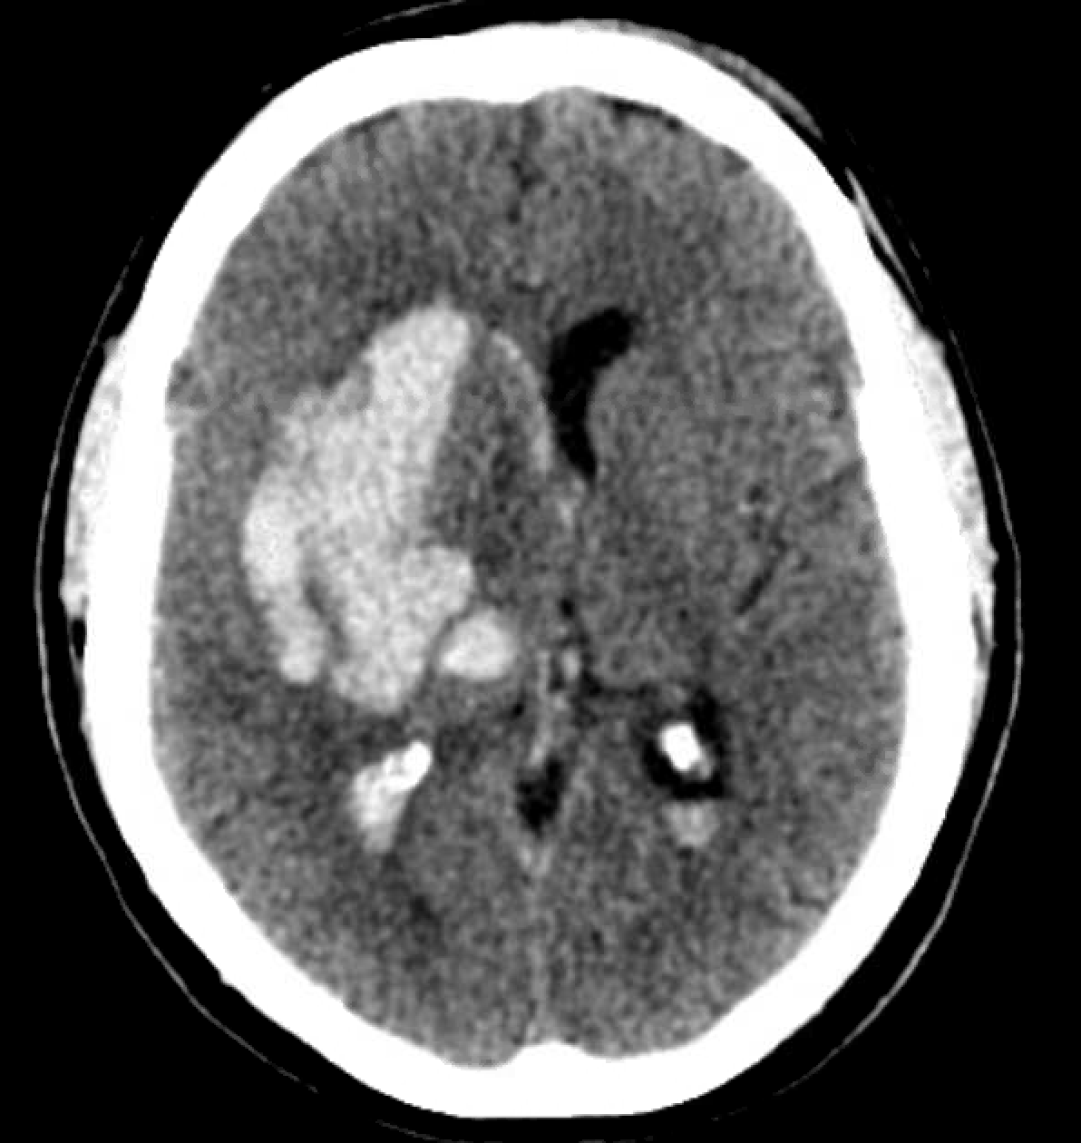
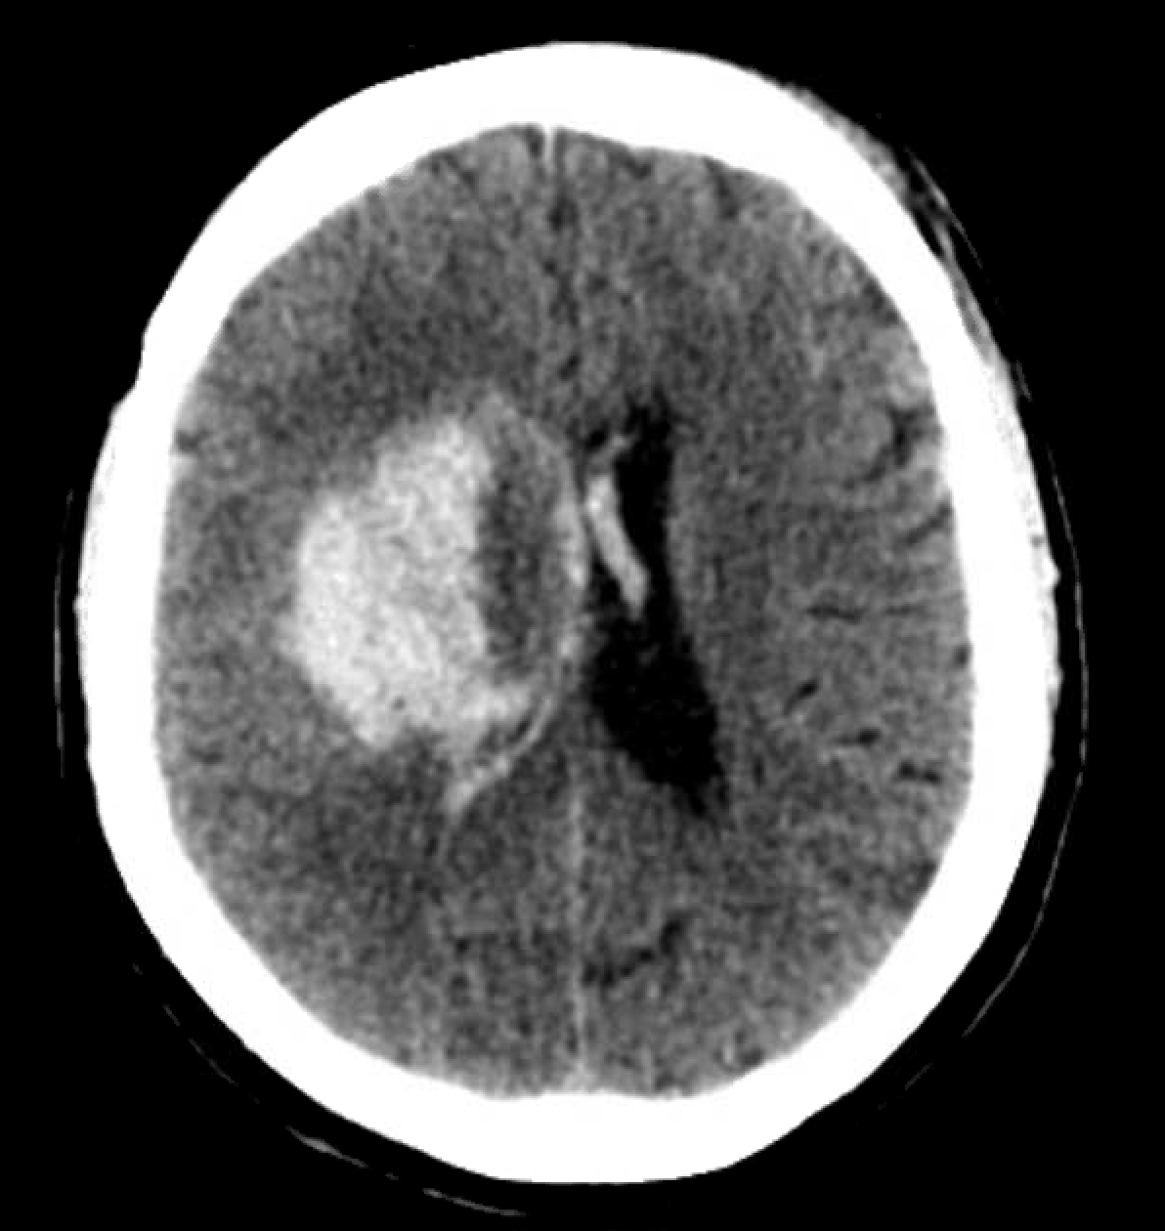
PREOP
73F found down at home 6 hours after last known well and was brought in to the ER by EMS.
NIHSS: 19
ICH Volume (ABC/2): 70mL
GCS: 8
ICH Score: 3
Graeb score: 13
Premorbid mRS: 0
PMH: HTN
AC/AP: No
Posterior limb

Slide 4
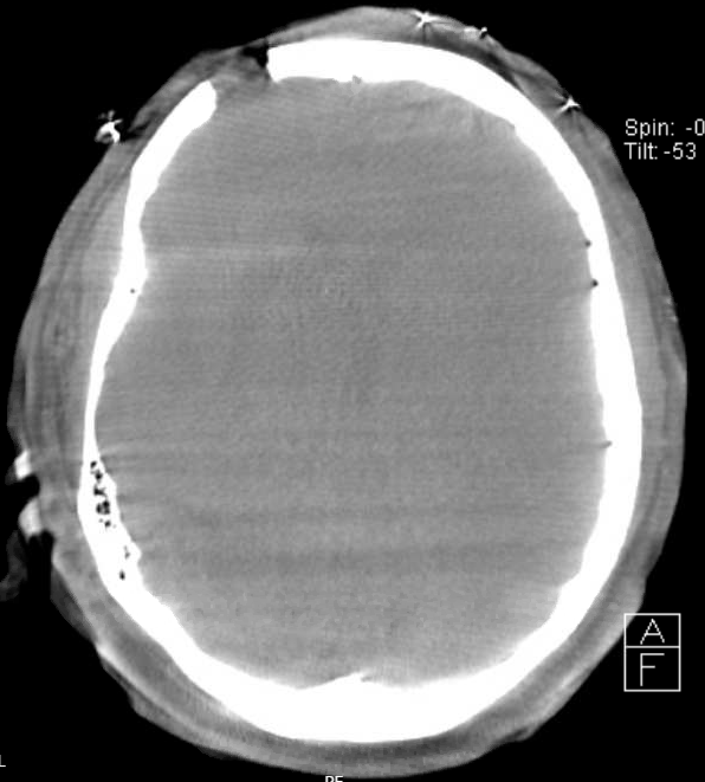
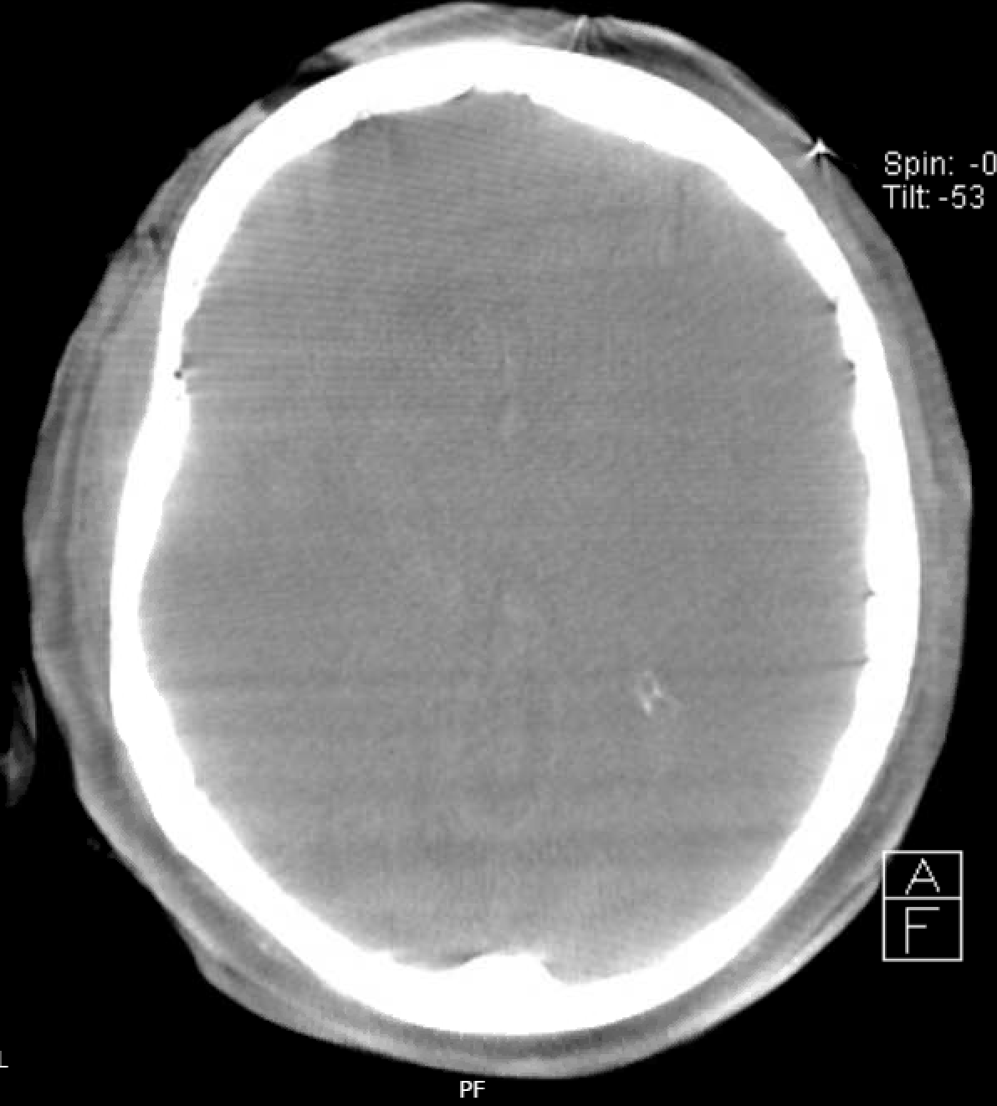
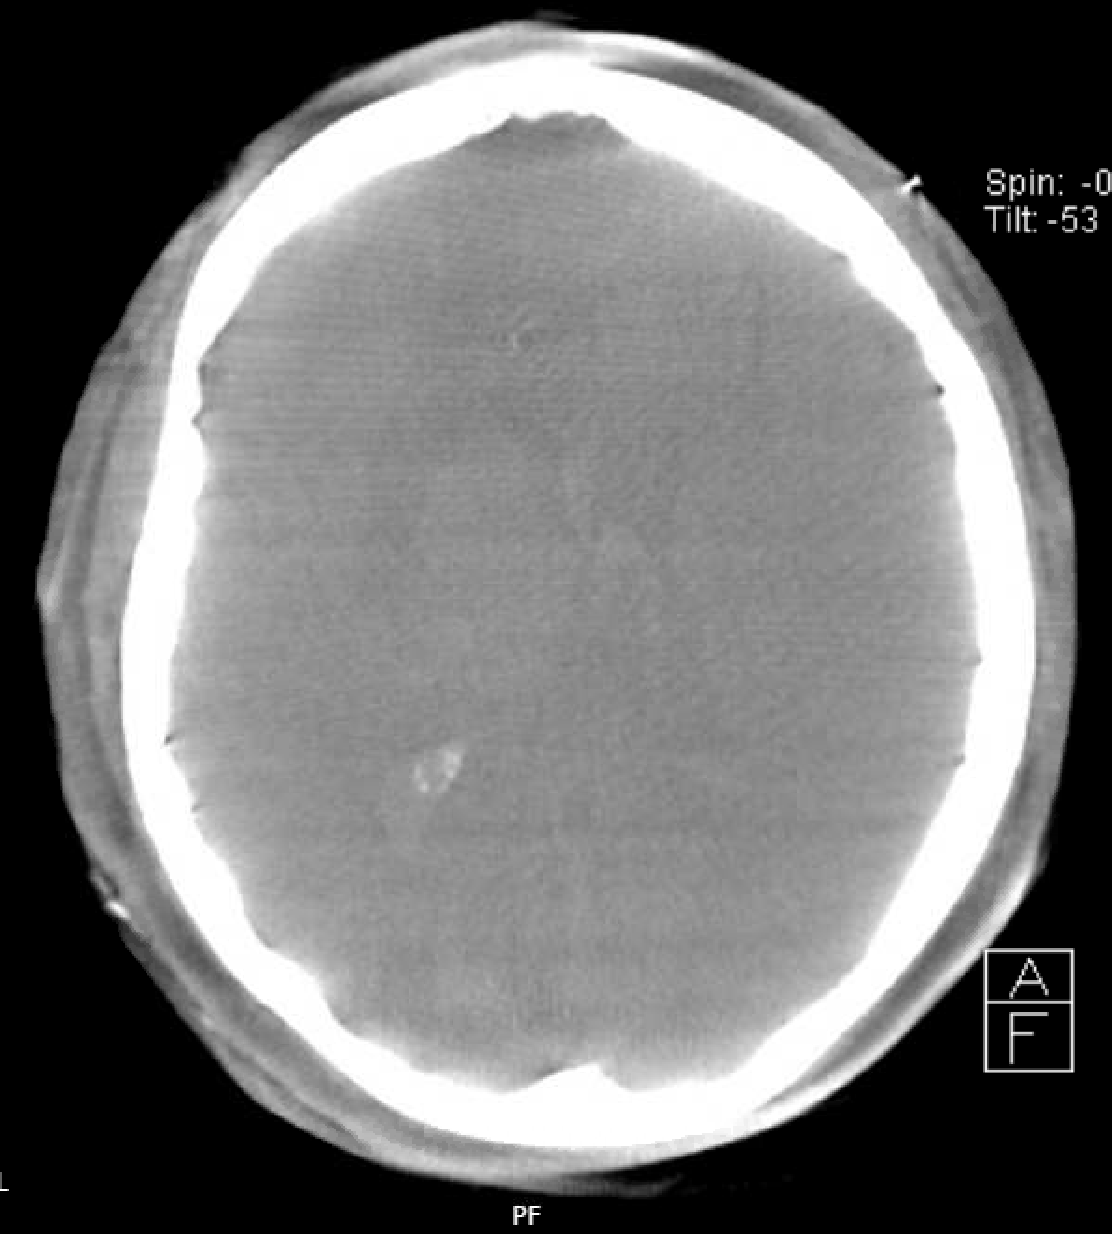
INTRAOP
Type of surgery: Right frontal SCUBA
Duration: 120 min
EBL: 50 ml
Brain biopsy: Yes
Residual hematoma dynaCT (ABC/2): 2ml
Number of sheath passes: 1
Clot consistency score: 5
Intraoperative bleeding scale score: 3

Slide 5
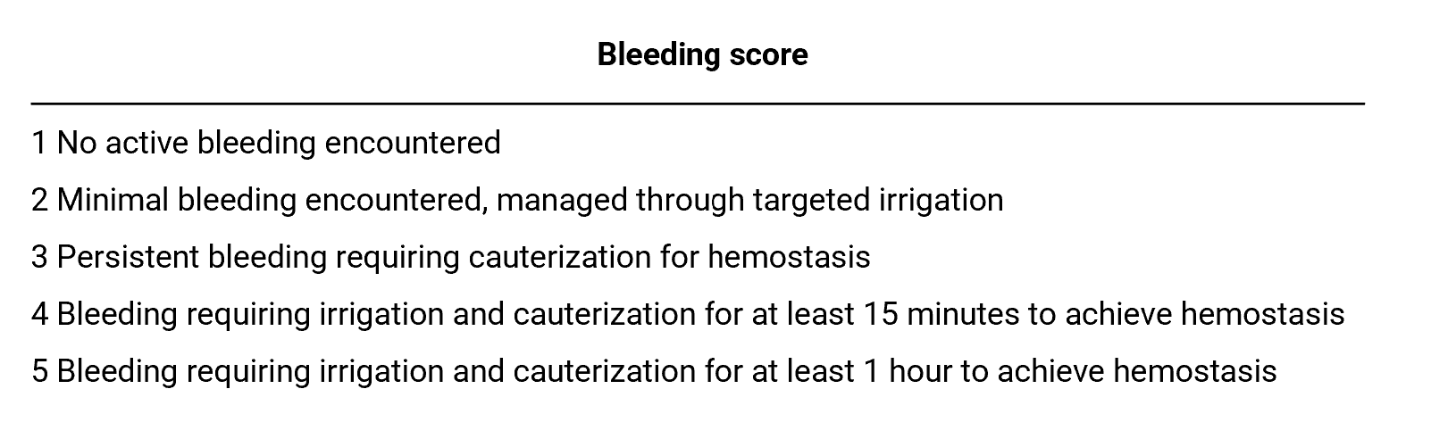
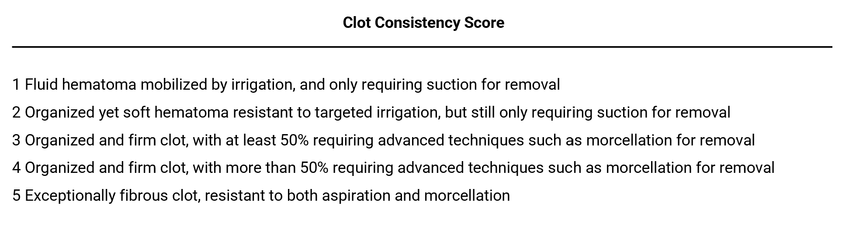
INTRAOP.
Posterior limb
Ali M, Smith C, Vasan V, et al. Management of intracavitary bleeding during ultra-early minimally invasive intracerebral hemorrhage evacuation. J Neurosurg. 2024;142(4):1003-1013. Published 2024 Nov 1. doi:10.3171/2024.6.JNS232985
Ali M, Smith C, Hameed MA, et al. Platelet transfusions and outcomes following minimally invasive intracerebral hemorrhage evacuation. J Neurosurg. 2025;143(4):939-951. Published 2025 Jun 13. doi:10.3171/2025.2.JNS241492

Slide 6
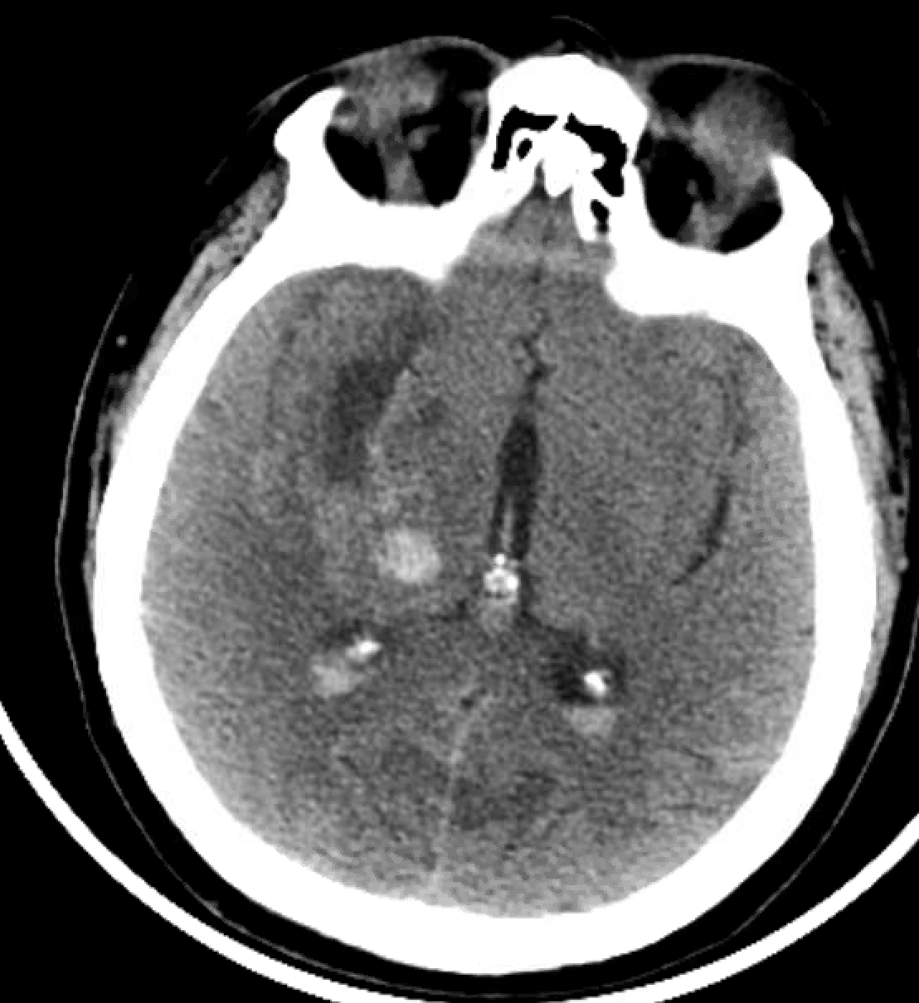
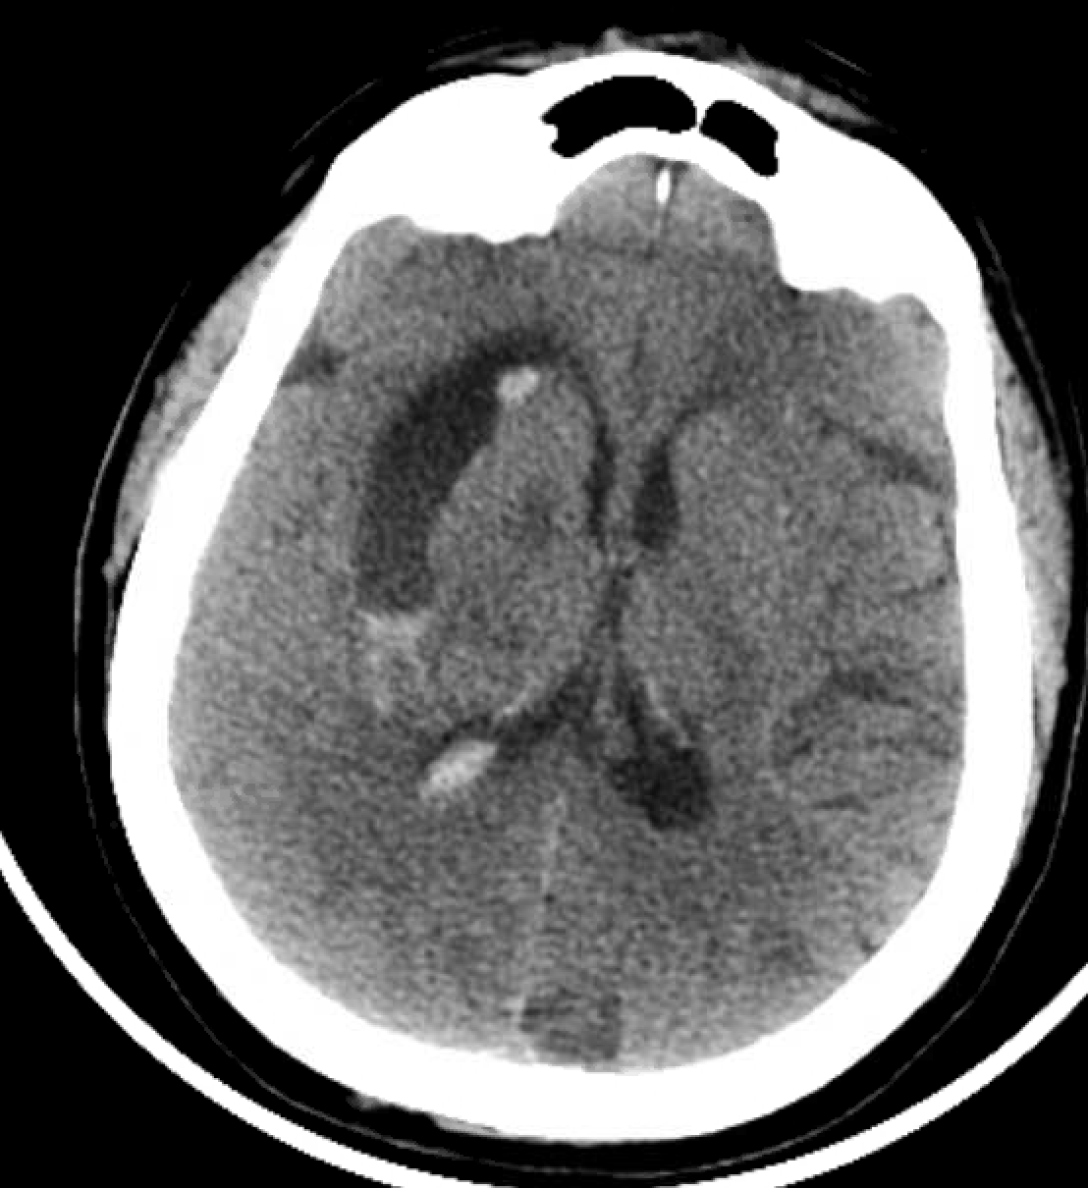
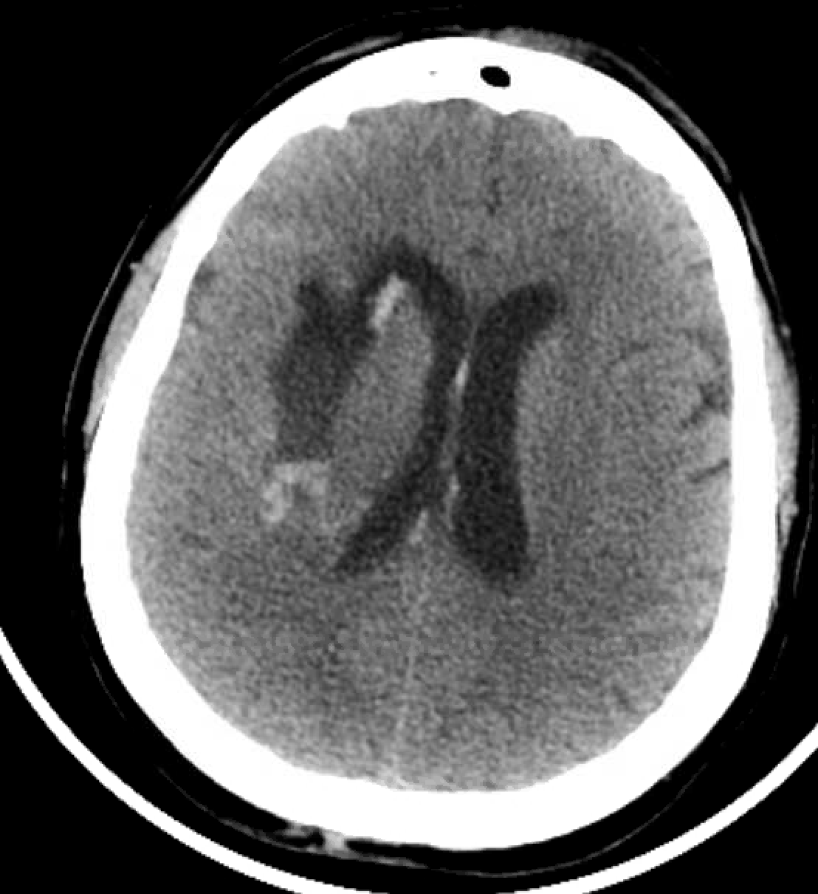
POSTOP
Hematoma Volume (ABC/2): 2ml
NSICU LOS: 5 days
LOS: 10 days
Discharge Destination: Acute Rehab
Discharge mRS: 4
Discharge NIHSS: 9

Slide 7
Case Template
Each case must include three slides: Preoperative (Pre-Op), Intraoperative (Intra-Op), and Postoperative (Post-Op).
For each phase, select three CT slices such that no two selected slices are adjacent (i.e., at least one slice must be skipped between selections).
When creating a new case, please copy and paste the template to maintain consistent formatting.

Slide 8
PREOP.
Description of Patient:
NIHSS:
ICH Volume (ABC/2):
GCS:
ICH Score:
Graeb score:
Premorbid mRS:
Past Medical History:
AC/AP:
Insert 3 CT Scans Below:
Posterior limb

Slide 9
INTRAOP.
Type of Surgery:
Devices:
Duration (min): ,
EBL:
Brain biopsy:
Residual hematoma dynaCT (ABC/2):
Number of sheath passes:
Clot consistency score:
Intraoperative bleeding scale score:
Insert 3 CT Scans Below:

Slide 10
POSTOP.
Post-CT Hematoma Volume (ABC/2):
Any Rebleeding?
Complications:
NSICU LOS:
LOS:
Discharge Destination:
Discharge mRS:
Discharge NIHSS:
Insert 3 CT Scans Below:

