Slide 1


Minimally Invasive Neuroendoscopic Ultra-Early Targeted ICH Evacuation​ (MINUTE)
Study Coordinator Training
Study Chairs:
J Mocco, MD, Professor of Neurosurgery, Mount Sinai Medical School, New York
Magdy Selim, MD, PhD, Professor of Neurology, Harvard Medical School, Boston
Sharon Yeatts, PhD, Professor of Biostatistics, Medical University of South Carolina
NCT07260916, Sponsored by NINDS (Grant PAR-24-101)
Updated 5/15/2026

Slide 2
MINUTE Study Contacts
Prime PI Team | Prime Project Manager | Ally Qi (ally.qi@mountsinai.org)
 | Senior Budget & Contract Specialist | Sarah Torres (sarah.torres@mountsinai.org)
National Coordinating Center (NCC) | Administrative Co-Director NCC Project Manager – StrokeNet, CTA, cIRB, SOW questions | Iris Davis (deedsss@ucmail.uc.edu) Cristina Francois (francoci@ucmail.uc.edu)
National Data Management Center (NDMC) | Data Managers – WebDCU CRF and data-related questions. | Susanna Steinmuller (crestett@musc.edu) Jordan Stallings (stallinj@musc.edu)
 | Site Monitoring Manager – Regulatory, ICF, monitoring questions. | Laura Kowalski (kowalsla@musc.edu)
Core Lab Imaging | Research Manager Clinical Research Professional II – Imaging, core lab related questions | Dr. Vivek Khandwala (khandwvj@ucmail.uc.edu) Siobhan McDermott (minute_imaging@ucmail.uc.edu)

Slide 3

Learning Goals
The coordinator will learn:
Site activation/readiness process
Screening Criteria
Consenting Process (ICF or eConsent)
Study Imaging
WebDCUTM
Subject Visits
Study Payments
Toolbox Resources

Slide 4
Site Activation Process
cIRB approval must be obtained & CTA is executed.
WebDCU™ DoA is completed and approved.
  The team must include the PI, Surgical PI & PSC. Other team members may be added as desired.
  More than one role can be assigned on DOA (e.g., PSC and Administrator). Tasks are assigned as needed.
All team member training has been completed and attestation forms or certificates have been uploaded into the WebDCU™ regulatory database.
  This includes all required people documents.
  The surgical PI must complete the one-day, in-person surgical training, watch the 5 SCUBA educational modules, and submit 4 non-trial cases.
Confirm availability of neuroendoscopic evacuation supplies, Viz AI or Rapid AI screening tool(optional), & 24/7 staff coverage.
Readiness call has been completed.
  Project Manager will arrange the readiness call.
  The site PI, surgical PI, and primary coordinator must be on the call.

Slide 5
Screening & Consent
I/E Criteria
Study Workflow
Baseline Imaging Requirement
Screen Failures
The Consent Process
  Subject Consent
  eConsent
  Using an LAR

Slide 6
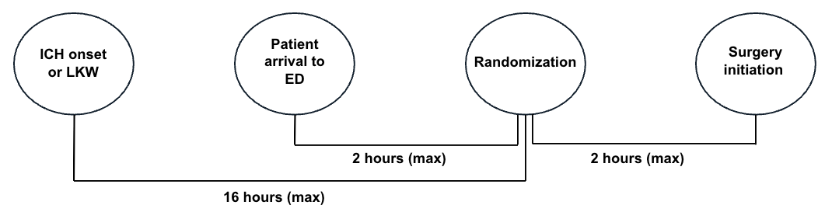
Screen Failures
Where?
The Screen Failure Log in WebDCU™ will be utilized.
Who to enter into the screening log?
Patients with an imaging confirmed BGH who present within 16 hours of ICH onset or LKW.
When to enter?
Within 5 days of screening (real-time, not monthly)
What information to enter?
Demographics
Screen failure details
Eligibility criteria
Enter as much information as possible on the screen failure log. In other words, sites should enter all of the known reasons for ineligibility.

Slide 7
The Consenting Process & eConsent in REDCap
Informed consent is an ongoing process in which qualified study staff explain the study’s purpose, procedures, risks, benefits, and participant rights to the potential participant and/or their legally authorized representative.
The informed consent process should encompass the following:
  A copy of the ICF for the potential participant &/or family to review.
  Disclosure to potential participant the information that is needed to make an informed decision.
  Ensuring the potential participant understands what has been disclosed
  Promotion of decision to participate is voluntary
All research activities will take place after the ICF has been signed by the participant or LAR.
Signed informed consent documents (unredacted) are required to be uploaded to WebDCU for remote monitoring within 5 days.
The MINUTE ICF will be available as an eConsent form in REDCap. The eConsent process must be approved by the cIRB.
We highly recommended your site to use the eConsent. Having the eConsent available on your site’s tablet is a more efficient and error-free process of obtaining the patient or LAR’s consent.
  The patient or LAR may sign the eConsent.
  Before having access to an eConsent, your site must be approved by submitting the “Implementation Form” to the cIRB that indicates your desire to use the eConsent and/or remote consent.
  Your eConsent will be produced in the REDCap platform using your cIRB approved documents.
  Two administrative users at each site, the PSC and typically another coordinator, will be provided a user ID, a user guide and training to use the REDCap platform.
  Any one who is delegated the responsibility to obtain consent on the DOA may and your site-specific eConsent link to consent participants.

Slide 8
The Consenting Process -LAR
An LAR is a Legally Authorized Representative that can act to make decisions on behalf of another person.
An LAR can be but is not limited to:
  Spouse
  Legal Guardian
  Adult child
  Parent
Does the subject have the cognitive capacity to decide about study participation? This assessment should be made by a study investigator and documented in the subject’s records.
⛔ No, then LAR signs and dates:
  Reconsent is needed when subject regains capacity.
✅ Yes, the subject signs and dates the ICF.
If the subject is physically incapable of signature, illiterate, visually impaired, or signing a short form consent, utilize witness of consent process and signature.
All research activities will take place after the ICF has been signed by the participant or LAR.
Many patients with severe BGH may be neurologically impaired and incapacitated. In such cases, the LAR will be approached for consent.

Slide 9
The Consenting Process - Non-English–Speaking Participants
Informed consent will be conducted in a language understood by the patient or their LAR.
  An IRB-approved translated ICF will be used whenever available
  A qualified medical interpreter (in person, phone, or video) will assist with the consent discussion
  If a translated consent form is not available, consent may be obtained using the IRB-approved short-form consent process
The consent process will be fully documented, and copies of signed forms will be provided to the participant or LAR
Please refer to StrokeNet SOP ADM 26 Consenting Non-English Speaking or Literacy-Challenged Participants
Scenario | Forms Used | Who Signs
Fully Translated ICF available (e.g. Spanish) | IRB-approved fully translated ICF (Bilingual Research Staff on DOA) | Patient or LAR, Person Obtaining Consent (must be certified to consent in this language)
 | IRB-approved fully translated ICF + English ICF (Interpreter-assisted consent) | Patient or LAR (Translated ICF), Person Obtaining Consent (English ICF), Interpreter (documentation as required by local institution)
No fully translated ICF available + Interpreter-assisted (Short-Form Consent) | Short-Form Consent (in participant’s language) + Full ICF (English) | Patient or LAR (Short Form), Person Obtaining Consent (English ICF), Impartial & Bilingual Witness (Short Form + English ICF), Interpreter may act as Impartial Witness
Witnessed consent (patient can consent but cannot sign) | ICF + Witness Signature | Witness(Full ICF), Person Obtaining Consent (Full ICF), Patient or LAR (may make their mark)

Slide 10
Randomization
After confirmation that all inclusion and exclusion criteria are met and informed consent has been obtained, randomization should proceed.
Before Randomization:
  Subject Enrollment must be completed in WebDCU™ to populate the Subject's CRF Binder. Eligibility and Randomization case report forms must be completed for randomization. All other forms can be data entered later to avoid delaying study intervention.
  Randomization is targeted to occur within 120 min of arrival to the treating/enrolling hospital’s ED.
  Baseline imaging & consent will need to be uploaded as soon as possible. The uploading of the ICF does not need to happen prior to randomization, just obtaining consent.
  Randomization will take into account the following variables: ICH-onset-to-randomization window (<8 hours vs. 8-16 hours); ICH volume at baseline (20-40 cc vs. >40 cc); and IVH (present vs absent).
Delegated team member can randomize the subject in WebDCU™.
  The subject is randomized to a treatment assignment.
  The study intervention should be initiated within 120 minutes of randomization.
  Notify the appropriate team members in real time and initiate treatment according to the participant’s randomization assignment.

Slide 11
Measures to Minimize Bias
  MINUTE is an on-label study with blinded end-point outcome assessment; participants, treating providers, and site investigators are not blinded to treatment assignment.
  Full blinding is not feasible because treating clinicians, clinical staff, and research teams must know the treatment to provide care and appropriately manage and report adverse events.
  Study follow-up outcome assessments will be performed by independent, blinded investigators certified in modified Rankin Scale (mRS) assessment.
  Blinded assessors will not have been involved in the participant’s clinical care and will be unaware of randomization status; the coordinator will ensure a large Band-Aid is placed on each patient’s forehead to prevent scar-related unblinding.
  Outcome assessors will record their best guess of treatment allocation and their confidence level to evaluate the effectiveness of blinding.

Slide 12
Study Imaging Requirement
Time Point | Control: Standard Medical Management | Intervention: SCUBA Procedure
Screening (before treatment arm is known) | A baseline CT & vascular imaging (e.g., CTA, MRA, DSA)
Day 0: Baseline | A stability CT scan at approximately 4–8 hours | An immediately post-evacuation CT scan, which replaces the standard stability scan
Day 1 | A 24-hour CT scan to confirm stability
Unscheduled | Any unscheduled brain imaging, either: • collected within 72 hours of randomization, or •related to an AE/SAE during entire study participation

Slide 13
Study Imaging Reminders
Within 7 days of patient discharge:
All imaging MUST be uploaded to the imaging portal
Complete the Imaging Collection form in WebDCU
Inform the Imaging Project Manager of any delays!
Make sure you are well-acquainted with your site process for ordering and obtaining imaging from your radiology department
Sites should also know their site process for obtaining external imaging if they expect to receive many transfer patients
Upload imaging as you receive it; do not need to wait!

Slide 14
Study Imaging Upload
All imaging must be in native, uncompressed DICOM format.
If your institution requires you to remove PHI prior to upload, make sure the date and time of image acquisition is intact
Google Chrome is the preferred browser
Do not close screen until upload completes
Full upload Instructions are found in the MINUTE Imaging MOP in WebDCU.

Slide 15
WebDCU™
Data Collection Guidelines
Document Parameter Guidelines
User Manual
Training

Slide 16
Data Collection Guidelines
The Data Collection Guidelines, published by NDMC, is a booklet to guide you through entering data into WebDCU™.
The booklet will be added to the WebDCU™ toolbox for the MINUTE study.
All data is to be entered into the subject’s binder in WebDCU™ within 5 days of data collection.
Subject Enrollment must be completed in WebDCU™ to populate the Subject's CRF Binder. Eligibility and Randomization case report forms must be completed for randomization. All other forms can be data entered later to avoid delaying study intervention.
Screen Failures are entered into WebDCU™ as they occur, not monthly.
Site payments are contingent upon complete subject data being entered into WebDCU™.

Slide 17
Regulatory Document Parameter Guidelines
The Document Parameter Guidelines is a document that guides you in the requirements of your regulatory documents that are uploaded to WebDCU™ and also contained in your site regulatory files. These include but are not limited to:
Site Documents
cIRB Approval | cIRB Approved ICF
cIRB Approved Translated ICF | Protocol Signature Page
Local IRB Acknowledgement | Site-specific BOR, if applicable
Site-specific HIPAA, if applicable | Translated copy of BOR &/or HIPAA, if applicable
cIRB Approved Translated Short Form ICFs | cIRB Approved Administrative Amendments, when applicable
 | HIPAA Authorization for Screening
People Documents
CV | Medical/Professional License
HSP Training Certificate | GCP Training Certificate
NIHSS Training Certificate | mRS Training Certificate
Protocol Training Attestation(Quiz) | Study Coordinator Training Attestation(Quiz)
ABC/2 Method Attestation | Surgical PI: One-Day In-Person Surgical Training (Attestation/Approval Form)
Core Lab Imaging Upload Training | Surgical PI: Five Educational Modules (Attestation)
 | Surgical PI: Four Non-Trial Case Submissions (Approval Form)
This document is stored in the WebDCU™ toolbox under your StrokeNet studies.

Slide 18
WebDCU™ User Manual
The WebDCU™ User Manual is your go-to guide for working with our clinical trial management system.
The manual will cover the following and more:
Logging in & out
Uploading Regulatory Documents
Project Documents, i.e. Protocol, Data Collection Guidelines, Regulatory Document Parameters, Current CTCAE version and other imperative trial documents
Data Entry Instructions
Instruction Documents
Regulatory Documents
Core Lab Imaging Documents
Tools for Site & Subjects
The WebDCU™ User Manual is available in the WebDCU™ toolbox.

Slide 19
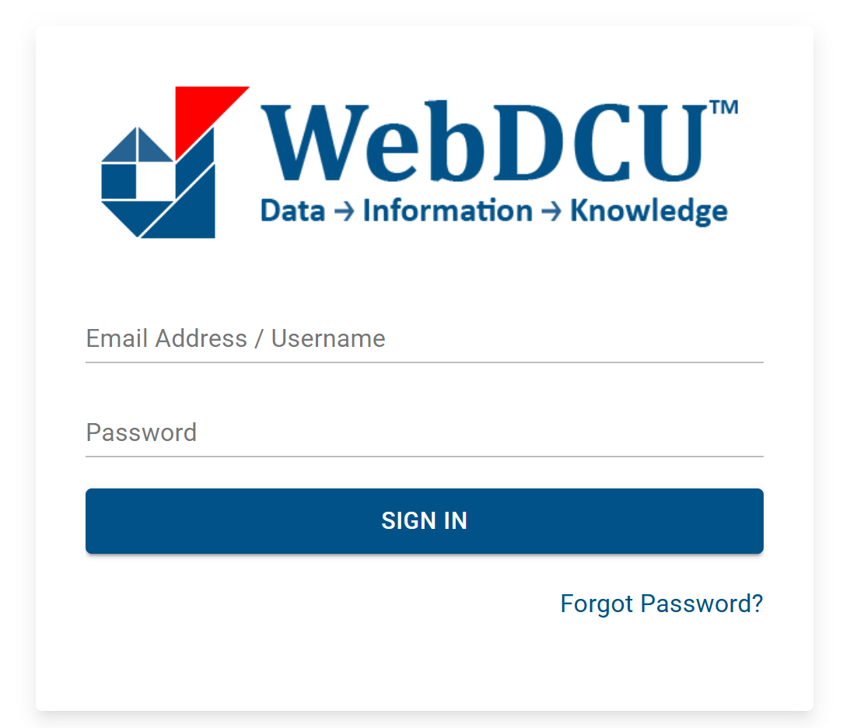
WebDCU™ Training
Training for WebDCU™ is in the WebDCU™ training center located on the login page. No WebDCU™ login is needed to access the training center.
https://webdcu.musc.edu/DCUApp/Login

Slide 20
Subject Visits
In-hospital (Screening, Day 0 Baseline, Day 1, Day 7 or Discharge)
Day 30,
Day 90,
Day 180,
Day 365

Slide 21
Subject Visits (In-hospital)
I/E Criteria | Demographics | Medical History | Medication Review
Pregnancy Test | SOC Lab Results | Diagnostic CT Head | Diagnostic CTA or MRA
Informed Consent | NIHSS | GCS | mRs
Screening
Day 0: Baseline
Randomization | Endoscopic Evacuation# | CT Head | AE & SAE | Vital Signs (HR & BP) | Concomitant Meds
# Only for SCUBA arm
Day 1: 24 士 6 hrs after Randomization
SOC Lab Results | CT Head | NIHSS | GCS
AE | SAE | Concomitant Meds
Day 7 or discharge (士 1 day), whichever comes first
SOC Lab Results | NIHSS | GCS
AE | SAE | Concomitant Meds

Slide 22
Subject Visits
mRS | SAE | Concomitant Meds
Day 30 士 7 Days
Day 90 士 30 Days
mRS | SAE | Concomitant Meds
Day 180 士 30 Days
mRS | SAE | EuroQol-5D (Quality of Life) | Concomitant Meds
Day 365 士 30 Days or Study Exit/Completion
mRS | SAE | EuroQol-5D (Quality of Life) | Concomitant Meds

Slide 23
Adverse Events Assessing & Reporting
Assessing for Adverse & Serious Adverse Events
Reporting AEs/SAEs in WebDCU™ & Timeline
Unanticipated Events/Protocol Deviations

Slide 24
Assessing for Adverse & Serious Adverse Events
The SC plays a key role in the discovery of any Adverse Event (AE) or Serious Adverse Event (SAE). If an AE/SAE is discovered during time spent with the subject or medical record review, the SC should obtain all data and present to the PI/SubI for assessment of the AE/SAE.
The PI is responsible for assessing any AE or SAE that occur with their subjects. This task can also be delegated to the site SubI(s).
The PI should assess for the following:
Severity
Relationship to Study Intervention
Relatedness to ICH
Anticipated or Unanticipated
Action taken regarding study intervention
Other actions taken
Outcome
Documentation of any AEs should be maintained at the site in the subject’s research binder, with PI acknowledgement, and reported in WebDCU™.

Slide 25
Reporting AEs/SAEs in WebDCU™ & Timeline
Reporting of an AE/SAE on WebDCU™
Enter the subject’s CRF binder
Click on your subject number
Click on F104 Adverse Event CRF
Enter the data following the questions in the form
  Please make sure to answer Q3, “Serious”, yes or no
Reporting Timeline
SAEs (unanticipated or at least possibly related to the procedure): within 24 hours from discovery. The SAE report does not have to be completed but at least started and submitted.
SAEs (not unanticipated, unrelated or unlikely to be related to the procedure): within 3 business days
Non-serious AEs: within 5 business days of discovery
Reference Anticipated Events list in the Manual of Procedures.

Slide 26
Unanticipated Events/Protocol Deviations
Unanticipated events (UEs) are those that are unexpected and may involve an increased risk of harm to the research subject. These may also include protocol deviations.
Examples of UEs:
Consent form errors, i.e., not using a witness when applicable, using incorrect version, etc.
Subject not meeting inclusion criteria for study
Out of window visit, i.e., incorrect specimen draw time
Non-compliance by site or subject
Researcher error
Breach of confidentiality, i.e., sending unsecured email with PHI
UEs will be captured in WebDCUTM on the CRFs and the Prime PI will monitor these events in aggregate.
UEs that increase risk or constitute serious noncompliance will also be reported via WebDCUTM on the UAE/PD Form and reported to the CIRB per the NCC PM.

Slide 27
Toolbox Resources –
Manuals & Protocols & Regulatory Documents
Protocol
The most current version of the protocol will be maintained in the toolbox.
Manuals
All current MOPs are available in the toolbox; these include:
  Protocol MOP
  Imaging
Regulatory Documents
All PRIME approval letters will be added to the WebDCU™ toolbox which include:
Initial approval letter for the study
All modification letters
  PRIME approval letters will also be emailed to the site.

Slide 28
Toolbox Resources – Instruction Documents
All instructional documents will be made available in the toolbox, these include but are not limited to:
Frequently Asked Questions (FAQ List)
How to create a digital signature
Site Readiness Checklist
Preparing PDFs for Upload into WebDCU™
Enrollment, Randomization & Visit Checklists

Slide 29
Toolbox Resources – Tools for Sites & Subjects
The WebDCU™ Toolbox will also contain many tools for the sites and subjects. All subject tools will be cIRB approved prior to uploading into the toolbox. These tools may include, but are not limited to:
Inclusion/Exclusion Criteria Card
Study Brochure
Information Video for Patients/Families (will be posted on NIHStrokeNet.org -> MINUTE website)
ICH Medical Management Recommendations/Guidelines
Visit scheduler
Data Collection Guidelines
Follow-up Visit Checklist
Wallet card
UAE/PD Checklist
Lost-to-follow letter to subject

Slide 30
Thank you! 👏 😊
Thank you for your time! Please take the coordinator training quiz in REDCap. Here's the link: https://redcap.link/minutecoordinatorquiz.
By completing this quiz, you are confirming you have reviewed the training slide deck.
You must answer at least 11 out of 13 questions correctly to receive a passing score. A PDF will be generated at the conclusion of this test and sent to the email address entered below.
That PDF must be uploaded to WebDCU to document your training.
A separate attestation form is not required for protocol or coordinator training.
Email Ally Qi, ally.qi@mountsinai.org if you have any questions regarding this material.

