Slide 1


Minimally Invasive Neuroendoscopic Ultra-Early Targeted ICH Evacuation​ (MINUTE)
Protocol Training
Study Chairs:
J Mocco, MD, Professor of Neurosurgery, Mount Sinai Medical School, New York
Magdy Selim, MD, PhD, Professor of Neurology, Harvard Medical School, Boston
Sharon Yeatts, PhD, Professor of Biostatistics, Medical University of South Carolina
Sponsored by NINDS (Grant PAR-24-101)
Last updated: 5/15/2026

Slide 2
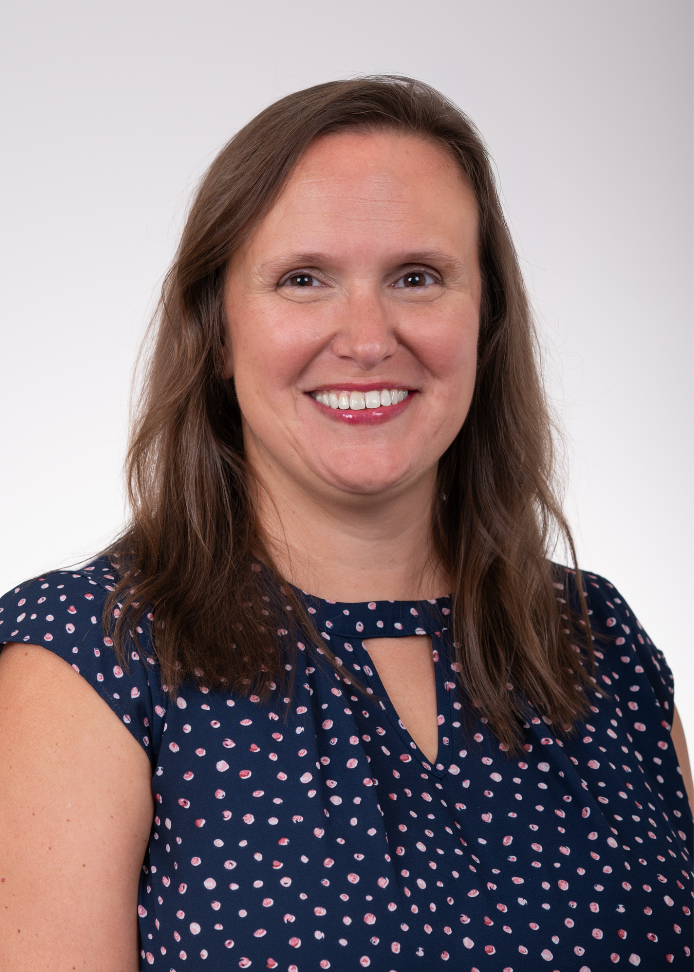
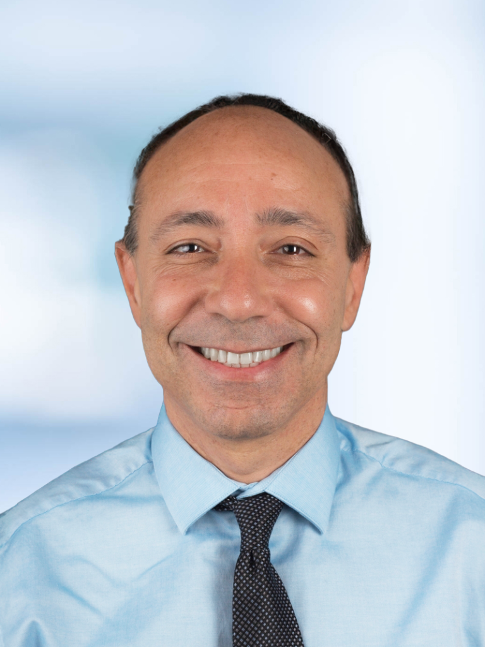
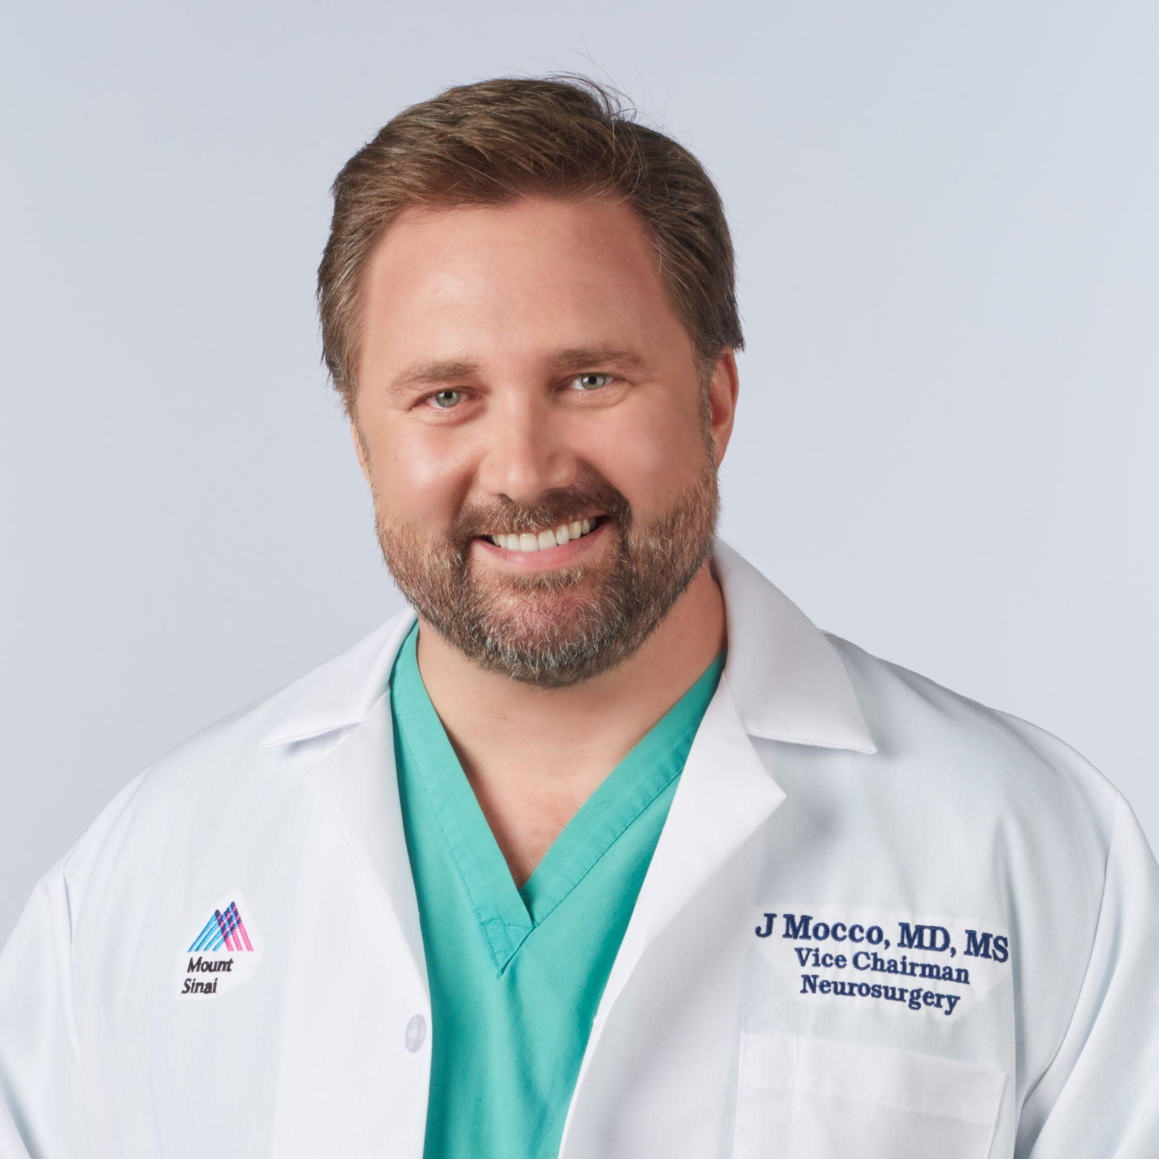

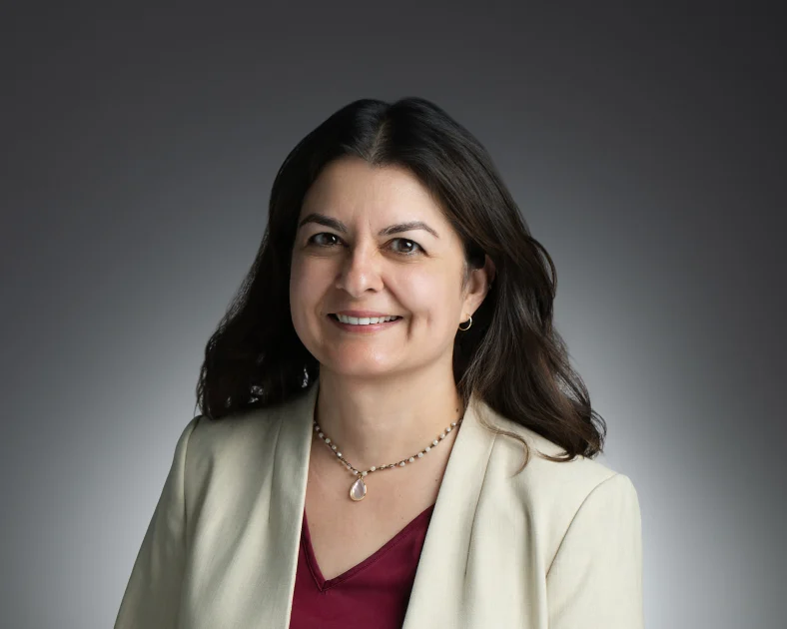
MINUTE Leadership
Icahn School of Medicine at Mount Sinai
MPI: J Mocco, MD
Site Role: Administrative contact, subaward contracting (main sites), enrollment.
Medical University of South Carolina
MPI: Sharon Yeatts, PhD
Site Role: Data maintenance, monitoring and computing, statistical support.
Beth Israel Deaconess Medical Center
MPI: Magdy Selim, MD
Site Role: Enrollment.
University of Cincinnati (StrokeNet National Coordinating Center)
Co-I: Joe Broderick, MD
Site Role: NCC interaction, Operational guidance, enrollment.
University of Cincinnati (StrokeNet National Coordinating Center)
NCC PI: Pooja Khatri, MD
Site Role: Coordination of subsites, per-patient reimbursement tracking, enrollment.

Slide 3
MINUTE Study Organization
StrokeNet National Coordinating Center(U Cincinnati)
Dr. Joe Broderick, NCC Co-I
Dr. Pooja Khatri, NCC PI
Iris Davis, co-Director
Cristina Francois, NCC Project Manager
StrokeNet Data Management Center(MUSC)
Jessica Griffin, Director of Trial Operations
Jocelyn Craven, StrokeNet Program Manager
Susanna Steinmuller, Data Manager
Jordan Stallings, Data Manager
Laura Kowalski, Site Data Monitoring Manager
Akash Roy, Assistant Professor of Biostatistics
Mount Sinai Neurosurgery Academic Research Organization​ (ARO)
Sukaina Davdani, Research Director
Ally Qi, Clinical Trials Manager
Sarah Torres, Senior Grants & Contracts Specialist
NIH/NINDS
Scott Janis, Scientific Program Director
Sean McCarthy, Program Official
Core Lab Imaging (U Cincinnati)
Dr. Vivek Khandwala
Dr. Achala Vagal
Siobhan McDermott (Imaging Core CRP)
Independent Medical Safety Monitor (University of Texas Health Science Center)
Dr. Justin R. Mascitelli
Berry Consultant
Dr. Kert Viele

Slide 4
MINUTE Timeline
Grant Notice of Award (NoA)
Sites invited to participate
1st Surgical Training Session
ISC Investigator Meeting in New Orleans
2nd Surgical Training Session
cIRB and CTA packets to 40 sites
Sites complete CTA & Initial IRB documents
Study Training Materials Ready
Protocol Approval
3rd Surgical Training
DSMB Approval
AANS Investigator Meeting
1st Site Activated
1st patient enrolled
Summer/Fall 2025
Winter 2025
February 2026
March
April
May

Slide 5
Protocol Training

Slide 6




Trial Design
Design
Study Population
Cohorts
Study Arms
Participant Duration
Study Period
Prospective, multi-center, randomized, controlled,
blinded-assessor
Up to 55 U.S. sites,
300 patients,
Adults 18–80 with
spontaneous BGH ≥ 20ml
<8h vs 8–16h from onset to randomization
SCUBA evacuation
vs
standard medical management
5 years with estimated 3.5 years of study recruitment
12 months

Slide 7
Study Objectives & Endpoints
 | Primary | Secondary
Objective | To evaluate the utility of early/ultra-early SCUBA evacuation in patients with BGH and LKW-to-randomization time ≤16h, and to determine whether SCUBA warrants further efficacy study in either <8h or 8-16h cohorts. | To evaluate the safety of early/ultra-early hematoma evacuation using the minimally invasive endoscopic SCUBA technique.
Safety Endpoints | 30-day all-cause mortality | Symptomatic rebleeding after evacuation CNS infection​ attributed to surgery
Efficacy Endpoints | UW-mRS at 180 days | Successful clot removal with ≤ 10 mL remaining on the post-evacuation CT scan ICH volume on the 24-hr CT scan Peri-cavity edema (PCE) on the 24-hr CT scan

Slide 8

Key Inclusion Criteria
Age ≥ 18 and ≤ 80 years
Non-traumatic, spontaneous, supratentorial, non-thalamic, BGH of volume ≥ 20 mL, as determined by the treating physician using ABC/2 method
NIHSS ≥ 6 at presentation
Computed Tomography Angiography (CTA) or Magnetic Resonance Angiography (MRA) is performed and does not show an underlying vascular lesion
Pre-ICH mRS 0-2
Informed consent from patient or legally authorized representative (LAR) to participate in the trial, wherein patient/LAR’s stated wishes are to pursue lifesaving therapies as opposed to early withdrawal of care (explicitly explained as <7 days following ictus)
The treating physician anticipates that surgery can be initiated <120 min from randomization
Randomization within 16 hours from LKW and within 2 hours of arrival to the randomizing center.

Slide 9

Key Exclusion Criteria
Suspected secondary cause for the ICH, such as an underlying vascular malformation (cavernous malformation, arteriovenous malformation, etc.), aneurysm, neoplasm, hemorrhagic transformation of an underlying ischemic infarct; or venous infarct
Infratentorial or thalamic hemorrhage
Midbrain extension/involvement
Coagulopathy defined as international normalized ratio (INR) > 1.4
Elevated activated Partial Thromboplastin Time (aPTT) > 40 s
Concurrent use of direct oral anticoagulants or low molecular weight heparin at ICH onset
Known hereditary or acquired hemorrhagic diathesis or coagulation factor deficiency
Platelet count <100 x 103 cells/mm3, or known platelet dysfunction (reversal of coagulopathy is not allowed)
GCS score <7 at presentation
Evidence of active infection indicated by fever ≥100.7 °F and/or open draining wound at the time of enrollment

Slide 10
Key Exclusion Criteria
11. Any comorbid disease or condition expected to compromise survival or ability to complete follow-up assessments through 365 days
12. Intraventricular extension of the hemorrhage is visually estimated to involve > 50% of either of the lateral ventricles
13. Pregnancy (women of childbearing potential must have a negative pregnancy test to participate)
14. Based on investigator’s judgment, the patient does not have the necessary mental capacity to participate or is unwilling to comply with the protocol follow-up schedule
15. Current participation in another interventional (drug or device) trial
16. Pre-existing Do Not Resuscitate (DNR)/Do Not Intubate (DNI) status
17. History of severe dementia

Slide 11
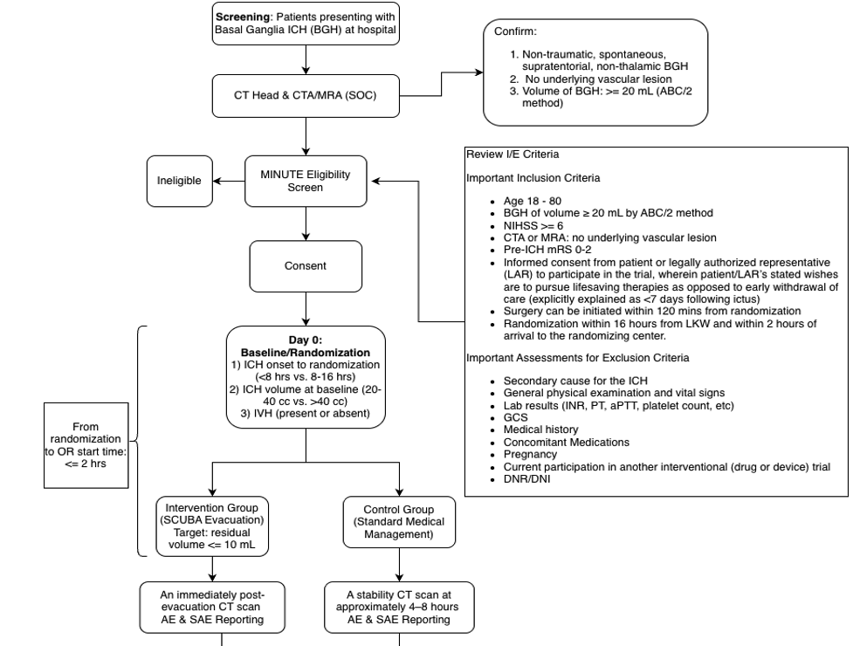
Study Workflow
Note: The whole enrollment process is less than or equal to 16 hours from ICH onset or LKW.

Slide 12
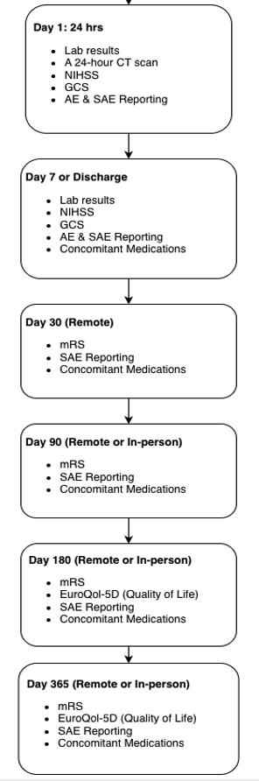
Study Workflow

Slide 13
Schedule of Activities (SOA)
Procedures | Baseline | Day 0 Baseline | Day 1, 24 ± 6 hours after Randomization | Day 7 or Discharge* | Day 30 ± 7 days | Day 90 ± 30 days | Day 180 ± 30 days | Day 365 ± 30 days
Inclusion/Exclusion Criteria | X
Demographics | X
Medical History | X
Prior Medication Review | X
Pregnancy Test | X
Review of Standard-of-Care Labs (CBC and Coagulation Panel) | X |  | X | X
Diagnostic CT (ICH location and volume, determined by ABC/2) | X | X^ | X
Diagnostic Pre-Operative CTA or MRA | X
Informed Consent | X
Vital Signs |  | X
Randomization |  | X
Endoscopic Evacuation of the Hematoma# |  | X
National Institutes of Health Stroke Scale (NIHSS) | X |  | X | X
Glasgow Coma Scale (GCS) | X |  | X | X
Modified Rankin Scale (mRS) | X |  |  |  | X | X | X | X
EuroQol-5D Quality of Life |  |  |  |  |  |  | X | X
Adverse Events |  | X | X | X
Serious Adverse Events |  | X | X | X | X | X | X | X
Concomitant Medications |  | X | X | X | X | X | X | X
# Only for the SCUBA surgical arm ^In the medical management arm: stability CT scan 4-8 hours after randomization; in the SCUBA surgical arm: CT scan immediately post-evacuation * Visit performed on Day 7 or on the day of discharge, whichever comes first

Slide 14
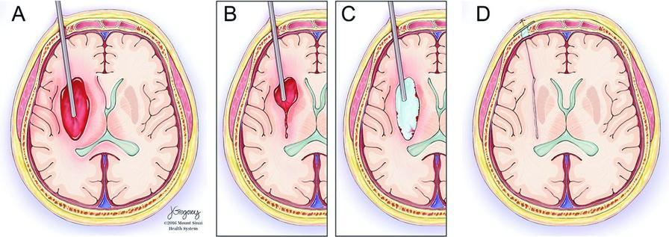
Intervention: SCUBA
SCUBA: Stereotactic Cerebral Underwater Blood Aspiration
  Goal: ≤10ml residual hematoma on post-op CT
  It’s a surgical technique and is not device specific. FDA exemption letter available.
  Multiple different evacuation devices have been used in SCUBA cases, such as Apollo (Penumbra), Artemis (Penumbra), Myriad (NICO), and standard endoscopic tools (Storz).
  SCUBA avoids traditional craniotomy and emphasizes minimal brain and soft tissue disruption.
Image credits: Kellner CP, Chartrain AG, Nistal DA, et al, The Stereotactic Intracerebral Hemorrhage Underwater Blood Aspiration (SCUBA) technique for minimally invasive endoscopic intracerebral hemorrhage evacuation, Journal of NeuroInterventional Surgery 2018;10:771-776.

Slide 15
Concomitant Medications
The use of low molecular weight fractionated and unfractionated heparin for deep vein thrombosis and the use of aspirin as clinically indicated for an underlying condition are permitted 48 hours after surgery, as long as repeat imaging assures ICH stability.
The use of other antithrombotic agents, such as warfarin, direct oral anticoagulants, antiplatelet agents, and IIb/IIIa inhibitors should be avoided as much as possible for 7 days after surgery.
Intraventricular thrombolytics is not allowed.

Slide 16
Surgical Leadership Committee (SLC) & Surgical Training Center
Committee Composition:
  The SLC consists of 3–5 experienced neurosurgeons; initially Drs. Mocco, Kellner, and Shigematsu will form the leadership team.
Clinical & Surgical Expertise:
  All SLC members are fully trained neurosurgeons with extensive experience in intracerebral hemorrhage (ICH) care and endoscopic ICH evacuation.
24/7 Surgical Support:
  SLC members jointly staff a round-the-clock hotline providing pre-operative planning support and intra-operative tele-proctoring.
Training & Education:
  The SLC will livestream ~20 endoscopic ICH evacuations annually from Mount Sinai using HIPAA-compliant technology and conduct one-day training courses and 3D model practice sessions.
Leadership & Membership:
  Surgeons from participating centers may join the SLC after submitting >7 cases; Dr. Kellner will lead the SLC throughout MINUTE, with membership rotating as needed once the committee reaches five members.

Slide 17

Control Arm: Standard Medical Management
  Standard medical management per AHA ASA ICH guidelines​ for management of spontaneous ICH
2022 Guideline for the Management of Patients With Spontaneous Intracerebral Hemorrhage: A Guideline From the American Heart Association/American Stroke Association
Citation: Greenberg SM, Ziai WC, Cordonnier C, Dowlatshahi D, Francis B, Goldstein JN, Hemphill JC 3rd, Johnson R, Keigher KM, Mack WJ, Mocco J, Newton EJ, Ruff IM, Sansing LH, Schulman S, Selim MH, Sheth KN, Sprigg N, Sunnerhagen KS; American Heart Association/American Stroke Association. 2022 Guideline for the Management of Patients With Spontaneous Intracerebral Hemorrhage: A Guideline From the American Heart Association/American Stroke Association. Stroke. 2022 Jul;53(7):e282-e361. doi: 10.1161/STR.0000000000000407. Epub 2022 May 17. PMID: 35579034.
Link: https://pubmed.ncbi.nlm.nih.gov/35579034/

Slide 18



Outcomes & Follow-up​
Primary:
UW-mRS at Day 180
Mortality (Day 30)
Secondary:
  Successful clot removal with ≤10 mL remaining on the post-evacuation CT scan;
  ICH volume on the 24-hour CT scan; and
  Peri-cavity edema (PCE) on the 24-hour CT scan
Follow-up: Day 1, 7, 30, 90, 180, 365

Slide 19
Statistical Considerations​
Sample size: 300 patients, powered for UW-mRS improvement ≥0.1​
Bayesian adaptive design: interim analyses for adaptive enrichment to determine optimal time window
  if low probability that SCUBA has a clinically meaningful effect in a given time window, enrollment in that window will be discontinued
  first interim after the first 100 patients have been randomized
  subsequent interims occur after every additional 50 patients have been randomized
Final analysis will be conducted when all patients have completed the 180-day follow-up period.
Possible decisions based on a posterior probability of superiority > 0.9
  recommend both windows
  recommend either ultra early or early window
  recommend neither

Slide 20
Primary Staff Roles and Responsibilities
Principal Investigator | Surgical Co-PI | Primary Coordinator

Slide 21
Site PI Responsibilities
Overall Study Responsibility
The investigator is responsible for patient selection, evaluation, protocol adherence, data collection, and overall study conduct in compliance with regulations and IRB requirements.
Delegation with Accountability
Although tasks may be delegated to qualified study staff, the investigator retains full responsibility for study execution and oversight.
Surgical PI & Primary Study Coordinator
The investigator must designate a surgical PI & a primary study coordinator to support the administrative and surgical operational aspects of the study.
Informed Consent & Protocol Compliance
The investigator ensures informed consent is obtained before enrollment and that all procedures follow the approved protocol.
Staff Qualifications & Documentation
The investigator must ensure study personnel are qualified and trained, maintain confidentiality, and keep delegation of authority logs and training records accurate.

Slide 22
Surgical PI Responsibilities
Site Surgical Leadership
Serve as the designated neurosurgical lead for the study at the site and oversee all SCUBA procedures.
Required Training
Attend and successfully complete the mandatory SCUBA surgical training requirements prior to site activation.
Procedure Oversight
Ensure the SCUBA procedure is performed correctly and consistently for all participants randomized to the SCUBA arm.
Protocol Compliance
Confirm adherence to the surgical protocol, study procedures, and applicable guidelines during pre-operative, intra-operative, and post-operative care.
Quality & Accountability
Act as the primary surgical point of contact for training, procedural questions, and surgical quality assurance in coordination with study leadership.

Slide 23
Primary Coordinator Responsibilities
Study Operations Support
Manage day-to-day study activities at the site and support the PI and Surgical PI in study execution.
Participant Coordination
Coordinate screening, enrollment, scheduling of study visits, procedures, and follow-up assessments.
Regulatory & Documentation
Maintain regulatory binders, ensure informed consent documentation is complete, and support IRB submissions and approvals.
Data Management
Ensure timely and accurate data entry, respond to data queries, and track protocol deviations and adverse events.
Communication & Compliance
Serve as the primary liaison between the site and study leadership, NDMC, and monitors, and ensure staff training and protocol adherence.

Slide 24
Required Study Trainings
🟢 Standard Trainings:
Protocol (quiz + webinar or slides)
Coordinator (quiz + slides)
ABC/2 Method (slides + attestation)
Core Lab (individual site training)
🟢 Certifications:
mRS – WebDCU Campus
NIHSS – WebDCU Campus
🟢 For Site Neurosurgeons Only:
In-person surgical training (attestation/approval form)
Five Educational modules: (attestation)
Case submissions: 4 non-trial cases (approval form)
🟢 Additional Resources:
AHA ASA ICH Medical Management Recommendations Guidelines
Randomization in WebDCU – WebDCU Campus
E-consenting in REDCap – WebDCU Campus
EuroQol-5D Quality of Life – Website Guide & WebDCU Campus Under STEP
Viz AI Introduction – WebDCU Campus
Adverse Event Reporting Workflow - WebDCU Tools
Angio-Suite Introduction - WebDCU Campus

Slide 25
Safety Monitoring Plan

Slide 26
Safety Monitoring​
Independent Safety Monitor + DSMB oversight​
  Anticipated semi-annual DSMB meetings
AE/SAE assessment through 1 year​
Interim 30-day mortality monitoring: every 30 consecutive evacuation subjects have had the opportunity to complete the 30-day period
General safety monitoring:
  The primary safety endpoint is 30-day all-cause mortality.
  The secondary safety endpoints include:
    Symptomatic rebleeding into the cavitary lesion after evacuation resulting in residual hematoma volume >10 mL and worsening of neurological status (defined as an increase in pre-evacuation NIHSS ≥4 points or a decrease in GCS ≥2 points which cannot be attributed to any other cause such as infection, seizures, sedation, or worsening edema) within 30 days; and
    CNS infection attributed to surgery.

Slide 27
List of Anticipated Adverse Events
Adverse Events Related to the Procedure (surgery + anesthesia)
Skin infection at the surgery site
Swelling/edema at the surgery site
CNS infection
CSF leak
Rebleeding/Hematoma expansion
Scar formation, skin irritation or itching at the surgery site
Ischemic stroke
Adverse Events Related to Anesthesia
Sore throat after intubation
Allergic reaction (rash, hives, flushing, headache, fever, and trouble breathing.
Malignant hyperthermia (very rare)
Myocardial infarction
Adverse Events Related to Imaging (CT/CTA or DSA)
Allergic reaction including flushing, nausea/vomiting, skin rash, anaphylaxis, difficulty breathing after CTA
Worsening renal functions after CTA (Contrast Induced Nephropathy)
Ischemic stroke - DSA
Contrast injection site complications
*Note, CTA/DSA are SOC and are not part of study-specific procedures
Adverse Events Related to ICH/Condition
Worsening neurological status
Brain edema/swelling
Hematoma expansion
Seizure
Worsening renal functions
Respiratory and urinary tract infection
Cardiac arrhythmias
DVT/PE
ARDS
Death
Ischemic stroke
Myocardial infarction
Anemia,
Electrolyte disturbances,
Fever
Confusion or altered mental status

Slide 28
Adverse Event Reporting Timelines
Reporting Timeline | SAE | AE
Within 24 hours* | Unanticipated or At least possibly related to the procedure
Within 3 business days* | Not unanticipated and are Unrelated, or unlikely to be related to the procedure
Within 5 business days* |  | Non-serious
* The investigator’s first knowledge of the event

Slide 29
Thank you! 👏 😊
Thank you for your time! Please take the protocol training quiz in REDCap. Here's the link: https://redcap.link/minuteprotocolquiz.
By completing this quiz, you are confirming you have attended the training webinar or reviewed the training slide deck.
You must answer at least 12 out of 14 questions correctly to receive a passing score. A PDF will be generated at the conclusion of this test and sent to the email address entered below.
That PDF must be uploaded to WebDCU to document your training.
A separate attestation form is not required for protocol or coordinator training.
If you can't make it to the webinar, the recording will be posted on WebDCU Training Campus. Please watch the recording and complete the REDCap quiz.
Email Ally Qi, ally.qi@mountsinai.org if you have any questions regarding this material.

