Slide 1
RHAPSODY-2 Biospecimen Collection, Storage, and Shipment
𝄞
USC Central Laboratory

Slide 2
Overview
Types of biospecimen collected
Specimen collection schedule
Supplies
Specimen Collection Protocols
Shipping instructions

Slide 3
Types of Biospecimen Collected
Whole blood collected at multiple time points for 2 different assays
Anti-Drug Antibody (ADA)
Pharmacokinetic (PK)
Stored on site
Batch shipped to USC Labs
Assays performed at Charles River Laboratories
Notes:
During the lead-in phase, whole blood will be collected from all subjects at multiple time points for anti-drug antibody (ADA) and pharmacokinetic (PK) testing. Serum and Plasma will be extracted from these samples, stored on site, shipped to Zilkha Neurogenetics Institute at the University of Southern California for intermediate storage. Then samples are batch shipped to Charles River Laboratories, where the assays will be performed.

Slide 4
Specimen Collection Schedule
Visit Schedule | Pre-dose 1 | At the end of one of the following infusions: dose 2-5 |  | Day 7/Discharge (± 3 days) | Day 90 (± 10 days)
 |  | 5-10 min after end of infusion | 25-50 min after end of infusion
Serum Anti-Drug Antibody | X |  |  | X | X
ADA samples will be collected at 3 time points following randomization
Before the first dose of study drug (Pre-dose 1)
On hospital Day 7 or discharge (±3 days) – whichever comes first
On Day 90 (±10 days)

Slide 5
Specimen Collection Schedule
Visit Schedule | Pre-dose 1 | At the end of one of the following infusions: dose 2-5 |  | Day 7/Discharge (± 3 days) | Day 90 (± 10 days)
 |  | 5-10 min after end of infusion | 25-50 min after end of infusion
Serum Anti-Drug Antibody | X |  |  | X | X
Plasma PK (pharmacokinetic) 2 time points following single dose selected from Doses 2, 3, 4, or 5 |  | X | X
PK samples will be collected at 2 timepoints after ONE of the following doses: Dose 2, Dose 3, Dose 4, OR Dose 5
5-10 min after the end of infusion of study drug AND
25-50 min after the end of infusion of study drug

Slide 6
Specimen Collection Schedule
Study team members can choose which dose to collect PK specimens from.
It is strongly encouraged to collect PK specimens after dose 2, 3, or 4. This way, sites will always have another chance to collect the sample should any problems occur

Slide 7
Overview of Supplies
Specimen Collection Kits
Kit Name | Kit Contents
ADA Kit | 1 – 3mL Red top draw tube 2 – 2mL Aliquot Cryovials (prelabeled) 1 – Primary Aliquot (Red Capped Cryovial) 1 – Secondary Aliquot (Yellow Capped Cryovial) 1 – Disposable sterile transfer pipette
PK Kit | 2 – 2mL Aliquot Cryovials (prelabeled) 1 – Primary Aliquot (Blue Capped Cryovial) 1 – Secondary Aliquot (Clear Capped Cryovial) 1 – 3mL Discard tube (White cap) 1 – Disposable sterile transfer pipette 1 – Multi Sample Luer Adapter (MSLA), 23G, with 7.5” tubing and tube holder 1 – Tourniquet (latex-free) SCAT-140- 3.6/5 draw tubes shipped separately
Each kit = 1 biospecimen per patient

Slide 8
Overview of Supplies
SCAT-140- 3.6/5 draw tubes will be sent in bulk
SCAT 140 3.6/5 tubes are not sterile and require a catheter of at least 5 inches in order to be used in direct phlebotomy
Must stay refrigerated (2°C – 8°C) until ready for use
10 tubes supplied in a refrigerated shipper
Supplied Annually
Additional supplies (all sites)
2 – Cardboard Cryo-boxes (5.25” x 5.25”) for storage
One for Primary cryovial samples
One for Secondary cryovial samples
Extra tubes:
3 – 3mL Red top draw tube
2 – SCAT-14-3.6/5 draw tubes (included with bulk supply)
Shipping supplies will be provided when samples are requested to be shipped by USC
1 Medium Cooler
FedEx Clear pouches for waybill
Dry Ice Labels Category B Labels
6”x9” Biohazard specimen transport bags

Slide 9
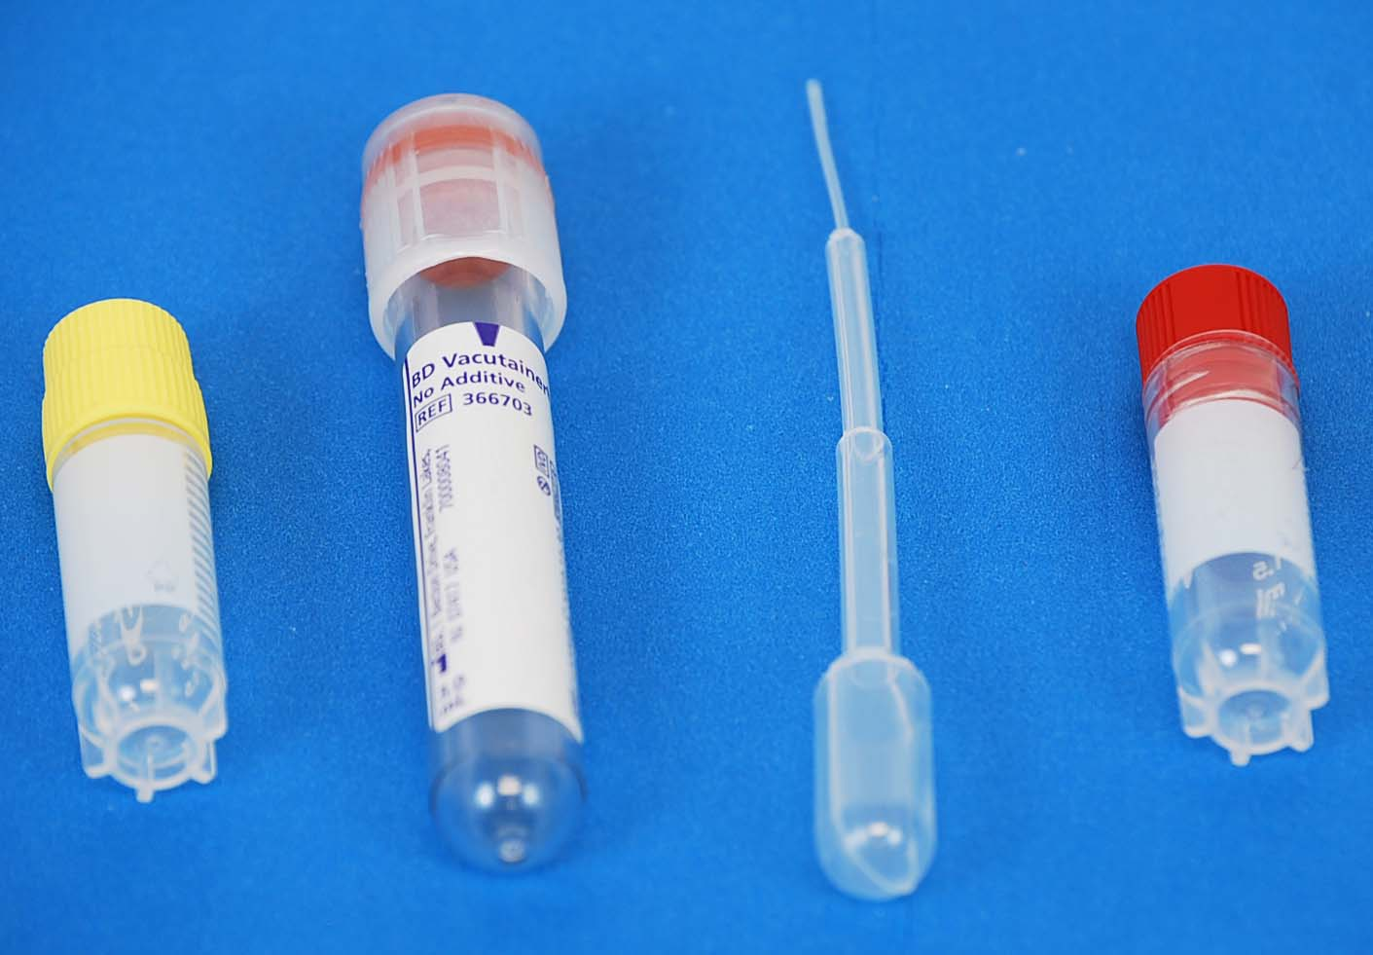
ADA Collection Kit Contents
Red Top
Draw Tube
Primary
Cryovial
ADA Collection Kit
Secondary
Cryovial
Disposable
Sterile Transfer
Pipette

Slide 10
ADA Specimen Collection Protocol
Draw blood from the subject to completely fill a 3 mL Red top draw tube
The blood sample may be drawn from an existing IV into a syringe, provided a discard is drawn prior to collecting the ADA sample.
The blood sample may also be drawn directly from a vein using a butterfly needle with vacutainer holder. Note: The butterfly needle and vacutainer holder are not provided in the ADA kit.
Gently invert the 3mL Red top draw tube 8 to 10 times. 3mL Red top draw tubes containing samples should sit at room temperature for at least 20 minutes to allow clotting prior to centrifugation.
Centrifuge the 3mL Red top draw tubes with specimen at 1500 - 2200 RPM (1500 x g) at 2°-8°C for 10-15 minutes using balance tubes as needed. If no refrigerated centrifuge is available, blood must be chilled in wet ice slurry for 2-3 minutes prior to centrifuge at room temperature at 1500-2200rpm (1500 x g) for 10-15 minutes.
Use a sterile transfer pipette to place at least 0.5 mL (500 uL) of serum into each of the two prelabeled 2mL aliquot cryovials (one Red- Aliquot 1, one Yellow- Aliquot 2).
ADA aliquot cryovials must be stored in corresponding primary and secondary cryo storage boxes and immediately placed into ≤ -70˚C freezer.

Slide 11
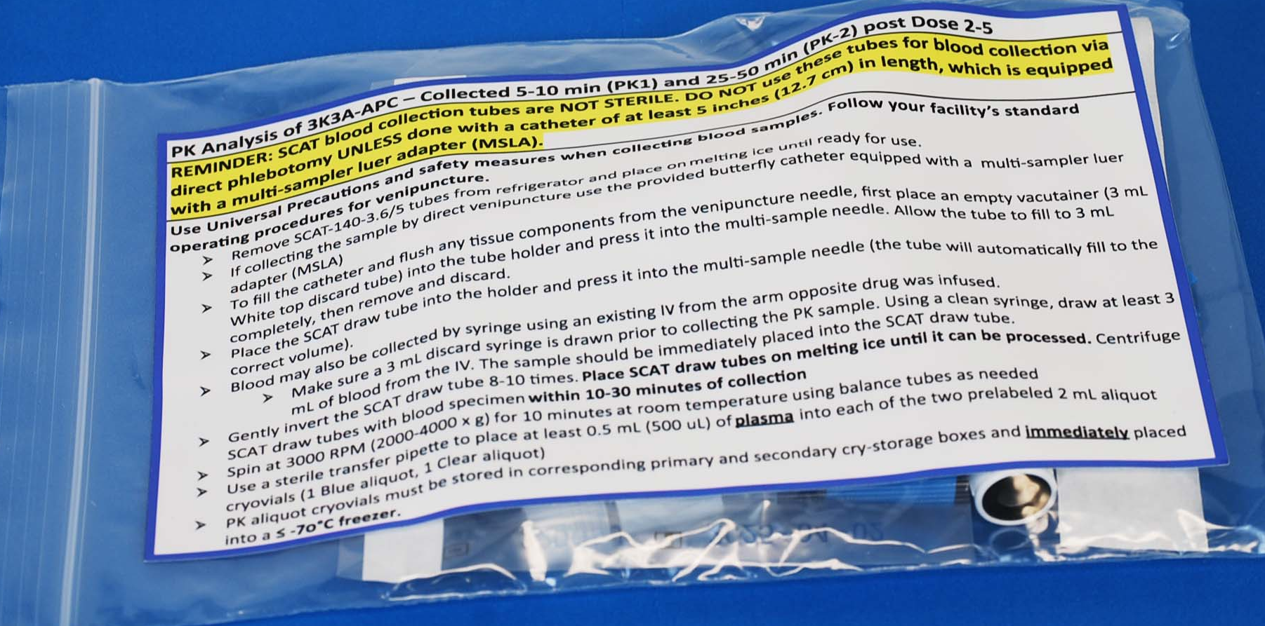
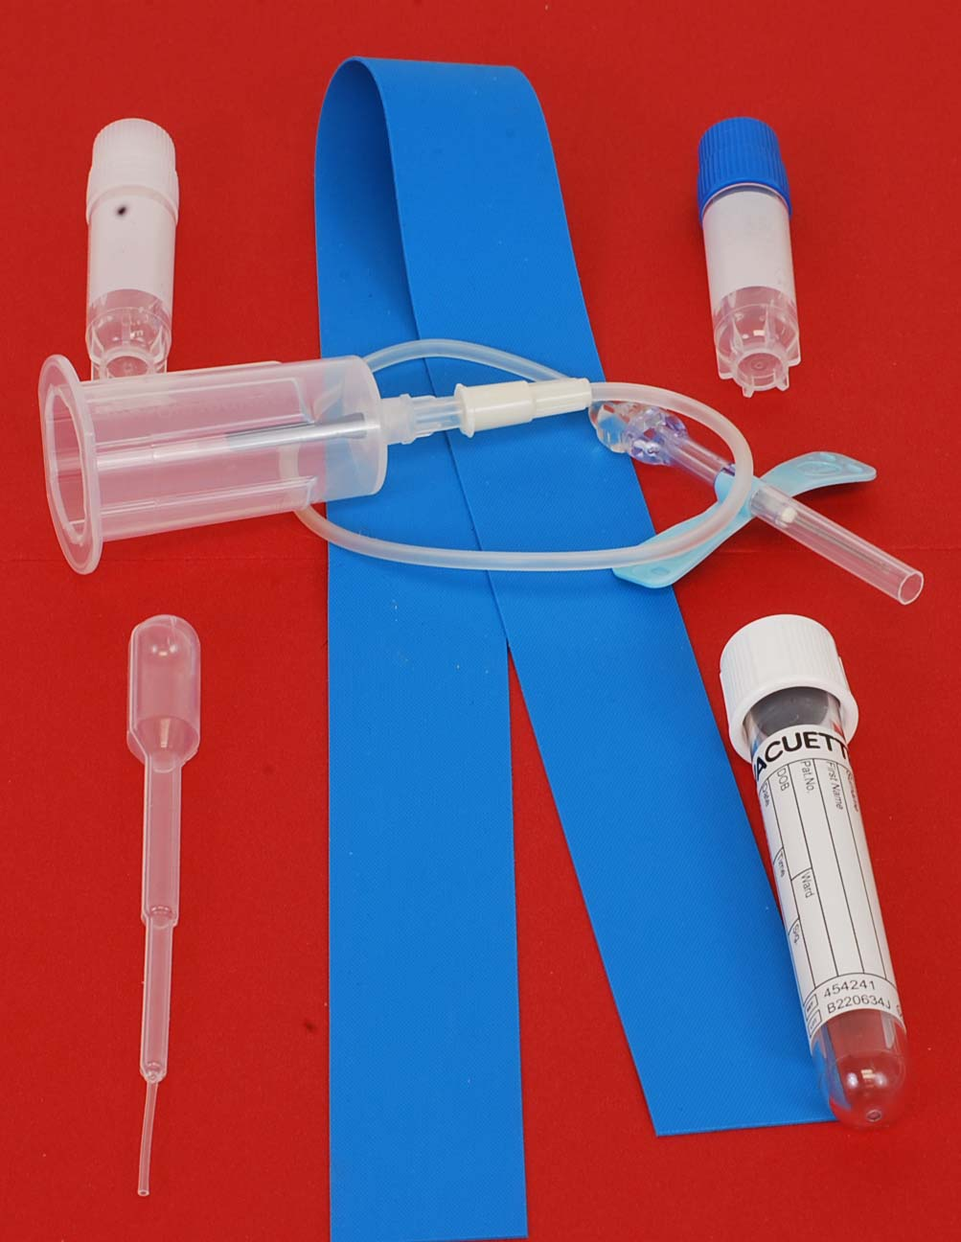
PK Collection Kit Contents
Tourniquet
(latex-free)
Primary
Cryovial
Secondary
Cryovial
MSLA
tubing
MSLA tube holder
MSLA (23G)
PK Collection Kit
Disposable
Sterile Transfer
Pipette
3mL Discard
Tube
SCAT-140-3.6/5 Draw Tube
(NOT STERILE)

Slide 12
PK Specimen Collection Protocol
CAUTION: SCAT Blood Collect Tubes Are NOT Sterile
Keep SCAT-140-3.6/5 tubes refrigerated (2°C – 8°C) – After removing from refrigerator keep SCAT tubes on melting ice until ready for use.
If collecting the sample by direct venipuncture use the provided butterfly catheter equipped with a multi-sampler luer adapter (MSLA) and 7.5-inch tubing.
To fill the catheter and flush any tissue components from the venipuncture needle first place an empty vacutainer (3ml White top discard tube) into the tube holder and press it into the multi-sample needle. Allow the tube to fill 3mL completely, then remove and discard.
Place the SCAT draw tube into the holder and press it into the multi-sample needle (the tube will automatically fill to the correct volume).
Blood may also be collected by syringe using an existing IV from the arm opposite drug was infused.
Make sure a 3 ml discard syringe is drawn prior to collecting the PK sample. Using a clean syringe, draw at least 3 ml of blood from the IV. The sample should be immediately placed into the SCAT draw tube.
Gently invert the SCAT draw tube 8 to 10 times. Place SCAT draw tubes on melting ice until it can be processed. Centrifuge SCAT draw tubes with blood specimen within 10 – 30 minutes of collection
Spin at 3000 RPM (2000-4000 x g) for 10 minutes at room temperature using balance tubes as needed
Use a sterile transfer pipette to place at least 0.5 mL (500 uL) of plasma into each of the two prelabeled 2mL aliquots Cryovials (one Blue- Aliquot 1, one Clear- Aliquot 2)
PK aliquot cryovials must be stored in corresponding primary and secondary cryo storage boxes and immediately placed into ≤ -70˚C freezer.

Slide 13
Shipping Reminders
All biospecimens are batch shipped from site to USC Labs when notified by USC
Ship the Frozen samples Monday – Wednesday ONLY via FedEx overnight priority
Patrick Lyden- ZNI
1501 San Pablo Street
ZNI Room 201- Lyden Lab
Los Angeles, CA 90033
Sites must store Secondary Aliquot of both ADA and PK specimens on site.
ONLY ship Secondary Aliquots if requested by USC Labs!
Notes:
All biospecimens are batch shipped from site to USC Labs quarterly -- may be more frequent if deemed necessary by USC Labs.

Slide 14
Preparing Samples for Shipment in WebDCUTM
After the specimen collection CRF in the Subject CRF Binder in WebDCUTM has been completed, click on [Study Material Tracking] and then [Specimen Shipping].
Find the lab kit code for the specimen you plan to send, click the blue hyperlink # next to the lab kit code, and click ‘Edit Record’
1
2
Notes:
(1) Log into the RHAPSODY-2 WebDCU system to select biospecimen(s) for shipment
(2) Find the lab kit code for the specimen you plan to send and click the blue hyperlink # next to the lab kit code.
(3) Click ‘Edit Record’ and select confirm ‘Yes’ for Specimen shipping confirm. This will enable the remaining fields on this form to be edited. Enter the shipping date, FedEx tracking number and shipping notes (if needed). Last, click on [Save Record].

Slide 15
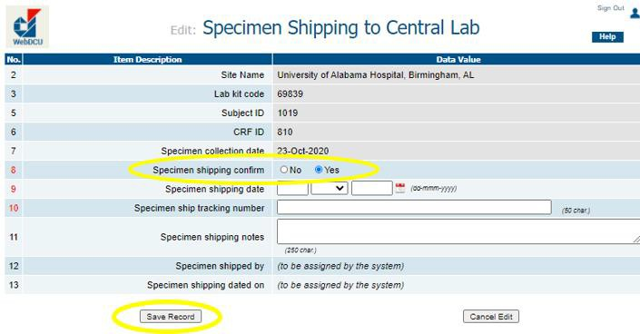
Preparing Samples for Shipment in WebDCUTM
Select ‘Yes’ for Specimen shipping confirm. This will enable the remaining fields on this form to be edited.
Enter the shipping date, FedEx tracking number and shipping notes (if needed).
Last, click on [Save Record].
3
4
5

Slide 16
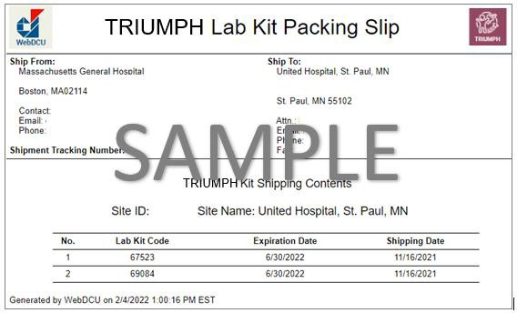
Preparing Samples for Shipment in WebDCUTM
To print the Lab Kit Packing Slip: From the [Specimen Shipping] List table, click on the icon in the “Specimen Packing Slip” column for the specimen lab kit(s) ID you plan to ship.
Print the Lab Kit Packing Slip for each specimen lab kit(s) ID you plan to ship.
Check the accuracy of the package prior to shipping.
Use the biospecimen collection CRF to ensure that all samples collected for the specimen type and Lab kit ID are included in the package.
Verify that the Lab Kit IDs listed on the packing slip match what is in the package.

Slide 17
Packaging the Samples
Once you’ve completed the WebDCUTM CRF Bio Sample Collection-Shipping Form, remove the cryovial tubes containing patient samples from the ≤-70˚C freezer and verify that each specimen is labeled with the appropriate Kit ID number.
Place each cryovial in a separate Biohazard Specimen Transport bag (provided by USC), and completely seal. Each aliquot should be in its own Biohazard bag.

Slide 18
Packaging the Samples
Place at least 5lbs of Dry Ice and the specimen packages inside the foam cooler
note: sites will source their own dry ice.
Sandwich specimens between layers of ice so that ice is both under and on top of the specimens. Then place the lid on the cooler.
DO NOT Tape or Seal the cooler lid to the cooler.
Place the lid on the insulated foam cooler. Fold the WebDCUTM Shipping Manifest and secure the form with packing tape to the outside lid of insulated foam cooler.

Slide 19
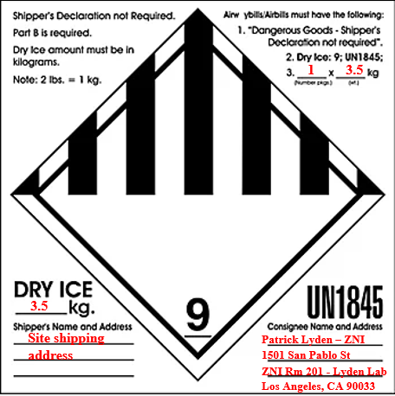
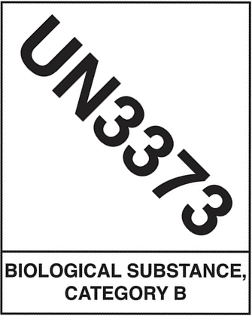
Packaging the Samples
Seal the cardboard shipping container with packing tape.
Place the printed FedEx waybill on top of the cardboard shipping container along with the UN1845 (Dry Ice) and UN3373 (Category B) stickers.

Slide 20
Creating a Shipping Label
On the www.fedex.com home page, click “Shipping” and select “Create a Shipment” from the drop-down menu.
If you are not logged in, FedEx will ask you to log in to your FedEx account. If you do not have a FedEx account, please refer to the Lab Manual for how to create one.
FedEx.com will now take you to the FedEx Ship Manager, where you can create your shipping label.
Please consult the Lab Manual for details on how to fill out the Ship Manager form and create your label.

Slide 21
Final Reminders
Note: the FedEx shipping label is NOT the same as the WebDCUTM packing slip.
The packing slip is a complete list of every specimen included in the shipment, while the shipping label is general package information for FedEx only
Please consult the RHAPSODY-2 Lab Manual for detailed shipping instructions
Please contact rhapsody@usc.edu if you have any questions regarding specimen collection, processing, storage, packaging, or shipping

