Slide 1
RHAPSODY-2 Image Archive
𝄞
USC and LONI

Slide 2
What is LONI?
The Laboratory of Neuro Imaging (LONI) has been providing central data repository and informatics systems for single and multisite research studies for over a decade. LONI is located at the University of Southern California (USC).
LONI has developed a secure data archive system and associated data de-identification, search, retrieval, conversion, and dissemination tools that provide maximal flexibility in data storage and sharing while minimizing complexity of use.
The Laboratory’s Image & Data Archive (IDA) is utilized by thousands of users around the globe to safely de-identify, store, and share biomedical research data.

Slide 3
6 Steps Summary to Certification
Create an IDA Account on LONI website
Email USC to gain access to RHAPSODY-2 project (send the User request form)
Install IDA Uploader Application to desktop/computer
Upload a USC-provided test MRI folder with the IDA Uploader Application. The zip file will need to be decompressed prior to upload.
Upload Image Upload Certificate (sent by USC) into WebDCU system

Slide 4
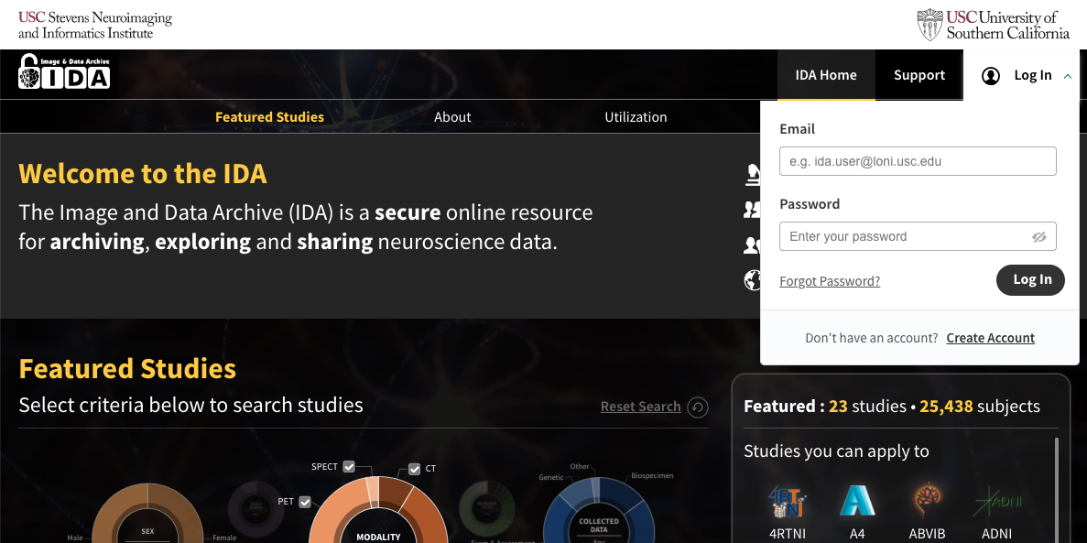
Registering
If you do not have an IDA account click on “Create Account” on the IDA Log-In page (https://ida.loni.usc.edu) and follow the instructions provided.

Slide 5
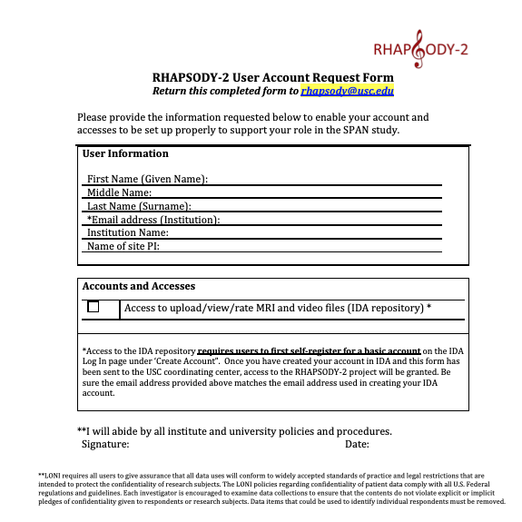
Registering
Once the user has completed the registration process, user will e-mail (rhapsody@usc.edu) with a completed RHAPSODY-2 User Request Form to request archive access for the RHAPSODY-2 trial. Make sure to provide the e-mail address that the was used to create the user's account in IDA. The Account Access Form can be found in the RHAPSODY-2 Toolbox on WebDCUTM.

Slide 6
Archiving
The IDA Uploader Application performs two steps in the archive process: de-identification and file transmission.
The de-identification step removes or replaces potentially identifying subject information from the image headers.
During the file transmission step, the de-identified files are securely transmitted to LONI and stored in the data archive.

Slide 7
Application Installation
After the USC team has notified the user that they have been added to the RHAPSODY-2 project in IDA, the user must log out and log back into their account on the IDA website to see the RHAPSODY-2 project on their IDA dashboard.
https://ida.loni.usc.edu/login.jsp

Slide 8
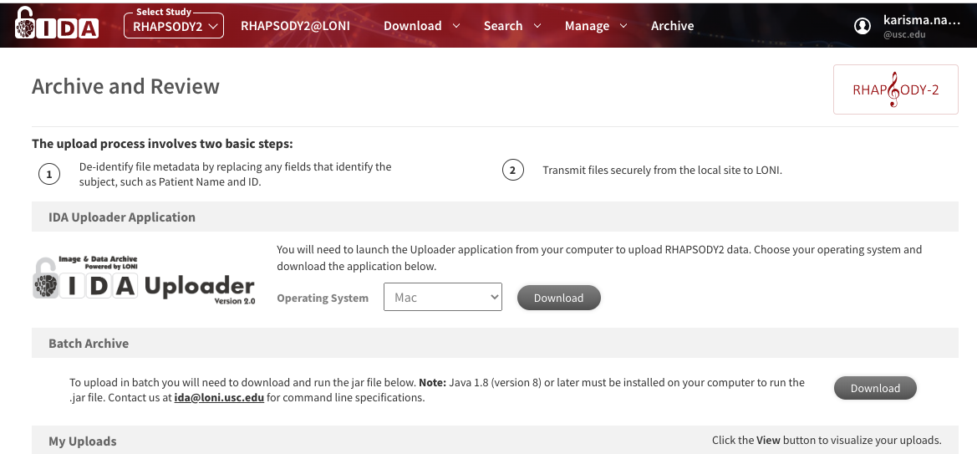
Application Installation for Archiving
Once the user has been added to the project, choose “Archive” from the header and select your operating system from the drop-down menu, click DOWNLOAD:

Slide 9
Application Installation on Windows
Select ‘Windows 64-bit’ in drop-down menu. Open the application by clicking on the download in your browser or downloads section of your file explorer.

Slide 10
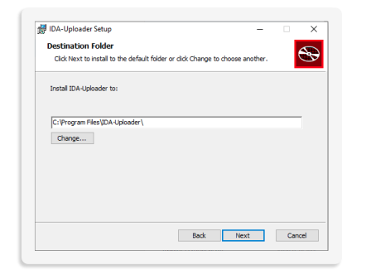
Application Installation on Windows
2. User will be taken to the IDA-Uploader Setup Wizard- click NEXT to continue
3. Choose your destination folder- Click NEXT

Slide 11
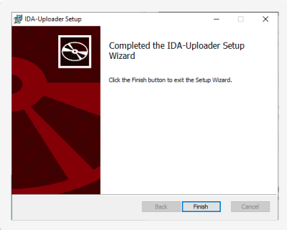
Application Installation on Windows
4. Click INSTALL Note: if you receive a popup asking permission to run the application. Click YES
5. Click FINISH to exit Setup Wizard

Slide 12
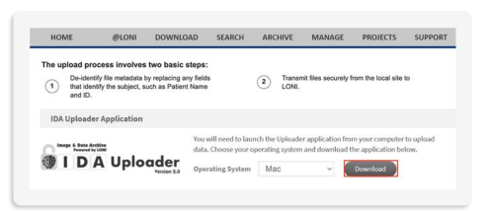
Application Installation on Mac
Select ‘Mac’ in drop-down menu. Open the application by clicking DOWNLOAD in your web browser.
Open your Finder application and click Downloads. Make sure to right click IDA-Uploader-2.0.pkg and select OPEN.
Note: if you try to double click. On ‘IDA-Uploader-2.0.pkg’ you may receive a message that it cannot be opened. Please ensure you follow instructions above to open successfully.

Slide 13
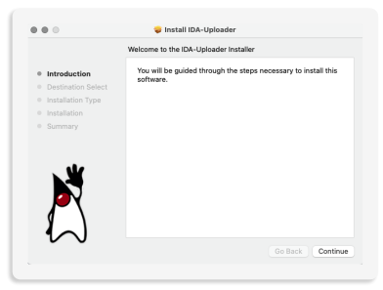
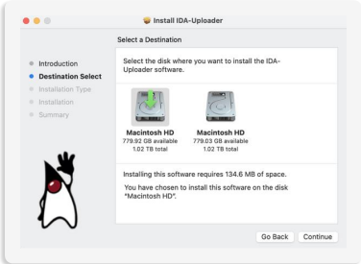
Application Installation on Mac
An Install IDA-Uploader window will appear. Click CONTINUE
4. Choose a destination for the installation, click CONTINUE

Slide 14
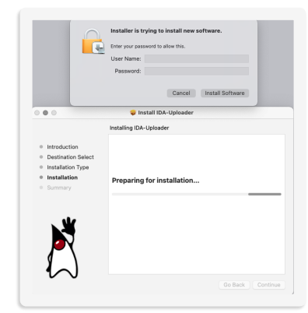
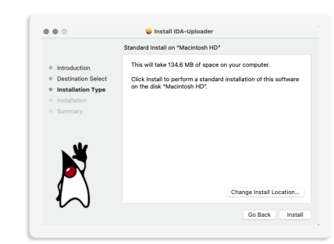
Application Installation on Mac
5. For installation type, review details of installation and click INSTALL
6. During installation you will need to enter the Username and Password for the computer/desktop you are using. Click INSTALL SOFTWARE

Slide 15
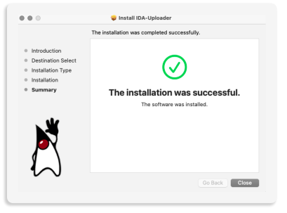
Application Installation on Mac
7. When installation is complete, the window will provide a summary of a successfully installation. Click CLOSE.

Slide 16
Application Installation on Mac
NOTE: A window will appear to ask “Do you want to move the “IDA-Uploader” installer to the trash?”. You can choose Keep or Move to Trash. 11.
8. Locate the application in your computer by opening your Finder application. Click on APPLICATIONS and double-click IDA-Uploader.

Slide 17
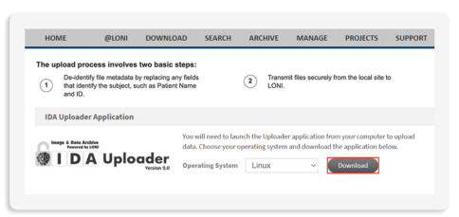
Application Installation on Linux
Select ‘Linux’ in drop-down menu. Click DOWNLOAD.
2. Please visit https://www.oracle.com/java/technologies/javase-downloads.html to download the latest Oracle JDK. NOTE: A minimum version of 15.0.1 is required to run IDA-Uploader-2.0.jar
3. Choose DEB, PRM or the compressed archive depending on your Linux Distribution.
4. Once you have completed the installation, open the terminal and run: java -jar IDA-Uploader2.0.jar

Slide 18
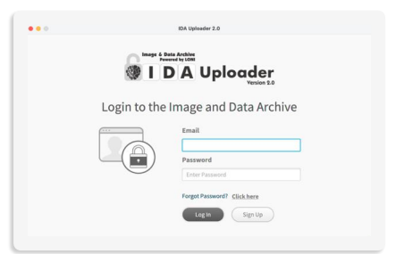
Archiving
Open the IDA Uploader Application on your desktop
Enter your email and password for your IDA account, then click login

Slide 19
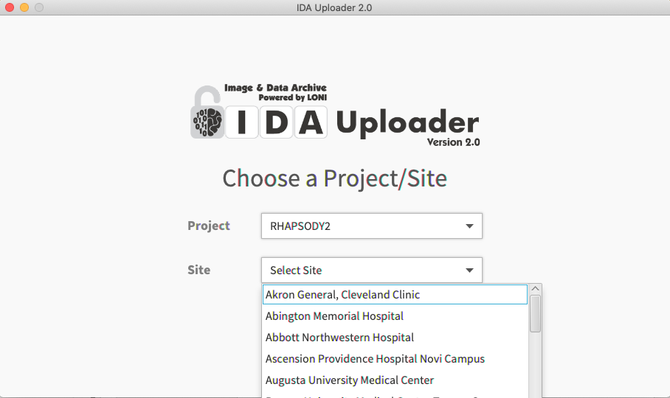
Archiving
3. Select RHAPSODY-2 and your [Site name] from the drop-down, Click CONTINUE

Slide 20
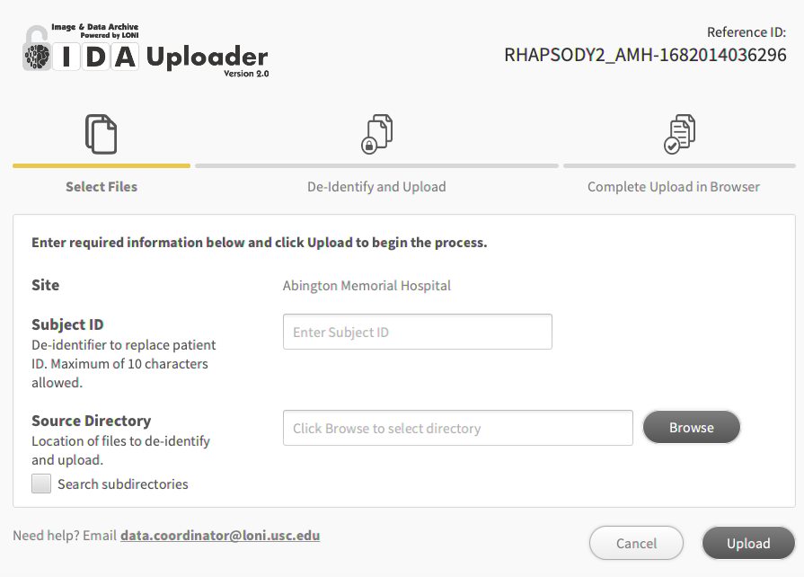
Archiving
4. Verify the correct [Site name] is listed under Site
5. For Subject ID
Note: Subject ID must be in the format #### where #### are four numeric digits
6. Browse your computer directory to find the DICOM files for MRI upload.

Slide 21
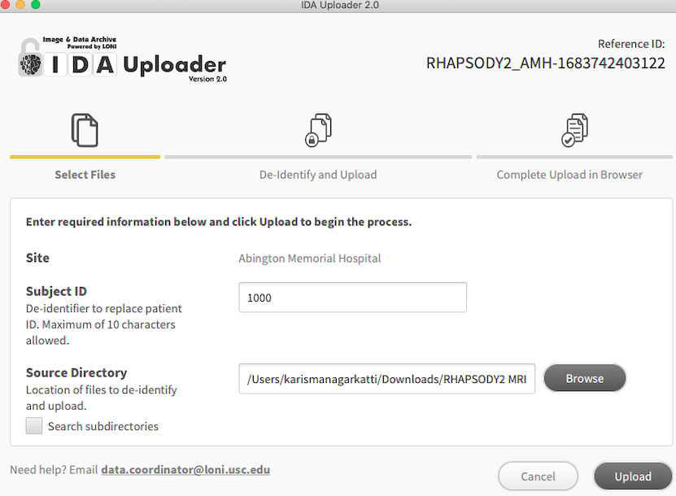
Archiving
Click UPLOAD. The IDA uploader application will not accept images stored in .zip folders. The downloaded DICOM file may need to be unzipped from the folder. The unzipped contents should be put in a new folder and that folder selected as the Source Directory in the IDA Uploader application.

Slide 22
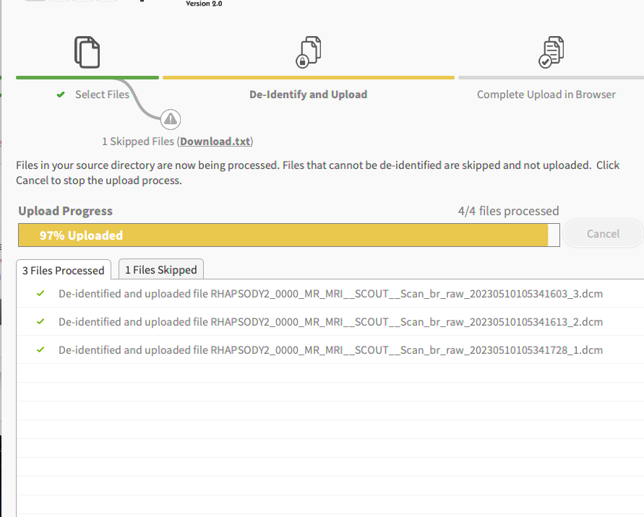
Archiving
8. A popup window will show that the application is deidentifying the DICOM scans.

Slide 23
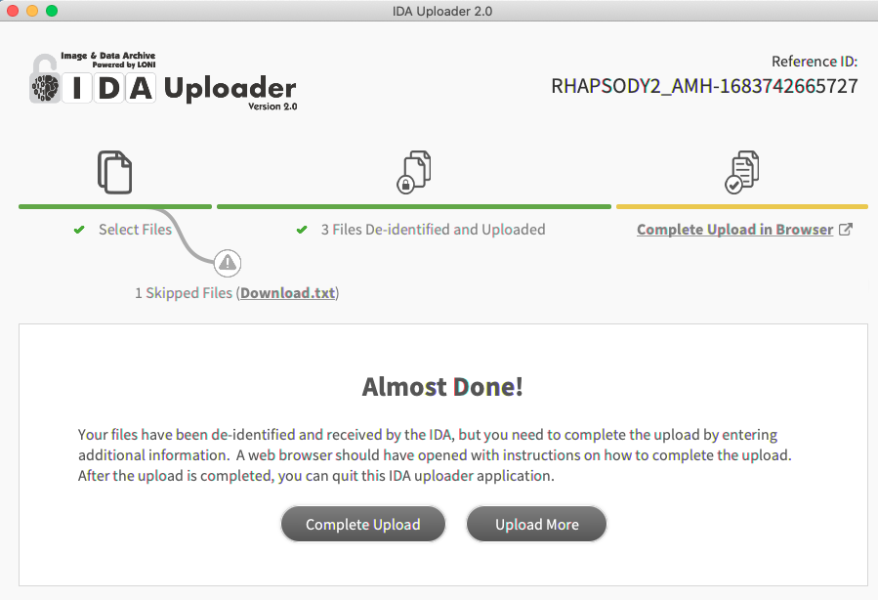
Archiving
9. The user will automatically be directed to enter information about the Visit and Subject Details.
If the user is not redirected to a new browser within a few seconds, the user will need to select the 'Complete upload' button.

Slide 24
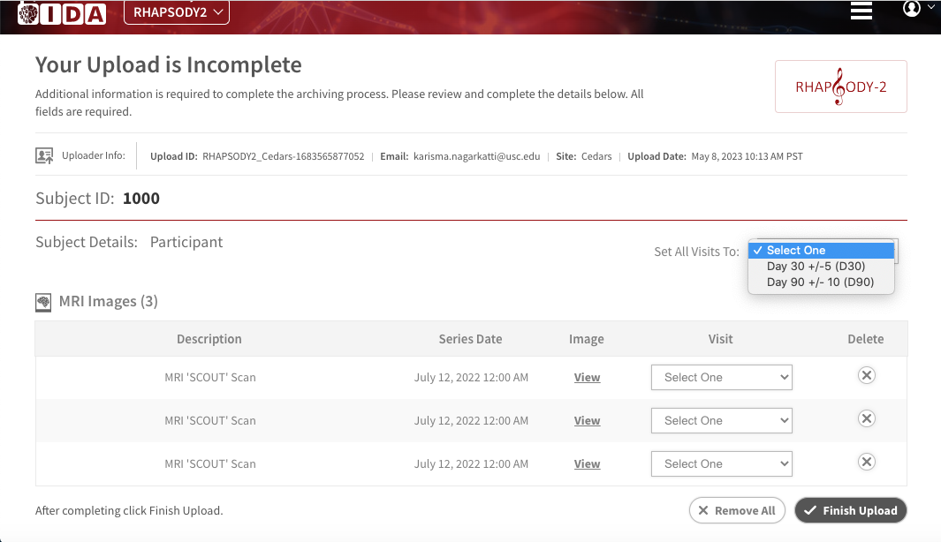
Archiving
10. User will automatically be directed to enter information about the Visit and Subject Details.
In the drop-down menu for Visit, select the appropriate timepoint of the scan: Day 30+/- 5 (D30) or Day 90 +/- 10 (D90)
11. Once completed, Select FINISH UPLOAD

Slide 25
How to get certified?
Imaging Certification for the WebDCUTM system will require each user to test upload a DICOM file into IDA.
Note: The DICOM file and Subject ID will be preassigned by USC after user has created an IDA account and emailed rhapsody@usc.edu
(see next slide for details).

Slide 26
Detailed WebDCUTM Certification Steps
1. User will register for an IDA account on IDA website https://ida.loni.usc.edu/
2. User emails rhapsody@usc.edu with the completed RHAPSODY2 IDA Account Access Form. The Account Access Form will be found in the Rhapsody-2 Toolbox on WebDCUTM.
3. The USC team will email the user when they have been added to the RHAPSODY-2 Project in IDA. At this time, USC will provide the user with a preassigned Subject ID and a google drive link to download a DICOM file. The DICOM file and preassigned Subject ID will be used to upload the test scan for WebDCUTM Image Upload certification.
4. User will download the IDA Uploader application from IDA. This is a one-time download; the application will not need to be downloaded prior to every scan if the IDA Uploader application is not deleted from computer/desktop.
5. User will upload a test DICOM image.
During Upload:
Use the preassigned Subject ID (provided by USC when user is added to RHAPSODY-2 project)
Upload the provided DICOM image ( which will be accessible via Google Drive).
For the Visit select Day 30 +/- 5 (D30)
6. Once the test DICOM file has been unzipped and successfully uploaded, email rhapsody@usc.edu.
In your email include:
include the preassigned Subject ID that was used for your upload
User's Full name and email address
Site Name and Site PI name
7. USC will review the test scan upload and if successfully completed, USC team will email the user that certification is complete.
8. Each user will upload the pdf copy of the email confirmation from the USC team into WebDCUTM
This step completes the User’s training for RHAPSODY-2 Image upload.

Slide 27
Contact Information
For questions about uploading into IDA, email
Will Alton and Karisma Nagarkatti at USC
rhapsody@usc.edu

