Slide 1
RHAPSODY-2 Pharmacy Training Slides
𝄞
StrokeNet Central Pharmacy
Prepared by: Chris Unger, PharmD
Lead Pharmacist-RHAPSODY-2

Slide 2
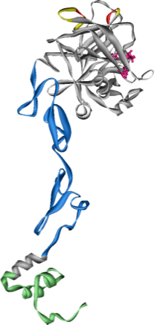
RHAPSODY-2 Pharmacy Introduction
RHAPSODY-2 is a: Randomized
Placebo-controlled
Double-blind
Phase 3 study
Evaluating the use of 3K3A-APC in combination with tissue plasminogen activator, mechanical thrombectomy, or both, in subjects with moderate to severe ischemic stroke.
3K3A-APC

Slide 3
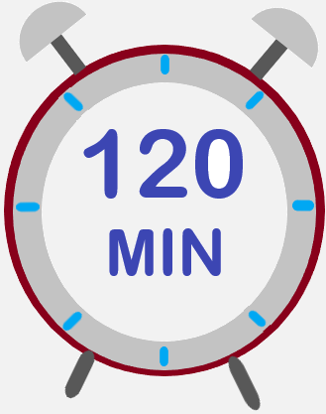
RHAPSODY-2 Pharmacy Introduction
3K3A-APC will be administered as an infusion and must be given within 120 minutes of thrombolysis infusion completion or initiation of mechanical thrombectomy (arterial puncture), whichever is sooner.
After the initial infusion, subsequent doses of study drug will be given every 12 hours (±1 hour) for up to 5 total doses (or until discharge, whichever occurs first).

Slide 4
RHAPSODY-2 Pharmacy Introduction
During the lead-in phase, there will be 4 arms for RHAPSODY-2:
3K3A-APC 10mg
3K3A-APC 15mg
3K3A-APC 30mg
Placebo
After the lead-in phase, approx. 360 subjects, two treatments arms will be dropped in favor of the most beneficial treatment arm.
Regardless of the arm, a 100ml infusion will be prepared for the subject.

Slide 5
RHAPSODY-2 Study Drug Supply
Vials of lyophilized 3K3A-APC powder will be sent to sites in kits.
Each kit will contain 10 of these vials.
Each 10ml vial will contain 5.4mg of lyophilized 3K3A-APC powder.
Sites will not be supplied with placebo or diluent by the study. Sites will use 100ml 0.9% sodium chloride bags from their local inventory.
3K3A-APC

Slide 6
RHAPSODY-2 Study Drug Supply
Prior to shipment of study drug, sites must upload an institutional pharmacy license into WebDCU™
WebDCU™> Regulatory Documents> Site Reg Doc Submission
Institutional pharmacy license address and drug shipping address must match.
If the addresses do not match, please notify the StrokeNet Central Pharmacy at RHAPSODY2rx@ucmail.uc.edu
When a site is released to receive study drug, an initial study drug shipment request will automatically be submitted to StrokeNet Central Pharmacy by WebDCU™

Slide 7
RHAPSODY-2 Study Drug Supply
Study drug shipments are processed Monday-Wednesday and will be received at sites Tuesday-Thursday
No shipments will take place for receipt on Friday, Saturday, Sunday or holidays, unless approved by both StrokeNet Pharmacy and the receiving site.
UPS® will send an email with a tracking number to the site to track shipments.
Only one email can be entered to receive UPS® tracking information
If you would like to use a group email for this notification, please enter the email in the “Investigational product shipping address” in WebDCU™.
UPS® tracking website: https://www.ups.com/WebTracking/track?loc=en_US
Study drug will be shipped with a USB temperature logger, cold packs, and enough insulation to maintain a temperature range of 2 to 8°C.

Slide 8
RHAPSODY-2 Study Drug Receiving
Each shipment of RHAPSODY-2 study drug will contain a packing slip detailing the contents of the shipment and a USB temperature monitoring data logger
Upon receipt of the drug shipment, site pharmacy personnel will verify receipt of the study drug kit(s) against the packing slip
The site will review the temperature data from the logger and confirm that the study drug did not experience any temperature excursions in transit
The site will print and store the temperature data log in the site’s RHAPSODY-2 trial binder where it will be reviewed during monitoring visits.
Once the data has been retrieved from the logger and the temperature curve is printed, the temperature logger can be disposed of per the institution’s policy.
If NO temperature excursions or discrepancies are identified, site pharmacy personnel will confirm receipt of all study drug kits in WebDCU™>RHAPSODY2>Drug Tracking>Drug Receiving
Kits will have a unique verification code on the kit label that is used to receive inventory into WebDCU™.
Study drug kits are unavailable for dispensing until received into WebDCU™

Slide 9
RHAPSODY-2 Study Drug Storage
3K3A-APC vials should be stored in the local site pharmacy in an alarmed, temperature-controlled, and monitored refrigerator at 2-8⁰C.
This refrigerator should be located in a secure, limited-access room.
Sites are required to maintain study drug accountability records and temperature monitoring logs
Sites may use their own institution-specific temperature monitoring log if their site temperature log is equivalent to the RHAPSODY-2 Temperature Accountability Log
Sites may use their institution’s electronic inventory system or use the provided paper logs (WebDCU™>RHAPSODY2>Project Documents)
Temperature logs must be kept from time of study drug receipt until the end of the site’s participation in the trial.
Temperature logs must be available during monitoring visits.
2-8⁰C

Slide 10
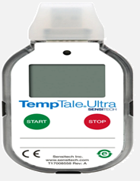
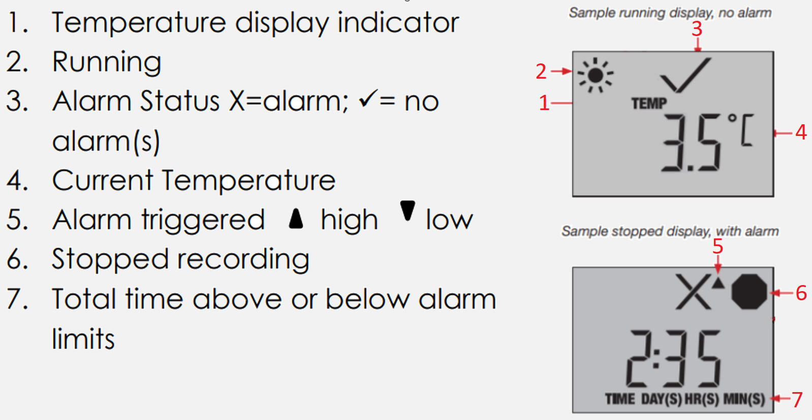
RHAPSODY-2 EXCURSION
A temperature excursion can occur during daily monitoring of the study drug storage area or during transit of the study drug.
Any study drug exposed to a temperature excursion should be quarantined in the appropriate storage temperature, 2-8⁰C.
Any known temperature excursions should be reported to:
StrokeNet Central Pharmacy: RHAPSODY2rx@ucmail.uc.edu
Submit the following documents for temperature excursions
Temperature Excursion Report Form (TERF) - available in WebDCU™
WebDCU>RHAPSODY2>Toolbox>Project Documents
Submit a TERF for both storage and in transit excursions.
Temperature data log from USB logger for excursions in transit only.
After reporting the temperature excursion, a RHAPSODY-2 representative will determine if the study drug is fit for use and contact the site.

Slide 11
RHAPSODY-2 Study Drug Blinding
RHAPSODY-2 is a double-blind study where the investigators and the subjects do not know which arm the subject is assigned to.
The site pharmacy personnel who maintain study drug inventory and prepare the doses of study drug will be unblinded.
Study staff and subjects must remain blinded throughout the duration of the study. It is important not to communicate any issues with drug inventory or dosing with study team members.

Slide 12
RHAPSODY-2 Study Drug Blinding
To maintain blinding, RHAPSODY-2 will utilize a Randomization Code List with randomization codes that correspond to the treatment arm the subject will be assigned.
Once sites are shipped study drug, they will be provided with a Randomization Code List.
This list should be stored in the pharmacy in a RHAPSODY-2 specific binder, and never shared with anyone except pharmacy personnel.
Only pharmacy personnel should receive, store, or have access to RHAPSODY-2 study drug.

Slide 13
RHAPSODY-2 Study Drug Blinding
RHAPSODY-2 RANDOMIZATION VERIFICATION FORM
Patient Name | Jane Doe
DOB | 4/1/1990
Subject ID | 12345
5-Letter Randomization Code | ABCDE
Once a subject is randomized, a Randomization Verification Form will be generated that includes subject specific information and a subject specific randomization code.
The study team will supply the compounding pharmacist with the Randomization Verification Form
The pharmacist will then match the randomization code to the RHAPSODY-2 Randomization Code List to determine the arm the patient is assigned.
RHAPSODY-2 RANDOMIZATION CODE LIST
5-Letter Randomization Code | Treatment Arm
JDVSD | PLACEBO
FDOGP | PLACEBO
JANDA | PLACEBO
OISDI | 10mg (2 Vials)
LKDGH | 10mg (2 Vials)
OURYA | 10mg (2 Vials)
NMSHD | 15mg (3 Vials)
ABCDE | 15mg (3 Vials)
NATSD | 15mg (3 Vials)
RQYWT | 30mg (6 Vials)
RMAJD | 30mg (6 Vials)
LOPOL | 30mg (6 Vials)

Slide 14
RHAPSODY-2 Study Drug Blinding
RHAPSODY-2 RANDOMIZATION VERIFICATION FORM
Patient Name | Jane Doe
DOB | 4/1/1990
Subject ID | 12345
5-Letter Randomization Code | ABCDE
RHAPSODY-2 RANDOMIZATION CODE LIST
5-Letter Randomization Code | Treatment Arm
JDVSD | PLACEBO
FDOGP | PLACEBO
JANDA | PLACEBO
OISDI | 10mg (2 Vials)
LKDGH | 10mg (2 Vials)
OURYA | 10mg (2 Vials)
NMSHD | 15mg (3 Vials)
ABCDE | 15mg (3 Vials)
NATSD | 15mg (3 Vials)
RQYWT | 30mg (6 Vials)
RMAJD | 30mg (6 Vials)
LOPOL | 30mg (6 Vials)

Slide 15
RHAPSODY-2 Study Drug Compounding
Sterile Compounding is required when preparing study drug for subjects assigned to the 3K3A-APC 10mg, 15mg, and 30mg arms.
Compounding should be done in a sterile hood following your site’s guidelines for the compounding of sterile infusions.
While each vial contains 5.4mg of 3K3A-APC, only 5mg (5ml) of 3K3A-APC should be extracted from each vial.
No sterile compounding is needed for subjects assigned to the placebo arms.

Slide 16
RHAPSODY-2 Study Drug Compounding
For compounding the 10mg, 15mg, or 30mg arms:
Determine the treatment arm by matching the randomization code on the Randomization Verification Form with the Randomization Code List.
Obtain the appropriate number of 3K3A-APC vials based on the treatment arm.
Using sterile technique reconstitute each vial with 5.4ml of 0.9% sodium chloride from the 100ml 0.9% sodium chloride bag. The resulting concentration will be 1mg/ml (5.4mg/5.4ml)
Remove only 5ml from each required 3K3A-APC vial and inject the volume into a 100ml 0.9% sodium chloride bag.
Label the infusion bag with your own sites specific RHAPSODY-2 label.
Cover the injection port and notify the study team that the infusion is ready.
Study drug must be administered within 8 hours of compounding

Slide 17
RHAPSODY-2 Study Drug Compounding
3K3A-APC Vials Used For Reconstitution
Treatment Arm | Vials Used
Placebo | 0 Vials
10mg | 2 Vials
15mg | 3 Vials
30mg | 6 Vials

Slide 18
RHAPSODY-2 Study Drug Compounding
For compounding the placebo arm:
Determine the treatment arm by matching the randomization code on the Randomization Verification Form with the Randomization Code List.
Obtain a 100ml 0.9% sodium chloride bag from your site’s local inventory.
Label the bag with your site-specific RHAPSODY-2 label
Cover the injection port to maintain blinding
Notify the study team that the infusion is ready.
Study drug must be given within 8 hours of compounding

Slide 19
RHAPSODY-2 Compounding and Blinding
It is important for the pharmacy to maintain blinding in RHAPSODY-2
The site-specific RHAPSODY-2 labels should not have any indication of dose, treatment vs. placebo, or any other unblinding information on the label.
When designing your site-specific labels, it is important to remember that treatment arms will be dropped.

Slide 20
RHAPSODY-2 Study Drug Administration
The initial dose of study drug must be administered within 120 minutes of thrombolysis infusion completion or initiation of mechanical thrombectomy (arterial puncture), whichever is sooner.
Subsequent doses of study drug will be given every 12 hours (±1 hour) for up to 5 total doses (or until discharge, whichever occurs first).
Doses should never be given within 8 hours of one another.
120 MIN

Slide 21
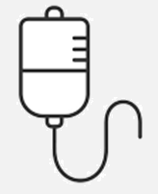
RHAPSODY-2 Study Drug Infusion/Flush
The 100ml infusion will run over 15 minutes at a rate of 400ml/hr.
The infusion should be administered peripherally.
After the infusion is complete, the entire IV line should be flushed per your site’s guidelines to ensure all study drug has been administered to the patient.
100 ML

Slide 22
RHAPSODY-2 Pharmacy Contacts
Please reach out to the StrokeNet Central Pharmacy with any RHAPSODY-2 pharmacy related questions:
StrokeNet Central Pharmacy
Chris Unger, PharmD-Lead Pharmacist for RHAPSODY-2
Hours of operation: M-F 0830-1700 (EST)
Phone: 513-584-3166
Email: RHAPSODY2RX@ucmail.uc.edu

