Slide 1
Strategy for Improving Stroke Treatment Response
Imaging Management Center Information

Slide 2
NIH StrokeNet Imaging Management Center Team
Achala Vagal, MD, MS
PI, NIH StrokeNet Imaging Management Center
Vivek Khandwala, Ph.D
Research Manager, NIH StrokeNet Imaging Management Center
Holly Wilcox, MS
Imaging CRP, NIH StrokeNet Imaging Management Center
(Primary point of contact for the sites)

Slide 3
Imaging Modalities
All brain parenchymal, vascular, and perfusion imaging modalities collected within the first 30 (+/-4) hours from drug administration should be uploaded in the central imaging database- AMBRA- within 7 days of hospitalization
Imaging modalities for baseline and 30 (+/- 4) hours from drug administration
NCCT / CTA / CTP
MRI / MRA / MRP
Choice of brain parenchymal imaging modality (i.e., CT vs MRI) for baseline is based on what is routinely performed as standard of care at your institution, however, for follow up imaging, NCCT is required.
Imaging variables will be ascertained centrally. The central readers will be blinded to the patient’s clinical data.

Slide 4
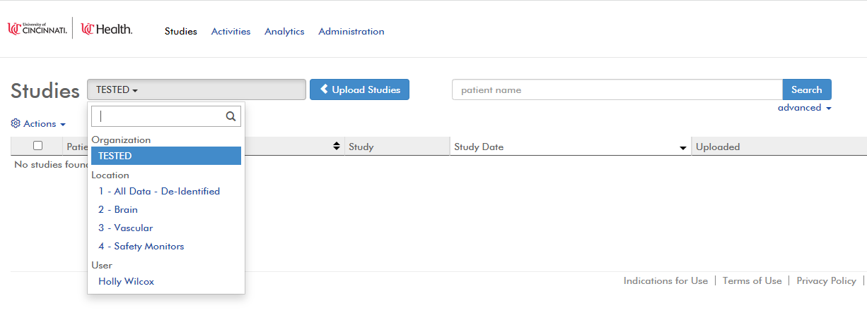
Imaging- How to Upload
Imaging will be electronically transferred from your site to the Imaging Management Center for central review using cloud based AMBRA platform.
Imaging Management Center will be working with each of the sites individually and walk them through uploading the imaging data into AMBRA platform.

Slide 5
Imaging Training
Once site is activated, Holly Wilcox (Imaging CRP) from our team will contact you to schedule individual site training
The following study personnel need to attend site imaging trainings:
Study coordinator(s)
Any other personnel that will be involved in sending images

Slide 6
Imaging Training Cont’d
During individual site training sessions, the following topics will be covered:
Navigating through the internal processes of acquiring imaging data
Instructions on accessing and uploading images into AMBRA
AMBRA accounts will be created prior to the training
Practice uploading images to AMBRA
Imaging Queries
Each site is different. Our main focus is to walk through your site’s institutional policies and processes and to determine the best workflow that allows for timely and successful upload of imaging studies for the trial.

