Slide 1
Strategy for Improving Stroke Treatment Response

Slide 2
SISTER LABORATORY TRAINING
Ryan Sullivan, DVM, RLATG
Clinical Project Manager
Translational Sciences, Inc.

Slide 3
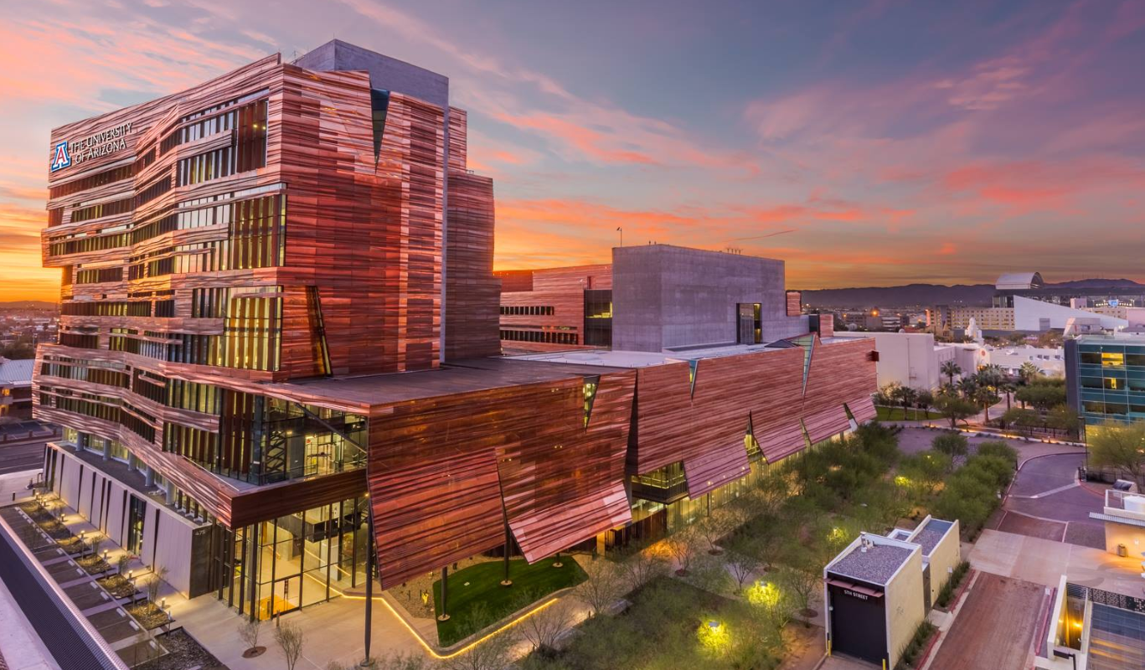
Introduction
^{REED CENTRAL LABORATORY (RCL)}
Translational Sciences, Inc. has a central laboratory located on the Phoenix Biomedical Campus in Phoenix, Arizona
^{Contacts:}
Name: | Phone: | Email:
Inna Gladysheva, PhD | 602-827-2919 | innagladysheva@arizona.edu
Joseph S.Y. Jeong, PhD | 919-282-7718 | sunyongj@translationalsciences.com
Ryan Sullivan, DVM, RLATG | 352-213-1045 | rsullivan@translationalsciences.com
UACOMP Reed Laboratory
475 N. 5th Street
Biomedical Sciences Partnership Building, 8th Floor
Phoenix, AZ 85004
USA
Notes:
All RCL frozen plasma samples will be collected from the individual Clinical Performance Sites and shipped or transferred to the RCL for further processing according to a site-specific frequency schedule (batch shipping, ~6 months)

Slide 4
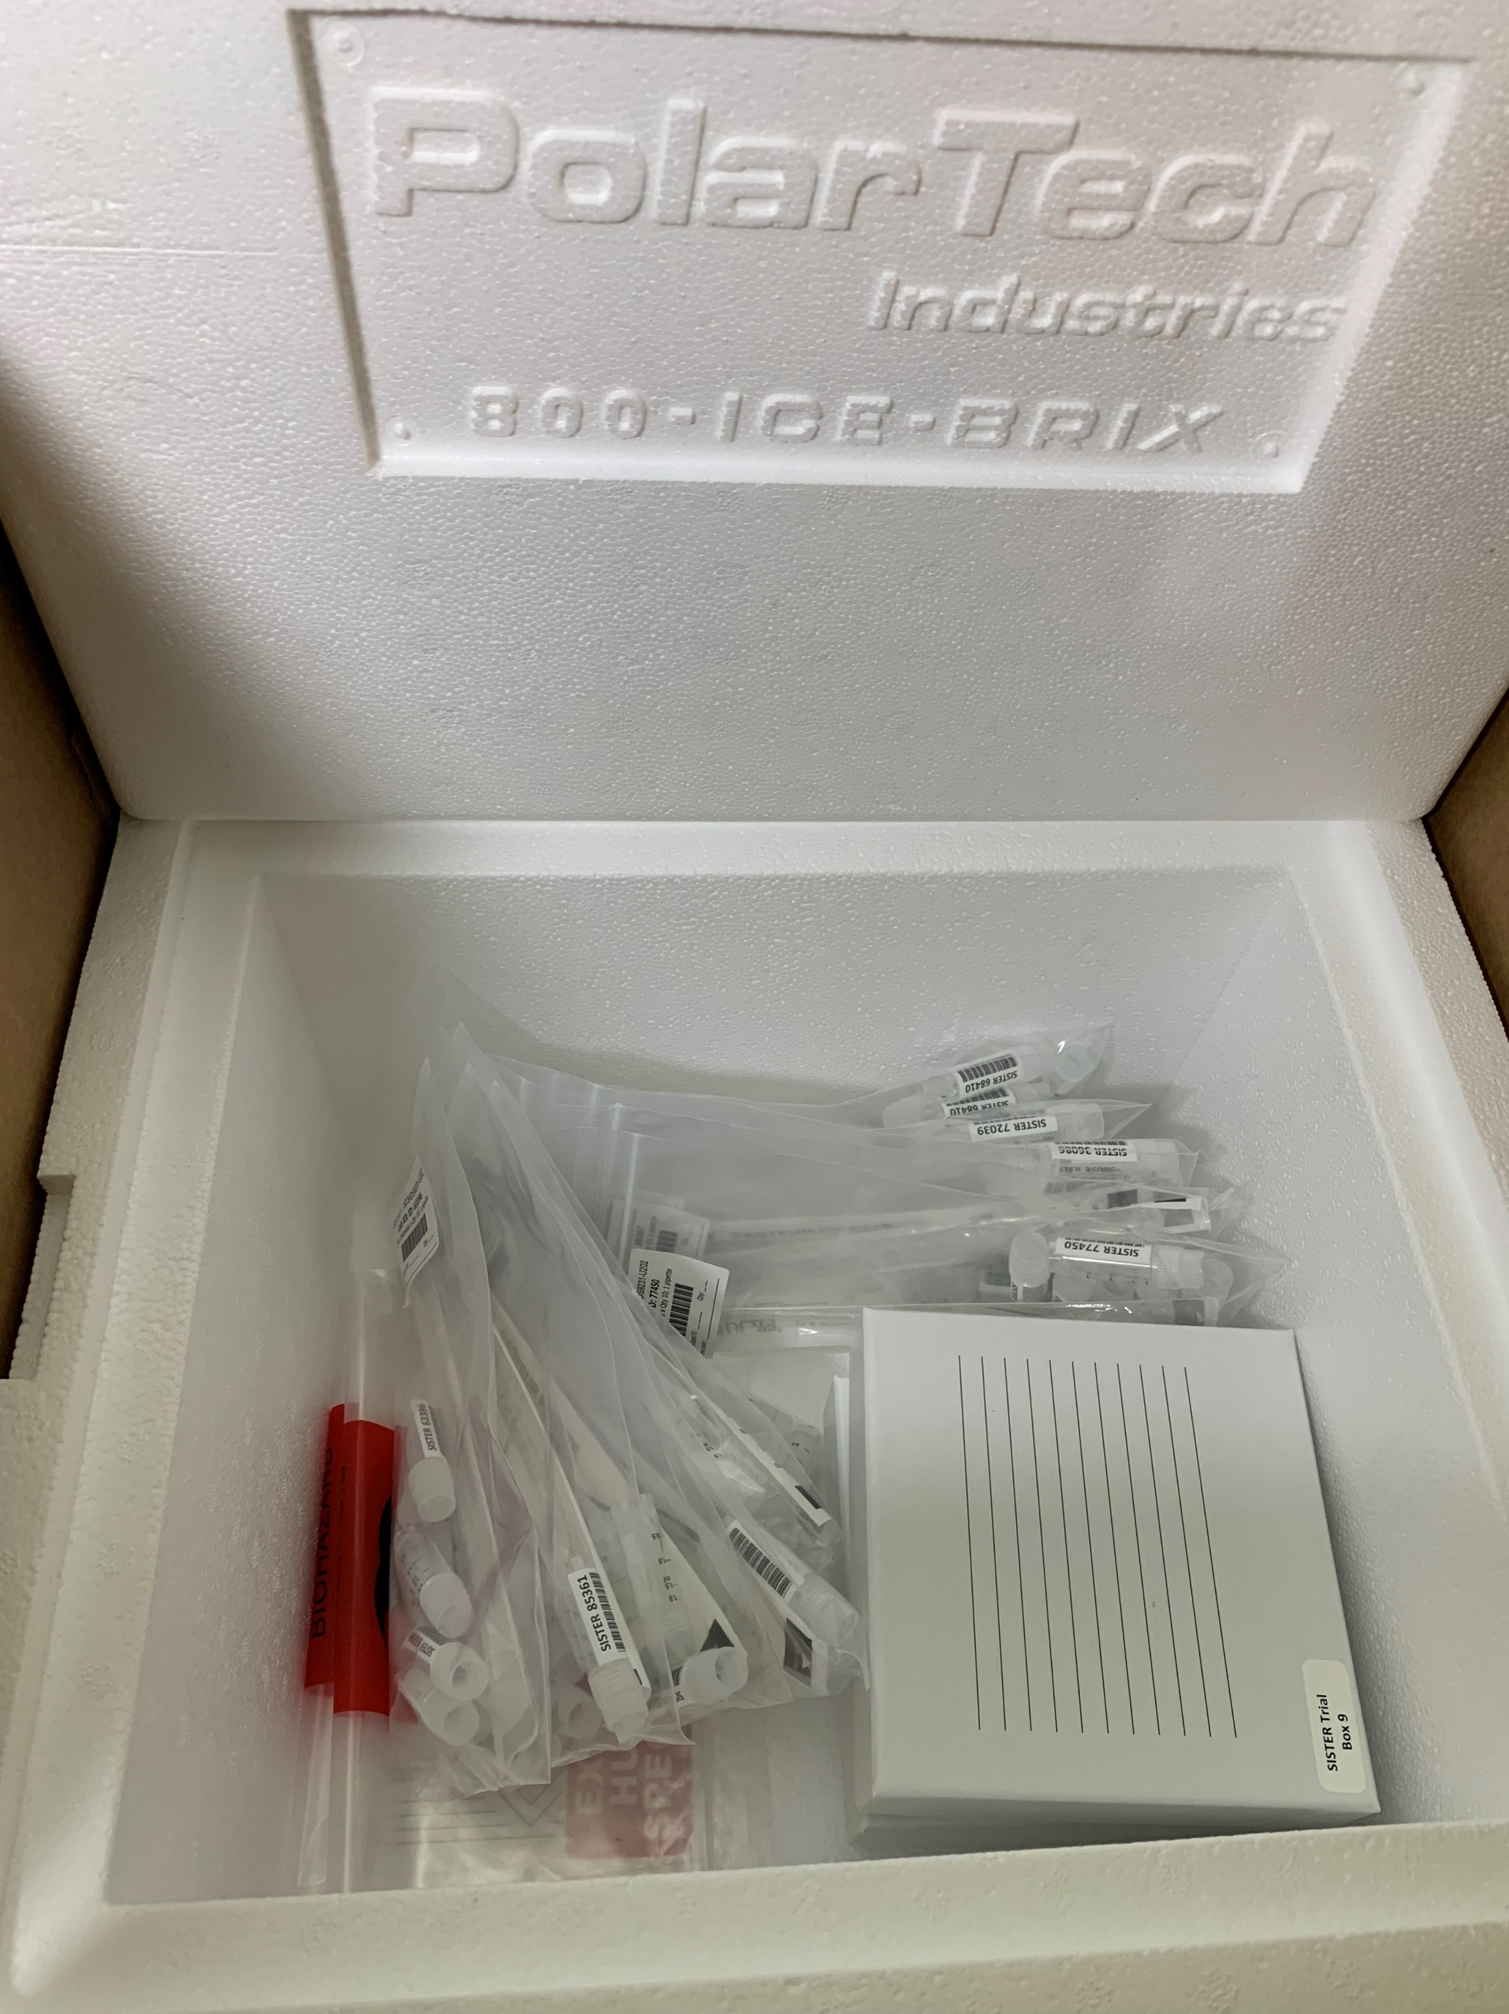
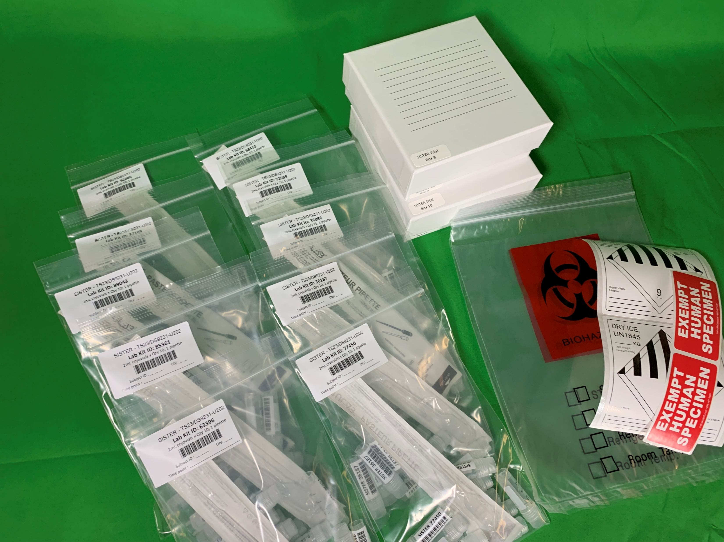
Initial Central Lab Stocking
Includes:
Lab Kits (Qty. 10)
Shipping Kit (Qty. 1)
Shipping to each site will occur when:
CTA has been executed
Site addresses have been entered into WebDCUTM
Reception should occur prior to Site Readiness Call.
Record arrival and inspection results within WebDCUTM

Slide 5
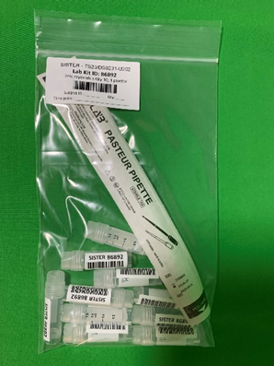
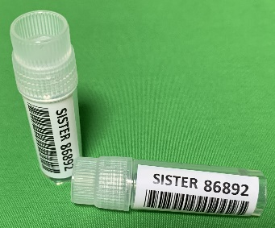
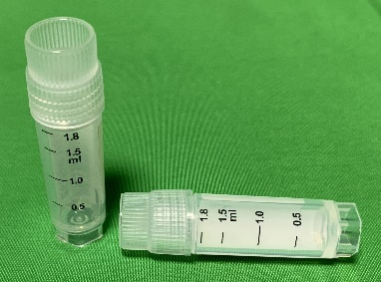
Lab Kits
Single kit for all time points.
Contents:
Kit bag: 5x8 inch zip closure w/ barcode label
2.0 mL graduated cryovials with external thread cap (Qty. 10)
Pre-labeled with Study, Lab Kit ID #, and barcode
Sterile transfer pipette* (disposable)
* No expirations
within trial period
(2028 – 07)

Slide 6
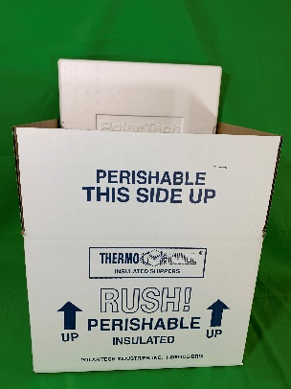
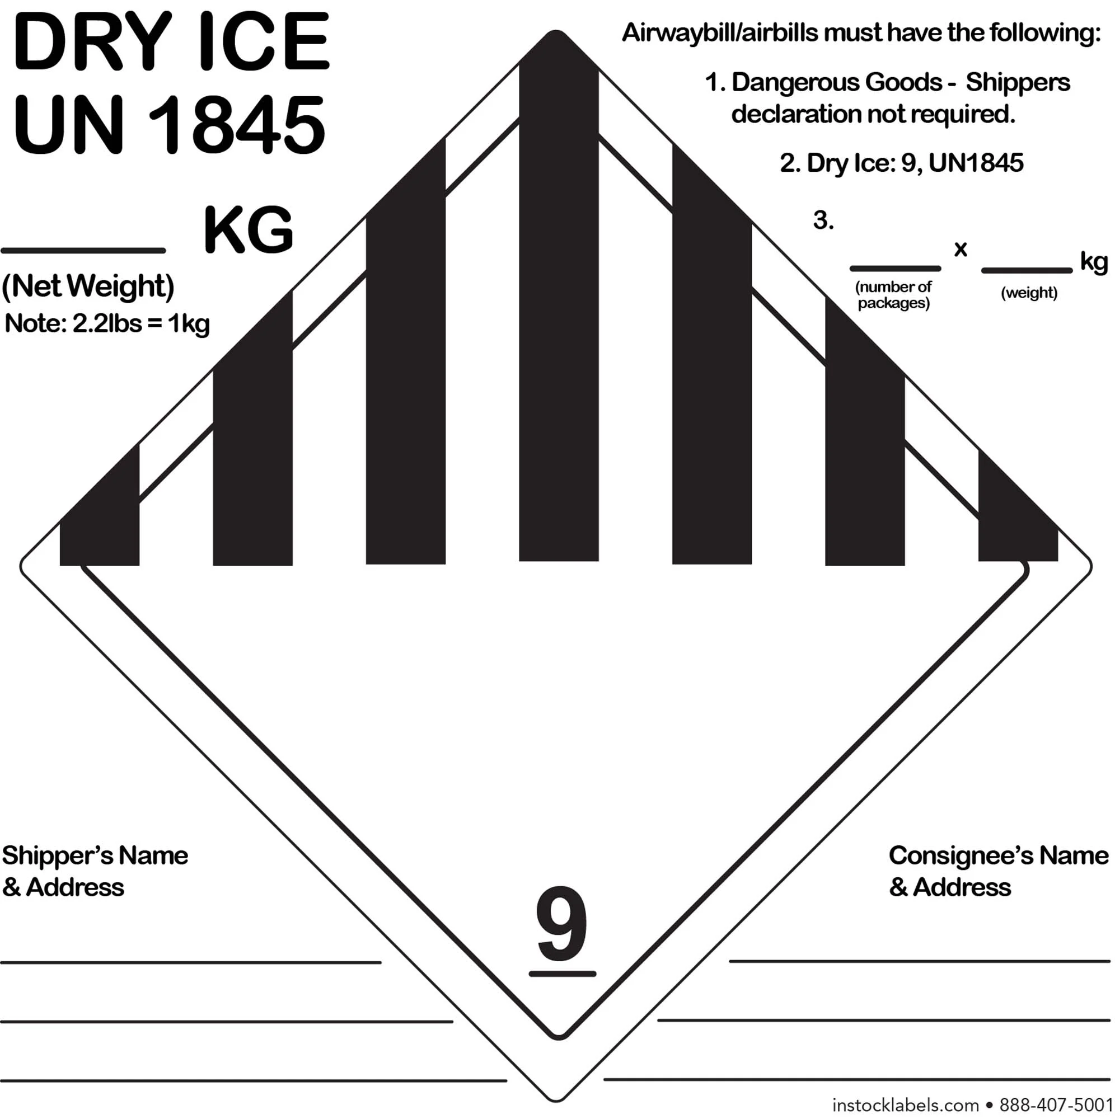
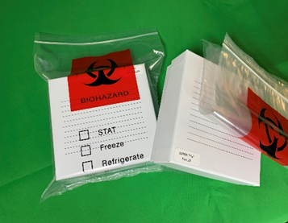
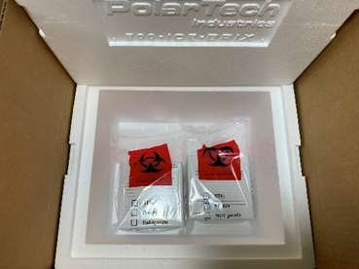
Shipping Kit
Contents:
Styrofoam shipper and exterior cardboard box (Qty. 1)
Shipping labels (Qty. 2 each)
Dry Ice UN1845
Exempt Human Specimen
Biohazard plastic bags (Qty. 2)
Storage cryoboxes (Qty. 2)
Pre-addressed shipping label

Slide 7
Site Requirements
Supplies:
Packing Tape
Sodium Citrate Tubes (light blue top)
Example: BD Vacutainer® Plus Venous Blood Collection Tube Sodium Citrate Additive 2.7 mL BD HemogardTM Closure Plastic Tube, BD#363083
Each subject will need 13 tubes total for RCL samples:
Baseline: 4 tubes
3h: 3 tubes
30h: 3 tubes
90d: 3 tubes
Dry Ice (>5kg) for shipping
Equipment:
Centrifuge (with appropriate tube size) – room temperature or refrigeration at 4-8ºC
Refrigerator 4ºC – if needing to hold samples prior to spinning
Freezer -80ºC for aliquot storage
Indelible/permanent marker (black or blue ink)

Slide 8
Central Labs Collection Schedule
 |  | Whole Blood Volume by Time Point
Test | Sample Type | Baseline | 3 ± 1 h | 30 ± 4h | 90 ± 7d | Total:
PK | plasma | 3 mL | 3 mL | 3 mL | 3 mL | 12 mL
Anti-drug antibodies | plasma | 3 mL |  |  | 6 mL | 9 mL
a2AP activity | plasma | 3 mL | 3 mL | 3 mL |  | 9 mL
MMP-9 | plasma | 3 mL | 3 mL | 3 mL |  | 9 mL
 | Total: | 12 mL | 9 mL | 9 mL | 9 mL | 39 mL
# of 2.7 mL Sodium Citrate tubes: |  | 4 | 3 | 3 | 3 | 13
~Plasma Volume (<50% Blood Volume): |  | 5 mL | 4 mL | 4 mL | 4 mL | 17 mL
Estimated 0.5 mL plasma cryovial aliquots: |  | 10 | 8 | 8 | 8 | 34
*Discard the 2 extra cryovials

Slide 9
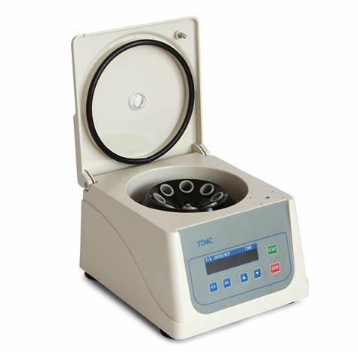
Blood Collection and Plasma Sample Processing
Steps for Plasma Sample Collection
Ensure all materials are present:
F181 Biospecimen Collection and Processing Form (WebDCUTM)
Sodium citrate 2.7mL vacutainer (Qty. 3-4) (site)
2.0 mL cryovials (clear cap, Qty. 10) with vial labels (Lab kit)
Sterile transfer pipette (Lab kit)
Collect blood samples from the subject following local institutional policies and standard procedures. Each sodium citrate tube should be filled with 2.7 mL draw volume. Tubes should be >90% filled (9:1 ratio of blood to anticoagulant).
Immediately following collection, gently invert all tubes 8-10 times, end-over-end, to ensure blood and anti-coagulant are mixed thoroughly.
Centrifuge immediately after collection at 1500 to 2000 x g (RCF) for 15 minutes at room temperature or 4 ºC to produce platelet poor plasma.
If needing to delay processing – filled sodium citrate tubes can be held at 4 ºC for up to 4 hours prior to centrifugation.¹
Using a disposable pipette, transfer plasma (avoid buffy coat) into provided cryovials in 0.5 mL aliquots (please note if a partial vial, <0.5 mL is collected).
Return filled cryovials to the laboratory kit bag with label. Fill out label with missing details (Subject ID, Qty of vials, Time point – baseline, 3h, 30h, or 90d) using an indelible/permanent marker (blue or black ink).
Freeze and store samples at -80ºC until shipment to RCL in provided study cryobox.

Slide 10
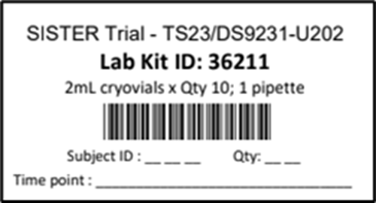
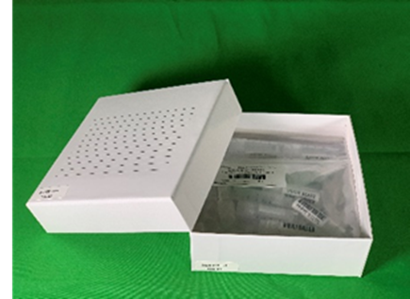
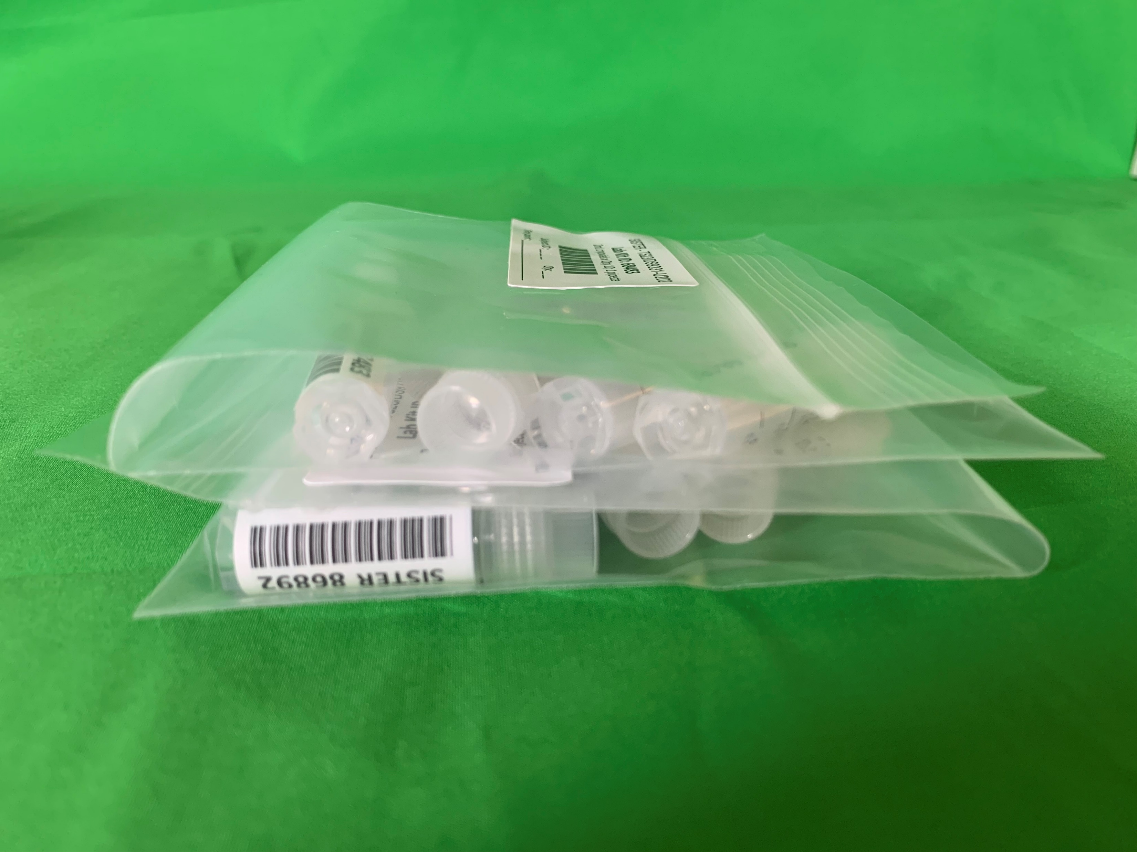
Plasma Sample Storage and Records
All aliquoted plasma samples should be stored at -80ºC until shipping to RCL.
Filled cryovials should be returned to the provided labeled Lab Kit Bag.
Fill out the label blanks with an indelible/permanent marker
Subject ID (3-digits)
Qty of cryovials (2-digits, 10 or 08)
Time point (baseline, 3h, 30h, 90d)
Place bag within the provided cryobox.
Each cryobox can hold 4 bags worth of samples.
Either as 4 single layers or rolled

Slide 11
Specimen Shipping
Frozen specimens will be shipped in the provided shipper (Shipping Kit + Dry Ice) using FedEx Priority Overnight courier service to REED CENTRAL LAB (RCL).
Designed to meet or exceed International Association of Air Transportation (IATA) and US Dept of Transportation (DOT) regulations for shipping biospecimens on dry ice.
Email rsullivan@translationalsciences.com (Ryan Sullivan) to secure a printed shipping label. Will work with site to ensure shipments avoid weekends, academic and national holidays.
The RCL will coordinate ~6-month batch shipping with the sites. Should more than the two cryoboxes (8 time points of samples) become full prior to that time, arrangements will be made to ship and restock sooner.
The RCL will automatically send replacement Shipping Kit(s)/Lab Kit(s) when receiving samples based on WebDCUTM inventory numbers.

Slide 12
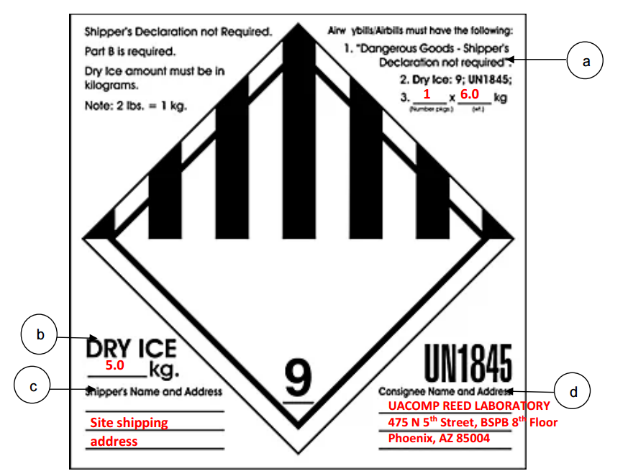
Specimen Shipping
To prepare samples for shipping:
Verify that each specimen is labeled with the appropriate kit ID number. (Labels already applied to the cryovials.)
Print a copy of F181 Biospecimen Collection and Processing and include within the box (outside of Styrofoam).
Verify that the ID on the eCRF matches the labels on the cryovials.
Place each cryobox within a biohazard plastic bag. Remove as much trapped air as possible and seal the bag. Place within Styrofoam shipper.
Add >5 kg (maximum of 10kg) of Dry Ice to shipper and close Styrofoam lid. DO NOT SEAL with tape – The evaporating CO2 gas needs to escape.
Tape the outside box closed – ensuring to leave some exposed seams for gas escape.
Attach FedEx Shipment Form to the top of the shipping box.
Fill out the provided Dry Ice label (UN1845) with necessary details and attach to the outside cardboard box along with an Exempt Human Specimen label.
Arrange for pickup per local site procedures or call FedEx at 1800-463-3339 to schedule directly for a pickup.
Once the shipping carrier is ready, follow instructions for WebDCUTM Specimen Shipping.

Slide 13
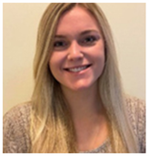
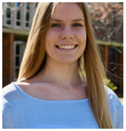
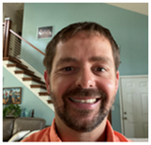
WebDCUTM
Trial Managers:
Katie Stever, MPH NDMC Data Manager
Riley Luckmann NDMC Data Manager
Aaron Perlmutter, MPH, MSW Site Monitoring Manger
Name: | Phone: | Email:
Katie Stever, MPH | 843-876-1114 | steverca@musc.edu
Aaron Perlmutter, MPH, MSW | 843-792-2784 | perlmutt@musc.edu
Riley Luckmann |  | luckmann@musc.edu

Slide 14
WebDCU™ Receiving Central Lab Kits

Slide 15
WebDCU™ Receiving Central Lab Kits

Slide 16
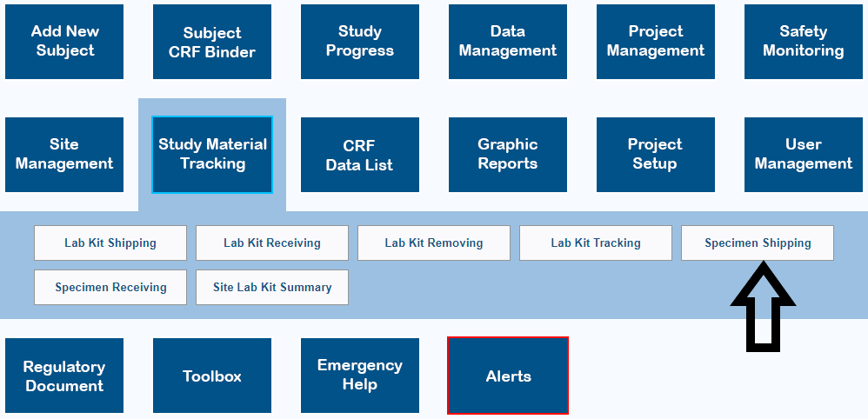
WebDCU™ Shipping Specimens to Central Lab

Slide 17
WebDCU™ Shipping Specimens to Central Lab

Slide 18
THANK YOU!
Please reach out to any of the SISTER Trial contacts to address any questions or concerns.
References: Study Protocol, Lab Manual, and MOP.

