Slide 1
SISTER PHARMACY TRAINING
NIH StrokeNet National Pharmacy Coordinating Center
Presenter: Christian Unger PharmD
NIH StrokeNet Clinical Research Pharmacist
Ph. 513-584-3166
SISTERtrialRX@ucmail.uc.edu

Slide 2
Presentation Outline
Introduction of StrokeNet Central Pharmacy
Quick overview of SISTER and TS23
How will sites receive and properly store study drug
Step-by-step SISTER infusion compounding and administration

Slide 3
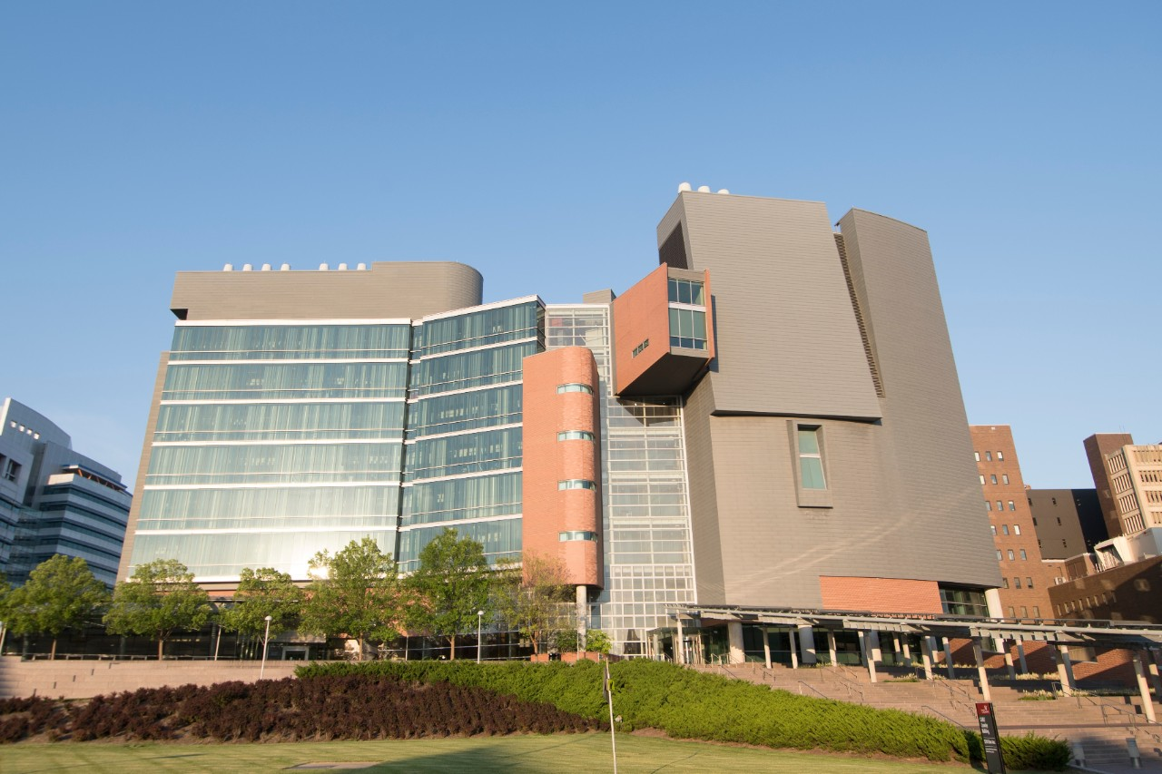
StrokeNet Central Pharmacy
StrokeNet Central Pharmacy is the distributional pharmacy for SISTER.
We are located at the University of Cincinnati Medical Sciences Building in Cincinnati, Ohio.
Our role is to ship SISTER study drug to sites and offer pharmacy support.
We are available to answer any pharmacy related questions and to help resolve any pharmacy issues.

Slide 4
SISTER Overview
SISTER will be comparing TS23 vs placebo in subjects with acute ischemic stroke.
Subjects will receive a single 200ml IV infusion of TS23 or placebo, which is prepared by the pharmacy and infused over 15 minutes.
Subjects must receive this infusion within:
4.5-24 hours of stroke onset or last known well
And
Within 90 minutes of qualifying perfusion imaging.*
* Study drug administration is encouraged within 60 minutes after qualifying perfusion image but is allowed up to 90 minutes. After 90 minutes, another perfusion image must be obtained to ensure that inclusion criteria is met.

Slide 5
SISTER Overview
SISTER will utilize weight-based dosing for subjects receiving TS23.
During the lead in phase, there will be 5 arms:
TS23 3mg/kg infusion
TS23 5mg/kg infusion
TS23 7mg/kg infusion
TS23 10mg/kg infusion
Placebo (0.9% sodium chloride infusion)
Every 50 subjects, responsive adaptive randomization updates will occur, favoring doses with the most utility.
Subjects and study teams will be blinded to which arm the subject is assigned, but the pharmacist preparing the infusion will be unblinded.

Slide 6
TS23 Overview
TS23 is a clear odorless intravenous solution that will be sent to sites in boxes containing 1-6 vials.
The concentration of TS23 in each vial is 10mg/ml.
Each vial contains 10ml, or 100mg, of TS23.
Vials must be stored under refrigeration at 2-8°C (36-46°F).
TS23

Slide 7
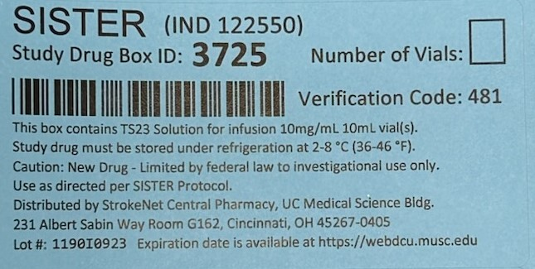
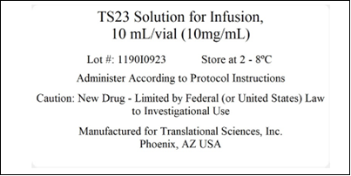
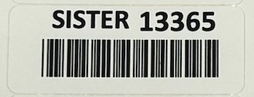
TS23 Labeling
Box Label
Each box label of TS23 will contain:
The Study Drug Box ID number
A verification code (needed for receiving the study drug in WebDCU)
The proper storage conditions.
Number of vials per box (6 vials will be initially sent to sites with each box).
Each vial label of TS23 will contain:
The volume and concentration.
The proper storage conditions.
Each vial will also have a secondary label which contains the vial ID number.
Vial Label
Secondary Vial Label

Slide 8
To receive SISTER Study Drug
Before sites can be sent study drug, the following regulatory documents must be uploaded to WebDCU
Pharmacy license
Shipping address (must match pharmacy license)
If the addresses do not match, please contact the StrokeNet Central Pharmacy and we will work with your site to approve the shipping address.
Pharmacy personnel added to site DOA list.
Pharmacy personnel do not have privileges to upload these regulatory documents to WebDCU. This information must be uploaded by the site clinical coordinator.
Once all regulatory steps have been completed, the site will be able to receive study drug and an automatic study drug shipment request will be submitted to StrokeNet Central Pharmacy.
SISTER study drug will be sent to sites immediately after their site readiness call.

Slide 9
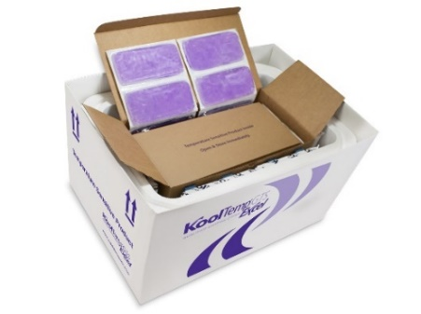
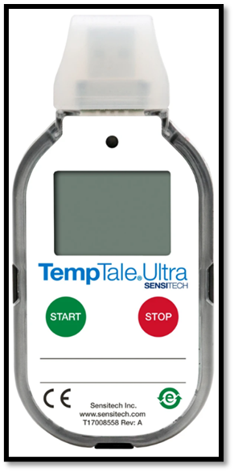
Shipment of Study Drug To Sites
SISTER study drug will be sent to sites in 6L shippers containing:
SISTER study drug boxes
A USB data logger for temperature monitoring
A packing slip detailing the contents of the shipment
Enough cold packs and insulation to maintain a temperature of 2-8⁰ C.
StrokeNet Central Pharmacy will send study drug overnight for next day morning delivery through UPS.
Study drug is shipped Monday – Wednesday for delivery Tuesday – Thursday. Study drug is not delivered on weekends or holidays.
The USB data logger can be discarded if the study drug shipment did not experience a temperature excursion.

Slide 10
Receiving Study Drug Into WebDCU
The next 5 slides will be presented by:
Aaron Perlmutter, MPH, MSW, Site Monitoring Manager
These slides will provide step-by-step on how to check study drug into WebDCU once you receive it at your site.

Slide 11
Receiving Study Drug Into WebDCU
Log into WebDCU and navigate to the SISTER page by clicking on the SISTER ICON.
Under “Drug Tracking” click on “Drug Site Receiving”

Slide 12
Receiving Study Drug Into WebDCU
Click on the blue number next to your site ID number (which can be found on the shipment packing slip) or your site name.

Slide 13
Receiving Study Drug Into WebDCU
Click on edit record.

Slide 14
Receiving Study Drug Into WebDCU
Change the receiving status to “confirmed received”.
Enter in the date received.
Enter in the verification code of the BOX of TS23 vials, which is found on the SISTER BOX label.

Slide 15
Receiving Study Drug Into WebDCU
Once all information has been entered, you have successfully checked SISTER study drug in to WebDCU.

Slide 16
SISTER Study Drug Storage
TS23 vials should be stored in the local site pharmacy refrigerator at 2-8⁰C.
This refrigerator must be monitored continuously for temperature excursions and at a minimum, daily maximum and minimum temperature readings must be recorded.
It is preferable to have:
Automated and continuous temperature monitoring with an alarm system in place.
A visual alarm and preferably an audible alarm with automatic telephone, SMS text warnings, or email messages to key personnel recommended.
Sites are required to maintain study drug accountability records and temperature monitoring logs.
SISTER specific temperature monitoring and accountability logs are available for use in WebDCU. (WebDCU™>SISTER>Project Documents)
Sites may use their own temperature monitoring log/ accountability records if they are equivalent to the SISTER logs.
These records must be kept from time of study drug receipt until the end of the site’s participation in the trial and must be available during monitoring visits.
2-8⁰C

Slide 17
SISTER Temperature Excursions
A temperature excursion occurs when the storage temperature for study drug falls outside of the 2-8⁰C temperature range.
A temperature excursion can occur during in-transit delivery of study drug to sites or during the regular storage of study drug at sites.
USP rounding rules do apply for temperature monitoring, for example:
1.5 ⁰C would be rounded up to 2 ⁰C
8.4 ⁰C would be rounded down to 8 ⁰C
Both of the above examples would not be a temperature excursion.
Temperature excursions with the duration up to a max of 30 minutes and with no previous excursions, do not need to be reported.

Slide 18
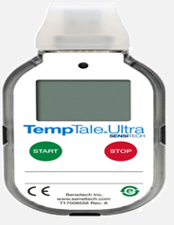
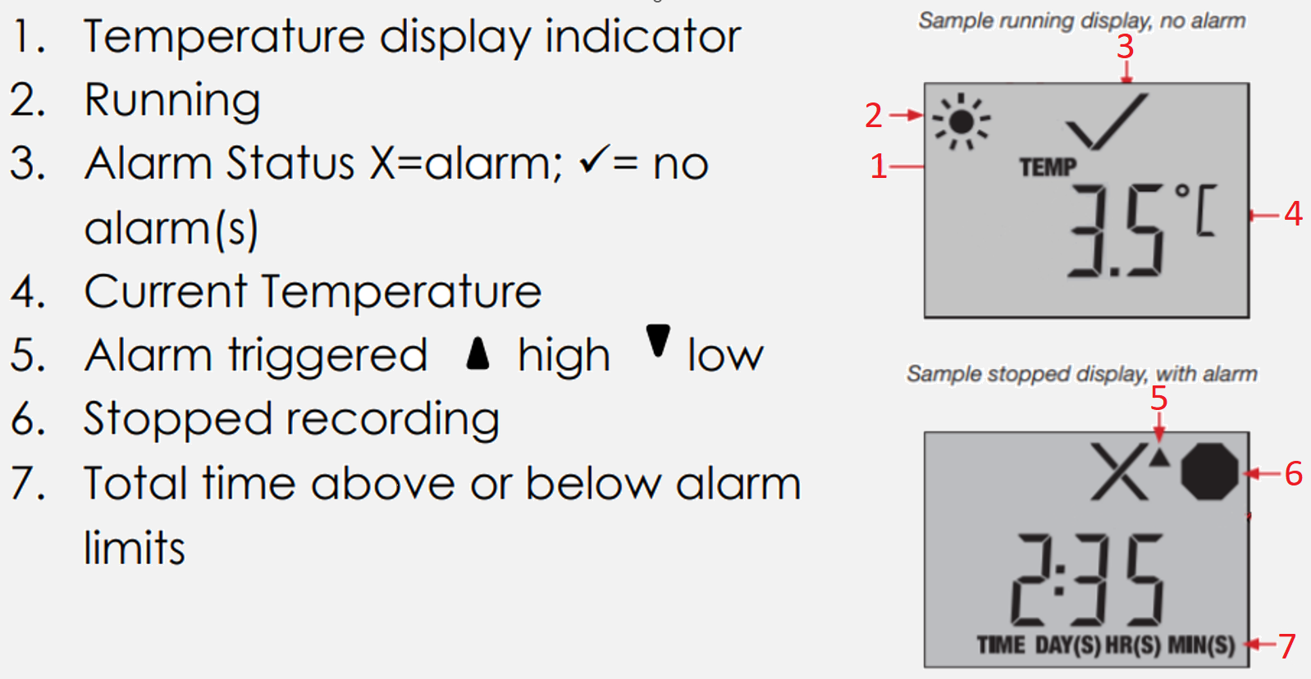
SISTER Temperature Excursions
If a temperature excursion does occur, affected study drug should be quarantined and placed in an appropriate storage temperature of 2-8⁰C.
Any known temperature excursions should be reported as soon as possible (must be within 48hrs).
The Temperature Excusion Report Form contains instructions on how to report he excursion.
Submit the following documents for temperature excursions
Temperature Excursion Report Form (TERF)
available in WebDCU™
WebDCU>SISTER>Toolbox>Project Documents
Submit a TERF for both storage and in transit excursions.
For in-transit excursions only, the data log from the USB
data logger must also be sent along with a completed
TERF.

Slide 19
Study Drug Expiration Dates
Expiration dates for SISTER study drug can be found:
WebDCU™ (Drug Tracking Tab> Site Drug Kit Removing)
SISTER study drug shipment packing slip
Sites will receive emails from WebDCU™ and StrokeNet Central Pharmacy when kits are nearing their expiration
Emails will contain instructions on how to handle expiring kits and when to expect replacement kits
Replacement kits will be sent before current inventory expirations to prevent sites from running out of study drug.
Due to ongoing stability testing, expiration dates of SISTER study drug may be extended.

Slide 20
Expired or Unusable Study Drug
Any expired, damaged, or otherwise unusable study drug may be destroyed per your site’s local drug destruction policies, only when given permission by the StrokeNet Central Pharmacy.
Study drug must be removed from WebDCU before it is physically destroyed at sites.
StrokeNet can accept returns for destruction of study drug if needed, at the expense of the site.
Instructions for the return of SISTER study drug are available in the SISTER Pharmacy MOP.

Slide 21
Drug Supplies Not Supplied To Sites
For SISTER, placebo will be a single infusion of 200ml 0.9% sodium chloride.
StrokeNet Central Pharmacy WILL NOT supply sites 0.9% sodium chloride.
For subjects who require placebo doses, sites will use a 250ml 0.9% sodium chloride bag from their local site inventory with the appropriate volume of 0.9% sodium chloride removed.
Sites will also need to use from their local inventory an IV extension set with 0.22-micron filter, Non-DEHP for the study drug infusion.

Slide 22
SISTER Blinding
SISTER is a double-blind study where the investigators and the subjects do not know which arm the subject is assigned to.
The pharmacy team members preparing the doses of study drug will be unblinded.
Study staff and subjects must remain blinded throughout the duration of the study. It is important for the pharmacy staff to not communicate any issues with drug inventory or dosing with study team members.
Only pharmacy staff should check-in, store, or have access to SISTER study drug.

Slide 23
Randomization Code List
To maintain blinding, SISTER will utilize a randomization code list with randomization codes that correspond to the treatment arm the subject will be assigned.
Once sites are shipped study drug, they will be able to access a randomization code list.
This code list should be stored in the pharmacy in a SISTER specific binder, and never given to study staff.
The SISTER pharmacy binder, code list, SISTER study drug should be easily accessible to after-hour pharmacy staff.

Slide 24
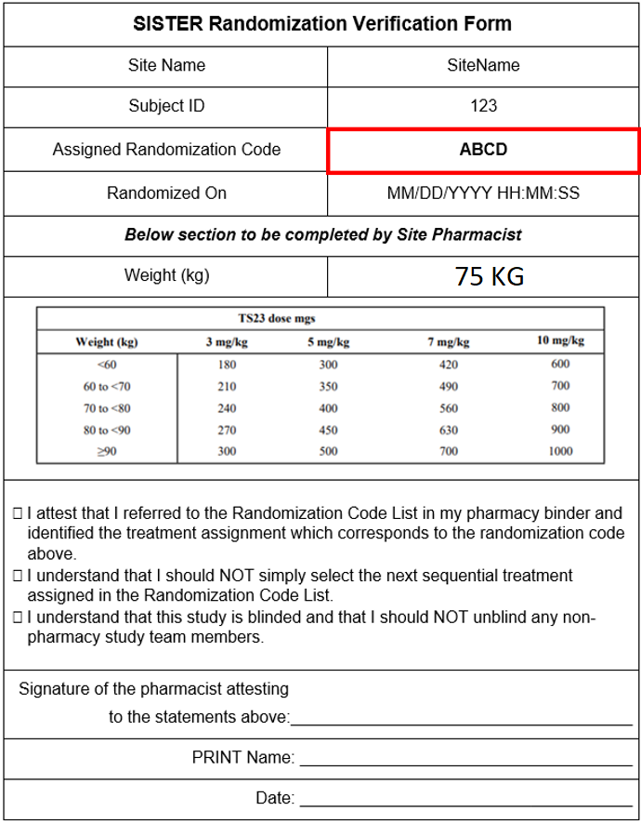
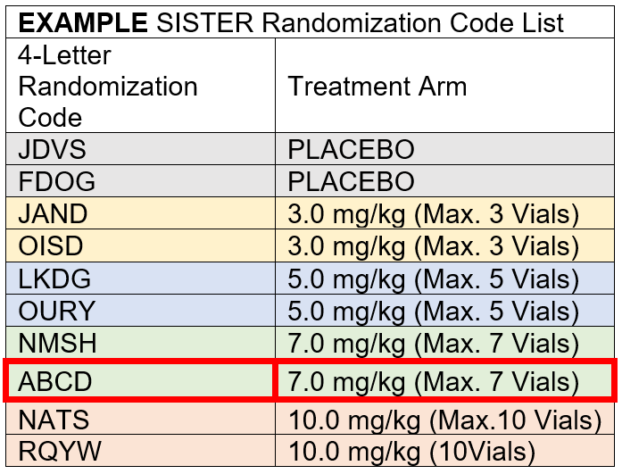
SISTER Blinding
Once a subject is randomized, a randomization verification form will be generated by WebDCU that includes subject specific information and a randomization code.
The study team will supply the pharmacist with the randomization verification form.
The pharmacist will then match the randomization codes to determine the arm the subject is assigned.
Pharmacist must complete the bottom of the randomization verification form and store in the pharmacy for monitoring visits.

Slide 25
SISTER Blinding

Slide 26
SISTER IV Infusion Compounding
Subjects will receive an IV infusion of either TS23 or placebo.
Sterile compounding is required when preparing TS23 or placebo for subjects.
Compounding should be done in a sterile hood following your site’s guidelines for the compounding of sterile infusions.
Once compounded, the IV bag is good for 12 hours at room temperature.

Slide 27
SISTER IV Infusion Compounding
The following steps are needed to be done by pharmacy in the preparation of SISTER study drug:
Determine what treatment arm the subject has been assigned.
Obtain the appropriate number of TS23 vials needed to compound the infusion and a 250ml 0.9% sodium chloride bag.
In a sterile environment, remove the appropriate volume of solution from the 0.9% sodium chloride bag.
In a sterile environment, add the appropriate amount of TS23 to the 0.9% sodium chloride bag and mix the bag.
Label the resulting IV mixture and deliver to the study team for administration.
Record the TS23 vial ID numbers used and enter into WebDCU.

Slide 28
Determining the Treatment Arm
The pharmacists obtains the SISTER randomization verification form from the study team member who randomized the subject.
Match the 4-letter randomization code on the SISTER Randomization Verification Form with the 4-letter code on the SISTER Randomization Code List to determine the assigned treatment arm for the subject.

Slide 29
Obtaining the TS23 Vials
Using the subject's weight and assigned treatment arm, determine the TS23 dose from the TS23 Dosing Table (Table 1) .
Obtain the appropriate number of vials required for the TS23 dose from a SISTER study box. The TS23 study drug is provided in 10 ml vials at a concentration of 10 mg/ml. For example, if subject 123 was assigned to the 7.0 mg/kg arm and weighs 75 kg, they will receive a TS23 infusion of 560 mg. To compound the infusion, 6 vials of TS23 will be needed.

Slide 30
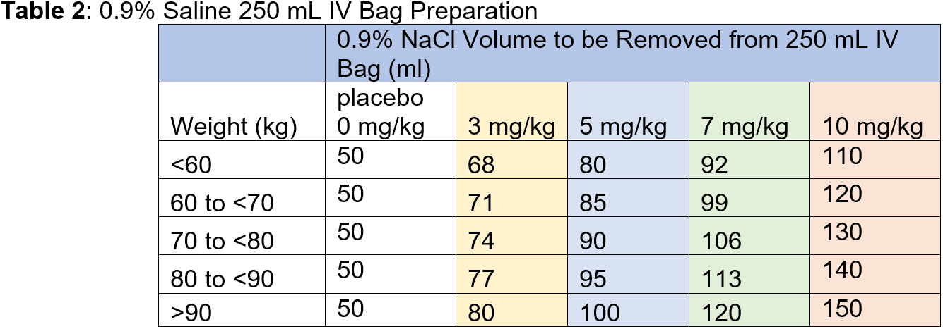
Preparing the Diluent Bag
Obtain a 250mL 0.9% sodium chloride infusion bag from your local inventory.
Using aseptic technique, remove the required volume from the 250 mL 0.9% sodium chloride IV bag based on Table 2. The remaining volume in the IV bag will be used as diluent for the final TS23 infusion.

Slide 31
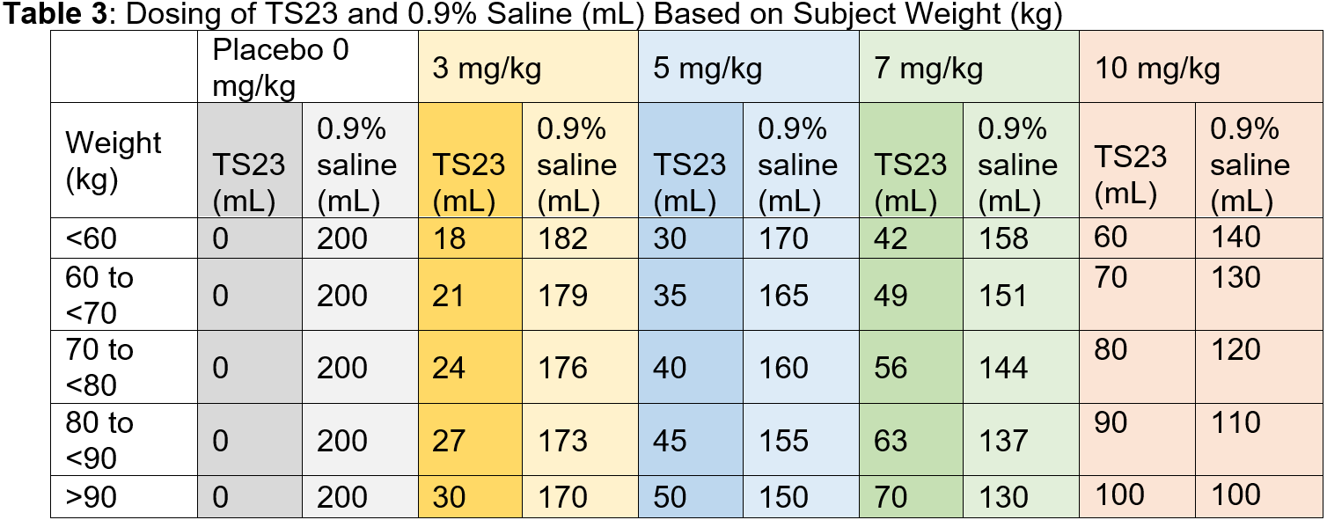
Add the TS23
Visually inspect each vial of TS23 to ensure absence of particulates in solution.
Using aseptic technique, withdraw the appropriate weight-based dose of TS23 (see Table 3) from the TS23 vials and add to the IV bag containing the 0.9% sodium chloride to make a final solution for infusion (200 mL total volume). For example, subject 123 assigned to the 7mg/kg arm and weighing 75kg will need 56ml of TS23.

Slide 32
Mixing and Labeling the Infusion
Mix the IV bag by slowly inverting the IV bag 5 times, do not shake the bag.
An IV label should be applied to the prepared bag in accordance with local policy and should include the following information at a minimum:
Protocol number (TS23/DS9231-U202)
Subject initials
Subject ID
Total volume (200 mL)
Infusion rate/duration
Time/date prepared
Expiration information (i.e., 12 hours following the start time of preparation).
There is to be no difference between active and placebo bag appearance or label.
11. Once the TS23 Infusion has been properly compounded and labeled, it can be given to the study team for administration.

Slide 33
Recording the SISTER Vial Numbers
Each vial of TS23 will have a unique 5-digit numerical code. This number should be recorded before any used vials are discarded. These numbers should be recorded such that only unblinded pharmacy staff at the site have access and should not be accessible to anyone else without the expressed consent of the SISTER primary investigator.
Once the vial numbers are recorded, the vial numbers should be entered into WebDCU™ no later than 72 hrs. post randomization.
The used TS23 vials can be discarded and documented per site’s local guidelines for destruction once the vial numbers have been recorded at the site level and in WebDCU™.

Slide 34
Placebo Step-By-Step Compounding
Subjects assigned to the placebo arm will receive a 200ml infusion of 0.9% sodium chloride.
Obtain a 250ml 0.9% sodium chloride IV bag from your site’s local inventory.
Using proper aseptic technique, withdraw 50ml from the 250ml 0.9% sodium chloride bag.
The placebo dose is now ready to be labeled following the same steps outlined for the TS23 infusion on slide 32.
After proper labeling, the placebo infusion can be delivered to the study team for administration.

Slide 35
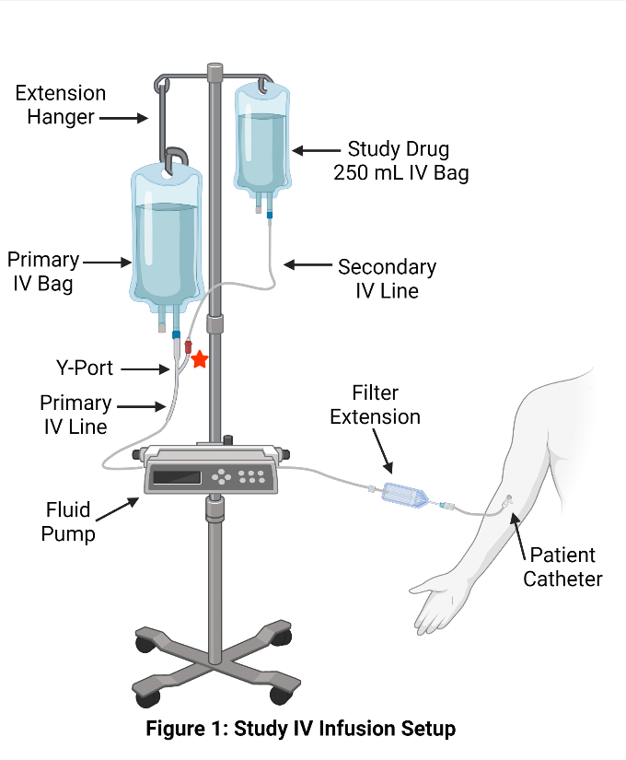
Study Drug Administration
After preparation, the SISTER infusion bag will be delivered to the subject’s bedside by a study team member or pharmacy member. Follow the listed steps below for administration of study drug:
Study drug will be infused intravenously through a peripheral vein at a constant rate over 15 minutes.
Study drug should be administered in a dedicated secondary IV line. An intravenous piggyback (IVPB) system should be used, with the 0.9% sodium chloride as the primary bag/flush fluids. The secondary line should be primed with the study drug and should NOT be back primed.

Slide 36
Study Drug Administration
Study drug will be administered via IV infusion using an infusion set, sterile filter, and an IV piggyback flush.
An infusion pump should be used to control the rate of infusion.
Total infusion volume with the primary/flush IV fluids and study drug (200mL) will be 240 mL, given at a rate of 13.3 mL/minute, with total duration of 18 minutes (~15 minutes of study drug, ~3 minutes for priming and flushing the IV lines).

Slide 37
Study Drug Administration
If a hypersensitivity reaction develops, the infusion of the study drug should be stopped, and the study drug bag/tubing disconnected from the subject. A separate 0.9% sodium chloride bag and line may be started to administer medications as required, and the subject treated accordingly.
An adverse event (AE) should be immediately reported by the study staff via the electronic database.
When the study drug administration has been completed, discard the empty study drug bag/tubing in accordance with local protocol.

Slide 38
Pharmacy Contact
If you have any pharmacy related questions, please feel free to contact:
StrokeNet Central Pharmacy
SISTERtrialRX@ucmail.uc.edu
513-584-3166
M-F 0830-1700

