Slide 1

Strategy for Improving Stroke Treatment Response
Protocol Version 3.0

Slide 2

SISTER Leadership Team:
Principal Investigators
Eva Mistry, MBBS, MSCI
SISTER Protocol PI
Guy Reed, MD, MS
TS23 Inventor and IND holder
Jordan Elm, PhD
Statistical PI
Pooja Khatri, MD, MSc
SISTER Contact PI

Slide 3
SISTER Leadership Team:
Trial Managers
Pam Plummer, MSN, RC, CCRC
NCC Project Manager
Jessica Griffin, MHA
Interim Site Monitoring Manger
Rebeca Aragon Garcia, BS, CCRC Prime Project Manager
Riley Luckmann NDMC Data Manager

Slide 4

SISTER Leadership Team
NIH StrokeNet National Coordinating Center
NINDS Program Support
Joseph Broderick, MD, MSc, NCC Co-Director
Iris Davis, NCC Administrative Co-Director
Scott Janis, PhD, NINDS Program Scientist
Mariam Afzal, BA, NINDS Program Official

Slide 5

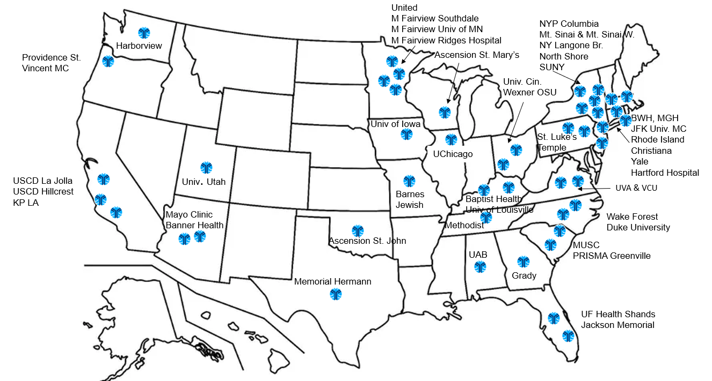
SISTER Sites

Slide 6
SISTER Timeline
Summer 2023
Grant Notice of Award (NoA)
Sites invited to participate
Fall 2023
CTA & cIRB completed within 6 weeks
January 2024
Virtual Investigator Meeting
February 2024
Site Readiness Calls
March 2024
10 Sites Open
April 2024
20 total sites open
cIRB and CTA packets to sites
1st patient enrolled
Individual site imaging training
Update: May 2, 2025
44 Sites/48 open with 34 participants randomized

Slide 7
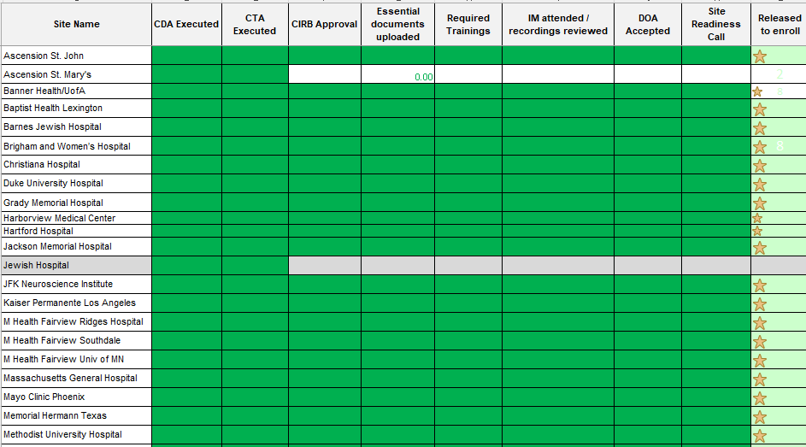
SISTER Site Status

Slide 8
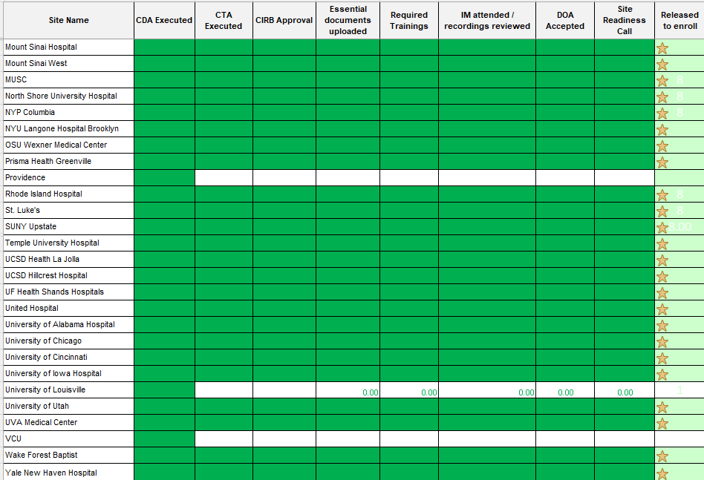
SISTER Site Status

Slide 9

TS23 Study Drug Background
Guy Reed, MD, MS
TS23 Inventor and IND holder

Slide 10

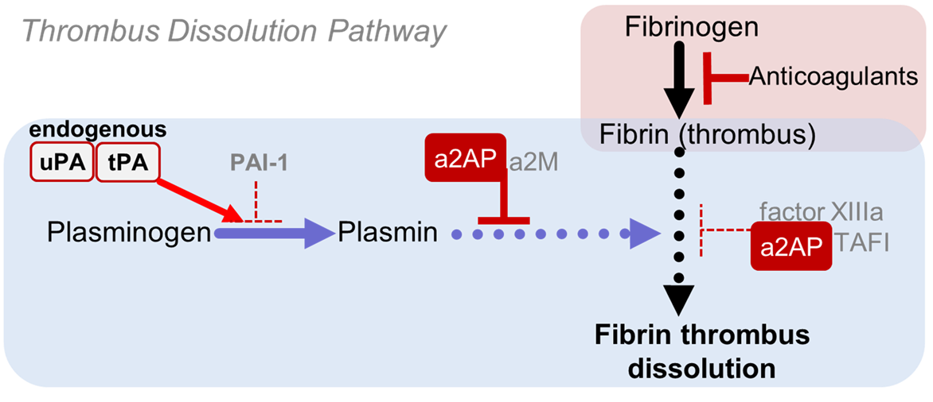
Thrombus dissolution improves outcomes in AIS
Old Paradigm
Thrombi are dissolved only by plasmin
Endogenous plasminogen activators (tPA and uPA) generate plasmin, but levels are too low for pathologic thrombus dissolution
Other molecules such as PAI-1, a2AP, a2M, TAFI, factor XIIIa protect against therapeutic plasminogen activator-induced bleeding
a2AP, a2M
a2AP

Slide 11
Thrombus dissolution improves outcomes in AIS
Traditional Therapeutic Paradigm
Pharmacologic therapy with TPA (or TNK)
  ⇧ tPA blood levels by ~1000-fold
  massive plasmin generation to dissolve thrombi
TPA-induced thrombus dissolution
a2AP, a2M
a2AP
TPA therapy

Slide 12
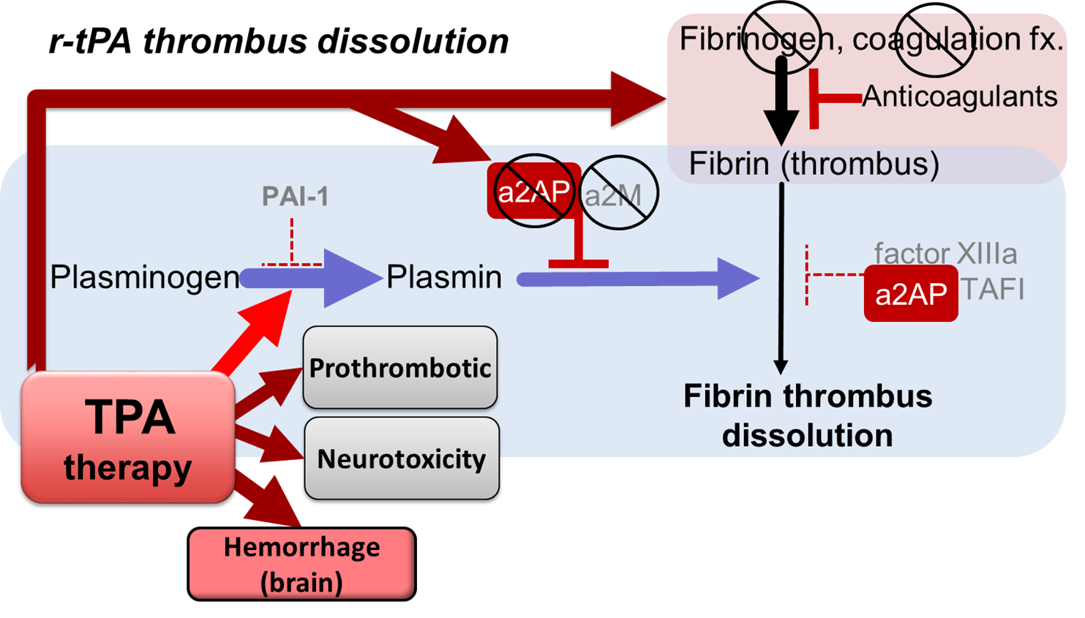
Limitations of TPA/TNK therapy
Depletes regulatory molecules, clotting factors
Causes bleeding, neurotoxic, prothrombotic effects that limit patient benefit
Limitations



a2AP,

a2AP

Slide 13
Targeting a2AP to dissolve thrombi
New Paradigm- a2AP as master regulator
a2AP - “puts the brakes on endogenous thrombus dissolution” by inhibiting plasmin
Clots from a2AP-deficient humans and mice dissolve spontaneously
Complete a2AP deficiency tolerated life-long (to old age) in humans and mice
Normal PT, PTT, platelets, fibrinogen
a2AP-deficient individuals can tolerate severe hemostatic challenges (e.g., cardiac surgery) with ε-aminocaproic acid or tranexamic acid
a2AP, a2M
a2AP
a2AP-inhibitors may be safe and effective for ischemic stroke
Harish, Blood Coag Fibrinolysis, 2006; Lijnen, Bloood 1999; Favier, Brit J Haematology, 2001

Slide 14
Experimental Evidence for targeting a2AP
Experimental ischemic stroke (TE, tMCAO, pMCAO), pulmonary embolism, venous thrombosis vs. controls, r-tPA
  Different species: mice, ferrets, rabbits
  a2AP-I or a2AP deficiency reduces
    ischemic brain infarction, swelling and hemorrhage
    mortality, inflammation, BBB breakdown
  a2AP-I has
    much longer therapeutic window than r-tPA
    potency of higher-dose rtPA, without causing bleeding
Houng, Exp Neurology, 2014; Reed, Arterioscler Thromb Vasc Biol, 2014; Singh, Circulation, 2017; Singh, Blood, 2019

Slide 15
Targeting a2AP- similar findings in labs worldwide
Preclinical studies targeting a2AP
Experimental Model | Species, Lab, Ref. | Model | Treatment v. Control | Thrombus Dissolution v. Control | Outcomes vs Controls | Bleeding v. Control
Ischemic Stroke | Mice ¹; Reed et al, USA Arterioscler Thromb Vasc Biol. 2014;34:2586-93. | MCA thromboembolism, blinded | KO vs. WT, a2AP-i vs. r-tPA vs. saline | ⇧  | survival (dose-response), infarction, bleeding, disability | ⇩
Ischemic Stroke | Mice ²; Reed et al, USA Experiment. Neuro. 2014; 255C:56-62. | MCA thromboembolism, blinded | a2AP-i + tPA v. tPA | ⇧ | survival, infarction, bleeding | ⇩
Ischemic Stroke | Mice³ Collen, Lijnen, et al, Belgium Blood. 2001;97:3086-92. | MCA ligation | KO v. WT a2AP-i vs. control | NA | ⇩ infarct | NA
Ischemic Stroke | Rats⁴; Suzuki, Nagai, et al. Belgium, China. Radiology. 2007;244:429-38. | Photothrombosis | Control, r-tPA vs. microplasmin | NA | infarction | ⇩ (one dose)
Venous & arterial thrombosis | Mice^{5;} Matsuno, Gifu, JP Thromb Haemost 2002;87:98-104. | Arterial & venous endothelial injury | KO v. WT | ⇧ | Spontaneous reperfusion | NC
Venous & arterial thrombosis | Rabbits⁶ Reed, USA Circulation.1990;82:164-8. | Jugular vein thrombosis | a2AP-i v. tPA | ⇧ | NA | ND
VTE prevention | Mice⁷ ;Reed, USA Blood.2019;134:970-978. | IVC stasis thrombosis | a2AP-i v. control, KO v. WT | ⇧ | venous thrombosis | ⬄
Pulmonary embolism | Mice⁸ Reed, USA Circulation.2017;135:1011-1020. | Autologous PE | a2AP-I v tPA, control; tPA | ⇧ | Synergism of a2AP-i with r-tPA | ⇩
Pulmonary embolism | Mice⁹ ;Matsuno, Gifu, JP J Thromb Haemost 2003;1:1734-9. | Photochemical thrombosis | KO v. WT vs r-tPA | ⇧ | a2AP KO and tPA synergistic,survival | NC
Pulmonary embolism | Mice¹⁰, Collen, Lijnen, Belgium Thromb Haemost. 2001;86:640-6. | Autologous PE | a2AP KO v. WT | ⇧ | Spontaneous dissolution of PE in a2AP KO mice | NC
Pulmonary embolism | Ferret¹¹ Reed, USA Circulation.1997;95:1886-91 | Human PE | a2AP-i, a2AP-i + r-tPA, r-tPA, Control | ⇧ | Synergism; a2AP-I + low dose r-tPA > than higher dose r-tPA- | NC
Human clot lysis | Booth¹² et al. Scotland J Thromb Haemost. 2007;5:812-7. | Human clots | a2AP-i | ⇧ | a2AP inhibits clot lysis > PAI-1, TAFI | NA

Slide 16
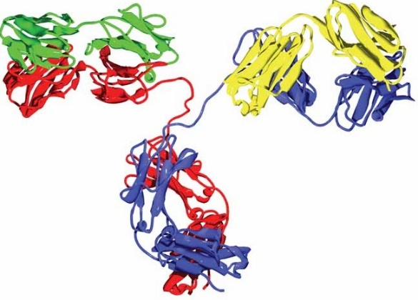
Development of TS23- novel a2AP-I
First-in-class, monoclonal antibody inhibitor of a2AP
Developed with NIH/NINDS support
  (e.g., NS073147, NS089707, HL092750)
NOAEL in safety tox studies at 20-fold higher than trial doses
Safe and effective in Phase I – no TS23-related SAE
Theoretical toxicities and reversal agents:
  Potential bleeding (though hemorrhage reduced experimentally)
    Antidote: Amicar (ε-aminocaproic acid), Lysteda (tranexamic acid)
  Potential antibody-associated allergic reactions (none seen)
TS23

Slide 17
SISTER Protocol
Eva Mistry, MBBS, MSCI
SISTER Protocol PI

Slide 18
Study Description
  Phase-2
  Prospective
  Randomized
  Placebo-controlled
  Blinded
  Adaptive Dose Finding

Slide 19
SISTER:
Basic Study Information
Study Population:
300 adults (≥18 years) with acute ischemic stroke
Study Duration:
Study intervention:
Participant Duration
Recruitment period 36 months
4 dosing arms and a control arm
3,5,7,10 mg/kg (max 300, 500,700, 1000 mg respectively) diluted in 200 ml NS and NS control
90 days

Slide 20
Study Objective
Primary Objective:
To identify a dose of TS23 that is safe and potentially more efficacious than placebo for the treatment of patients from 4.5 to 24 hours of ischemic stroke onset, who have evidence of core-penumbra mismatch on perfusion imaging.

Slide 21

Study Population
≥18 years old with anterior circulation acute ischemic stroke
NIHSS ≥4, with disabling stroke if NIHSS is 4-5, and are able to receive study drug within 4.5-24 hours after stroke onset or last known well
Evidence of core-penumbra mismatch on baseline perfusion imaging
Notes:
Detailed inclusion and exclusion criteria will be cover in the next few slides

Slide 22

Key Inclusion Criteria
Age 18 years and older
Suspected anterior circulation acute ischemic stroke
NIH Stroke Scale score ≥ 4 prior to randomization.
● The participant must have a clearly disabling deficit if NIHSS is 4-5.
4. Favorable baseline neuroimaging consisting of all of the following:
  ASPECTS of 6 or more on CT (or ASPECTS of ≥ 7 on MRI)
  Favorable perfusion imaging on CT perfusion (CTP)/MR-perfusion weighted imaging (PWI) consisting of all of the following:
    Mismatch ratio of penumbra:core >1.2
    Mismatch volume >10 cc
    Core <70 cc
5. Able to receive assigned study drug within 4.5 to 24 hours of stroke onset or last known well.
6. Able to receive assigned study drug within 90 minutes of qualifying perfusion imaging.*
Notes:
Can re-do imaging if 90 minutes are passed
Fetal PCA is allowed
Patient sitting overnight
What is the core larger than CTP?
What if Viz and RAPID show different cores?- go by RAPID.

Slide 23
Key Exclusion Criteria
Received endovascular treatment with clot engagement.
a) Patients who undergo groin puncture but clot engagement is not attempted due to spontaneous distal migration are permitted to be enrolled in the trial if all other eligibility criteria are met.
b) Patients who undergo groin puncture but clot is not engaged due to reasons other than spontaneous distal migration are NOT permitted.
Received or plan to receive IV thrombolysis.
Pre-stroke modified Rankin score (mRS) >2
GP IIB/IIIA inhibitors <14 days
Positive urine pregnancy test
Receiving renal dialysis, regardless of creatinine
Other standard alteplase exclusion criteria

Slide 24
Primary Endpoints
Safety:
Efficacy:
ANY intracranial hemorrhage (ICH) visualized on the CT scan 30 (±4) h after study drug administration.
NIH Stroke Scale Score at 30 (±4) h after study drug administration (adjusted for the baseline in analysis)

Slide 25
Secondary Endpoints
Biomarker Efficacy:
Clinical Efficacy:
a2AP activity at 3 (±1) h after completion of therapy
Matrix metalloproteinase-9 (MMP-9) plasma level 3 (±1) h after completion of therapy.
% tissue reperfusion on 30 (±4) h perfusion scan compared to the baseline
Improvement in level of global disability (Modified Rankin Scale (mRS) distribution) at 90 (±7) days.
Frequency of excellent functional outcome (mRS 0-1) at 90 (±7) days.
National Institutes of Health Stroke Scale (NIHSS) at 72 (±12) h (or discharge if sooner; adjusted for the baseline in analysis)

Slide 26
Secondary Endpoints Continued
Pharmacokinetics & anti-drug antibodies:
Safety:
Pharmacokinetic (PK) profile of TS23 at 3 (+/-1) h and 30 (±4) h after completion of therapy and 90 (±7) days.
Evaluation of anti-drug antibodies to TS23 (at baseline and 90 (±7) d follow-up visit).
Incidence of symptomatic ICH within 30 (±4) h of study drug administration (SITS-MOST definition)
Incidence of non-ICH major or clinically relevant non-major bleeding within 30 (±5) days of study drug administration.
Non-bleeding, serious adverse events (SAEs) within 90 (±7) days
Incidence of stroke-related and all-cause deaths within 90 (±7) days

Slide 27
Study Workflow
Standard of care
Review I/E criteria using
Demographic features
Clinical features
ASPECT score (by certified rater)
EVT/thrombolysis decisions
Lab studies
Perfusion study if already performed

Slide 28
Study Workflow
    Perfusion study has to show:
    Mismatch ratio of penumbra:core >1.2
    AND
    2. Mismatch volume >10 cc
    AND
    3. Core <70 cc

Slide 29
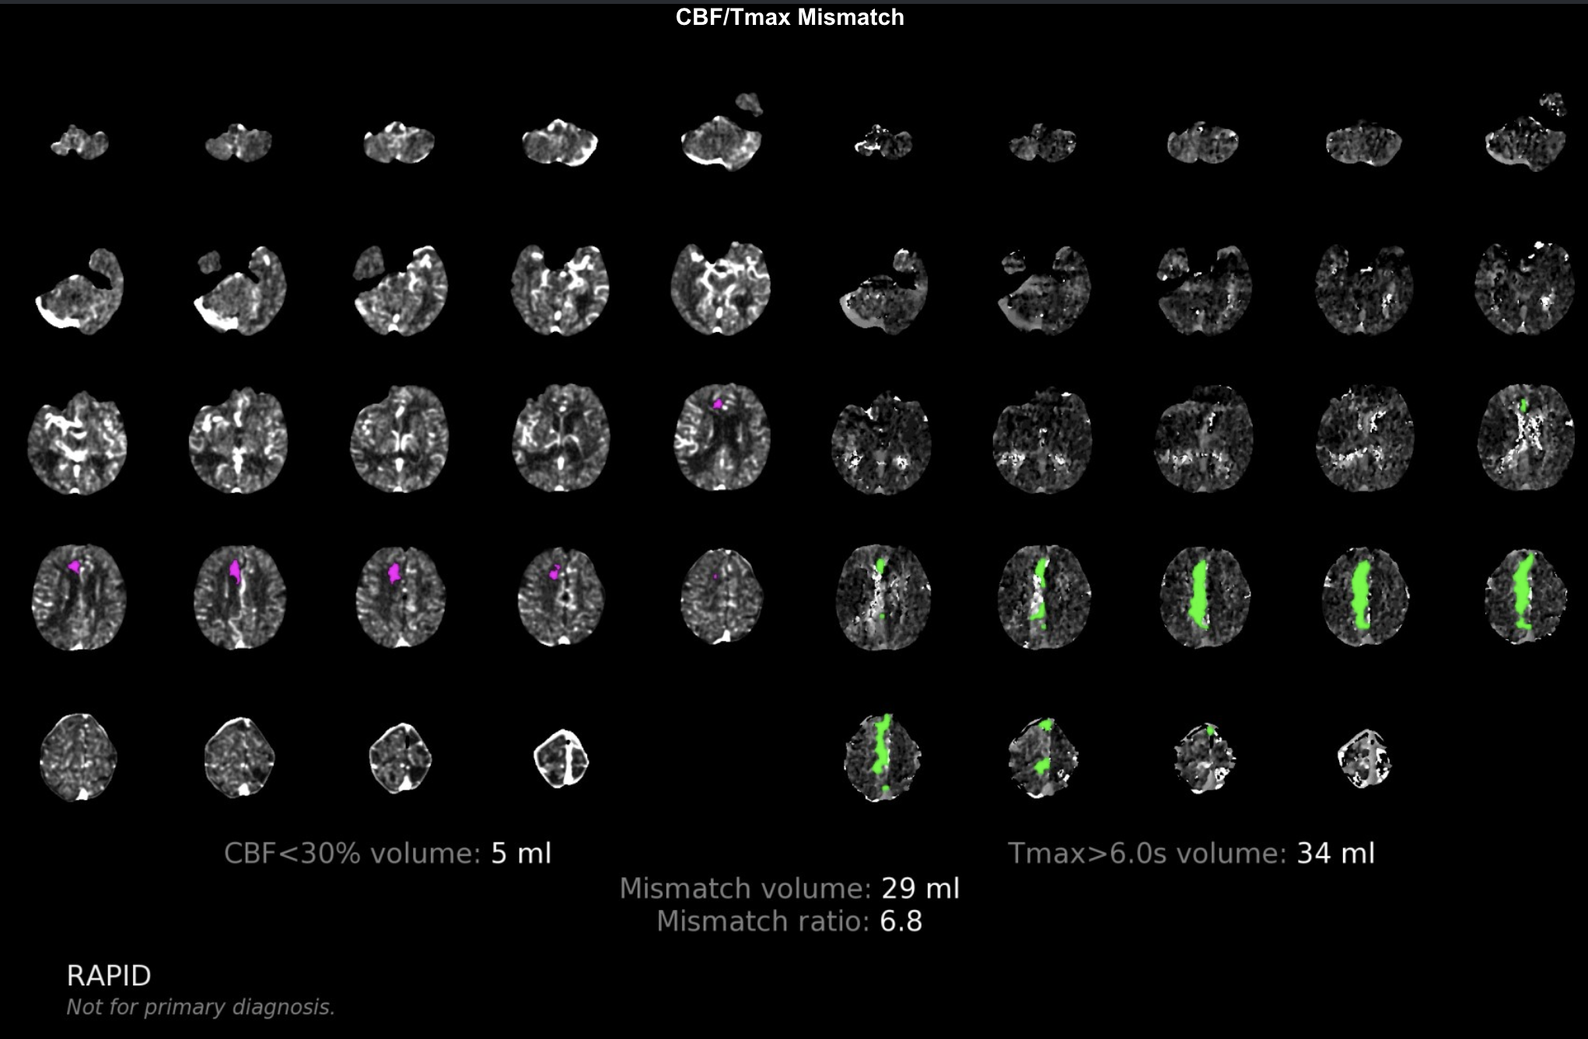
Study Workflow
    Perfusion study has to show:
    Mismatch ratio of penumbra:core >1.2
    AND
    2. Mismatch volume >10 cc
    AND
    3. Core <70 cc

Slide 30

Study Workflow
    Perfusion study has to show:
    Mismatch ratio of penumbra:core >1.2
    AND
    2. Mismatch volume >10 cc
    AND
    3. Core <70 cc

Slide 31
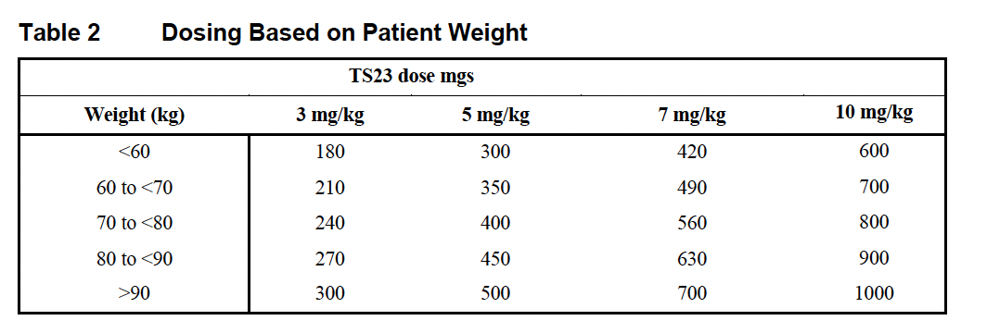
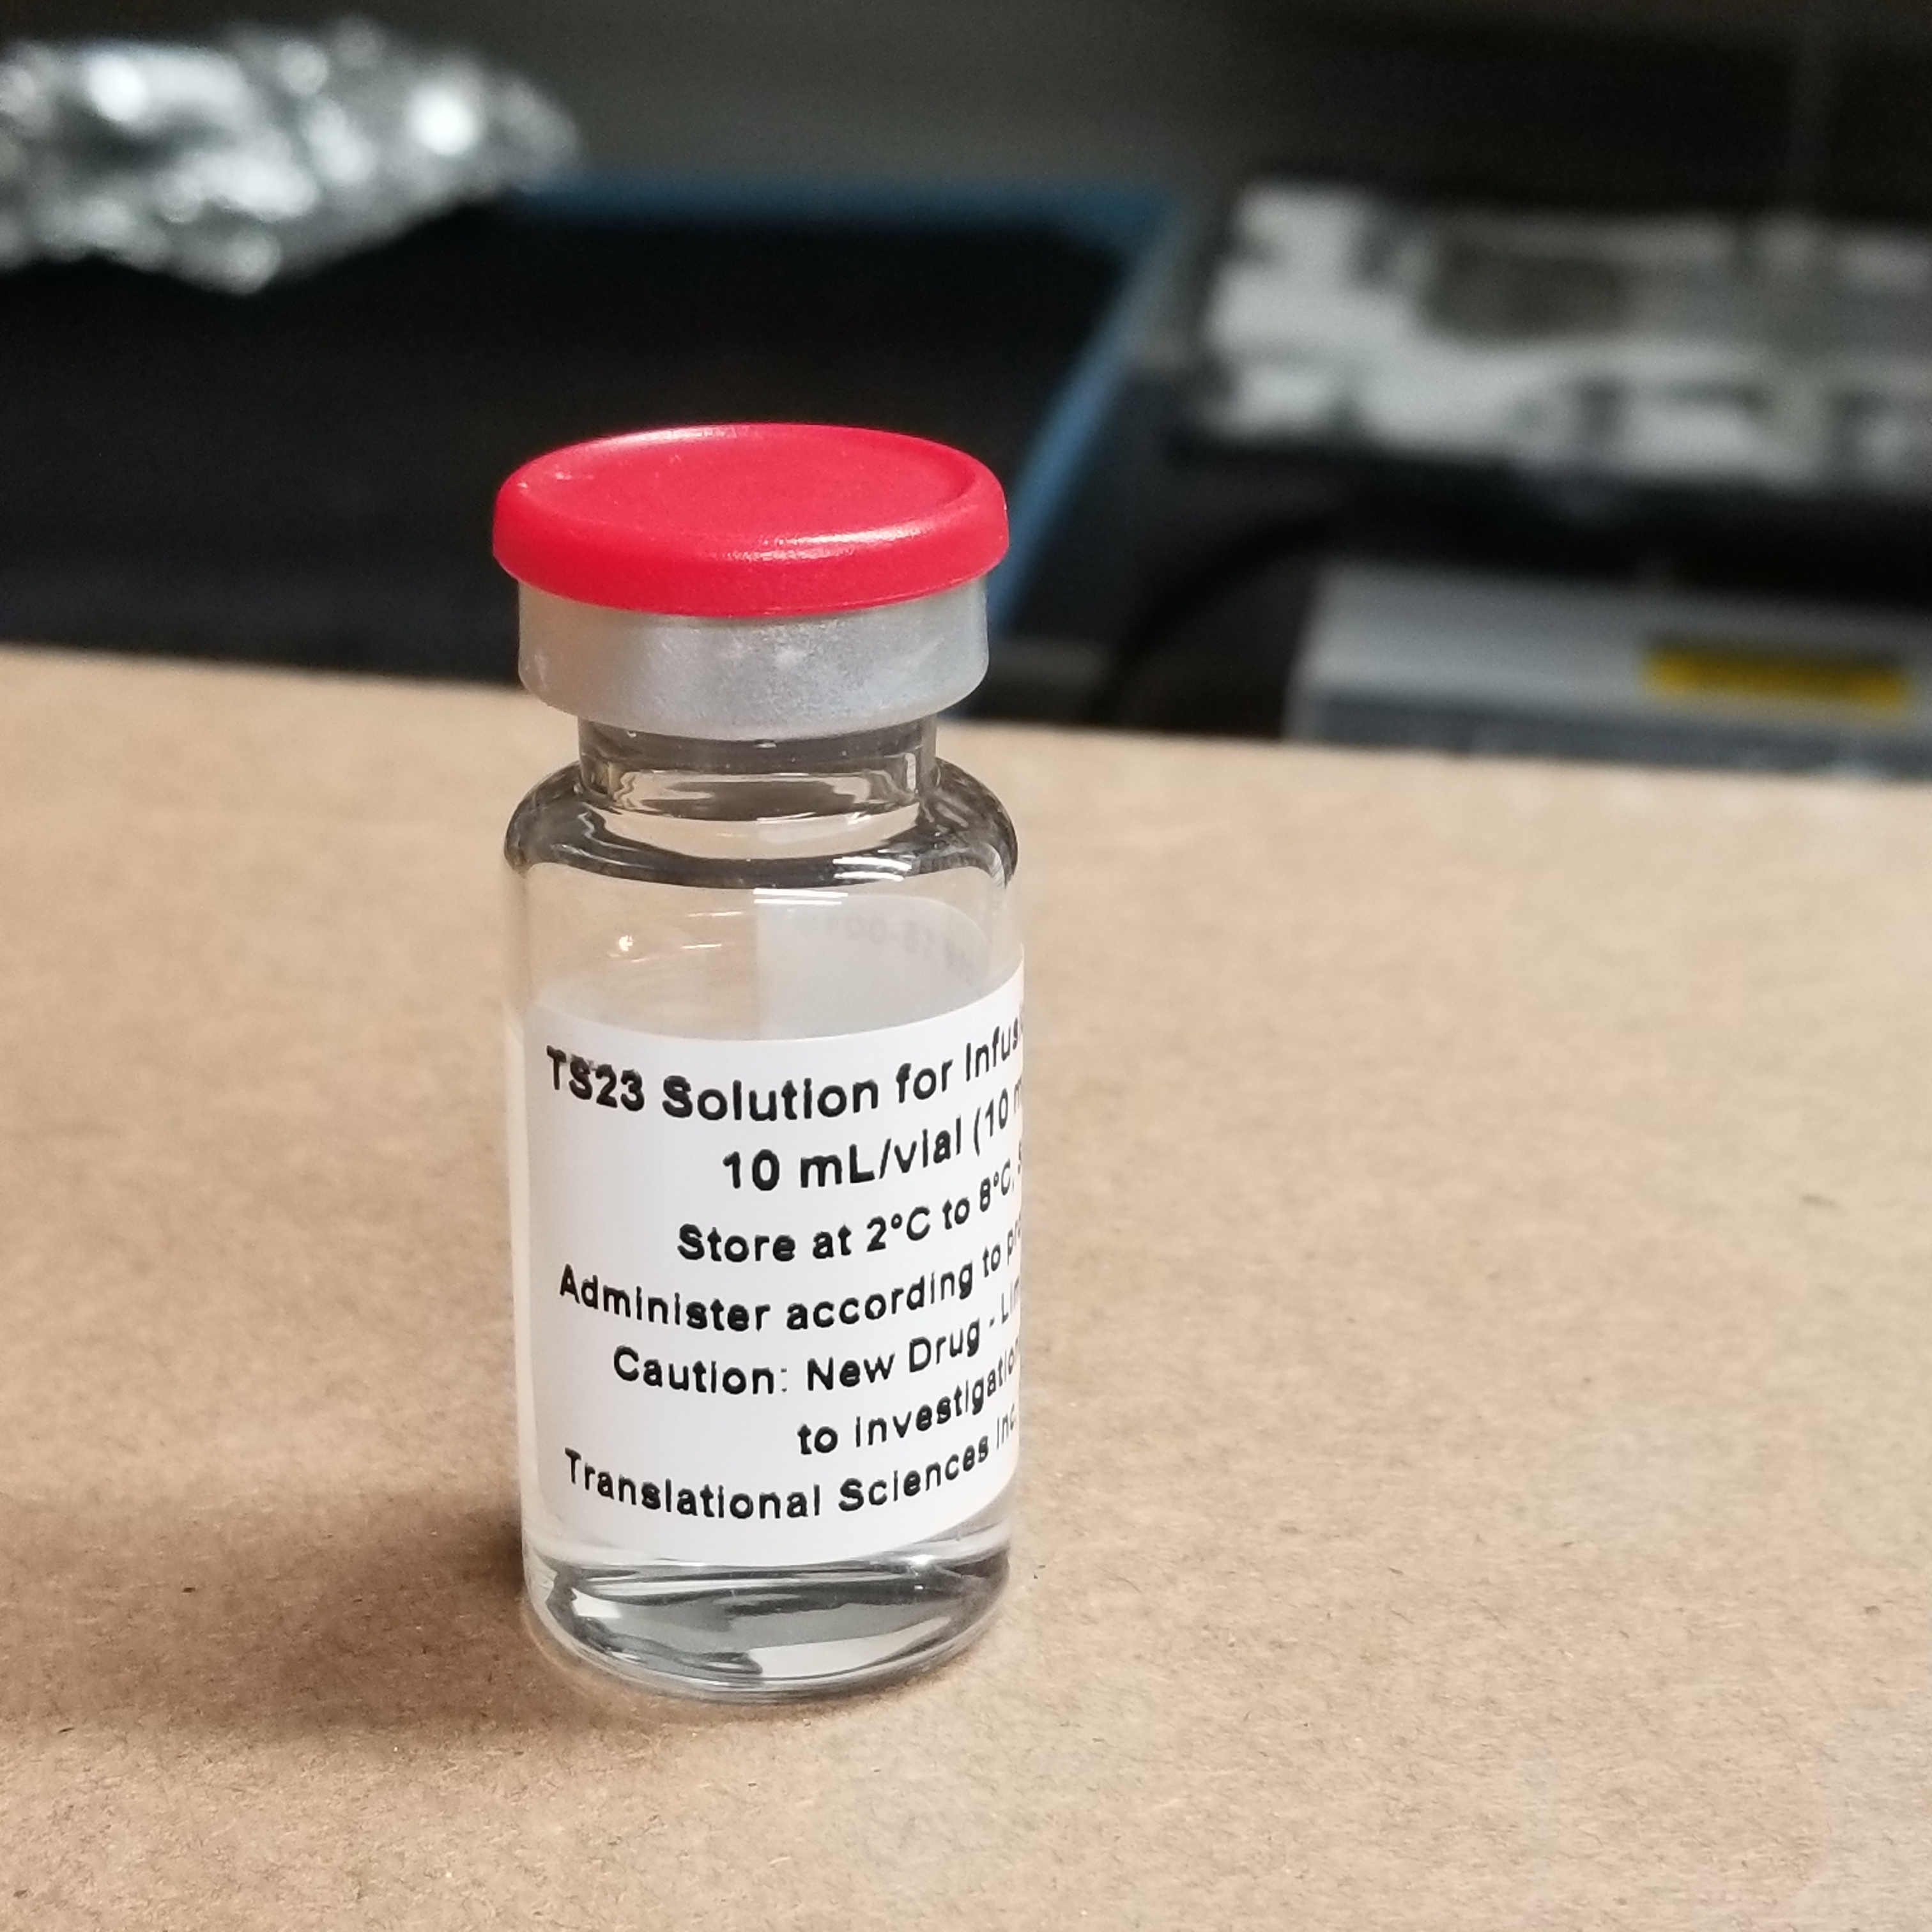
Study Workflow
Performed by unblinded Pharmacist
TS23 vial 10 mg/ml; 100 mg per vial

Slide 32
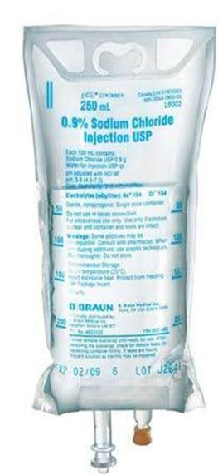
Study Workflow
    200 ml solution in 250 ml bag
    200 ml infused over 15 minutes in a dedicated IV line
    An intravenous piggyback (IVPB) system should be used, with the 0.9% NaCl as the primary bag/flush fluids.
    ~40 ml 0.9% NaCl flush should be administered over ~3minutes after study drug infusion is complete

Slide 33
Study Workflow
    ALL enrolled participants should get a non contrast CT Brain at 30 +/- 4 hours
      MRI is not a substitute for this CT
    ALL enrolled participants should get a perfusion scan (using the same modality, CT/MR, as was used for baseline)
    ONLY participants who have a visible vessel occlusion on baseline CTA/MRA should get a 30 +/-4 hour CTA/MRA
      Check radiology read
      Check with the PI/Sub-I
    PRIMRY OUTCOME VISIT

Slide 34
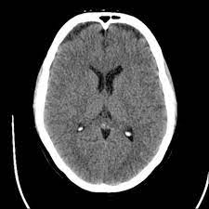
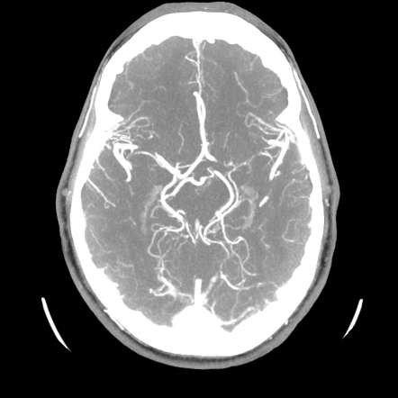
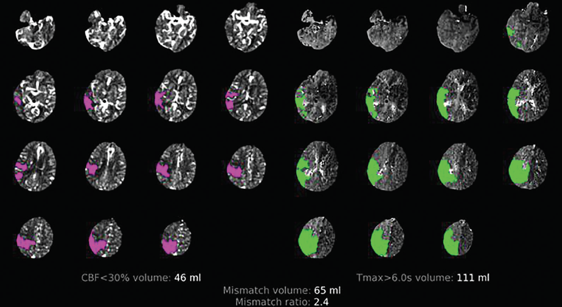
Imaging studies
Imaging modality | Contrast required? | Baseline | 30 (+/-4) hours
CT brain | No | SOC= Yes | SOC= Yes/No
CTA head and neck | Yes | SOC= Yes | SOC= No ***ONLY obtain if baseline CTA shows an intracranial vessel occlusion
CT Perfusion | Yes | SOC= Yes/No ***Obtain after consent if not done as SOC | SOC=No

Slide 35
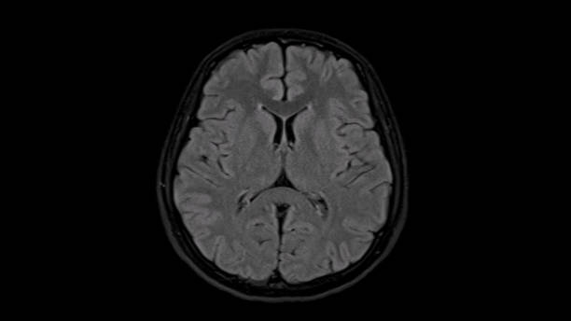
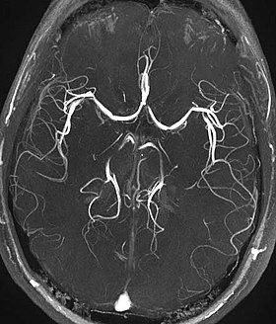
Imaging studies
Imaging modality | Contrast required? | Baseline | 30 (+/-4) hours
MRI brain | No | SOC= Yes | SOC= Yes/No
MRA head and neck | No | SOC= Yes | SOC= No ***ONLY obtain if baseline CTA shows an intracranial vessel occlusion
MR Perfusion | Yes | SOC= Yes/No ***Obtain after consent if not done as SOC | SOC=No

Slide 36


Study Workflow
    In person or remote
    In person visit
    If in person visit is not possible then make all attempts to capture mRS and NIHSS remotely, or over telephone
Notes:
72 hour or discharge whichever first
XX dollars deducted for doing this visit remotely

Slide 37
Schedule of Events
Schedule of Events
 |  |  | Time after initiation of study drug administration
 | Baseline | Study drug administration | 3 (±1) hours | 30 (±4) hours** | 72 (+12)/ Discharge Visit whichever is 1st | Discharge Visit | Day 30±5 | Day 90±7
Screening & Eligibility | X^{R}
Medical History | X^{S}
Laboratory Studies | X^{S} & X^{R} | X^{R*} | X^{R} | X^{S} & X^{R**} |  |  |  | X^{R}
Pre-stroke mRS | X^{R}
NIH stroke scale | X^{R} |  |  | X^{R} | X^{R} |  | X^{R} | X^{R}
Vital Signs | X^{S} |  |  | X^{S}
CT brain | X^{S} |  |  | X^{S} or X^{R}
CT/MR Perfusion | X^{S} or X^{R} |  |  | X^{R}
CTA/MRA Head & Neck | X^{S} |  |  | X^{R#}
Informed Consent | X^{R}
Randomization | X^{R}
Study drug administration |  | X^{R}
Discharge Summary |  |  |  |  |  | X^{S}
Concomitant Medications | X^{S} | X^{R} | X^{R} | X^{R} |  | X^{R} | X^{R} | X^{R}
Adverse Events |  | X^{R} | X^{R} | X^{R} |  | X^{R} | X^{R} | X^{R}
Serious Adverse Events |  | X^{R} | X^{R} | X^{R} |  | X^{R} | X^{R} | X^{R}
mRS |  |  |  |  |  | X^{R} | X^{R} | X^{R}
End of Study |  |  |  |  |  |  |  | X^{R}
X^{S}: Standard of Care; X^{R}: Research Procedure; D/C = Discharge; CTA/MRA = CT pr MR Angiogram; mRS: Modified Rankin Scale score *PK/PD lab draw before and 3(+/-1) hour after study drug administration **PK/PD and CBC lab draw 30(+/-4) hour after study drug administration #Required only if visible vessel occlusion present on the baseline CTA or MRA per site read

Slide 38
Uncommon Scenarios and Answers
Is fetal PCA considered anterior circulation?
  Yes
If patient presented overnight but study team is seeing them in the morning, within 4.5-23 hours of LKW, can we still consent them?
  Yes, but only enroll if perfusion imaging criteria are met. This should be a rare scenario. SISTER should be treated as a hyperacute study where patient should be consented as soon as they undergo imaging and acute reperfusion decision is made.

Slide 39
Uncommon Scenarios and Answers
If we have multiple automated imaging software, which software map should we go by?
  Go by RAPID map
What if 120 minutes pass after perfusion imaging and drug was not administered?
  You are free to perform another perfusion imaging and administer drug (ASAP) if perfusion imaging criteria are met
What if ASPECT is low but perfusion criteria are met?
  ASPECT needs to be 6 or greater to be in the study, regardless of perfusion criteria

Slide 40
Participant Recruitment Plan
300 patients recruited over 36 months at up to 50 active sties
Participants will be screened and enrolled in the ED
Screen and enroll consecutive patients who meet the trial criteria.
Establish effective screening strategies at your sites. For example:
  Screen stroke pages
  Involve stroke fellows, residents, stroke attendings, mid-levels, ER staff
  Send weekly reminders
  Screen perfusion imaging software outputs

Slide 41
Participant Recruitment Plan
Establish effective recruitment strategies at your sites. For example:
  Only use REDCap consent module and prioritize using e-consent.
  Consent remote LARs
  Hold mock consent sessions
  Use consent translations that are available

Slide 42
Adaptive Randomization
The first 50 participants will be randomized in a dose escalation burn-in period ensuring equal allocation to each arm.
Response Adaptive Randomization updates will occur every 50 participants, thereafter, (favoring the best dose).
Balancing of following variables will be conducted using the Minimal Sufficient Balance randomization algorithm.
  age <65y vs not
  NIHSS 4-10, >10
  time to drug 4.5-9h, >9-24h

Slide 43
Participant Retention Plan
30 (+/-4) hour visit is the primary outcomes visit
  The imaging and NIHSS score assessment should be scheduled immediately after study drug administration.
  The follow up imaging should be a part of the hospital electronic medical record study order-set.
  The timing of the scan and assessment should be communicated and coordinated with bedside nursing staff and imaging technologist.
Notes:
Every effort should be made by the site PI, primary study coordinator, and the study team to ensure participants complete each study visit and evaluation for the trial. The strategies listed here should be used to help maximize retention and minimize participants lost to follow-up
It is important for the PI and PSC to develop rapport with the participant and their family and/or caregivers by taking time to thorough explain the study and giving them ample time to ask questions and express concerns. Communication between discharge and the follow up visits will be important to maintain participant engagement.
The 2 follow up visits at 30 and 90 days should be highlighted and schedule prior to the participant being discharged.
A tool as been provided and should be used to schedule the follow up visits.
Study personnel will note the patient’s name, date-of birth, and medical record numbers upon enrollment. They will also clearly communicate and remind the clinical care teams about the study assessment timeline to from time-to-time.

Slide 44
Participant Retention Plan
There are 2 study visits following discharge, one at 30 and 90 days
  Build rapport with each participant and their family/ caregivers
  Follow-up visits should be scheduled prior to discharge
    Use Excel tool to determine dates of 2 follow-up visits
    Provide visit dates and times to participant prior to discharge
  Participants should receive visit reminders at least 10 days prior to the appointment
  Collect phone and fax numbers, mailing and email addresses for patients, their legally authorized representatives, primary caregivers, and other close relatives at enrollment
  Efforts should be made for up to 150 days from randomization to retrospectively determine the participant’s 90-day status
Notes:
Every effort should be made by the site PI, primary study coordinator, and the study team to ensure participants complete each study visit and evaluation for the trial. The strategies listed here should be used to help maximize retention and minimize participants lost to follow-up
It is important for the PI and PSC to develop rapport with the participant and their family and/or caregivers by taking time to thorough explain the study and giving them ample time to ask questions and express concerns. Communication between discharge and the follow up visits will be important to maintain participant engagement.
The 2 follow up visits at 30 and 90 days should be highlighted and schedule prior to the participant being discharged.
A tool as been provided and should be used to schedule the follow up visits.
Study personnel will note the patient’s name, date-of birth, and medical record numbers upon enrollment. They will also clearly communicate and remind the clinical care teams about the study assessment timeline to from time-to-time.

Slide 45
Recruitment and Retention Monitoring
Screen failure logs will be reviewed weekly.
Non-enrollment call with the SISTER National Team no patient enrolled for 6 months
A site may be place on probation if after an additional 6-month period no patients have been consented
Sites may be suspended if after an additional 4-month probation period they still do not have any consented patients
Sites may also be put on probation if they have 3 consecutive patients who meet randomization criteria based on the screening but are not randomized.

Slide 46
Withdrawal of Consent:
Replacement
Participants who sign the informed consent and are randomized but do NOT receive the study intervention may be replaced.
Participants who sign the informed consent, and are randomized and receive the study intervention, and then withdraw, will not be replaced.

Slide 47

Lost to Follow up:
Reasons and Documentation
A participant may be considered lost to follow-up if they cannot be reached for up to 150 days from randomization
A participant can be lost to follow-up for the following reasons:
  Unable to contact for follow-up
  Opted to withdraw from the trial
  Moved away from and unable to return for follow-up visits
  Become ill and unable to communicate
Appropriate documentation of lost to follow-up should be maintained in the participant’s record

Slide 48
Unblinding
Unblinding can occur if there is an emergency clinical need to know the participant’s treatment assignment. These clinical emergencies include but are not limited to:
  A severe allergic reaction
  Recurrent ischemic stroke during the index hospital stay
  A significant, continuing bleeding event, such as a major hemorrhage, that requires ongoing and urgent pharmacologic or surgical intervention
  The need for emergency major surgery (for example, open cardiac procedures, open neurosurgical procedure, etc.)
Unblinding may not be necessary for these emergencies if 15 days are passed since the administration of study intervention, because of the drug’s half life.
Check for your local site’s ability to obtain alpha-2 antiplasmin level
Notes:
.

Slide 49
Unblinding
For any emergency request for unblinding, the site investigator or emergency care provider should:
Call the SISTER clinical hotline 1-866-212-7187.
Discuss the case with the SISTER PI on call, who will evaluate the clinical scenario promptly, including review of conditions whereby unblinding may not be necessary
If unblinding occurs due to a major bleeding event for a patient who received active drug, the SISTER PI on the hotline call may discuss potential drugs for hemostasis with the site PI.

Slide 50
Primary Staff Roles and Responsibilities
Principal Investigator
Primary Site Coordinator
Primary Pharmacist

Slide 51
Site PI
Responsibilities
Screening and Publicity
Enrolling and Participant Follow-up
Endpoint or Adverse Event
Communication

Slide 52
Site PI Responsibilities:
Screening and Publicity
Screening eligible patients for the trial
Generate enthusiasm for the trial at your site
Work with coordinator to develop a system for screening and recruiting participants
Ensure participants meet all inclusion and no exclusion criteria for enrollment

Slide 53
Site PI Responsibilities:
Enrolling and Participant Follow- up
Conduct or delegate the responsibility to conduct the neurological exam at enrollment and as required during follow-up
Assist the coordinator in uploading the protocol-required images to the online portal
Assist the coordinator with completion of clinical baseline and follow-up CRF worksheets and sign relevant source documents.
Ensure adherence to the study protocol by all one site study personnel.
Monitor and respond to any adverse events as outlined in the protocol.

Slide 54
Site PI Responsibilities:
End Point or Adverse Event
Determine if an endpoint or adverse event has occurred.
Work with primary coordinator for AE reporting

Slide 55
Site PI Responsibilities:
Communication with Coordinating Centers
Maintain an open line of communication with local and national study staff.
Attend investigator meetings and study webinars.

Slide 56
Safety Monitoring Plan
Adverse Events and Serious Adverse Events
Unanticipated Problems
Independent Medical Monitor
Safety Stopping Rule
Formal Interim Analysis

Slide 57
Serious Adverse Events and Reporting
SAE is any untoward medical occurrence that:
  Results in death,
  Is life-threatening,
  Requires inpatient hospitalization or prolongation of existing hospitalization,
  Results in persistent or significant disability/incapacity,
  Is a congenital anomaly/birth defect, or
  Is an important medical event.
SAEs are reportable within 24 hours of awareness of the event, including:
  Severity
  Action taken regarding study drug
Combined elevations of aminotransferases and bilirubin, either serious or nonserious and whether or not causally related, meeting the criteria of a potential Hy’s Law case (total bilirubin level ≥ 2 × upper limit of normal (ULN) with simultaneously ALT or AST ≥ 3 × ULN) should always be reported as soon as possible
  These are identified on SOC labs. Study specific liver panel is not required

Slide 58
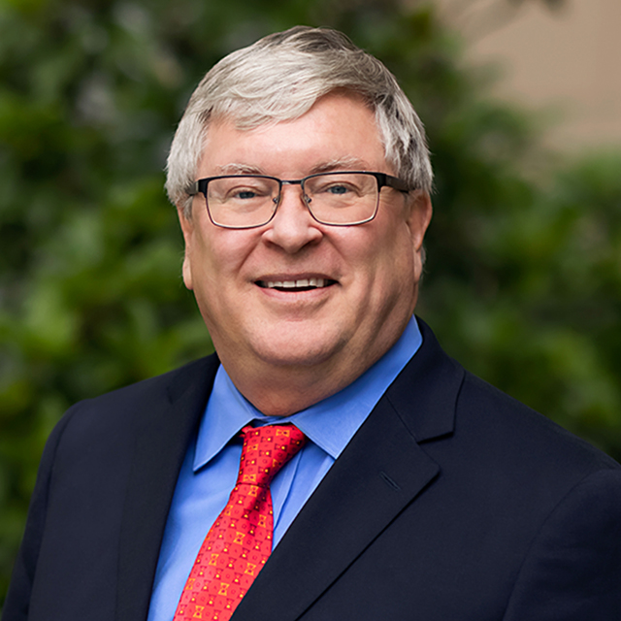
Independent Medical Monitor
The Independent Medical Monitor (IMM) will monitor the study with regard to safety on an ongoing basis to identify any safety concerns.
  Review all SAEs
  Determine relatedness to study intervention and expectedness
  Communicate with the investigators for any questions or clarifications regarding an event.
Dr. Wade Smith

Slide 59
Safety Stopping Rule
If for a given arm, the probability that symptomatic ICH rate is >5% exceeds 90%, then enrollment may be shut down.
This will be reviewed by the DSMB on a monthly basis

Slide 60
Formal Interim Stopping rule for Safety
Is the bleeding rate for the best dose too high?
The trial will stop early if there is > 90% probability that the best dose has a higher than 60% rate of any ICH.
Formal interim analysis for safety will occur after N=150 participants have been enrolled and every 50 participants, thereafter.

Slide 61
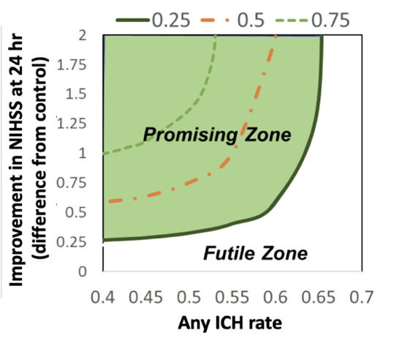
Final Analysis
At the final analysis, criteria for trial to be a success (‘Go’):
The trial is a success if the best dose has 0.25 utility or higher with at least 80% probability.
[Pr(Utility >0.25| Greatest Umax) >80%]

Slide 62
Other required trainings
Modified Rankin Scale (mRS)
NIH Stroke Scale Assessment (NIHSS)
WebDCU
Pharmacy Training
Imaging Training
Lab Training
Shipping Training
ASPECT
https://www.letsgetproof.com/pages/aspect-in-stroke/homepage
https://webdcu.musc.edu/campus/
RAPID AI

